Slide 1
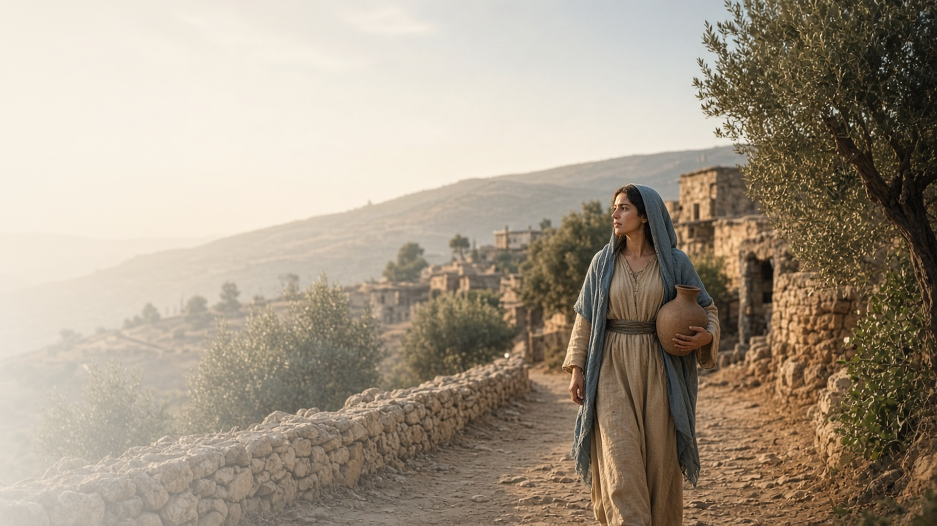
COME, FOLLOW ME · NEW TESTAMENT 2027
Be It unto Me
According to Thy Word
December 28 – January 3
Matthew 1; Luke 1
Notes:
TEACHING
We open the New Testament with two births that, by any earthly measure, could not happen: a son for an elderly couple who had long been childless, and a Son for a young virgin. Luke tells us he wrote carefully so that readers could know these things with certainty. Matthew begins by rooting Jesus in the covenant family of Abraham and David. Together these chapters set this year's theme: God keeps His promises, often in ways we would never have predicted, and He invites each of us to answer as Mary did.
SCRIPTURE (KJV)
Luke 1:1–4
1 Forasmuch as many have taken in hand to set forth in order a declaration of those things which are most surely believed among us,
2 Even as they delivered them unto us, which from the beginning were eyewitnesses, and ministers of the word;
3 It seemed good to me also, having had perfect understanding of all things from the very first, to write unto thee in order, most excellent Theophilus,
4 That thou mightest know the certainty of those things, wherein thou hast been instructed.
Matthew 1:1
1 The book of the generation of Jesus Christ, the son of David, the son of Abraham.
DISCUSSION
• What feels "impossible" in your life right now, and what might these chapters say to it?
• Why do you think Luke wanted his readers to "know the certainty" of what they had been taught?

Slide 2
LUKE 1:1–17
Christ’s Church, then and now
Priesthood, temples, prayer, and angels, then and now.
“To make ready a people prepared for the Lord.”
LUKE 1:17
Notes:
TEACHING
Luke's account opens inside the temple. Zacharias holds priesthood authority, serves in an assigned rotation, and offers incense while the people pray outside. An angel then delivers a message from God about a son who will prepare the way for the Messiah. Each of these pieces (priesthood offices, temple worship, ordinances, prayer, revelation through messengers, and standards of personal commitment) has a counterpart in the restored Church. Seeing the pattern helps us recognize the Restoration as a return of the same Church the Lord has always organized, not a new invention. This year, invite class members to keep watching for those parallels.
SCRIPTURE (KJV)
Luke 1:5–17
5 There was in the days of Herod, the king of Judaea, a certain priest named Zacharias, of the course of Abia: and his wife was of the daughters of Aaron, and her name was Elisabeth.
6 And they were both righteous before God, walking in all the commandments and ordinances of the Lord blameless.
7 And they had no child, because that Elisabeth was barren, and they both were now well stricken in years.
8 And it came to pass, that while he executed the priest’s office before God in the order of his course,
9 According to the custom of the priest’s office, his lot was to burn incense when he went into the temple of the Lord.
10 And the whole multitude of the people were praying without at the time of incense.
11 And there appeared unto him an angel of the Lord standing on the right side of the altar of incense.
12 And when Zacharias saw him, he was troubled, and fear fell upon him.
13 But the angel said unto him, Fear not, Zacharias: for thy prayer is heard; and thy wife Elisabeth shall bear thee a son, and thou shalt call his name John.
14 And thou shalt have joy and gladness; and many shall rejoice at his birth.
15 For he shall be great in the sight of the Lord, and shall drink neither wine nor strong drink; and he shall be filled with the Holy Ghost, even from his mother’s womb.
16 And many of the children of Israel shall he turn to the Lord their God.
17 And he shall go before him in the spirit and power of Elias, to turn the hearts of the fathers to the children, and the disobedient to the wisdom of the just; to make ready a people prepared for the Lord.
DISCUSSION
• Which detail in Luke 1:5–17 feels most familiar from your own Church experience?
• How does seeing these parallels strengthen your testimony of the Restoration?

Slide 3
LUKE 1:5–25, 57–80
Faithful while we wait
They stayed true through years of waiting.
“And they were both righteous before God.”
LUKE 1:6
Notes:
TEACHING
Elisabeth and Zacharias were obedient and blameless, yet they spent most of their lives without the child they longed for. In their culture childlessness carried social shame, which Elisabeth calls her "reproach." Their righteousness did not earn them an early answer, and their waiting was not a sign of God's displeasure. They kept serving anyway. When the blessing came, they responded with gratitude and praise: Elisabeth credited the Lord, and Zacharias, once doubtful, obeyed the angel's instruction to name the child John and burst into prophecy. Their story invites us to keep our covenants while we wait and to trust that God hears every prayer, even when the answer is slow.
SCRIPTURE (KJV)
Luke 1:5–7
5 There was in the days of Herod, the king of Judaea, a certain priest named Zacharias, of the course of Abia: and his wife was of the daughters of Aaron, and her name was Elisabeth.
6 And they were both righteous before God, walking in all the commandments and ordinances of the Lord blameless.
7 And they had no child, because that Elisabeth was barren, and they both were now well stricken in years.
Luke 1:24–25
24 And after those days his wife Elisabeth conceived, and hid herself five months, saying,
25 Thus hath the Lord dealt with me in the days wherein he looked on me, to take away my reproach among men.
Luke 1:57–58
57 Now Elisabeth’s full time came that she should be delivered; and she brought forth a son.
58 And her neighbours and her cousins heard how the Lord had shewed great mercy upon her; and they rejoiced with her.
Luke 1:63–64
63 And he asked for a writing table, and wrote, saying, His name is John. And they marvelled all.
64 And his mouth was opened immediately, and his tongue loosed, and he spake, and praised God.
DISCUSSION
• What helps you stay faithful when a righteous desire goes unfulfilled?
• What might the Lord want you to do, or become, while you wait?

Slide 4
MATTHEW 1:18–25; LUKE 1:26–38, 46–55
Trusting the Lord’s will
Mary and Joseph said yes before they could see it all.
“My soul doth magnify the Lord,
And my spirit hath rejoiced in God my Saviour.”
LUKE 1:46–47
Notes:
TEACHING
Mary was troubled by Gabriel's greeting and asked an honest question: how could this be? The angel did not give her every detail, but he did give her the assurance that God was with her and that nothing is impossible for Him. Her answer, "be it unto me according to thy word," is a model of willing trust. Later, in her song of praise, she testifies of a God who lifts the humble and remembers His promises. Joseph also faced a decision that could upend his life. He was a just and merciful man who planned to protect Mary quietly, and when the angel came to him in a dream, he obeyed without delay. Both teach that accepting God's will is an act of trust, not of understanding everything first.
SCRIPTURE (KJV)
Luke 1:26–38
26 And in the sixth month the angel Gabriel was sent from God unto a city of Galilee, named Nazareth,
27 To a virgin espoused to a man whose name was Joseph, of the house of David; and the virgin’s name was Mary.
28 And the angel came in unto her, and said, Hail, thou that art highly favoured, the Lord is with thee: blessed art thou among women.
29 And when she saw him, she was troubled at his saying, and cast in her mind what manner of salutation this should be.
30 And the angel said unto her, Fear not, Mary: for thou hast found favour with God.
31 And, behold, thou shalt conceive in thy womb, and bring forth a son, and shalt call his name JESUS.
32 He shall be great, and shall be called the Son of the Highest: and the Lord God shall give unto him the throne of his father David:
33 And he shall reign over the house of Jacob for ever; and of his kingdom there shall be no end.
34 Then said Mary unto the angel, How shall this be, seeing I know not a man?
35 And the angel answered and said unto her, The Holy Ghost shall come upon thee, and the power of the Highest shall overshadow thee: therefore also that holy thing which shall be born of thee shall be called the Son of God.
36 And, behold, thy cousin Elisabeth, she hath also conceived a son in her old age: and this is the sixth month with her, who was called barren.
37 For with God nothing shall be impossible.
38 And Mary said, Behold the handmaid of the Lord; be it unto me according to thy word. And the angel departed from her.
Luke 1:46–49
46 And Mary said, My soul doth magnify the Lord,
47 And my spirit hath rejoiced in God my Saviour.
48 For he hath regarded the low estate of his handmaiden: for, behold, from henceforth all generations shall call me blessed.
49 For he that is mighty hath done to me great things; and holy is his name.
Matthew 1:18–21
18 Now the birth of Jesus Christ was on this wise: When as his mother Mary was espoused to Joseph, before they came together, she was found with child of the Holy Ghost.
19 Then Joseph her husband, being a just man, and not willing to make her a publick example, was minded to put her away privily.
20 But while he thought on these things, behold, the angel of the Lord appeared unto him in a dream, saying, Joseph, thou son of David, fear not to take unto thee Mary thy wife: for that which is conceived in her is of the Holy Ghost.
21 And she shall bring forth a son, and thou shalt call his name JESUS: for he shall save his people from their sins.
Matthew 1:24–25
24 Then Joseph being raised from sleep did as the angel of the Lord had bidden him, and took unto him his wife:
25 And knew her not till she had brought forth her firstborn son: and he called his name JESUS.
DISCUSSION
• What do Mary's question and her answer teach about how to respond when God's will surprises us?
• What "great things" has the Lord done for you, and how could you magnify Him for them?

Slide 5
LUKE 1:38
“Behold the handmaid of the Lord;
be it unto me according to thy word.”
This week, give the Lord your “yes” in one thing.
Notes:
TEACHING
Mary's response was not passive. She called herself the Lord's servant and freely offered her will to His, before she knew how her story would unfold. Joseph showed the same willingness through action when he woke and did what the angel asked. Close by inviting each person to identify one specific thing the Lord seems to be asking of them right now and to answer it this week with Mary's words in mind.
SCRIPTURE (KJV)
Luke 1:38
38 And Mary said, Behold the handmaid of the Lord; be it unto me according to thy word. And the angel departed from her.
Matthew 1:24–25
24 Then Joseph being raised from sleep did as the angel of the Lord had bidden him, and took unto him his wife:
25 And knew her not till she had brought forth her firstborn son: and he called his name JESUS.
DISCUSSION
• What is one thing the Lord may be asking of you right now?
• What would it look like for you to say, "Be it unto me according to thy word"?

