Slide 1
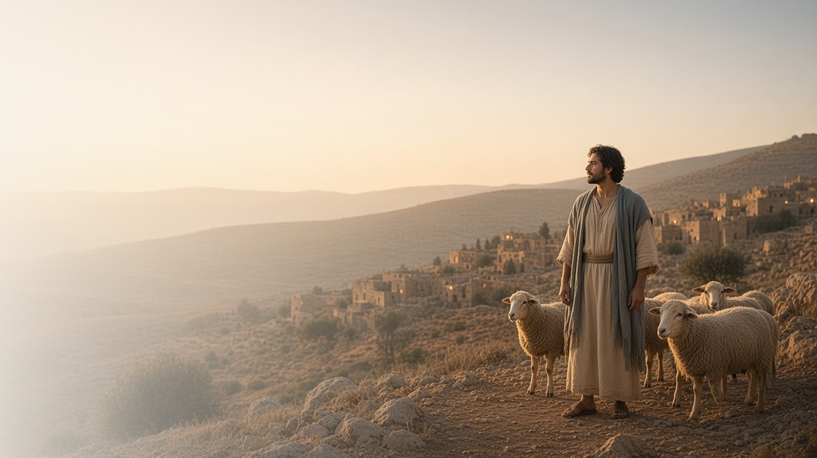
COME, FOLLOW ME · NEW TESTAMENT 2027
We Have Come
to Worship Him
January 4–10
Matthew 2; Luke 2
Notes:
TEACHING
This week we read the familiar Christmas chapters with fresh eyes. Luke tells of a humble birth announced to shepherds; Matthew tells of Wise Men who traveled far to worship a King. Both accounts invite us to ask what each detail teaches about who Jesus is and why He came, and how we, like those first witnesses, can come to worship Him.
SCRIPTURE (KJV)
Luke 2:10–11
10 And the angel said unto them, Fear not: for, behold, I bring you good tidings of great joy, which shall be to all people.
11 For unto you is born this day in the city of David a Saviour, which is Christ the Lord.
DISCUSSION
• Which detail of the Savior's birth means the most to you this year, and why?
• How do you come to worship Him in your own life?

Slide 2
MATTHEW 2:1–2; LUKE 2:1–19
A birth that testifies
Bethlehem, a manger, shepherds, a star: each points to His mission.
“For unto you is born this day in the city of David a Saviour, which is Christ the Lord.”
LUKE 2:11
Notes:
TEACHING
The circumstances of Jesus's birth were not random. He was born in Bethlehem, a name meaning "house of bread," and laid in a manger, a feeding trough, foreshadowing that He would be the Bread of Life. Shepherds, who cared for lambs, were the first invited to see the Good Shepherd and Lamb of God. A new star announced the Light of the World. Invite class members to look at each detail and ask what it reveals about the Savior's identity and mission.
SCRIPTURE (KJV)
Luke 2:4–14
4 And Joseph also went up from Galilee, out of the city of Nazareth, into Judaea, unto the city of David, which is called Bethlehem; (because he was of the house and lineage of David:)
5 To be taxed with Mary his espoused wife, being great with child.
6 And so it was, that, while they were there, the days were accomplished that she should be delivered.
7 And she brought forth her firstborn son, and wrapped him in swaddling clothes, and laid him in a manger; because there was no room for them in the inn.
8 And there were in the same country shepherds abiding in the field, keeping watch over their flock by night.
9 And, lo, the angel of the Lord came upon them, and the glory of the Lord shone round about them: and they were sore afraid.
10 And the angel said unto them, Fear not: for, behold, I bring you good tidings of great joy, which shall be to all people.
11 For unto you is born this day in the city of David a Saviour, which is Christ the Lord.
12 And this shall be a sign unto you; Ye shall find the babe wrapped in swaddling clothes, lying in a manger.
13 And suddenly there was with the angel a multitude of the heavenly host praising God, and saying,
14 Glory to God in the highest, and on earth peace, good will toward men.
Matthew 2:1–2
1 Now when Jesus was born in Bethlehem of Judaea in the days of Herod the king, behold, there came wise men from the east to Jerusalem,
2 Saying, Where is he that is born King of the Jews? for we have seen his star in the east, and are come to worship him.
DISCUSSION (questions quoted from the manual)
• “But have you ever wondered why things happened the way they did?”
• “Why was He born in Bethlehem rather than His mother’s home in Nazareth?”
• “Why was He laid in a manger?”
• “Why were shepherds the first to worship Him?”
• “For each one, ask yourself, “What does this teach me about the Savior, His roles, and His divine mission?””
• “What other details from the Savior’s birth teach you something about Him and His mission?”

Slide 3
MATTHEW 2:1–12; LUKE 2:8–38
Many witnesses of His birth
Shepherds, Wise Men, Simeon, and Anna each worshipped and testified.
“We have seen his star in the east, and are come to worship him.”
MATTHEW 2:2
Notes:
TEACHING
God surrounded His Son's birth with witnesses from very different walks of life: poor shepherds from nearby fields, learned travelers from the East, an aged man who had waited for years, and a widow who served in the temple day and night. Each one recognized Jesus and responded in a way that fit their circumstances, whether by hurrying to see Him, offering gifts, giving thanks, or telling others. Their examples show that anyone can witness of Christ and that worship takes many forms.
SCRIPTURE (KJV)
Luke 2:15–20
15 And it came to pass, as the angels were gone away from them into heaven, the shepherds said one to another, Let us now go even unto Bethlehem, and see this thing which is come to pass, which the Lord hath made known unto us.
16 And they came with haste, and found Mary, and Joseph, and the babe lying in a manger.
17 And when they had seen it, they made known abroad the saying which was told them concerning this child.
18 And all they that heard it wondered at those things which were told them by the shepherds.
19 But Mary kept all these things, and pondered them in her heart.
20 And the shepherds returned, glorifying and praising God for all the things that they had heard and seen, as it was told unto them.
Luke 2:25–32
25 And, behold, there was a man in Jerusalem, whose name was Simeon; and the same man was just and devout, waiting for the consolation of Israel: and the Holy Ghost was upon him.
26 And it was revealed unto him by the Holy Ghost, that he should not see death, before he had seen the Lord’s Christ.
27 And he came by the Spirit into the temple: and when the parents brought in the child Jesus, to do for him after the custom of the law,
28 Then took he him up in his arms, and blessed God, and said,
29 Lord, now lettest thou thy servant depart in peace, according to thy word:
30 For mine eyes have seen thy salvation,
31 Which thou hast prepared before the face of all people;
32 A light to lighten the Gentiles, and the glory of thy people Israel.
Luke 2:36–38
36 And there was one Anna, a prophetess, the daughter of Phanuel, of the tribe of Aser: she was of a great age, and had lived with an husband seven years from her virginity;
37 And she was a widow of about fourscore and four years, which departed not from the temple, but served God with fastings and prayers night and day.
38 And she coming in that instant gave thanks likewise unto the Lord, and spake of him to all them that looked for redemption in Jerusalem.
Matthew 2:9–11
9 When they had heard the king, they departed; and, lo, the star, which they saw in the east, went before them, till it came and stood over where the young child was.
10 When they saw the star, they rejoiced with exceeding great joy.
11 And when they were come into the house, they saw the young child with Mary his mother, and fell down, and worshipped him: and when they had opened their treasures, they presented unto him gifts; gold, and frankincense, and myrrh.
DISCUSSION (questions quoted from the manual)
• “As you explore their stories, what do you learn about ways to worship and witness of Christ?”
• “What do I learn about worshipping and witnessing of Christ?”

Slide 4
MATTHEW 2:13–23
Revelation to protect families
Joseph heeded warnings from heaven to keep Jesus safe.
“Arise, and take the young child and his mother, and flee into Egypt.”
MATTHEW 2:13
Notes:
TEACHING
Herod was powerful and dangerous, and Joseph could not protect the young Jesus by his own strength. He protected his family the same way faithful parents can today: by receiving and obeying revelation. Three times Joseph received guidance in dreams, and each time he acted promptly. Discuss the spiritual dangers families face now and how God guides parents and others who care for children when they seek and heed His direction.
SCRIPTURE (KJV)
Matthew 2:12–15
12 And being warned of God in a dream that they should not return to Herod, they departed into their own country another way.
13 And when they were departed, behold, the angel of the Lord appeareth to Joseph in a dream, saying, Arise, and take the young child and his mother, and flee into Egypt, and be thou there until I bring thee word: for Herod will seek the young child to destroy him.
14 When he arose, he took the young child and his mother by night, and departed into Egypt:
15 And was there until the death of Herod: that it might be fulfilled which was spoken of the Lord by the prophet, saying, Out of Egypt have I called my son.
Matthew 2:19–23
19 But when Herod was dead, behold, an angel of the Lord appeareth in a dream to Joseph in Egypt,
20 Saying, Arise, and take the young child and his mother, and go into the land of Israel: for they are dead which sought the young child’s life.
21 And he arose, and took the young child and his mother, and came into the land of Israel.
22 But when he heard that Archelaus did reign in Judaea in the room of his father Herod, he was afraid to go thither: notwithstanding, being warned of God in a dream, he turned aside into the parts of Galilee:
23 And he came and dwelt in a city called Nazareth: that it might be fulfilled which was spoken by the prophets, He shall be called a Nazarene.
DISCUSSION (questions quoted from the manual)
• “How could Joseph protect young Jesus from powerful enemies like King Herod?”
• “How has God guided you to safety from those dangers?”
• “What can you do to receive His guidance in the future?”

Slide 5
LUKE 2:40–51
About His Father’s business
Even at twelve, Jesus put His Father’s will first.
“Wist ye not that I must be about my Father’s business?”
LUKE 2:49
Notes:
TEACHING
Luke offers a rare glimpse of Jesus as a youth. At twelve He stayed behind in the temple, where He listened to the teachers and asked them questions, and they marveled at His understanding. When Mary and Joseph found Him, He gently reminded them that He must be about His Father's business, and then He returned home and was subject to them. He shows that devotion to God and respect for parents belong together.
SCRIPTURE (KJV)
Luke 2:40–51
40 And the child grew, and waxed strong in spirit, filled with wisdom: and the grace of God was upon him.
41 Now his parents went to Jerusalem every year at the feast of the passover.
42 And when he was twelve years old, they went up to Jerusalem after the custom of the feast.
43 And when they had fulfilled the days, as they returned, the child Jesus tarried behind in Jerusalem; and Joseph and his mother knew not of it.
44 But they, supposing him to have been in the company, went a day’s journey; and they sought him among their kinsfolk and acquaintance.
45 And when they found him not, they turned back again to Jerusalem, seeking him.
46 And it came to pass, that after three days they found him in the temple, sitting in the midst of the doctors, both hearing them, and asking them questions.
47 And all that heard him were astonished at his understanding and answers.
48 And when they saw him, they were amazed: and his mother said unto him, Son, why hast thou thus dealt with us? behold, thy father and I have sought thee sorrowing.
49 And he said unto them, How is it that ye sought me? wist ye not that I must be about my Father’s business?
50 And they understood not the saying which he spake unto them.
51 And he went down with them, and came to Nazareth, and was subject unto them: but his mother kept all these sayings in her heart.
DISCUSSION (questions quoted from the manual)
• “What do you learn about the Savior from His interaction with the teachers in the temple? (see the Joseph Smith Translation in verse 46, footnote c).”
• “What do you learn about Him from His interaction with His mother?”
• “How would you describe the “Father’s business”?”

Slide 6
LUKE 2:52
A pattern for growth
Wisdom, stature, and favor with God and with others.
“And Jesus increased in wisdom and stature, and in favour with God and man.”
LUKE 2:52
Notes:
TEACHING
One verse summarizes nearly two decades of the Savior's life, and it gives us a balanced pattern for our own growth: intellectual (wisdom), physical (stature), spiritual (favor with God), and social (favor with man). Jesus grew "grace for grace" like we do. Invite class members to pick one of these four areas and choose a small, specific way to grow in it this week, following His example.
SCRIPTURE (KJV)
Luke 2:40
40 And the child grew, and waxed strong in spirit, filled with wisdom: and the grace of God was upon him.
Luke 2:52
52 And Jesus increased in wisdom and stature, and in favour with God and man.
DISCUSSION (questions quoted from the manual)
• “How are you increasing in wisdom? (“Truth Will Make You Free,” 58–61).”
• “How can you increase in stature, even if you aren’t still growing physically? (“Your Body Is Sacred,” 50–56).”
• “What do you think it means to increase in favor with God? (“Walk in God’s Light,” 22–26).”
• “How does the gospel of Jesus Christ help you increase in favor with others? (“Love God, Love Your Neighbor,” 28–32).”

Slide 7
LUKE 2:14
“Glory to God in the highest,
and on earth peace, good will toward men.”
This week, find one way to come and worship Him.
Notes:
TEACHING
The angels' song of praise frames everything we studied: the birth of Jesus Christ brings glory to God and offers peace to all who receive Him. The shepherds came with haste, the Wise Men came with gifts, and Simeon and Anna came with gratitude. Close by inviting each person to choose one way to come to the Savior this week, through prayer, scripture, service, or the sacrament.
SCRIPTURE (KJV)
Luke 2:13–14
13 And suddenly there was with the angel a multitude of the heavenly host praising God, and saying,
14 Glory to God in the highest, and on earth peace, good will toward men.
Matthew 2:10–11
10 When they saw the star, they rejoiced with exceeding great joy.
11 And when they were come into the house, they saw the young child with Mary his mother, and fell down, and worshipped him: and when they had opened their treasures, they presented unto him gifts; gold, and frankincense, and myrrh.
DISCUSSION
• What does it look like for you to "come and worship" the Savior this week?
• Who could you share your witness of His birth with?

