Slide 1
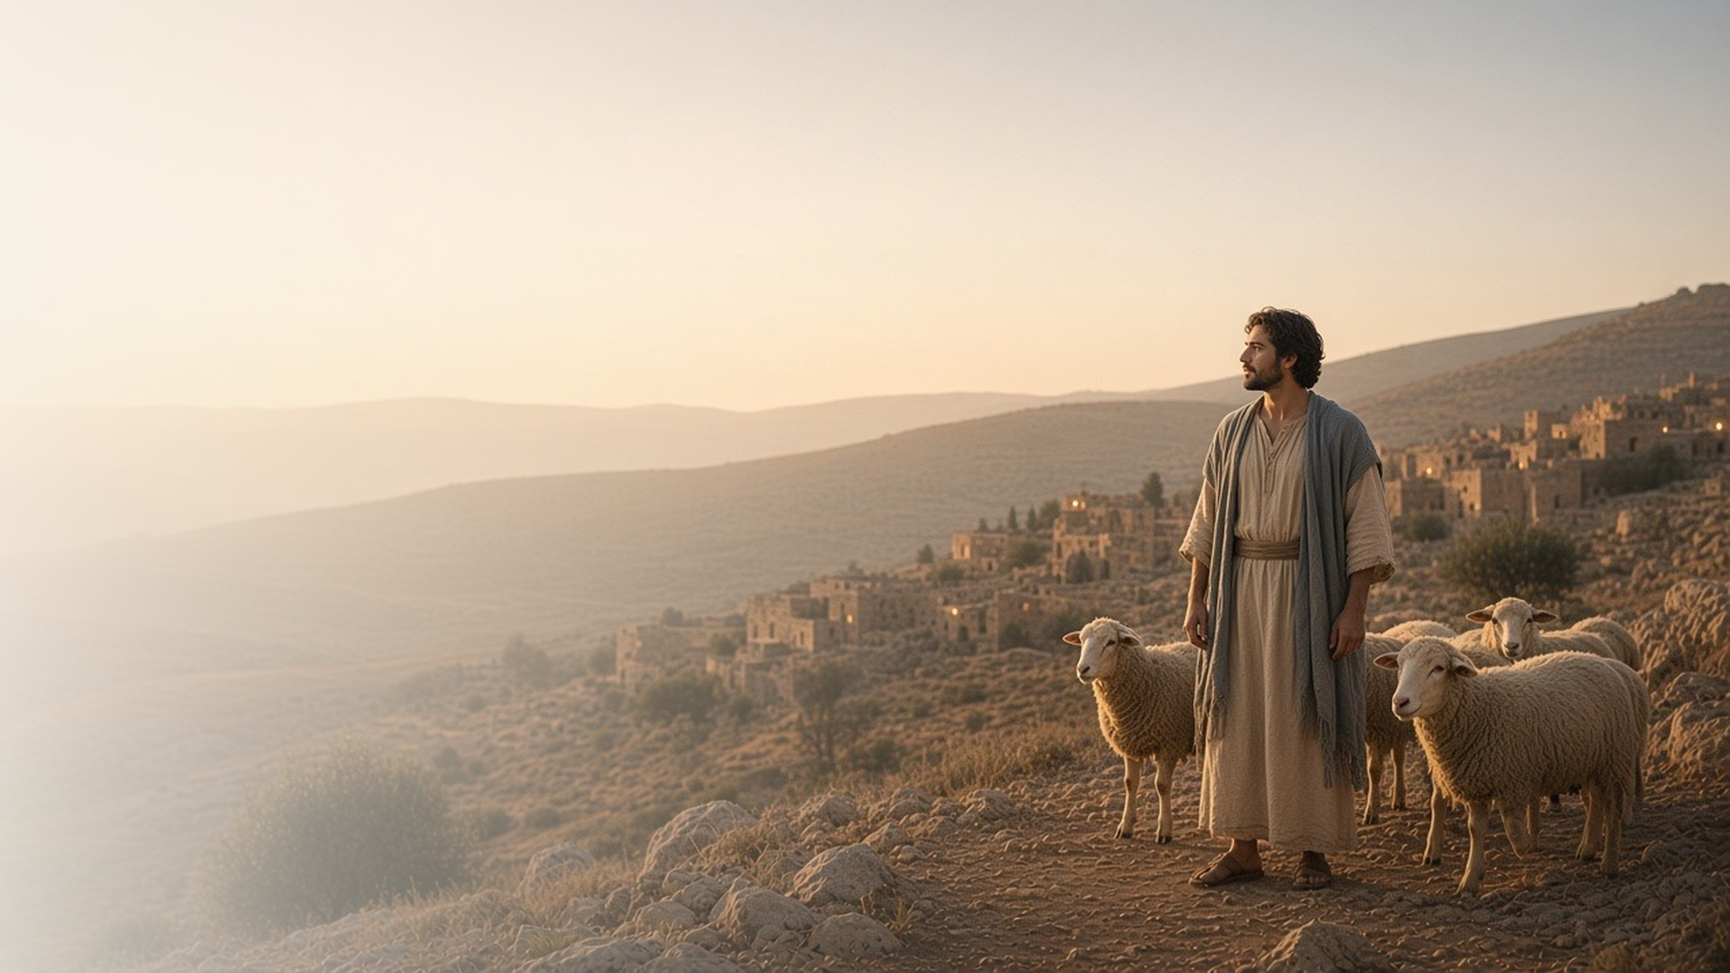
COME, FOLLOW ME · FOR CHILDREN
We Have Come
to Worship Him
January 4–10
Matthew 2; Luke 2
Notes:
TEACHING
This week children hear the story of Jesus's birth: Mary and Joseph traveled to Bethlehem, baby Jesus was laid in a manger, angels told shepherds the good news, and Wise Men followed a star. Invite children to listen for who came to see baby Jesus and how they showed their love for Him.
SCRIPTURE (KJV)
Luke 2:10–12
10 And the angel said unto them, Fear not: for, behold, I bring you good tidings of great joy, which shall be to all people.
11 For unto you is born this day in the city of David a Saviour, which is Christ the Lord.
12 And this shall be a sign unto you; Ye shall find the babe wrapped in swaddling clothes, lying in a manger.
DISCUSSION
• Who came to see baby Jesus?
• How can we show Jesus that we love Him?

Slide 2
MATTHEW 2:1–12; LUKE 2:1–21
Prophets said He would come
Long before, prophets looked forward to Jesus’s birth.
“For out of thee shall come a Governor, that shall rule my people Israel.”
MATTHEW 2:6
Notes:
TEACHING
Long before Jesus was born, prophets knew He would come, and they even said where. When the Wise Men asked where the new King would be born, the priests and scribes found the answer in the scriptures: Bethlehem. The manual also points to Samuel the Lamanite's prophecy in Helaman 14:2–5 (Book of Mormon). Help children see that God told His prophets about Jesus so people could be ready for Him.
SCRIPTURE (KJV)
Matthew 2:5–6
5 And they said unto him, In Bethlehem of Judaea: for thus it is written by the prophet,
6 And thou Bethlehem, in the land of Juda, art not the least among the princes of Juda: for out of thee shall come a Governor, that shall rule my people Israel.
Full passage: Matthew 2:4–6
Restoration scripture (public-domain text: bcbooks/scriptures-json)
Helaman 14:2, 5 (Book of Mormon)
2 And behold, he said unto them: Behold, I give unto you a sign; for five years more cometh, and behold, then cometh the Son of God to redeem all those who shall believe on his name.
5 And behold, there shall a new star arise, such an one as ye never have beheld; and this also shall be a sign unto you.
Full passage: Helaman 14:2–5
DISCUSSION (questions quoted from the manual)
• “What have our prophets today prophesied? (see, for example, Russell M.”

Slide 3
MATTHEW 2:1–12; LUKE 2:1–38
Jesus was born
Baby Jesus was born in Bethlehem and laid in a manger.
“And she brought forth her firstborn son, and wrapped him in swaddling clothes, and laid him in a manger.”
LUKE 2:7
Notes:
TEACHING
Let children tell or act out the story: Mary and Joseph travel to Bethlehem, there is no room in the inn, and baby Jesus is laid in a manger. Angels appear to shepherds in the fields, and the shepherds hurry to find Him. Later, Wise Men follow a star and bring gifts. Help children notice how each person showed love for Jesus, and how we can too.
SCRIPTURE (KJV)
Luke 2:7, 10–11, 16
7 And she brought forth her firstborn son, and wrapped him in swaddling clothes, and laid him in a manger; because there was no room for them in the inn.
10 And the angel said unto them, Fear not: for, behold, I bring you good tidings of great joy, which shall be to all people.
11 For unto you is born this day in the city of David a Saviour, which is Christ the Lord.
16 And they came with haste, and found Mary, and Joseph, and the babe lying in a manger.
Full passage: Luke 2:4–16
DISCUSSION (questions quoted from the manual)
• (The manual gives no direct questions for this section.)
Suggested: How did the shepherds and Wise Men show their love for baby Jesus?

Slide 4
LUKE 2:40, 52
Jesus grew, and so can I
He grew in wisdom, in stature, and in favor with God and others.
“And Jesus increased in wisdom and stature, and in favour with God and man.”
LUKE 2:52
Notes:
TEACHING
Jesus was once a child, and He grew up just like children do. Explain the words in Luke 2:52: wisdom means learning, stature means growing taller and stronger, favour with God means becoming closer to Heavenly Father, and favour with man means being kind and loved by others. Do a simple action for each: point to your head, stretch up tall, fold your arms, and give a hug or a wave.
SCRIPTURE (KJV)
Luke 2:40
40 And the child grew, and waxed strong in spirit, filled with wisdom: and the grace of God was upon him.
Luke 2:52
52 And Jesus increased in wisdom and stature, and in favour with God and man.
DISCUSSION (questions quoted from the manual)
• “How would He have treated His family?”

Slide 5
LUKE 2:41–52
Jesus did His Father’s work
At the temple, young Jesus listened, asked, and taught.
“Wist ye not that I must be about my Father’s business?”
LUKE 2:49
Notes:
TEACHING
When Jesus was twelve, His family went to Jerusalem for a feast. On the way home, Mary and Joseph could not find Him. After three days they found Him in the temple, listening to the teachers and asking questions. Jesus said He was doing His Father's business. Ask children what Heavenly Father's work might look like for them, such as praying, helping, learning, and being kind.
SCRIPTURE (KJV)
Luke 2:43, 46–47, 49
43 And when they had fulfilled the days, as they returned, the child Jesus tarried behind in Jerusalem; and Joseph and his mother knew not of it.
46 And it came to pass, that after three days they found him in the temple, sitting in the midst of the doctors, both hearing them, and asking them questions.
47 And all that heard him were astonished at his understanding and answers.
49 And he said unto them, How is it that ye sought me? wist ye not that I must be about my Father’s business?
Full passage: Luke 2:41–49
DISCUSSION (questions quoted from the manual)
• (The manual gives no direct questions for this section.)
Suggested: What is one way you can do Heavenly Father's work this week?

Slide 6
LUKE 2:14
“Glory to God in the highest,
and on earth peace, good will toward men.”
This week, tell someone the story of baby Jesus.
Notes:
TEACHING
The angels were so happy that Jesus was born that they sang praises to God. The shepherds were so happy that they told everyone about Him. Invite children to be like the shepherds this week by telling a family member or friend the story of baby Jesus, or by singing a Christmas song for someone.
SCRIPTURE (KJV)
Luke 2:13–14
13 And suddenly there was with the angel a multitude of the heavenly host praising God, and saying,
14 Glory to God in the highest, and on earth peace, good will toward men.
DISCUSSION
• Why were the angels and shepherds so happy?
• Who could you tell about baby Jesus this week?

