Slide 1
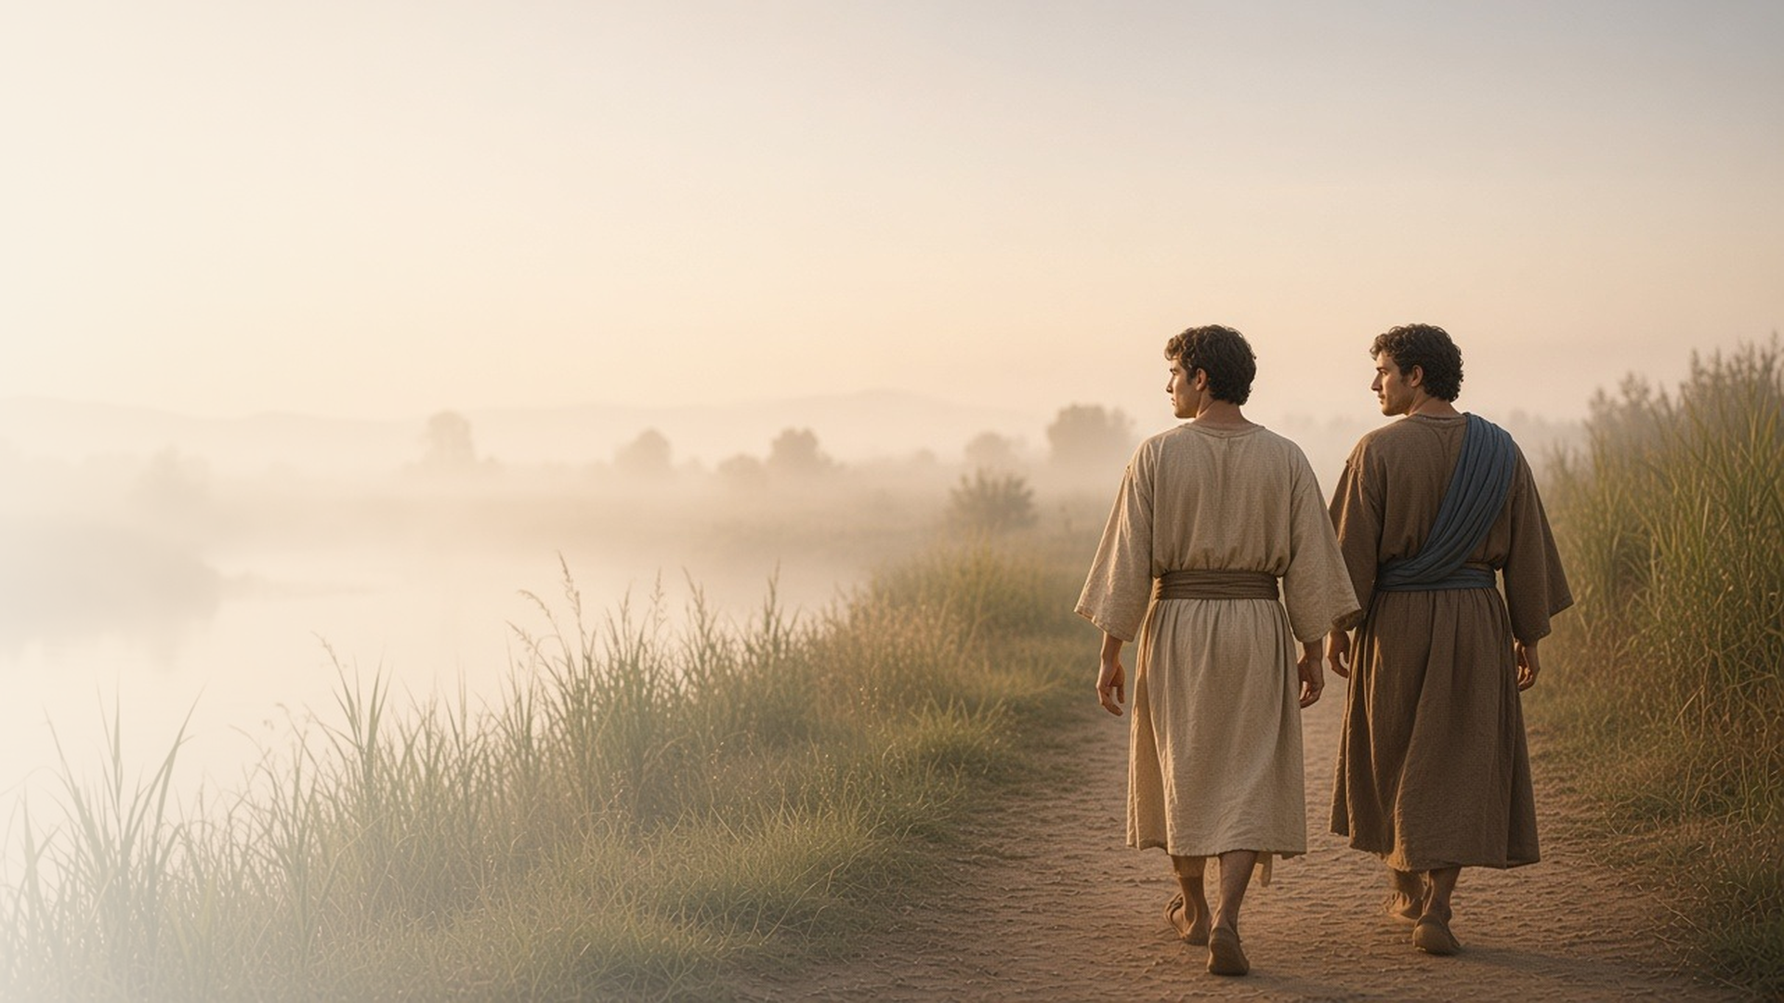
COME, FOLLOW ME · FOR CHILDREN
We Have Found
the Messiah
January 11–17
John 1
Notes:
TEACHING
This week children learn that Jesus lived with Heavenly Father before He was born, that He created the world, that He is our light, and that we can invite others to come and learn about Him, just as His first disciples did.
SCRIPTURE (KJV)
John 1:1–3
1 In the beginning was the Word, and the Word was with God, and the Word was God.
2 The same was in the beginning with God.
3 All things were made by him; and without him was not any thing made that was made.
DISCUSSION
• Where did Jesus live before He was born?
• What are some things Jesus made?

Slide 2
JOHN 1:1–5
Jesus lived with God first
Before He was born, Jesus lived with Heavenly Father.
“The same was in the beginning with God.”
JOHN 1:2
Notes:
TEACHING
Show a picture of Jesus as a baby, then ask where He was before He was born. John 1 teaches that Jesus was with Heavenly Father in the beginning. Remind children that they also lived with Heavenly Father before they were born. The manual suggests Moses 4:2 and the song "I Lived in Heaven" (Children's Songbook, 4).
SCRIPTURE (KJV)
John 1:1–3
1 In the beginning was the Word, and the Word was with God, and the Word was God.
2 The same was in the beginning with God.
3 All things were made by him; and without him was not any thing made that was made.
Full passage: John 1:1–5
Restoration scripture (public-domain text: bcbooks/scriptures-json)
Moses 4:2 (Pearl of Great Price)
2 But, behold, my Beloved Son, which was my Beloved and Chosen from the beginning, said unto me—Father, thy will be done, and the glory be thine forever.
DISCUSSION (questions quoted from the manual)
• “What did Jesus do before He was born?”

Slide 3
JOHN 1:3
Jesus made all things
The sky, the trees, the animals: Jesus created them all.
“All things were made by him; and without him was not any thing made that was made.”
JOHN 1:3
Notes:
TEACHING
Take a short walk or look out a window and name things Jesus created. Read John 1:3 together and explain that Jesus made the world under Heavenly Father's direction. Let children share their favorite creation and say thank you to Heavenly Father in a prayer.
SCRIPTURE (KJV)
John 1:3
3 All things were made by him; and without him was not any thing made that was made.
DISCUSSION (questions quoted from the manual)
• (The manual gives no direct questions for this section.)
Suggested: What is your favorite thing that Jesus made, and why?

Slide 4
JOHN 1:4–9
Jesus is my light
Like a light in the dark, Jesus helps me see the right way.
“That was the true Light, which lighteth every man that cometh into the world.”
JOHN 1:9
Notes:
TEACHING
Talk about why we are thankful for light: it helps us see, keeps us safe, and chases away fear. Turn off the lights and turn on a flashlight. Explain that Jesus is like a light because His example and teachings show us the way to go. Children could point to a picture of Jesus whenever they hear the word light.
SCRIPTURE (KJV)
John 1:4–5, 9
4 In him was life; and the life was the light of men.
5 And the light shineth in darkness; and the darkness comprehended it not.
9 That was the true Light, which lighteth every man that cometh into the world.
Full passage: John 1:4–9
DISCUSSION (questions quoted from the manual)
• “How is Jesus Christ like a light?”

Slide 5
JOHN 1:35–51
I can invite others to Jesus
Andrew found Jesus, then brought his brother Simon.
“We have found the Messias, which is, being interpreted, the Christ.”
JOHN 1:41
Notes:
TEACHING
Andrew spent a day with Jesus and then ran to tell his brother: we have found the Messiah! Philip did the same for his friend Nathanael. Play a simple "come and see" game: hide a picture of Jesus under a blanket, let one child look and then invite another child to come and see. Talk about how sharing the gospel is like sharing something we love.
SCRIPTURE (KJV)
John 1:37, 40–42
37 And the two disciples heard him speak, and they followed Jesus.
40 One of the two which heard John speak, and followed him, was Andrew, Simon Peter’s brother.
41 He first findeth his own brother Simon, and saith unto him, We have found the Messias, which is, being interpreted, the Christ.
42 And he brought him to Jesus. And when Jesus beheld him, he said, Thou art Simon the son of Jona: thou shalt be called Cephas, which is by interpretation, A stone.
Full passage: John 1:35–42
DISCUSSION (questions quoted from the manual)
• “What helped these people learn about Jesus?”
• “Who invited you to “come and see”?”
• “Why is an invitation to “come and see” a good way to share the gospel?”

Slide 6
JOHN 1:39
“Come and see.
They came and saw where he dwelt.”
This week, invite someone to come and learn about Jesus.
Notes:
TEACHING
Jesus invited His new friends to come and see where He lived, and they stayed with Him all day. We can invite friends and family to learn about Jesus too, by inviting them to church, to family home evening, or just by telling them what we love about Him.
SCRIPTURE (KJV)
John 1:39
39 He saith unto them, Come and see. They came and saw where he dwelt, and abode with him that day: for it was about the tenth hour.
DISCUSSION
• What did Jesus invite His friends to do?
• Who could you invite to learn about Jesus?

