Slide 1
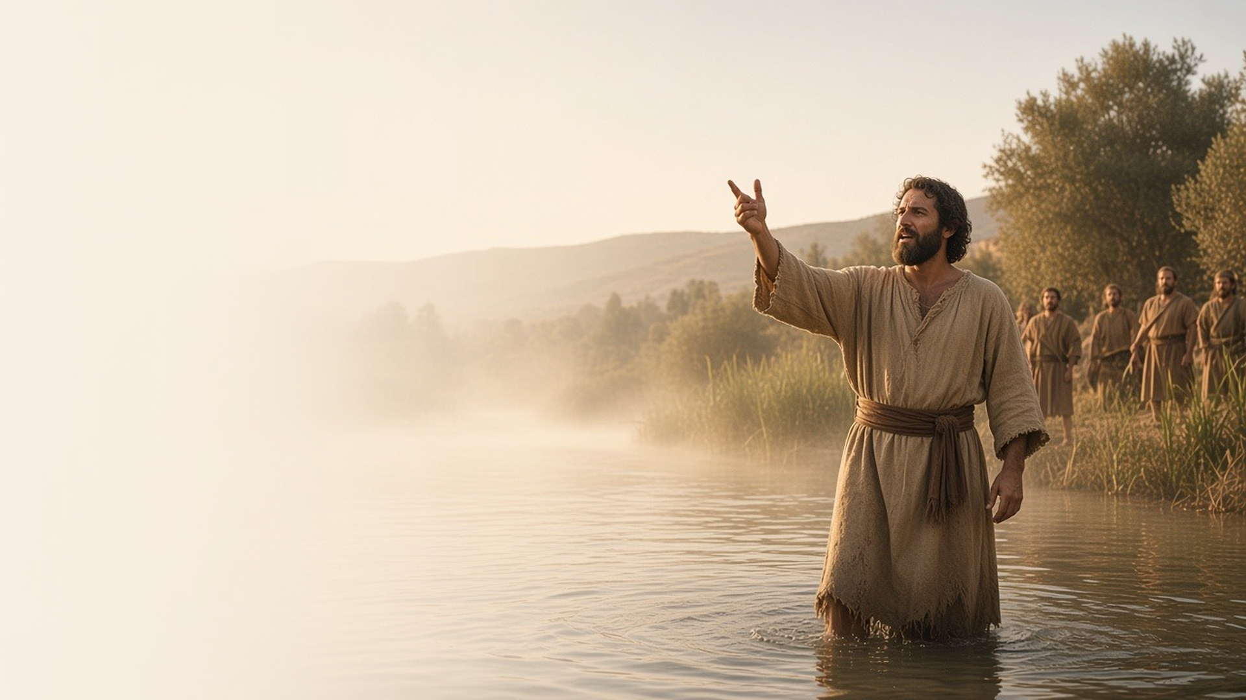
COME, FOLLOW ME · NEW TESTAMENT 2027
Prepare Ye the Way
of the Lord
January 18–24
Matthew 3; Mark 1; Luke 3
Notes:
TEACHING
John the Baptist's mission was to prepare hearts to receive the Savior. His message was repentance and baptism, and his ministry reached its high point when he baptized Jesus Christ and witnessed the Father's voice and the Spirit's descent. This week asks how we prepare our own hearts for the Lord.
SCRIPTURE (KJV)
Matthew 3:1–3
1 In those days came John the Baptist, preaching in the wilderness of Judaea,
2 And saying, Repent ye: for the kingdom of heaven is at hand.
3 For this is he that was spoken of by the prophet Esaias, saying, The voice of one crying in the wilderness, Prepare ye the way of the Lord, make his paths straight.
DISCUSSION
• What does it look like to "prepare the way" for the Lord in your own life?
• What did John the Baptist's ministry teach about humility?

Slide 2
MATTHEW 3:1–12; MARK 1:1–8; LUKE 3:2–18
Repentance: a mighty change
John called for a change of heart that shows in how we live.
“Bring forth therefore fruits meet for repentance.”
MATTHEW 3:8
Notes:
TEACHING
John's images were vivid: an axe at the root of the tree, a winnowing fan separating wheat from chaff, fruit that reveals the health of a tree. Repentance in his preaching is more than regret; it is a turning of the whole mind and heart that produces visible fruit. When people asked what to do, his answers were practical: share with those in need, deal honestly, and treat others fairly.
SCRIPTURE (KJV)
Matthew 3:1–8
1 In those days came John the Baptist, preaching in the wilderness of Judaea,
2 And saying, Repent ye: for the kingdom of heaven is at hand.
3 For this is he that was spoken of by the prophet Esaias, saying, The voice of one crying in the wilderness, Prepare ye the way of the Lord, make his paths straight.
4 And the same John had his raiment of camel’s hair, and a leathern girdle about his loins; and his meat was locusts and wild honey.
5 Then went out to him Jerusalem, and all Judaea, and all the region round about Jordan,
6 And were baptized of him in Jordan, confessing their sins.
7 But when he saw many of the Pharisees and Sadducees come to his baptism, he said unto them, O generation of vipers, who hath warned you to flee from the wrath to come?
8 Bring forth therefore fruits meet for repentance:
Luke 3:10–14
10 And the people asked him, saying, What shall we do then?
11 He answereth and saith unto them, He that hath two coats, let him impart to him that hath none; and he that hath meat, let him do likewise.
12 Then came also publicans to be baptized, and said unto him, Master, what shall we do?
13 And he said unto them, Exact no more than that which is appointed you.
14 And the soldiers likewise demanded of him, saying, And what shall we do? And he said unto them, Do violence to no man, neither accuse any falsely; and be content with your wages.
Restoration scripture (public-domain text: bcbooks/scriptures-json)
Moroni 6:1–3 (Book of Mormon)
1 And now I speak concerning baptism. Behold, elders, priests, and teachers were baptized; and they were not baptized save they brought forth fruit meet that they were worthy of it.
2 Neither did they receive any unto baptism save they came forth with a broken heart and a contrite spirit, and witnessed unto the church that they truly repented of all their sins.
3 And none were received unto baptism save they took upon them the name of Christ, having a determination to serve him to the end.
Doctrine and Covenants 20:37 (Doctrine and Covenants)
37 And again, by way of commandment to the church concerning the manner of baptism—All those who humble themselves before God, and desire to be baptized, and come forth with broken hearts and contrite spirits, and witness before the church that they have truly repented of all their sins, and are willing to take upon them the name of Jesus Christ, having a determination to serve him to the end, and truly manifest by their works that they have received of the Spirit of Christ unto the remission of their sins, shall be received by baptism into his church.
DISCUSSION (questions quoted from the manual)
• “What do these images teach you about repentance?”
• “In Luke 3:7–14, what changes did John invite the people to make to prepare to receive Christ?”
• “What does it mean to bring forth “fruits worthy of repentance”? (see also Moroni 6:1–3; Doctrine and Covenants 20:37).”
• “What attitudes and behaviors have you noticed in yourself or others who truly are trying to repent?”

Slide 3
MATTHEW 3:11, 13–17; MARK 1:9–11; LUKE 3:15–16, 21–22
Baptized as our example
Jesus was baptized by immersion, by proper authority, as our pattern.
“Suffer it to be so now: for thus it becometh us to fulfil all righteousness. Then he suffered him.”
MATTHEW 3:15
Notes:
TEACHING
Jesus had no sins to wash away, yet He traveled to the Jordan to be baptized. He sought out someone holding the right authority, went down into the water, and showed obedience to every commandment of His Father. In doing so He set the pattern we follow. Invite class members to compare His baptism with their own: who performed it, how it was done, and what covenant was made.
SCRIPTURE (KJV)
Matthew 3:13–17
13 Then cometh Jesus from Galilee to Jordan unto John, to be baptized of him.
14 But John forbad him, saying, I have need to be baptized of thee, and comest thou to me?
15 And Jesus answering said unto him, Suffer it to be so now: for thus it becometh us to fulfil all righteousness. Then he suffered him.
16 And Jesus, when he was baptized, went up straightway out of the water: and, lo, the heavens were opened unto him, and he saw the Spirit of God descending like a dove, and lighting upon him:
17 And lo a voice from heaven, saying, This is my beloved Son, in whom I am well pleased.
DISCUSSION (questions quoted from the manual)
• “Who baptized Jesus, and what authority did he hold?”
• “Who baptized you, and what authority did he hold?”
• “Where was Jesus baptized?”
• “Where were you baptized?”
• “How was Jesus baptized?”
• “How were you baptized?”
(+5 more in the manual)

Slide 4
MATTHEW 3:11, 16–17; LUKE 3:16
A baptism of fire
The Holy Ghost purifies and renews us, like a refining fire.
“He shall baptize you with the Holy Ghost, and with fire.”
MATTHEW 3:11
Notes:
TEACHING
John taught that his baptism in water was only part of the gift; the One coming after him would baptize with the Holy Ghost and with fire. Fire refines, purifies, warms, and gives light. Receiving the Holy Ghost cleanses and changes us in ways water alone cannot. At Jesus's baptism the Spirit descended like a dove, a symbol of peace and purity.
SCRIPTURE (KJV)
Matthew 3:11
11 I indeed baptize you with water unto repentance: but he that cometh after me is mightier than I, whose shoes I am not worthy to bear: he shall baptize you with the Holy Ghost, and with fire:
Luke 3:16
16 John answered, saying unto them all, I indeed baptize you with water; but one mightier than I cometh, the latchet of whose shoes I am not worthy to unloose: he shall baptize you with the Holy Ghost and with fire:
Restoration scripture (public-domain text: bcbooks/scriptures-json)
3 Nephi 9:20 (Book of Mormon)
20 And ye shall offer for a sacrifice unto me a broken heart and a contrite spirit. And whoso cometh unto me with a broken heart and a contrite spirit, him will I baptize with fire and with the Holy Ghost, even as the Lamanites, because of their faith in me at the time of their conversion, were baptized with fire and with the Holy Ghost, and they knew it not.
DISCUSSION (questions quoted from the manual)
• “What might fire represent? (See 3 Nephi 9:20; “Baptism of the Holy Ghost” [video], Gospel Library.)”
• “What does the symbolism of a dove suggest to you about the Holy Ghost?”
• “How would you help a person being baptized understand that receiving the gift of the Holy Ghost is just as important as their baptism?”
• “What are you doing to continually receive the Holy Ghost in your life?”

Slide 5
MATTHEW 3:16–17; MARK 1:9–11; LUKE 3:21–22
Three separate beings
The Father spoke, the Son was baptized, and the Spirit descended.
“And lo a voice from heaven, saying, This is my beloved Son, in whom I am well pleased.”
MATTHEW 3:17
Notes:
TEACHING
The accounts of the Savior's baptism show all three members of the Godhead at once and in distinct ways: the Son stands in the water, the Holy Ghost descends like a dove, and the Father speaks from heaven. Together they teach that the Godhead are three separate beings, perfectly united in purpose. Invite class members to list what they learn about each member of the Godhead from these verses.
SCRIPTURE (KJV)
Matthew 3:16–17
16 And Jesus, when he was baptized, went up straightway out of the water: and, lo, the heavens were opened unto him, and he saw the Spirit of God descending like a dove, and lighting upon him:
17 And lo a voice from heaven, saying, This is my beloved Son, in whom I am well pleased.
Mark 1:9–11
9 And it came to pass in those days, that Jesus came from Nazareth of Galilee, and was baptized of John in Jordan.
10 And straightway coming up out of the water, he saw the heavens opened, and the Spirit like a dove descending upon him:
11 And there came a voice from heaven, saying, Thou art my beloved Son, in whom I am well pleased.
Luke 3:21–22
21 Now when all the people were baptized, it came to pass, that Jesus also being baptized, and praying, the heaven was opened,
22 And the Holy Ghost descended in a bodily shape like a dove upon him, and a voice came from heaven, which said, Thou art my beloved Son; in thee I am well pleased.
DISCUSSION (questions quoted from the manual)
• “Why are these truths important to you?”

Slide 6
MARK 1:11
“Thou art my beloved Son,
in whom I am well pleased.”
This week, renew your covenant as you take the sacrament.
Notes:
TEACHING
At the Savior's baptism the Father declared His love and approval. As we keep our baptismal covenant and renew it each week through the sacrament, we follow the same path and can feel that same love. Invite class members to prepare for the sacrament this week by pondering what repentance and renewal they want to bring to it.
SCRIPTURE (KJV)
Mark 1:9–11
9 And it came to pass in those days, that Jesus came from Nazareth of Galilee, and was baptized of John in Jordan.
10 And straightway coming up out of the water, he saw the heavens opened, and the Spirit like a dove descending upon him:
11 And there came a voice from heaven, saying, Thou art my beloved Son, in whom I am well pleased.
DISCUSSION
• How can taking the sacrament this week be more like a renewal of your baptism?
• What one fruit of repentance would you like to show this week?

