Slide 1
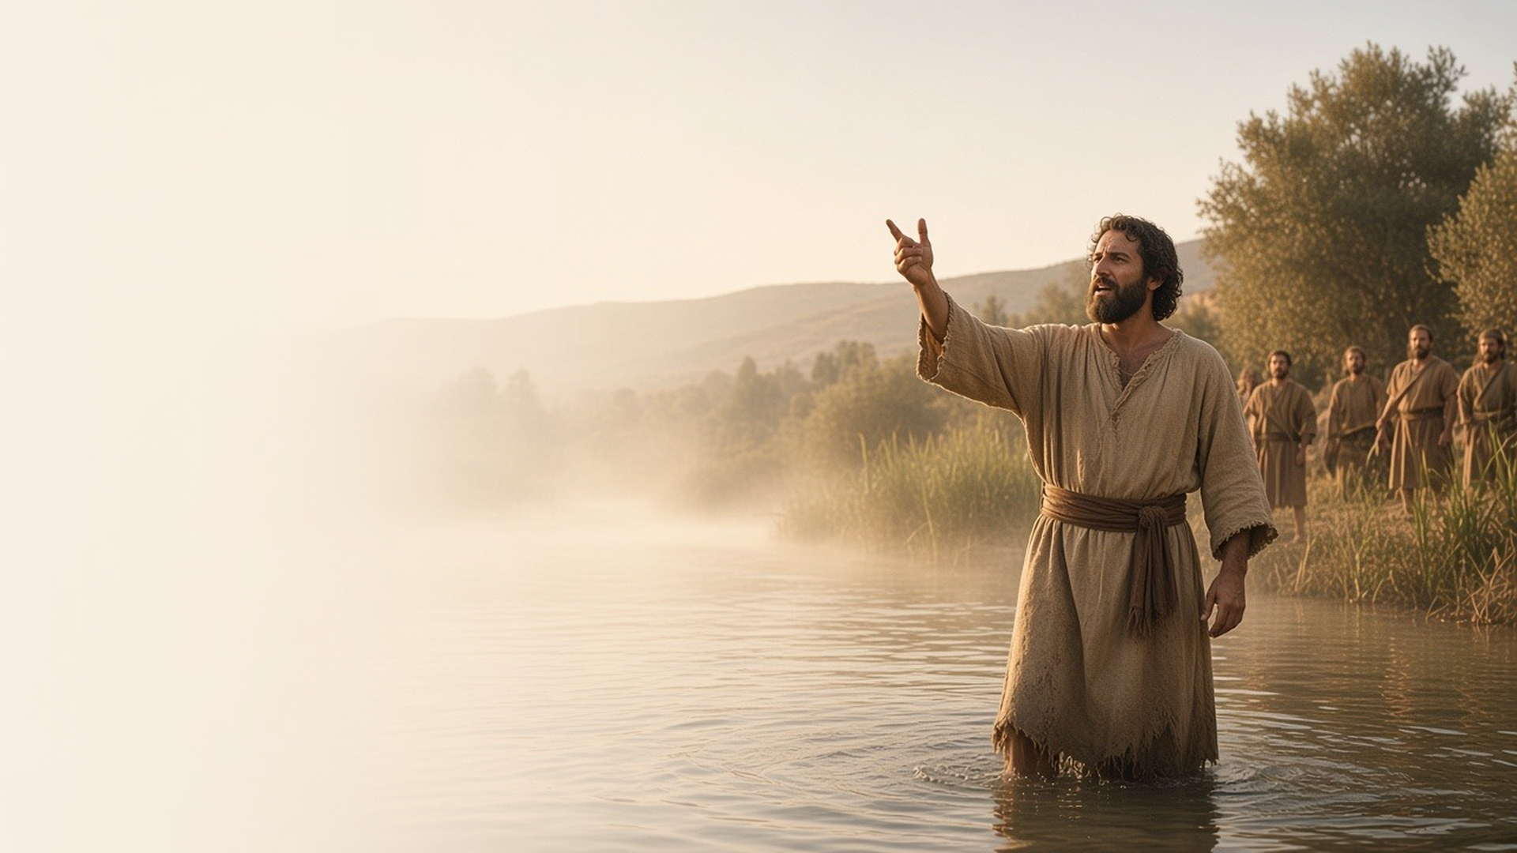
COME, FOLLOW ME · FOR CHILDREN
Prepare Ye the Way
of the Lord
January 18–24
Matthew 3; Mark 1; Luke 3
Notes:
TEACHING
This week children learn about John the Baptist, who helped people get ready for Jesus. They learn how Jesus was baptized, how the Holy Ghost came like a dove, and that John later restored the Aaronic Priesthood to Joseph Smith.
SCRIPTURE (KJV)
Mark 1:9–11
9 And it came to pass in those days, that Jesus came from Nazareth of Galilee, and was baptized of John in Jordan.
10 And straightway coming up out of the water, he saw the heavens opened, and the Spirit like a dove descending upon him:
11 And there came a voice from heaven, saying, Thou art my beloved Son, in whom I am well pleased.
DISCUSSION
• Who baptized Jesus?
• How can we get ready to follow Jesus?

Slide 2
MATTHEW 3:13–17; MARK 1:1–11; LUKE 3:2–18
I can be baptized like Jesus
Jesus went down into the water and was baptized by John.
“Jesus came from Nazareth of Galilee, and was baptized of John in Jordan.”
MARK 1:9
Notes:
TEACHING
Read Mark 1:1–11 and ask: Who baptized Jesus? Where? How? Explain that being baptized by immersion means going all the way under the water, like being buried and coming up new. Jesus didn't need to be cleansed from sin, but He was baptized to obey Heavenly Father and show us the way. Point out how baptisms today follow His example.
SCRIPTURE (KJV)
Mark 1:9–11
9 And it came to pass in those days, that Jesus came from Nazareth of Galilee, and was baptized of John in Jordan.
10 And straightway coming up out of the water, he saw the heavens opened, and the Spirit like a dove descending upon him:
11 And there came a voice from heaven, saying, Thou art my beloved Son, in whom I am well pleased.
Full passage: Mark 1:4–11
DISCUSSION (questions quoted from the manual)
• “Who baptized Jesus Christ?”
• “Where was Jesus baptized?”
• “Why is it important to be baptized by immersion (go all the way under the water)?”
• “Why was Jesus baptized even though He did not need to be cleansed from sin?”

Slide 3
MATTHEW 3:11, 16
The Holy Ghost helps me
The Holy Ghost can comfort me and help me choose the right.
“He saw the Spirit of God descending like a dove, and lighting upon him.”
MATTHEW 3:16
Notes:
TEACHING
After Jesus was baptized, the Holy Ghost came upon Him, shown by the sign of a dove. Show a picture of a child being confirmed and explain that after baptism we receive the gift of the Holy Ghost. Find objects that represent ways the Holy Ghost helps: a blanket for comfort, a compass or map for guidance, a picture of Jesus because He testifies of Christ.
SCRIPTURE (KJV)
Matthew 3:16
16 And Jesus, when he was baptized, went up straightway out of the water: and, lo, the heavens were opened unto him, and he saw the Spirit of God descending like a dove, and lighting upon him:
Restoration scripture (public-domain text: bcbooks/scriptures-json)
2 Nephi 32:5 (Book of Mormon)
5 For behold, again I say unto you that if ye will enter in by the way, and receive the Holy Ghost, it will show unto you all things what ye should do.
DISCUSSION (questions quoted from the manual)
• “How is He like a dove? (see John 15:26; 2 Nephi 32:5).”

Slide 4
MATTHEW 3
John held the priesthood
John the Baptist later restored the Aaronic Priesthood.
“Prepare ye the way of the Lord, make his paths straight.”
MATTHEW 3:3
Notes:
TEACHING
John the Baptist had priesthood authority to baptize. Many centuries later, in 1829, he came as an angel and gave that same Aaronic Priesthood to Joseph Smith and Oliver Cowdery (Doctrine and Covenants 13). Children could stand up each time they hear the word baptism as you read.
SCRIPTURE (KJV)
Matthew 3:1–3
1 In those days came John the Baptist, preaching in the wilderness of Judaea,
2 And saying, Repent ye: for the kingdom of heaven is at hand.
3 For this is he that was spoken of by the prophet Esaias, saying, The voice of one crying in the wilderness, Prepare ye the way of the Lord, make his paths straight.
Restoration scripture (public-domain text: bcbooks/scriptures-json)
Doctrine and Covenants 13 (full section) (Doctrine and Covenants)
1 Upon you my fellow servants, in the name of Messiah I confer the Priesthood of Aaron, which holds the keys of the ministering of angels, and of the gospel of repentance, and of baptism by immersion for the remission of sins; and this shall never be taken again from the earth, until the sons of Levi do offer again an offering unto the Lord in righteousness.
DISCUSSION (questions quoted from the manual)
• “According to section 13, what other blessings does God give us through the Aaronic Priesthood?”

Slide 5
MARK 1:11
“Thou art my beloved Son,
in whom I am well pleased.”
This week, think about your baptism day, or the day you’ll be baptized.
Notes:
TEACHING
When Jesus was baptized, Heavenly Father said He loved His Son and was pleased with Him. Heavenly Father loves each of us too and is happy when we choose to follow Jesus. Invite children to talk with their family about baptism this week.
SCRIPTURE (KJV)
Mark 1:11
11 And there came a voice from heaven, saying, Thou art my beloved Son, in whom I am well pleased.
DISCUSSION
• What did Heavenly Father say when Jesus was baptized?
• How can you get ready to be baptized, or remember your baptism?

