Slide 1
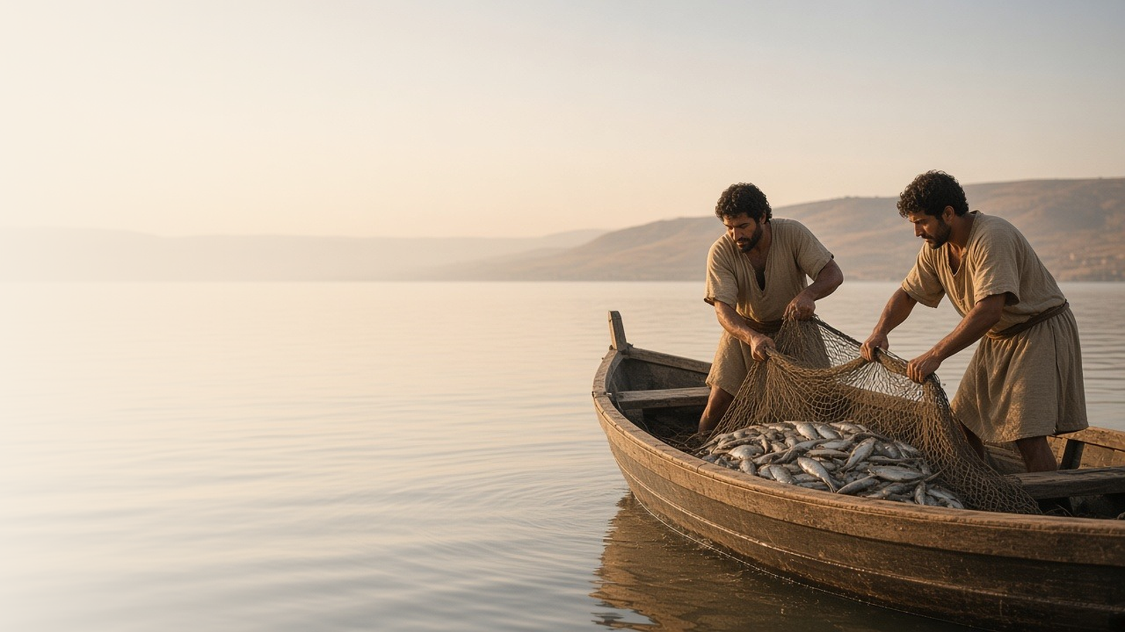
COME, FOLLOW ME · NEW TESTAMENT 2027
The Spirit of the Lord
Is upon Me
January 25–31
Matthew 4; Luke 4–5
Notes:
TEACHING
These chapters open the Savior's public ministry. He prepares through fasting and communion with God, resists Satan's temptations, announces His mission in the synagogue at Nazareth, and calls fishermen to leave their nets and follow Him. Each scene shows what it means to live and serve with the Spirit of the Lord.
SCRIPTURE (KJV)
Luke 4:18–19
18 The Spirit of the Lord is upon me, because he hath anointed me to preach the gospel to the poor; he hath sent me to heal the brokenhearted, to preach deliverance to the captives, and recovering of sight to the blind, to set at liberty them that are bruised,
19 To preach the acceptable year of the Lord.
DISCUSSION
• How did Jesus prepare for His mission, and how can we prepare for ours?
• Which part of the Savior's mission in Luke 4:18 do you most need right now?

Slide 2
MATTHEW 4:1–2
Preparing to serve
Before His ministry, Jesus fasted and drew near to God.
“And when he had fasted forty days and forty nights, he was afterward an hungred.”
MATTHEW 4:2
Notes:
TEACHING
Before teaching a single sermon, Jesus withdrew into the wilderness to fast and, as the Joseph Smith Translation says, "to be with God." Fasting quiets physical appetites so spiritual ones can grow. Ask class members how fasting and prayer have prepared them for a calling, a decision, or a hard conversation, and what they might fast for this month.
SCRIPTURE (KJV)
Matthew 4:1–2
1 Then was Jesus led up of the Spirit into the wilderness to be tempted of the devil.
2 And when he had fasted forty days and forty nights, he was afterward an hungred.
DISCUSSION (questions quoted from the manual)
• “Why do you think fasting was part of His preparation?”
• “How have those experiences helped you prepare to serve the Lord?”

Slide 3
MATTHEW 4:1–11; LUKE 4:1–13
Resisting temptation
Jesus answered each temptation with scripture and kept His focus.
“Get thee hence, Satan: for it is written, Thou shalt worship the Lord thy God, and him only shalt thou serve.”
MATTHEW 4:10
Notes:
TEACHING
Being tempted is not a sin; even the sinless Savior was tempted. Satan targeted physical hunger, the desire to prove His identity, and the lure of worldly power, often beginning with "If thou be the Son of God." Each time, Jesus answered with scripture and refused to be pulled from His purpose. Invite class members to compare these temptations with the forms Satan uses today.
SCRIPTURE (KJV)
Matthew 4:1–11
1 Then was Jesus led up of the Spirit into the wilderness to be tempted of the devil.
2 And when he had fasted forty days and forty nights, he was afterward an hungred.
3 And when the tempter came to him, he said, If thou be the Son of God, command that these stones be made bread.
4 But he answered and said, It is written, Man shall not live by bread alone, but by every word that proceedeth out of the mouth of God.
5 Then the devil taketh him up into the holy city, and setteth him on a pinnacle of the temple,
6 And saith unto him, If thou be the Son of God, cast thyself down: for it is written, He shall give his angels charge concerning thee: and in their hands they shall bear thee up, lest at any time thou dash thy foot against a stone.
7 Jesus said unto him, It is written again, Thou shalt not tempt the Lord thy God.
8 Again, the devil taketh him up into an exceeding high mountain, and sheweth him all the kingdoms of the world, and the glory of them;
9 And saith unto him, All these things will I give thee, if thou wilt fall down and worship me.
10 Then saith Jesus unto him, Get thee hence, Satan: for it is written, Thou shalt worship the Lord thy God, and him only shalt thou serve.
11 Then the devil leaveth him, and, behold, angels came and ministered unto him.
DISCUSSION (questions quoted from the manual)
• “What did Satan tempt Jesus to do?”
• “What does Satan tempt me to do?”
• “How did Jesus resist the temptation?”
• “How can I resist temptation?”
• “What additional insights do you gain from the Joseph Smith Translation of Matthew 4? (see footnotes throughout Matthew 4).”

Slide 4
LUKE 4:16–32
The promised Messiah
In Nazareth, Jesus declared that Isaiah’s prophecy was about Him.
“This day is this scripture fulfilled in your ears.”
LUKE 4:21
Notes:
TEACHING
In His hometown synagogue Jesus read Isaiah's prophecy of the Anointed One who would preach to the poor, heal the brokenhearted, free captives, and give sight to the blind, and then declared it fulfilled. Many could not see past His familiar background and even tried to kill Him. Discuss what might have made it hard for them to accept Him, and what has helped us accept Him as our personal Savior.
SCRIPTURE (KJV)
Luke 4:16–22
16 And he came to Nazareth, where he had been brought up: and, as his custom was, he went into the synagogue on the sabbath day, and stood up for to read.
17 And there was delivered unto him the book of the prophet Esaias. And when he had opened the book, he found the place where it was written,
18 The Spirit of the Lord is upon me, because he hath anointed me to preach the gospel to the poor; he hath sent me to heal the brokenhearted, to preach deliverance to the captives, and recovering of sight to the blind, to set at liberty them that are bruised,
19 To preach the acceptable year of the Lord.
20 And he closed the book, and he gave it again to the minister, and sat down. And the eyes of all them that were in the synagogue were fastened on him.
21 And he began to say unto them, This day is this scripture fulfilled in your ears.
22 And all bare him witness, and wondered at the gracious words which proceeded out of his mouth. And they said, Is not this Joseph’s son?
Luke 4:28–30
28 And all they in the synagogue, when they heard these things, were filled with wrath,
29 And rose up, and thrust him out of the city, and led him unto the brow of the hill whereon their city was built, that they might cast him down headlong.
30 But he passing through the midst of them went his way,
DISCUSSION (questions quoted from the manual)
• “If you were asked to describe why Jesus Christ was sent to earth, what would you say?”
• “What do you learn about His mission as you read these verses?”
• “What are some ways the Savior invites you to participate in His work?”
• “What might have made it hard for them to accept Jesus as the Messiah?”
• “What experiences have helped you believe that Jesus Christ is your personal Savior?”

Slide 5
MATTHEW 4:18–22; LUKE 5:1–11
At His word
When Peter obeyed, the nets filled and his life changed.
“Master, we have toiled all the night, and have taken nothing: nevertheless at thy word I will let down the net.”
LUKE 5:5
Notes:
TEACHING
Peter was the experienced fisherman, and the Savior's instruction to cast again after a fruitless night made little sense. He obeyed anyway, and the catch broke the nets. Overwhelmed, Peter felt unworthy, but Jesus called him to a far greater work. When we trust the Lord's direction before we understand it, He can make more of our lives than we could on our own.
SCRIPTURE (KJV)
Luke 5:1–11
1 And it came to pass, that, as the people pressed upon him to hear the word of God, he stood by the lake of Gennesaret,
2 And saw two ships standing by the lake: but the fishermen were gone out of them, and were washing their nets.
3 And he entered into one of the ships, which was Simon’s, and prayed him that he would thrust out a little from the land. And he sat down, and taught the people out of the ship.
4 Now when he had left speaking, he said unto Simon, Launch out into the deep, and let down your nets for a draught.
5 And Simon answering said unto him, Master, we have toiled all the night, and have taken nothing: nevertheless at thy word I will let down the net.
6 And when they had this done, they inclosed a great multitude of fishes: and their net brake.
7 And they beckoned unto their partners, which were in the other ship, that they should come and help them. And they came, and filled both the ships, so that they began to sink.
8 When Simon Peter saw it, he fell down at Jesus’ knees, saying, Depart from me; for I am a sinful man, O Lord.
9 For he was astonished, and all that were with him, at the draught of the fishes which they had taken:
10 And so was also James, and John, the sons of Zebedee, which were partners with Simon. And Jesus said unto Simon, Fear not; from henceforth thou shalt catch men.
11 And when they had brought their ships to land, they forsook all, and followed him.
Matthew 4:18–22
18 And Jesus, walking by the sea of Galilee, saw two brethren, Simon called Peter, and Andrew his brother, casting a net into the sea: for they were fishers.
19 And he saith unto them, Follow me, and I will make you fishers of men.
20 And they straightway left their nets, and followed him.
21 And going on from thence, he saw other two brethren, James the son of Zebedee, and John his brother, in a ship with Zebedee their father, mending their nets; and he called them.
22 And they immediately left the ship and their father, and followed him.
DISCUSSION (questions quoted from the manual)
• “Why might Peter have doubted Jesus’s instructions?”
• “How might this experience have affected Peter’s feelings about the Savior and himself?”
• “How might it have prepared him for His calling?”
• “What has the Savior asked you to forsake?”
• “How has He blessed you for doing so?”
• “Why is it important to obey the Lord, even when His commandments don’t make sense to us at first?”
(+2 more in the manual)

Slide 6
LUKE 5:11
“And when they had brought their ships to land,
they forsook all, and followed him.”
This week, leave one “net” behind to follow Him more fully.
Notes:
TEACHING
Peter, James, and John had just enjoyed the best catch of their lives, yet they left it on the shore. Following Christ often means leaving behind something good for something better. Close by inviting each person to identify one habit, distraction, or worry they can set down this week to follow the Savior more fully.
SCRIPTURE (KJV)
Luke 5:10–11
10 And so was also James, and John, the sons of Zebedee, which were partners with Simon. And Jesus said unto Simon, Fear not; from henceforth thou shalt catch men.
11 And when they had brought their ships to land, they forsook all, and followed him.
DISCUSSION
• What "net" might the Lord be asking you to leave behind?
• How has the Lord made more of your life when you followed Him?

