Slide 1
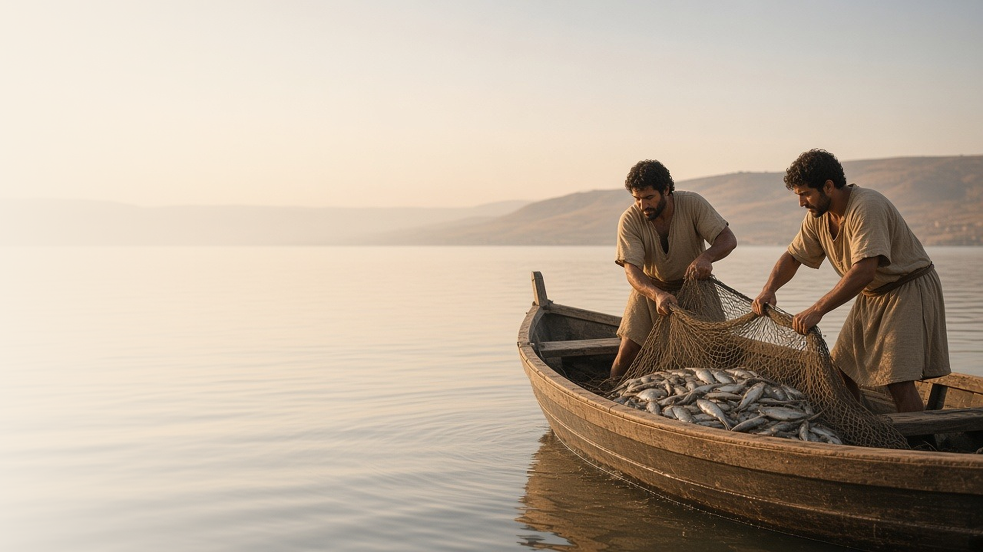
COME, FOLLOW ME · FOR CHILDREN
The Spirit of the Lord
Is upon Me
January 25–31
Matthew 4; Luke 4–5
Notes:
TEACHING
This week children learn that Jesus fasted to be close to Heavenly Father, chose the right when Satan tempted Him, taught that He is our Savior, and invited fishermen to follow Him and become "fishers of men."
SCRIPTURE (KJV)
Matthew 4:18–20
18 And Jesus, walking by the sea of Galilee, saw two brethren, Simon called Peter, and Andrew his brother, casting a net into the sea: for they were fishers.
19 And he saith unto them, Follow me, and I will make you fishers of men.
20 And they straightway left their nets, and followed him.
DISCUSSION
• What did Jesus ask Peter and Andrew to do?
• How can we follow Jesus?

Slide 2
MATTHEW 4:1–2
Fasting brings me close to God
Jesus fasted to be with Heavenly Father. Fasting can help me too.
“And when he had fasted forty days and forty nights, he was afterward an hungred.”
MATTHEW 4:2
Notes:
TEACHING
Explain that Jesus went to a quiet place to fast and to be with Heavenly Father. Fasting means going without food and drink for a while and praying for something important. Children who are too young to fast can still pray and think about Heavenly Father on fast Sunday. Share why you fast and how it helps you.
SCRIPTURE (KJV)
Matthew 4:1–2
1 Then was Jesus led up of the Spirit into the wilderness to be tempted of the devil.
2 And when he had fasted forty days and forty nights, he was afterward an hungred.
DISCUSSION (questions quoted from the manual)
• “What experiences can you or the children share about fasting?”

Slide 3
MATTHEW 4:1–11; LUKE 4:1–13
I can choose the right
Jesus said no to Satan by remembering God’s words.
“It is written, Man shall not live by bread alone, but by every word that proceedeth out of the mouth of God.”
MATTHEW 4:4
Notes:
TEACHING
As you read Matthew 4:1–11, pause at each temptation and ask what Jesus did. Each time, He remembered what the scriptures say and chose the right. Older children could make a simple chart of Satan's temptations and Jesus's answers, then talk about ways we can choose the right when we're tempted.
SCRIPTURE (KJV)
Matthew 4:1, 4, 10–11
1 Then was Jesus led up of the Spirit into the wilderness to be tempted of the devil.
4 But he answered and said, It is written, Man shall not live by bread alone, but by every word that proceedeth out of the mouth of God.
10 Then saith Jesus unto him, Get thee hence, Satan: for it is written, Thou shalt worship the Lord thy God, and him only shalt thou serve.
11 Then the devil leaveth him, and, behold, angels came and ministered unto him.
Full passage: Matthew 4:1–11
DISCUSSION (questions quoted from the manual)
• (The manual gives no direct questions for this section.)
Suggested: What can you do when you are tempted to make a wrong choice?

Slide 4
LUKE 4:16–22, 28–30
Jesus is my Savior
Jesus came to heal, to help, and to set people free.
“The Spirit of the Lord is upon me, because he hath anointed me to preach the gospel to the poor.”
LUKE 4:18
Notes:
TEACHING
Read Luke 4:18–19 and find pictures of Jesus doing what He promised: teaching, healing, comforting, and helping. Explain that some people in Nazareth didn't believe Jesus, but we can know He is our Savior. Invite a child to pretend to be someone from Nazareth while others share why they believe in Jesus.
SCRIPTURE (KJV)
Luke 4:16, 18, 21
16 And he came to Nazareth, where he had been brought up: and, as his custom was, he went into the synagogue on the sabbath day, and stood up for to read.
18 The Spirit of the Lord is upon me, because he hath anointed me to preach the gospel to the poor; he hath sent me to heal the brokenhearted, to preach deliverance to the captives, and recovering of sight to the blind, to set at liberty them that are bruised,
21 And he began to say unto them, This day is this scripture fulfilled in your ears.
Full passage: Luke 4:16–22
DISCUSSION (questions quoted from the manual)
• “What would we say to this person to help them believe that Jesus is the Savior?”
• “How would we explain why we believe in Him?”

Slide 5
MATTHEW 4:18–22; LUKE 5:1–11
Jesus invites me to follow Him
Peter and Andrew left their nets right away to follow Jesus.
“And they straightway left their nets, and followed him.”
MATTHEW 4:20
Notes:
TEACHING
Act out the story: Peter and Andrew are fishing when Jesus calls, "Follow me, and I will make you fishers of men," and they leave their nets straightway. Explain that being a "fisher of men" means helping others come to Jesus. Sing a song like "Holding Hands Around the World" and name things children can do to follow Him.
SCRIPTURE (KJV)
Matthew 4:18–22
18 And Jesus, walking by the sea of Galilee, saw two brethren, Simon called Peter, and Andrew his brother, casting a net into the sea: for they were fishers.
19 And he saith unto them, Follow me, and I will make you fishers of men.
20 And they straightway left their nets, and followed him.
21 And going on from thence, he saw other two brethren, James the son of Zebedee, and John his brother, in a ship with Zebedee their father, mending their nets; and he called them.
22 And they immediately left the ship and their father, and followed him.
DISCUSSION (questions quoted from the manual)
• “What did these men give up to follow Jesus?”

Slide 6
MATTHEW 4:19
“Follow me, and I will make you fishers of men.”
This week, follow Jesus by helping someone else come to Him.
Notes:
TEACHING
Jesus invited Peter and Andrew to follow Him and help others come to Him. He invites us too. Help children think of simple ways to follow Jesus this week: being kind, inviting a friend to Primary, or telling someone about Jesus.
SCRIPTURE (KJV)
Matthew 4:19
19 And he saith unto them, Follow me, and I will make you fishers of men.
DISCUSSION
• What did Jesus invite Peter and Andrew to do?
• What is one way you can follow Jesus this week?

