Slide 1
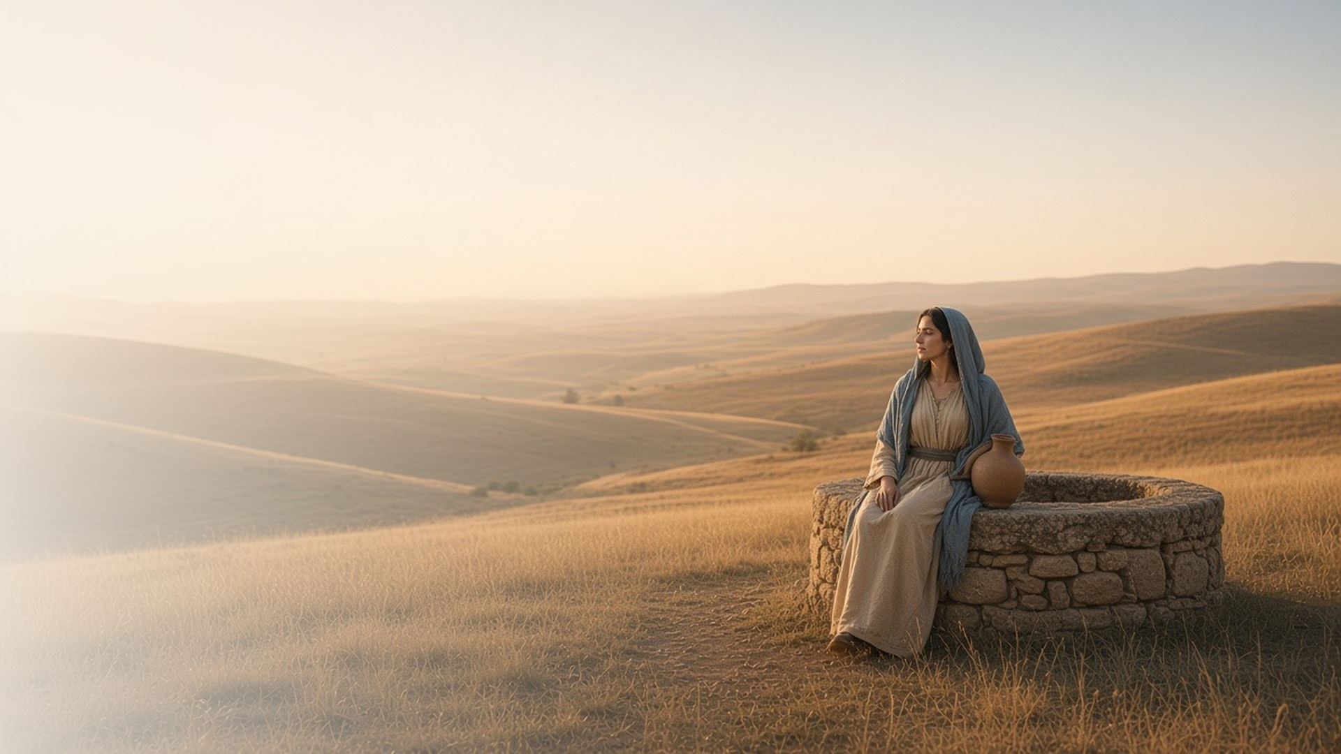
COME, FOLLOW ME · NEW TESTAMENT 2027
Ye Must Be
Born Again
February 1–7
John 2–4
Notes:
TEACHING
John 2–4 shows the Savior meeting people in very different settings: a wedding feast, the temple courts, a night conversation with a Pharisee, and a midday encounter with a Samaritan woman at a well. In each, He offers more than people expected, inviting them into a new life that He calls being born again.
SCRIPTURE (KJV)
John 3:3–5
3 Jesus answered and said unto him, Verily, verily, I say unto thee, Except a man be born again, he cannot see the kingdom of God.
4 Nicodemus saith unto him, How can a man be born when he is old? can he enter the second time into his mother’s womb, and be born?
5 Jesus answered, Verily, verily, I say unto thee, Except a man be born of water and of the Spirit, he cannot enter into the kingdom of God.
DISCUSSION
• What does being "born again" mean to you?
• Which of these encounters with Jesus feels most like your own experience?

Slide 2
JOHN 2:1–11
A God of miracles
At Cana, Jesus turned water into wine at His mother’s request.
“This beginning of miracles did Jesus in Cana of Galilee, and manifested forth his glory; and his disciples believed on him.”
JOHN 2:11
Notes:
TEACHING
The Savior's first recorded miracle happened at a family celebration. Mary trusted Him with a small but real problem, told the servants to do whatever He said, and He transformed ordinary water into the best wine. Consider the perspectives of Mary, the servants, and the disciples. Miracles reveal His glory and build faith, and He still cares about the everyday needs of our homes.
SCRIPTURE (KJV)
John 2:1–11
1 And the third day there was a marriage in Cana of Galilee; and the mother of Jesus was there:
2 And both Jesus was called, and his disciples, to the marriage.
3 And when they wanted wine, the mother of Jesus saith unto him, They have no wine.
4 Jesus saith unto her, Woman, what have I to do with thee? mine hour is not yet come.
5 His mother saith unto the servants, Whatsoever he saith unto you, do it.
6 And there were set there six waterpots of stone, after the manner of the purifying of the Jews, containing two or three firkins apiece.
7 Jesus saith unto them, Fill the waterpots with water. And they filled them up to the brim.
8 And he saith unto them, Draw out now, and bear unto the governor of the feast. And they bare it.
9 When the ruler of the feast had tasted the water that was made wine, and knew not whence it was: (but the servants which drew the water knew;) the governor of the feast called the bridegroom,
10 And saith unto him, Every man at the beginning doth set forth good wine; and when men have well drunk, then that which is worse: but thou hast kept the good wine until now.
11 This beginning of miracles did Jesus in Cana of Galilee, and manifested forth his glory; and his disciples believed on him.
DISCUSSION (questions quoted from the manual)
• “If you had witnessed this miracle, how would you have felt about Jesus?”
• “What does this miracle teach you about Him?”

Slide 3
JOHN 2:13–22
The Lord’s house is sacred
Jesus cleansed the temple to protect what was holy.
“Make not my Father’s house an house of merchandise.”
JOHN 2:16
Notes:
TEACHING
Commerce had crowded into the temple courts, turning a place of worship into a marketplace. Jesus drove it out with uncharacteristic force, and the disciples remembered the scripture, "The zeal of thine house hath eaten me up." His reaction shows how deeply He reverences sacred places. Discuss what we can do to keep temples, chapels, homes, and our own hearts holy.
SCRIPTURE (KJV)
John 2:13–22
13 And the Jews’ passover was at hand, and Jesus went up to Jerusalem,
14 And found in the temple those that sold oxen and sheep and doves, and the changers of money sitting:
15 And when he had made a scourge of small cords, he drove them all out of the temple, and the sheep, and the oxen; and poured out the changers’ money, and overthrew the tables;
16 And said unto them that sold doves, Take these things hence; make not my Father’s house an house of merchandise.
17 And his disciples remembered that it was written, The zeal of thine house hath eaten me up.
18 Then answered the Jews and said unto him, What sign shewest thou unto us, seeing that thou doest these things?
19 Jesus answered and said unto them, Destroy this temple, and in three days I will raise it up.
20 Then said the Jews, Forty and six years was this temple in building, and wilt thou rear it up in three days?
21 But he spake of the temple of his body.
22 When therefore he was risen from the dead, his disciples remembered that he had said this unto them; and they believed the scripture, and the word which Jesus had said.
DISCUSSION (questions quoted from the manual)
• “As you study John 2:13–22, what impresses you about Jesus’s attitude toward the temple?”
• “What are some other things He considers sacred?”
• “What can you do to defend sacred places and things?”
• ““overthrow,” or “take hence”? (see verses 15–16).”

Slide 4
JOHN 3:1–21
Born again
Entering God’s kingdom requires a new birth of water and Spirit.
“Except a man be born of water and of the Spirit, he cannot enter into the kingdom of God.”
JOHN 3:5
Notes:
TEACHING
Nicodemus came by night, curious but cautious. Jesus told him that seeing and entering God's kingdom requires being born again, of water and of the Spirit. Like birth, this change brings a new life, a new family, and continued growth. It begins with baptism and the gift of the Holy Ghost and continues as the Spirit changes our hearts over time.
SCRIPTURE (KJV)
John 3:1–8
1 There was a man of the Pharisees, named Nicodemus, a ruler of the Jews:
2 The same came to Jesus by night, and said unto him, Rabbi, we know that thou art a teacher come from God: for no man can do these miracles that thou doest, except God be with him.
3 Jesus answered and said unto him, Verily, verily, I say unto thee, Except a man be born again, he cannot see the kingdom of God.
4 Nicodemus saith unto him, How can a man be born when he is old? can he enter the second time into his mother’s womb, and be born?
5 Jesus answered, Verily, verily, I say unto thee, Except a man be born of water and of the Spirit, he cannot enter into the kingdom of God.
6 That which is born of the flesh is flesh; and that which is born of the Spirit is spirit.
7 Marvel not that I said unto thee, Ye must be born again.
8 The wind bloweth where it listeth, and thou hearest the sound thereof, but canst not tell whence it cometh, and whither it goeth: so is every one that is born of the Spirit.
Restoration scripture (public-domain text: bcbooks/scriptures-json)
Moses 6:59–60 (Pearl of Great Price)
59 That by reason of transgression cometh the fall, which fall bringeth death, and inasmuch as ye were born into the world by water, and blood, and the spirit, which I have made, and so became of dust a living soul, even so ye must be born again into the kingdom of heaven, of water, and of the Spirit, and be cleansed by blood, even the blood of mine Only Begotten; that ye might be sanctified from all sin, and enjoy the words of eternal life in this world, and eternal life in the world to come, even immortal glory;
60 For by the water ye keep the commandment; by the Spirit ye are justified, and by the blood ye are sanctified;
DISCUSSION (questions quoted from the manual)
• “What do you know about birth?”
• “What does it suggest to you about the change we need to experience to enter God’s kingdom? (see also Moses 6:59–60).”
• “How has the Savior changed you?”
• “What attitudes or attributes make it easier?”
• “How would you explain it?”

Slide 5
JOHN 3:14–17
God so loved the world
The Father’s gift of His Son is the clearest sign of His love.
“For God so loved the world, that he gave his only begotten Son.”
JOHN 3:16
Notes:
TEACHING
In a few verses Jesus summarizes His mission: like the brass serpent Moses raised in the wilderness, He would be lifted up so that all who look to Him in faith can live. The motive behind it all is the Father's love. God sent His Son not to condemn the world but to save it. Invite class members to summarize the Savior's mission in their own words.
SCRIPTURE (KJV)
John 3:14–17
14 And as Moses lifted up the serpent in the wilderness, even so must the Son of man be lifted up:
15 That whosoever believeth in him should not perish, but have eternal life.
16 For God so loved the world, that he gave his only begotten Son, that whosoever believeth in him should not perish, but have everlasting life.
17 For God sent not his Son into the world to condemn the world; but that the world through him might be saved.
DISCUSSION (questions quoted from the manual)
• “After pondering these verses, how would you summarize that mission?”
• “What does this hymn add to your understanding of the Savior’s mission?”
• “How have you felt the love of God through the gift of His Son?”

Slide 6
JOHN 4:5–30
The Savior knows me
At the well, Jesus saw the Samaritan woman fully and offered her more.
“Whosoever drinketh of the water that I shall give him shall never thirst.”
JOHN 4:14
Notes:
TEACHING
Jews and Samaritans avoided each other, and a rabbi would rarely speak to a woman alone. Yet Jesus asked her for a drink, offered her living water, revealed that He knew her life, and then told her plainly that He was the Messiah. She left her waterpot and ran to tell the town. He knows each of us just as completely and offers what truly satisfies.
SCRIPTURE (KJV)
John 4:5–15
5 Then cometh he to a city of Samaria, which is called Sychar, near to the parcel of ground that Jacob gave to his son Joseph.
6 Now Jacob’s well was there. Jesus therefore, being wearied with his journey, sat thus on the well: and it was about the sixth hour.
7 There cometh a woman of Samaria to draw water: Jesus saith unto her, Give me to drink.
8 (For his disciples were gone away unto the city to buy meat.)
9 Then saith the woman of Samaria unto him, How is it that thou, being a Jew, askest drink of me, which am a woman of Samaria? for the Jews have no dealings with the Samaritans.
10 Jesus answered and said unto her, If thou knewest the gift of God, and who it is that saith to thee, Give me to drink; thou wouldest have asked of him, and he would have given thee living water.
11 The woman saith unto him, Sir, thou hast nothing to draw with, and the well is deep: from whence then hast thou that living water?
12 Art thou greater than our father Jacob, which gave us the well, and drank thereof himself, and his children, and his cattle?
13 Jesus answered and said unto her, Whosoever drinketh of this water shall thirst again:
14 But whosoever drinketh of the water that I shall give him shall never thirst; but the water that I shall give him shall be in him a well of water springing up into everlasting life.
15 The woman saith unto him, Sir, give me this water, that I thirst not, neither come hither to draw.
John 4:25–30
25 The woman saith unto him, I know that Messias cometh, which is called Christ: when he is come, he will tell us all things.
26 Jesus saith unto her, I that speak unto thee am he.
27 And upon this came his disciples, and marvelled that he talked with the woman: yet no man said, What seekest thou? or, Why talkest thou with her?
28 The woman then left her waterpot, and went her way into the city, and saith to the men,
29 Come, see a man, which told me all things that ever I did: is not this the Christ?
30 Then they went out of the city, and came unto him.
DISCUSSION (questions quoted from the manual)
• (The manual gives no direct questions for this section.)
Suggested: When have you felt that the Savior knows you personally?

Slide 7
JOHN 4:20–24
In spirit and in truth
True worship comes from the heart and rests on truth.
“God is a Spirit: and they that worship him must worship him in spirit and in truth.”
JOHN 4:24
Notes:
TEACHING
The Samaritan woman asked a question about the right place to worship. Jesus shifted the focus from where we worship to how: true worshippers worship the Father in spirit and in truth. Worship in spirit comes from sincere hearts; worship in truth rests on a correct understanding of God. Both matter, in the temple, in sacrament meeting, and at home.
SCRIPTURE (KJV)
John 4:19–24
19 The woman saith unto him, Sir, I perceive that thou art a prophet.
20 Our fathers worshipped in this mountain; and ye say, that in Jerusalem is the place where men ought to worship.
21 Jesus saith unto her, Woman, believe me, the hour cometh, when ye shall neither in this mountain, nor yet at Jerusalem, worship the Father.
22 Ye worship ye know not what: we know what we worship: for salvation is of the Jews.
23 But the hour cometh, and now is, when the true worshippers shall worship the Father in spirit and in truth: for the Father seeketh such to worship him.
24 God is a Spirit: and they that worship him must worship him in spirit and in truth.
Restoration scripture (public-domain text: bcbooks/scriptures-json)
Alma 32:4–11 (Book of Mormon)
4 Now, as Alma was teaching and speaking unto the people upon the hill Onidah, there came a great multitude unto him, who were those of whom we have been speaking, of whom were poor in heart, because of their poverty as to the things of the world.
5 And they came unto Alma; and the one who was the foremost among them said unto him: Behold, what shall these my brethren do, for they are despised of all men because of their poverty, yea, and more especially by our priests; for they have cast us out of our synagogues which we have labored abundantly to build with our own hands; and they have cast us out because of our exceeding poverty; and we have no place to worship our God; and behold, what shall we do?
6 And now when Alma heard this, he turned him about, his face immediately towards him, and he beheld with great joy; for he beheld that their afflictions had truly humbled them, and that they were in a preparation to hear the word.
7 Therefore he did say no more to the other multitude; but he stretched forth his hand, and cried unto those whom he beheld, who were truly penitent, and said unto them:
8 I behold that ye are lowly in heart; and if so, blessed are ye.
9 Behold thy brother hath said, What shall we do?—for we are cast out of our synagogues, that we cannot worship our God.
10 Behold I say unto you, do ye suppose that ye cannot worship God save it be in your synagogues only?
11 And moreover, I would ask, do ye suppose that ye must not worship God only once in a week?
DISCUSSION (questions quoted from the manual)
• “Or must people worship in Jerusalem? (See John 4:19–20.)”
• “What do you learn from Jesus’s answer in verse 23?”
• “Why do you worship God?”
• “What does it mean to you to worship “in spirit and in truth”? (see, for example, Alma 32:4–11).”

Slide 8
JOHN 4:42
“We have heard him ourselves,
and know that this is indeed the Christ.”
This week, seek your own witness of the Savior.
Notes:
TEACHING
The Samaritans first believed because of the woman's testimony, but after spending time with Jesus they could say they knew for themselves. Others' testimonies can lead us to Christ, but each of us needs our own witness. Close by inviting each person to seek a personal witness this week through prayer, scripture study, and worship.
SCRIPTURE (KJV)
John 4:39–42
39 And many of the Samaritans of that city believed on him for the saying of the woman, which testified, He told me all that ever I did.
40 So when the Samaritans were come unto him, they besought him that he would tarry with them: and he abode there two days.
41 And many more believed because of his own word;
42 And said unto the woman, Now we believe, not because of thy saying: for we have heard him ourselves, and know that this is indeed the Christ, the Saviour of the world.
DISCUSSION
• How has someone else's testimony led you closer to Christ?
• What will you do this week to hear Him for yourself?

