Slide 1
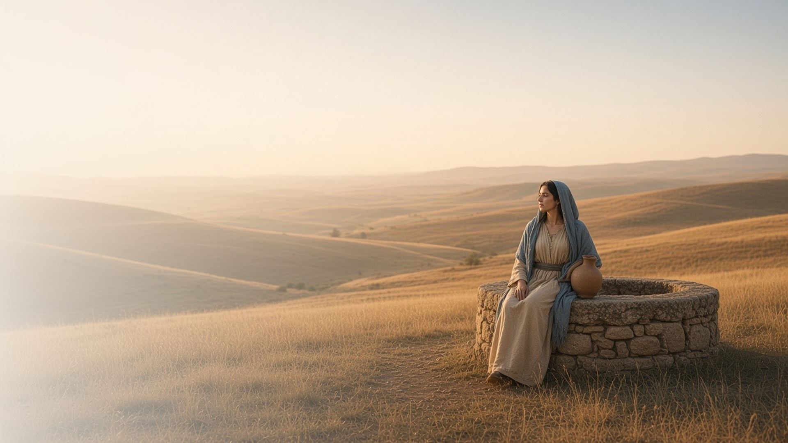
COME, FOLLOW ME · FOR CHILDREN
Ye Must Be
Born Again
February 1–7
John 2–4
Notes:
TEACHING
This week children learn that the temple is sacred, that baptism and confirmation are like being born again, that Heavenly Father gave us a Savior because He loves us, and that Jesus offers "living water" that helps our spirits live.
SCRIPTURE (KJV)
John 3:16
16 For God so loved the world, that he gave his only begotten Son, that whosoever believeth in him should not perish, but have everlasting life.
DISCUSSION
• Why did Heavenly Father send Jesus?
• What does Jesus give us that is like water?

Slide 2
JOHN 2:13–17
The temple is sacred
Jesus loved His Father’s house and wanted it kept holy.
“Make not my Father’s house an house of merchandise.”
JOHN 2:16
Notes:
TEACHING
Watch or tell the story of Jesus cleansing the temple. Ask why the temple was so important to Jesus. Show a picture of a temple near you and talk about what makes it sacred and how we can show reverence there and in our church buildings.
SCRIPTURE (KJV)
John 2:13–17
13 And the Jews’ passover was at hand, and Jesus went up to Jerusalem,
14 And found in the temple those that sold oxen and sheep and doves, and the changers of money sitting:
15 And when he had made a scourge of small cords, he drove them all out of the temple, and the sheep, and the oxen; and poured out the changers’ money, and overthrew the tables;
16 And said unto them that sold doves, Take these things hence; make not my Father’s house an house of merchandise.
17 And his disciples remembered that it was written, The zeal of thine house hath eaten me up.
DISCUSSION (questions quoted from the manual)
• “Why was the temple sacred or important to Jesus?”
• “What things are sacred to us?”
• “How can we show that they are sacred?”

Slide 3
JOHN 3:1–8
Baptism is a new beginning
When I am baptized and confirmed, I start a new life.
“Except a man be born of water and of the Spirit, he cannot enter into the kingdom of God.”
JOHN 3:5
Notes:
TEACHING
Show pictures of a newborn baby, a baptism, and a confirmation. Explain that Jesus compared baptism to being born again: we come up out of the water with a fresh start, and the Holy Ghost helps us keep growing. Baptized children could share memories of their baptism, or you could share yours.
SCRIPTURE (KJV)
John 3:3, 5
3 Jesus answered and said unto him, Verily, verily, I say unto thee, Except a man be born again, he cannot see the kingdom of God.
5 Jesus answered, Verily, verily, I say unto thee, Except a man be born of water and of the Spirit, he cannot enter into the kingdom of God.
Full passage: John 3:1–5
Restoration scripture (public-domain text: bcbooks/scriptures-json)
Mosiah 18:10 (Book of Mormon)
10 Now I say unto you, if this be the desire of your hearts, what have you against being baptized in the name of the Lord, as a witness before him that ye have entered into a covenant with him, that ye will serve him and keep his commandments, that he may pour out his Spirit more abundantly upon you?
Full passage: Mosiah 18:10, 13
Doctrine and Covenants 20:37 (Doctrine and Covenants)
37 And again, by way of commandment to the church concerning the manner of baptism—All those who humble themselves before God, and desire to be baptized, and come forth with broken hearts and contrite spirits, and witness before the church that they have truly repented of all their sins, and are willing to take upon them the name of Jesus Christ, having a determination to serve him to the end, and truly manifest by their works that they have received of the Spirit of Christ unto the remission of their sins, shall be received by baptism into his church.
DISCUSSION (questions quoted from the manual)
• “How are we like a newborn baby after we are baptized and confirmed? (see John 3:3–5).”
• “What do we promise when we are baptized? (see Mosiah 18:10, 13; Doctrine and Covenants 20:37).”
• “How does keeping this covenant help us enter the kingdom of God? (see John 3:5).”

Slide 4
JOHN 3:16–17
God gave me a Savior
Heavenly Father loves me so much that He sent Jesus.
“For God so loved the world, that he gave his only begotten Son.”
JOHN 3:16
Notes:
TEACHING
Draw a favorite gift you've received, then read John 3:16 to learn about Heavenly Father's greatest gift. Read it again replacing "the world" with each child's name. Help children finish the sentence "Because God loves me, He …"
SCRIPTURE (KJV)
John 3:16–17
16 For God so loved the world, that he gave his only begotten Son, that whosoever believeth in him should not perish, but have everlasting life.
17 For God sent not his Son into the world to condemn the world; but that the world through him might be saved.
DISCUSSION (questions quoted from the manual)
• “How does this gift show His love?”
• “How would you and your children complete a sentence like this one: “Because God loves me, He …”?”

Slide 5
JOHN 4
Jesus offers living water
Like water, Jesus’s gospel keeps my spirit alive.
“Whosoever drinketh of the water that I shall give him shall never thirst.”
JOHN 4:14
Notes:
TEACHING
Tell the story of Jesus and the woman at the well. Let children look at, drink, or feel running water and talk about why we need it every day. Explain that Jesus called His gospel "living water" because it helps our spirits live and grow, just as water helps our bodies.
SCRIPTURE (KJV)
John 4:7, 10, 13–14
7 There cometh a woman of Samaria to draw water: Jesus saith unto her, Give me to drink.
10 Jesus answered and said unto her, If thou knewest the gift of God, and who it is that saith to thee, Give me to drink; thou wouldest have asked of him, and he would have given thee living water.
13 Jesus answered and said unto her, Whosoever drinketh of this water shall thirst again:
14 But whosoever drinketh of the water that I shall give him shall never thirst; but the water that I shall give him shall be in him a well of water springing up into everlasting life.
Full passage: John 4:5–15
DISCUSSION (questions quoted from the manual)
• “What was Jesus trying to teach the woman—and us?”
• “Why do we need water every day?”
• “Why do we need the Savior every day?”

Slide 6
JOHN 4:42
“We have heard him ourselves,
and know that this is indeed the Christ.”
This week, thank Heavenly Father for the gift of Jesus.
Notes:
TEACHING
The people in the woman's town listened to Jesus themselves and knew that He is the Savior of the world. We can know too. Invite children to thank Heavenly Father in their prayers this week for sending Jesus.
SCRIPTURE (KJV)
John 4:42
42 And said unto the woman, Now we believe, not because of thy saying: for we have heard him ourselves, and know that this is indeed the Christ, the Saviour of the world.
DISCUSSION
• What did the people learn about Jesus?
• How can you learn about Jesus for yourself?

