Slide 1
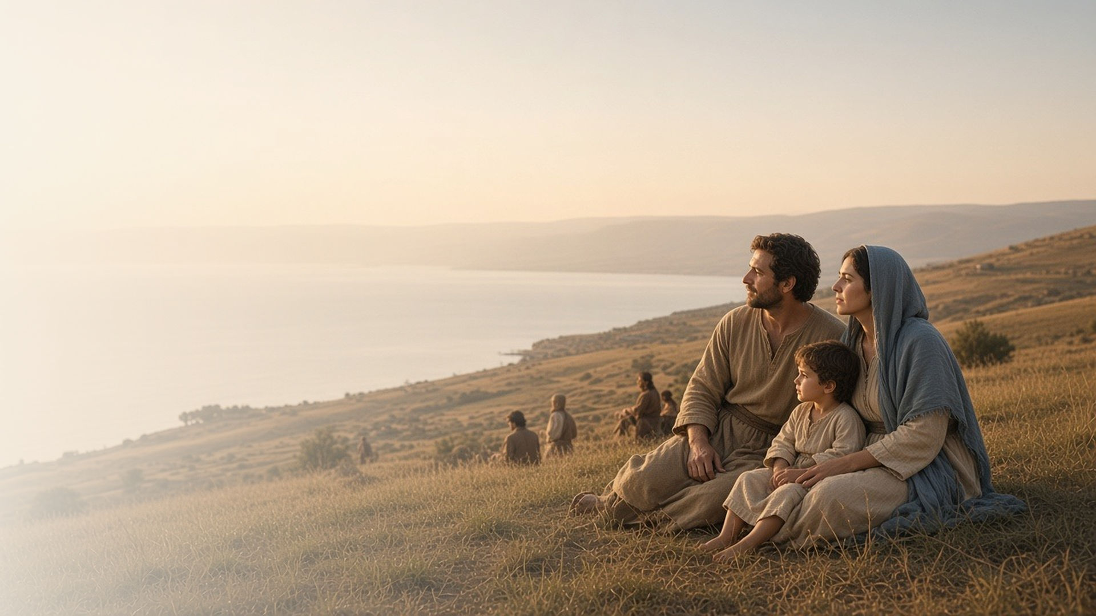
COME, FOLLOW ME · NEW TESTAMENT 2027
Blessed Are Ye
February 8–14
Matthew 5; Luke 6
Notes:
TEACHING
The Sermon on the Mount begins with the Beatitudes and then calls disciples to be salt and light and to live a higher law that reaches the heart. Luke's parallel sermon on the plain adds both blessings and warnings. Together they describe the kind of people Jesus invites us to become.
SCRIPTURE (KJV)
Matthew 5:1–3
1 And seeing the multitudes, he went up into a mountain: and when he was set, his disciples came unto him:
2 And he opened his mouth, and taught them, saying,
3 Blessed are the poor in spirit: for theirs is the kingdom of heaven.
DISCUSSION
• What does it mean to you to be truly "blessed"?
• Which teaching in Matthew 5 challenges you most?

Slide 2
MATTHEW 5:1–12; LUKE 6:20–26
What it means to be blessed
The Beatitudes describe a disciple’s heart, not a life of ease.
“Blessed are the poor in spirit: for theirs is the kingdom of heaven.”
MATTHEW 5:3
Notes:
TEACHING
The world tends to call people blessed when they are comfortable, wealthy, and free of worry. Jesus pronounced blessings on the poor in spirit, those who mourn, the meek, the hungry for righteousness, the merciful, the pure in heart, the peacemakers, and the persecuted. These qualities describe the character of a true disciple, and the promised blessings show what God gives those who become that kind of person.
SCRIPTURE (KJV)
Matthew 5:1–12
1 And seeing the multitudes, he went up into a mountain: and when he was set, his disciples came unto him:
2 And he opened his mouth, and taught them, saying,
3 Blessed are the poor in spirit: for theirs is the kingdom of heaven.
4 Blessed are they that mourn: for they shall be comforted.
5 Blessed are the meek: for they shall inherit the earth.
6 Blessed are they which do hunger and thirst after righteousness: for they shall be filled.
7 Blessed are the merciful: for they shall obtain mercy.
8 Blessed are the pure in heart: for they shall see God.
9 Blessed are the peacemakers: for they shall be called the children of God.
10 Blessed are they which are persecuted for righteousness sake: for theirs is the kingdom of heaven.
11 Blessed are ye, when men shall revile you, and persecute you, and shall say all manner of evil against you falsely, for my sake.
12 Rejoice, and be exceeding glad: for great is your reward in heaven: for so persecuted they the prophets which were before you.
Luke 6:20–23
20 And he lifted up his eyes on his disciples, and said, Blessed be ye poor: for yours is the kingdom of God.
21 Blessed are ye that hunger now: for ye shall be filled. Blessed are ye that weep now: for ye shall laugh.
22 Blessed are ye, when men shall hate you, and when they shall separate you from their company, and shall reproach you, and cast out your name as evil, for the Son of man’s sake.
23 Rejoice ye in that day, and leap for joy: for, behold, your reward is great in heaven: for in the like manner did their fathers unto the prophets.
DISCUSSION (questions quoted from the manual)
• “What do you learn from Matthew 5:1–12 and Luke 6:20–26 about being “blessed”?”
• “How does the Savior’s description of a “blessed” life affect the way you see your circumstances?”

Slide 3
MATTHEW 5:13–16
Salt and light
Disciples preserve, season, and shine so others see the Father.
“Let your light so shine before men, that they may see your good works, and glorify your Father which is in heaven.”
MATTHEW 5:16
Notes:
TEACHING
Salt preserved food and was used in covenant offerings, so being "the salt of the earth" suggests keeping covenants and preserving good in the world. Salt loses its savor when mixed with impurities. Light exists to be seen, not hidden. Disciples are meant to keep their distinctiveness and to let good works shine so that others give glory to God, not to us.
SCRIPTURE (KJV)
Matthew 5:13–16
13 Ye are the salt of the earth: but if the salt have lost his savour, wherewith shall it be salted? it is thenceforth good for nothing, but to be cast out, and to be trodden under foot of men.
14 Ye are the light of the world. A city that is set on an hill cannot be hid.
15 Neither do men light a candle, and put it under a bushel, but on a candlestick; and it giveth light unto all that are in the house.
16 Let your light so shine before men, that they may see your good works, and glorify your Father which is in heaven.
DISCUSSION (questions quoted from the manual)
• “Why do you suppose Jesus wants you to be like salt?”
• “What else about salt makes it a good symbol for a disciple of Jesus Christ? (For some ideas, see José A.”
• “How will you keep your savor as a disciple of Jesus Christ?”
• “What does being “the salt of the earth” look like to you?”
• “What does this phrase mean to you?”
• “What could it mean to hide your light “under a bushel”? (verse 15).”
(+3 more in the manual)

Slide 4
MATTHEW 5:21–47
A higher law
Jesus moved the law from outward acts to the heart.
“Love your enemies, bless them that curse you.”
MATTHEW 5:44
Notes:
TEACHING
Again and again Jesus said, "Ye have heard … but I say unto you." The old law forbade murder; the higher law addresses anger. The old law limited retaliation; the higher law invites turning the other cheek and loving enemies. Living from this higher ground changes how we see others and helps us become more like our Father in Heaven, who sends rain on the just and the unjust.
SCRIPTURE (KJV)
Matthew 5:21–24
21 Ye have heard that it was said by them of old time, Thou shalt not kill; and whosoever shall kill shall be in danger of the judgment:
22 But I say unto you, That whosoever is angry with his brother without a cause shall be in danger of the judgment: and whosoever shall say to his brother, Raca, shall be in danger of the council: but whosoever shall say, Thou fool, shall be in danger of hell fire.
23 Therefore if thou bring thy gift to the altar, and there rememberest that thy brother hath ought against thee;
24 Leave there thy gift before the altar, and go thy way; first be reconciled to thy brother, and then come and offer thy gift.
Matthew 5:38–47
38 Ye have heard that it hath been said, An eye for an eye, and a tooth for a tooth:
39 But I say unto you, That ye resist not evil: but whosoever shall smite thee on thy right cheek, turn to him the other also.
40 And if any man will sue thee at the law, and take away thy coat, let him have thy cloke also.
41 And whosoever shall compel thee to go a mile, go with him twain.
42 Give to him that asketh thee, and from him that would borrow of thee turn not thou away.
43 Ye have heard that it hath been said, Thou shalt love thy neighbour, and hate thine enemy.
44 But I say unto you, Love your enemies, bless them that curse you, do good to them that hate you, and pray for them which despitefully use you, and persecute you;
45 That ye may be the children of your Father which is in heaven: for he maketh his sun to rise on the evil and on the good, and sendeth rain on the just and on the unjust.
46 For if ye love them which love you, what reward have ye? do not even the publicans the same?
47 And if ye salute your brethren only, what do ye more than others? do not even the publicans so?
DISCUSSION (questions quoted from the manual)
• “Have you ever climbed a hill or mountain or looked at your town from the top of a building?”
• “How does being on higher ground change the way you see things?”

Slide 5
MATTHEW 5:48
Be ye therefore perfect
Perfection is a lifelong process made possible through Christ.
“Be ye therefore perfect, even as your Father which is in heaven is perfect.”
MATTHEW 5:48
Notes:
TEACHING
This command can feel crushing if we read it as "never make a mistake." The Greek word behind "perfect" suggests being complete or fully developed. It describes the destination of eternal progression, reached only through the grace of Jesus Christ. President Jeffrey R. Holland's message "Be Ye Therefore Perfect—Eventually" (cited in the manual) reassures us that the Lord is patient as we keep striving.
SCRIPTURE (KJV)
Matthew 5:48
48 Be ye therefore perfect, even as your Father which is in heaven is perfect.
DISCUSSION (questions quoted from the manual)
• “How can we ever expect to be perfect?”
• “How do his words help you?”

Slide 6
LUKE 6:31
“And as ye would that men should do to you,
do ye also to them likewise.”
This week, live one Beatitude on purpose.
Notes:
TEACHING
Luke's version of the sermon brings the higher law down to a single, practical rule: treat others as you want to be treated. Close by inviting each person to choose one Beatitude or one teaching from Matthew 5 and act on it deliberately this week, then notice how it changes them.
SCRIPTURE (KJV)
Luke 6:27–31
27 But I say unto you which hear, Love your enemies, do good to them which hate you,
28 Bless them that curse you, and pray for them which despitefully use you.
29 And unto him that smiteth thee on the one cheek offer also the other; and him that taketh away thy cloke forbid not to take thy coat also.
30 Give to every man that asketh of thee; and of him that taketh away thy goods ask them not again.
31 And as ye would that men should do to you, do ye also to them likewise.
DISCUSSION
• Which Beatitude will you focus on this week?
• How might living the Golden Rule change a relationship you care about?

