Slide 1
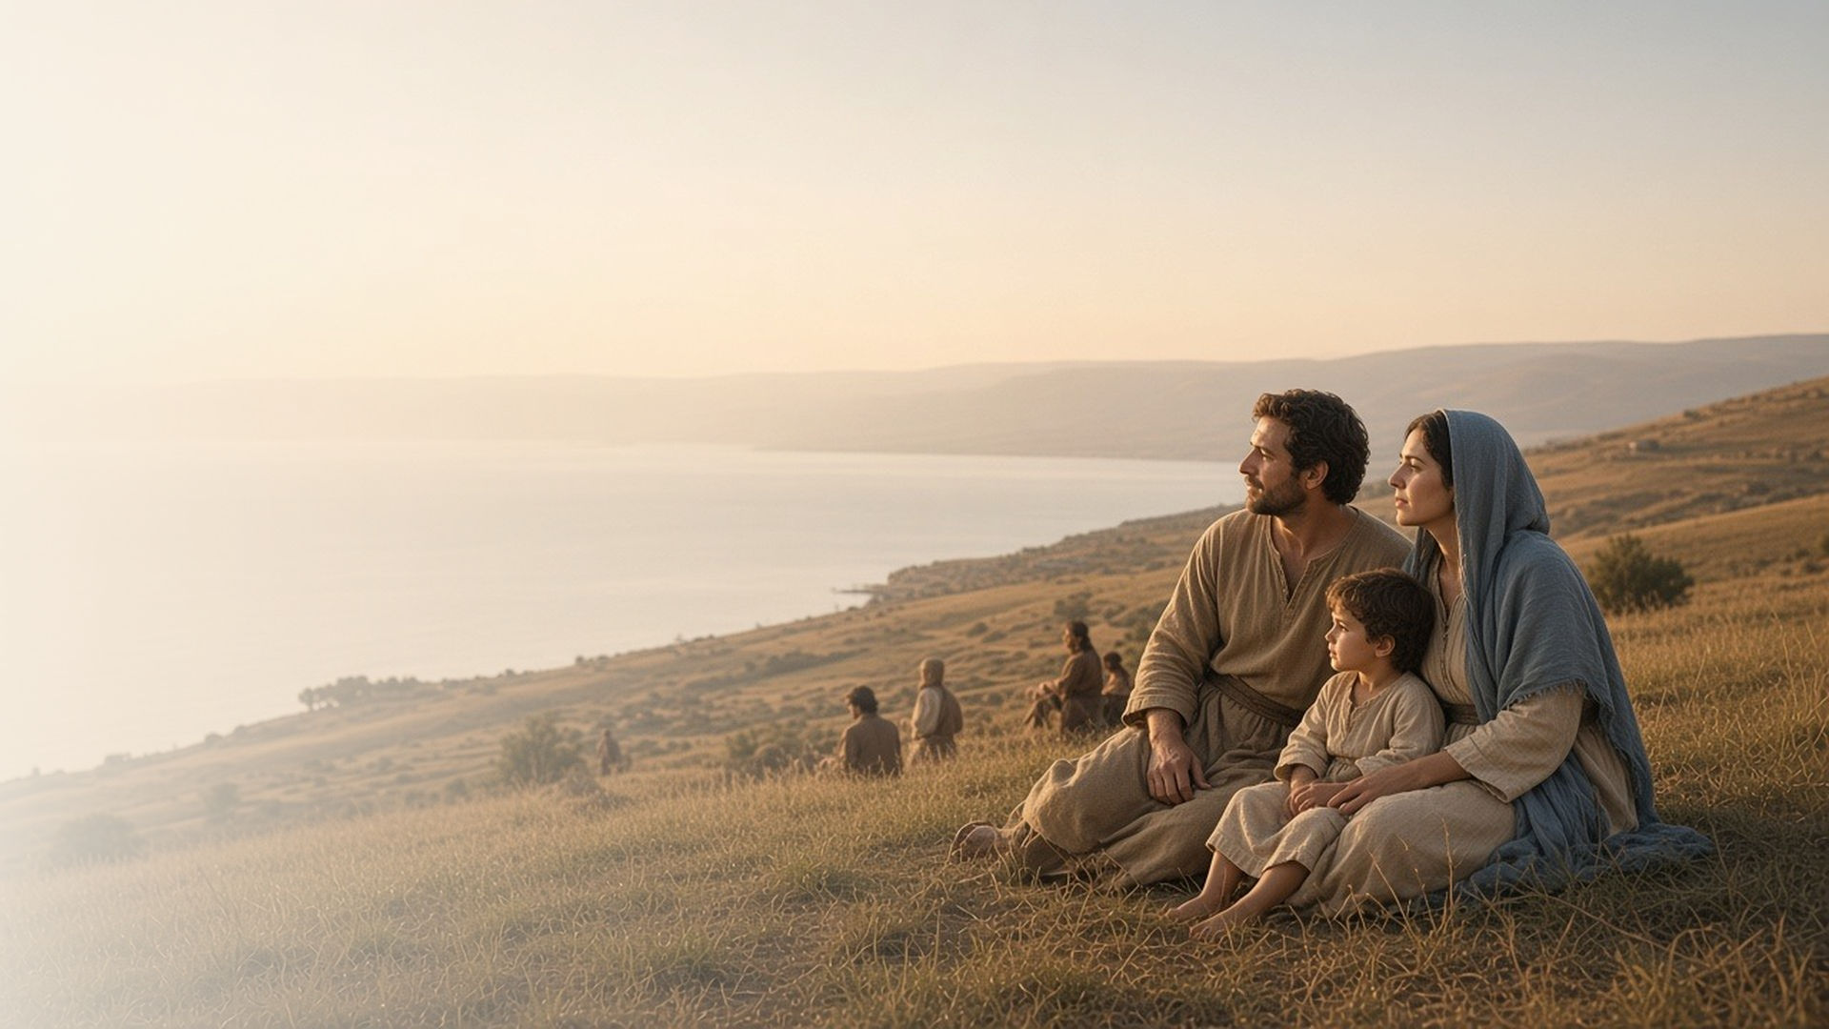
COME, FOLLOW ME · FOR CHILDREN
Blessed Are Ye
February 8–14
Matthew 5; Luke 6
Notes:
TEACHING
This week children learn what Jesus taught about being blessed, being a peacemaker even with people who are unkind, and letting their light shine so others can find Jesus.
SCRIPTURE (KJV)
Matthew 5:14–16
14 Ye are the light of the world. A city that is set on an hill cannot be hid.
15 Neither do men light a candle, and put it under a bushel, but on a candlestick; and it giveth light unto all that are in the house.
16 Let your light so shine before men, that they may see your good works, and glorify your Father which is in heaven.
DISCUSSION
• How can you be a light for others?
• What does a peacemaker do?

Slide 2
MATTHEW 5:3–12
Jesus teaches me to be blessed
Being meek, merciful, and pure in heart brings true happiness.
“Blessed are the pure in heart: for they shall see God.”
MATTHEW 5:8
Notes:
TEACHING
Read Matthew 5:3–12 and let children act out the attributes: meek, merciful, peacemaker, pure in heart. Play a matching game pairing each quality with its promised blessing, such as "merciful" with "obtain mercy." Explain that "blessed" means truly happy.
SCRIPTURE (KJV)
Matthew 5:5, 7–9
5 Blessed are the meek: for they shall inherit the earth.
7 Blessed are the merciful: for they shall obtain mercy.
8 Blessed are the pure in heart: for they shall see God.
9 Blessed are the peacemakers: for they shall be called the children of God.
Full passage: Matthew 5:3–12
DISCUSSION (questions quoted from the manual)
• “How has He fulfilled these promises to you?”

Slide 3
MATTHEW 5:9, 44–45
I can be a peacemaker
I can show love, even to people who are unkind to me.
“Blessed are the peacemakers: for they shall be called the children of God.”
MATTHEW 5:9
Notes:
TEACHING
Write a few everyday situations on slips of paper, such as a sibling grabbing a toy or a classmate being unkind, and let children share how a peacemaker would respond. Read Matthew 5:44–45 and explain the words. Share how you have tried to show love to someone who wasn't kind to you.
SCRIPTURE (KJV)
Matthew 5:9
9 Blessed are the peacemakers: for they shall be called the children of God.
Matthew 5:43–45
43 Ye have heard that it hath been said, Thou shalt love thy neighbour, and hate thine enemy.
44 But I say unto you, Love your enemies, bless them that curse you, do good to them that hate you, and pray for them which despitefully use you, and persecute you;
45 That ye may be the children of your Father which is in heaven: for he maketh his sun to rise on the evil and on the good, and sendeth rain on the just and on the unjust.
DISCUSSION (questions quoted from the manual)
• “What do we learn from this song about loving others?”

Slide 4
MATTHEW 5:13–16
My light can help others
When I follow Jesus, my example lights the way for others.
“Ye are the light of the world. A city that is set on an hill cannot be hid.”
MATTHEW 5:14
Notes:
TEACHING
Taste food with and without salt and talk about how salt makes things better. Then turn off the lights, shine a flashlight, and invite children to follow it. Explain that when we follow Jesus, our good example is like a light that helps others find Him too.
SCRIPTURE (KJV)
Matthew 5:13–16
13 Ye are the salt of the earth: but if the salt have lost his savour, wherewith shall it be salted? it is thenceforth good for nothing, but to be cast out, and to be trodden under foot of men.
14 Ye are the light of the world. A city that is set on an hill cannot be hid.
15 Neither do men light a candle, and put it under a bushel, but on a candlestick; and it giveth light unto all that are in the house.
16 Let your light so shine before men, that they may see your good works, and glorify your Father which is in heaven.
DISCUSSION (questions quoted from the manual)
• “Why does Jesus want us to be “the salt of the earth”?”
• “How can we shine our light to help others find the Savior?”

Slide 5
LUKE 6:31
“And as ye would that men should do to you,
do ye also to them likewise.”
This week, treat others the way you want to be treated.
Notes:
TEACHING
Jesus taught a simple rule: be kind to others the way you would like them to be kind to you. Help children think of one person they can be kind to this week, and how.
SCRIPTURE (KJV)
Luke 6:31
31 And as ye would that men should do to you, do ye also to them likewise.
DISCUSSION
• How do you like other people to treat you?
• Who can you be kind to this week?

