Slide 1
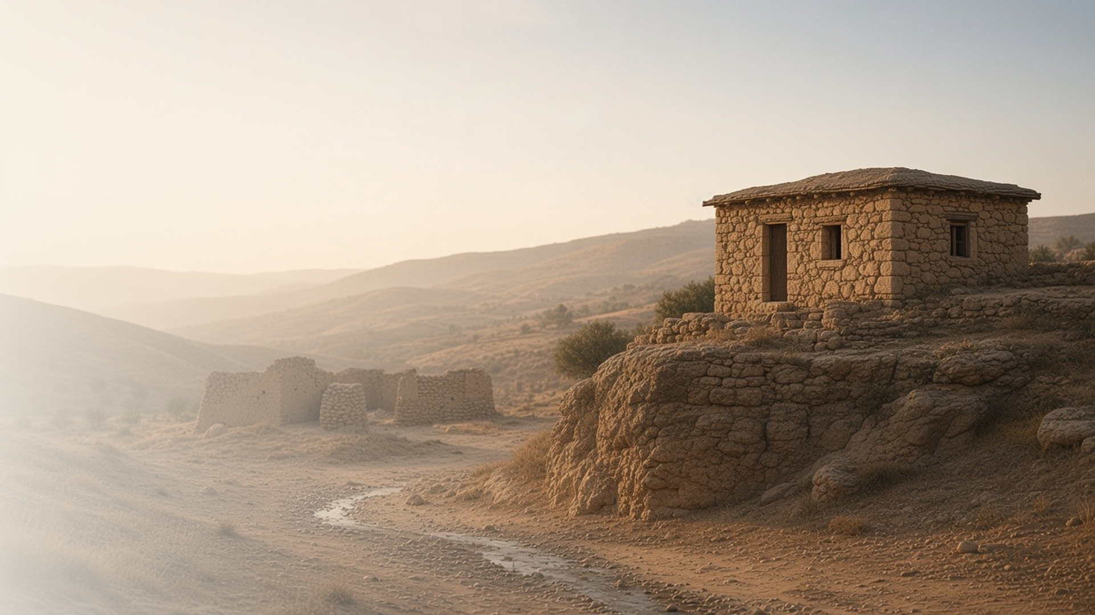
COME, FOLLOW ME · NEW TESTAMENT 2027
He Taught Them as One
Having Authority
February 15–21
Matthew 6–7
Notes:
TEACHING
Matthew 6–7 completes the Sermon on the Mount: sincere giving and prayer, treasures in heaven, seeking God's kingdom first, judging righteously, asking and receiving, recognizing true messengers by their fruits, and building on the rock. The people were astonished because He taught with authority, not as the scribes did.
SCRIPTURE (KJV)
Matthew 7:28–29
28 And it came to pass, when Jesus had ended these sayings, the people were astonished at his doctrine:
29 For he taught them as one having authority, and not as the scribes.
DISCUSSION
• Which teaching in Matthew 6–7 do you most need to live right now?
• What does it mean that Jesus taught "as one having authority"?

Slide 2
MATTHEW 6–7
Becoming like Him
Living His sermon, line by line, makes us more like Him.
“But seek ye first the kingdom of God, and his righteousness; and all these things shall be added unto you.”
MATTHEW 6:33
Notes:
TEACHING
The Sermon on the Mount is less a list of rules than a portrait of the Savior's own character. Invite class members to ask Heavenly Father what He wants them to learn as they read Matthew 6–7, then pick one principle, such as giving in secret, seeking the kingdom first, or not worrying about tomorrow, and look for ways to practice it.
SCRIPTURE (KJV)
Matthew 6:19–21
19 Lay not up for yourselves treasures upon earth, where moth and rust doth corrupt, and where thieves break through and steal:
20 But lay up for yourselves treasures in heaven, where neither moth nor rust doth corrupt, and where thieves do not break through nor steal:
21 For where your treasure is, there will your heart be also.
Matthew 6:31–34
31 Therefore take no thought, saying, What shall we eat? or, What shall we drink? or, Wherewithal shall we be clothed?
32 (For after all these things do the Gentiles seek:) for your heavenly Father knoweth that ye have need of all these things.
33 But seek ye first the kingdom of God, and his righteousness; and all these things shall be added unto you.
34 Take therefore no thought for the morrow: for the morrow shall take thought for the things of itself. Sufficient unto the day is the evil thereof.
DISCUSSION (questions quoted from the manual)
• “What else do you find?”

Slide 3
MATTHEW 6:5–13; LUKE 11:1–4
He taught me how to pray
The Lord’s Prayer models reverence, submission, and simple asking.
“Our Father which art in heaven, Hallowed be thy name.”
MATTHEW 6:9
Notes:
TEACHING
Jesus warned against praying to be seen or using vain repetitions, then gave a model prayer. It begins with reverence for the Father, submits to His will, asks for daily needs, seeks forgiveness while forgiving others, and pleads for protection from evil. It is a pattern to learn from, not just words to recite.
SCRIPTURE (KJV)
Matthew 6:5–13
5 And when thou prayest, thou shalt not be as the hypocrites are: for they love to pray standing in the synagogues and in the corners of the streets, that they may be seen of men. Verily I say unto you, They have their reward.
6 But thou, when thou prayest, enter into thy closet, and when thou hast shut thy door, pray to thy Father which is in secret; and thy Father which seeth in secret shall reward thee openly.
7 But when ye pray, use not vain repetitions, as the heathen do: for they think that they shall be heard for their much speaking.
8 Be not ye therefore like unto them: for your Father knoweth what things ye have need of, before ye ask him.
9 After this manner therefore pray ye: Our Father which art in heaven, Hallowed be thy name.
10 Thy kingdom come. Thy will be done in earth, as it is in heaven.
11 Give us this day our daily bread.
12 And forgive us our debts, as we forgive our debtors.
13 And lead us not into temptation, but deliver us from evil: For thine is the kingdom, and the power, and the glory, for ever. Amen.
DISCUSSION (questions quoted from the manual)
• “If the Savior were reading these verses with you, what do you think He would want you to notice?”

Slide 4
MATTHEW 7:1–5
Judging righteously
Remove the beam from our own eye before helping with the mote.
“Judge not, that ye be not judged.”
MATTHEW 7:1
Notes:
TEACHING
Jesus does not forbid all judgment; elsewhere He tells us to judge righteous judgment, and the Joseph Smith Translation renders verse 1 "Judge not unrighteously." The image of a beam in our own eye exposes the hypocrisy of harsh, self-righteous judging. Righteous judgment is humble, merciful, and focused first on our own repentance.
SCRIPTURE (KJV)
Matthew 7:1–5
1 Judge not, that ye be not judged.
2 For with what judgment ye judge, ye shall be judged: and with what measure ye mete, it shall be measured to you again.
3 And why beholdest thou the mote that is in thy brother’s eye, but considerest not the beam that is in thine own eye?
4 Or how wilt thou say to thy brother, Let me pull out the mote out of thine eye; and, behold, a beam is in thine own eye?
5 Thou hypocrite, first cast out the beam out of thine own eye; and then shalt thou see clearly to cast out the mote out of thy brother’s eye.
DISCUSSION (questions quoted from the manual)
• “What do you find in Matthew 7:1–5, along with the rest of the chapter, that helps you know how to “judge righteous judgment”?”

Slide 5
MATTHEW 7:7–11
Ask, seek, knock
Heavenly Father gives good gifts to children who ask.
“Ask, and it shall be given you; seek, and ye shall find; knock, and it shall be opened unto you.”
MATTHEW 7:7
Notes:
TEACHING
Three invitations, three promises. Asking, seeking, and knocking suggest increasing effort and persistence. Jesus then reasons from human parents: if imperfect parents give their children bread rather than a stone, how much more will our perfect Father give good things to those who ask. Invite class members to share how He has kept these promises in their lives.
SCRIPTURE (KJV)
Matthew 7:7–11
7 Ask, and it shall be given you; seek, and ye shall find; knock, and it shall be opened unto you:
8 For every one that asketh receiveth; and he that seeketh findeth; and to him that knocketh it shall be opened.
9 Or what man is there of you, whom if his son ask bread, will he give him a stone?
10 Or if he ask a fish, will he give him a serpent?
11 If ye then, being evil, know how to give good gifts unto your children, how much more shall your Father which is in heaven give good things to them that ask him?
Restoration scripture (public-domain text: bcbooks/scriptures-json)
1 Nephi 11:1 (Book of Mormon)
1 For it came to pass after I had desired to know the things that my father had seen, and believing that the Lord was able to make them known unto me, as I sat pondering in mine heart I was caught away in the Spirit of the Lord, yea, into an exceedingly high mountain, which I never had before seen, and upon which I never had before set my foot.
Ether 2:23, 25 (Book of Mormon)
23 And the Lord said unto the brother of Jared: What will ye that I should do that ye may have light in your vessels? For behold, ye cannot have windows, for they will be dashed in pieces; neither shall ye take fire with you, for ye shall not go by the light of fire.
25 And behold, I prepare you against these things; for ye cannot cross this great deep save I prepare you against the waves of the sea, and the winds which have gone forth, and the floods which shall come. Therefore what will ye that I should prepare for you that ye may have light when ye are swallowed up in the depths of the sea?
Full passage: Ether 2:18–25
Ether 3:4, 6 (Book of Mormon)
4 And I know, O Lord, that thou hast all power, and can do whatsoever thou wilt for the benefit of man; therefore touch these stones, O Lord, with thy finger, and prepare them that they may shine forth in darkness; and they shall shine forth unto us in the vessels which we have prepared, that we may have light while we shall cross the sea.
6 And it came to pass that when the brother of Jared had said these words, behold, the Lord stretched forth his hand and touched the stones one by one with his finger. And the veil was taken from off the eyes of the brother of Jared, and he saw the finger of the Lord; and it was as the finger of a man, like unto flesh and blood; and the brother of Jared fell down before the Lord, for he was struck with fear.
Full passage: Ether 3:1–6
Joseph Smith—History 1:11–12, 14–17 (Pearl of Great Price)
11 While I was laboring under the extreme difficulties caused by the contests of these parties of religionists, I was one day reading the Epistle of James, first chapter and fifth verse, which reads: If any of you lack wisdom, let him ask of God, that giveth to all men liberally, and upbraideth not; and it shall be given him.
12 Never did any passage of scripture come with more power to the heart of man than this did at this time to mine. It seemed to enter with great force into every feeling of my heart. I reflected on it again and again, knowing that if any person needed wisdom from God, I did; for how to act I did not know, and unless I could get more wisdom than I then had, I would never know; for the teachers of religion of the different sects understood the same passages of scripture so differently as to destroy all confidence in settling the question by an appeal to the Bible.
14 So, in accordance with this, my determination to ask of God, I retired to the woods to make the attempt. It was on the morning of a beautiful, clear day, early in the spring of eighteen hundred and twenty. It was the first time in my life that I had made such an attempt, for amidst all my anxieties I had never as yet made the attempt to pray vocally.
15 After I had retired to the place where I had previously designed to go, having looked around me, and finding myself alone, I kneeled down and began to offer up the desires of my heart to God. I had scarcely done so, when immediately I was seized upon by some power which entirely overcame me, and had such an astonishing influence over me as to bind my tongue so that I could not speak. Thick darkness gathered around me, and it seemed to me for a time as if I were doomed to sudden destruction.
16 But, exerting all my powers to call upon God to deliver me out of the power of this enemy which had seized upon me, and at the very moment when I was ready to sink into despair and abandon myself to destruction—not to an imaginary ruin, but to the power of some actual being from the unseen world, who had such marvelous power as I had never before felt in any being—just at this moment of great alarm, I saw a pillar of light exactly over my head, above the brightness of the sun, which descended gradually until it fell upon me.
17 It no sooner appeared than I found myself delivered from the enemy which held me bound. When the light rested upon me I saw two Personages, whose brightness and glory defy all description, standing above me in the air. One of them spake unto me, calling me by name and said, pointing to the other—This is My Beloved Son. Hear Him!
Full passage: Joseph Smith—History 1:11–17
DISCUSSION (questions quoted from the manual)
• “How have you acted on the invitations, and how has the Lord kept the promises?”
• “Can you think of examples in the scriptures where God has answered humble prayers?”
• “What do you learn from these examples? (See, for instance, 1 Nephi 11:1; Ether 2:18–25; 3:1–6; Joseph Smith—History 1:11–17.)”

Slide 6
MATTHEW 7:15–20
By their fruits
We discern true and false messengers by what their teachings produce.
“Wherefore by their fruits ye shall know them.”
MATTHEW 7:20
Notes:
TEACHING
False prophets can look harmless, like sheep, while leading people away from Christ. Jesus gave a simple test: look at the fruit. Ideas and voices that draw us toward faith, repentance, covenants, and Christlike love produce good fruit; those that erode them do not. Discuss how this principle helps us evaluate what we encounter online and elsewhere.
SCRIPTURE (KJV)
Matthew 7:15–20
15 Beware of false prophets, which come to you in sheep’s clothing, but inwardly they are ravening wolves.
16 Ye shall know them by their fruits. Do men gather grapes of thorns, or figs of thistles?
17 Even so every good tree bringeth forth good fruit; but a corrupt tree bringeth forth evil fruit.
18 A good tree cannot bring forth evil fruit, neither can a corrupt tree bring forth good fruit.
19 Every tree that bringeth not forth good fruit is hewn down, and cast into the fire.
20 Wherefore by their fruits ye shall know them.
DISCUSSION (questions quoted from the manual)
• “How can you know what’s true and what isn’t?”
• “What “fruits” have you experienced from following the counsel of living prophets?”

Slide 7
MATTHEW 7:21–23
Knowing Him by doing His will
Discipleship is shown in obedience, not just in words.
“Not every one that saith unto me, Lord, Lord, shall enter into the kingdom of heaven.”
MATTHEW 7:21
Notes:
TEACHING
Saying "Lord, Lord" and even doing impressive works is not the same as knowing Him. The Joseph Smith Translation changes "I never knew you" to "Ye never knew me," placing the emphasis on our relationship with Christ. We come to know Him as we do the will of His Father, not merely by professing belief.
SCRIPTURE (KJV)
Matthew 7:21–23
21 Not every one that saith unto me, Lord, Lord, shall enter into the kingdom of heaven; but he that doeth the will of my Father which is in heaven.
22 Many will say to me in that day, Lord, Lord, have we not prophesied in thy name? and in thy name have cast out devils? and in thy name done many wonderful works?
23 And then will I profess unto them, I never knew you: depart from me, ye that work iniquity.
DISCUSSION (questions quoted from the manual)
• “How does this change help you better understand what the Lord taught in verses 21–22?”
• “How well do you feel you know the Lord?”
• “What can you do to know Him better?”

Slide 8
MATTHEW 7:24–27
A firm foundation
Hearing and doing His sayings is building on the rock.
“Therefore whosoever heareth these sayings of mine, and doeth them, I will liken him unto a wise man, which built his house upon a rock.”
MATTHEW 7:24
Notes:
TEACHING
Both houses in the parable faced the same rain, floods, and wind. The difference was the foundation. Following Christ does not remove storms from our lives, but it gives us something that holds. The wise builder is not the one who simply hears the Savior's words but the one who does them.
SCRIPTURE (KJV)
Matthew 7:24–27
24 Therefore whosoever heareth these sayings of mine, and doeth them, I will liken him unto a wise man, which built his house upon a rock:
25 And the rain descended, and the floods came, and the winds blew, and beat upon that house; and it fell not: for it was founded upon a rock.
26 And every one that heareth these sayings of mine, and doeth them not, shall be likened unto a foolish man, which built his house upon the sand:
27 And the rain descended, and the floods came, and the winds blew, and beat upon that house; and it fell: and great was the fall of it.
DISCUSSION (questions quoted from the manual)
• “What insights do you gain about this parable from the painting at the end of this outline?”
• “What do you learn about building a firm foundation for your life from pages 4–5 of For the Strength of Youth: A Guide for Making Choices?”
• “How has living the Savior’s teachings created a solid foundation for you?”

Slide 9
MATTHEW 7:29
“For he taught them as one having authority,
and not as the scribes.”
This week, choose one teaching from Matthew 6–7 and live it.
Notes:
TEACHING
The crowds noticed that Jesus spoke with authority, not as one quoting other teachers. His authority came from who He is. Close by inviting each person to take one teaching from the sermon and treat it as a personal command from the Lord this week, and then report back next week on what they learned.
SCRIPTURE (KJV)
Matthew 7:28–29
28 And it came to pass, when Jesus had ended these sayings, the people were astonished at his doctrine:
29 For he taught them as one having authority, and not as the scribes.
DISCUSSION
• Which teaching will you choose, and how will you live it?
• How has living a teaching of Jesus given you a firmer foundation?

