Slide 1
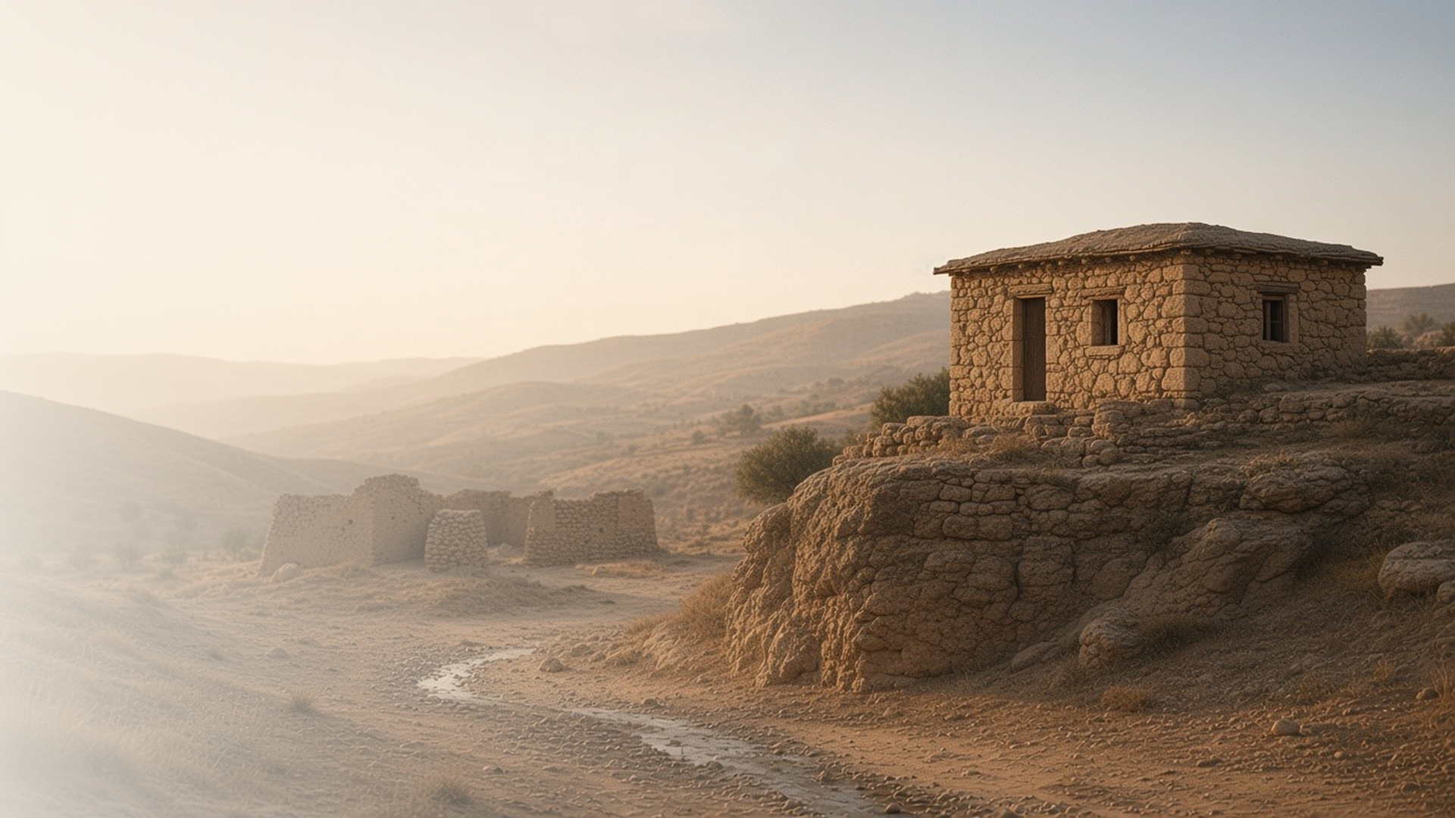
COME, FOLLOW ME · FOR CHILDREN
He Taught Them as One
Having Authority
February 15–21
Matthew 6–7
Notes:
TEACHING
This week children learn from the Sermon on the Mount: Heavenly Father hears our prayers, eternal treasures matter more than earthly ones, we should treat others as we want to be treated, and following Jesus is like building a house on a rock.
SCRIPTURE (KJV)
Matthew 7:24–25
24 Therefore whosoever heareth these sayings of mine, and doeth them, I will liken him unto a wise man, which built his house upon a rock:
25 And the rain descended, and the floods came, and the winds blew, and beat upon that house; and it fell not: for it was founded upon a rock.
DISCUSSION
• Where did the wise man build his house?
• How can we build on the rock?

Slide 2
MATTHEW 6–7
Jesus has messages for me
In the Sermon on the Mount, Jesus taught how to be happy.
“For he taught them as one having authority, and not as the scribes.”
MATTHEW 7:29
Notes:
TEACHING
Write a few short phrases from Matthew 6–7 on cards, such as "Ask, and it shall be given you" or "Build on a rock," and let children match or act them out. Explain that Jesus taught these things on a mountain to many people, and His words are for us too.
SCRIPTURE (KJV)
Matthew 7:28–29
28 And it came to pass, when Jesus had ended these sayings, the people were astonished at his doctrine:
29 For he taught them as one having authority, and not as the scribes.
DISCUSSION (questions quoted from the manual)
• (The manual gives no direct questions for this section.)
Suggested: Which of Jesus's teachings do you like best?

Slide 3
MATTHEW 6:5–13; 7:7–11
Heavenly Father hears me
I can pray anytime, anywhere, and He will answer.
“Ask, and it shall be given you; seek, and ye shall find.”
MATTHEW 7:7
Notes:
TEACHING
Use Matthew 6:5–13 and the song "Anytime, Anywhere" to find truths about prayer. Help children memorize Matthew 7:7 with a ball-toss game: each child says the next word or phrase and tosses the ball to someone else. Share an experience when Heavenly Father answered your prayer.
SCRIPTURE (KJV)
Matthew 6:9–11
9 After this manner therefore pray ye: Our Father which art in heaven, Hallowed be thy name.
10 Thy kingdom come. Thy will be done in earth, as it is in heaven.
11 Give us this day our daily bread.
Full passage: Matthew 6:9–13
Matthew 7:7
7 Ask, and it shall be given you; seek, and ye shall find; knock, and it shall be opened unto you:
Full passage: Matthew 7:7–8
DISCUSSION (questions quoted from the manual)
• “What does Jesus want us to know about prayer?”

Slide 4
MATTHEW 6:19–21
Treasures in heaven
Kindness, faith, and family last longer than toys or money.
“For where your treasure is, there will your heart be also.”
MATTHEW 6:21
Notes:
TEACHING
Fill a box with things like toys or play money, and talk about how they can break, get lost, or wear out. Then talk about treasures that last forever: family, faith, kindness, and the gospel. Children could draw a heavenly treasure they want to keep.
SCRIPTURE (KJV)
Matthew 6:19–21
19 Lay not up for yourselves treasures upon earth, where moth and rust doth corrupt, and where thieves break through and steal:
20 But lay up for yourselves treasures in heaven, where neither moth nor rust doth corrupt, and where thieves do not break through nor steal:
21 For where your treasure is, there will your heart be also.
DISCUSSION (questions quoted from the manual)
• (The manual gives no direct questions for this section.)
Suggested: What is a treasure in heaven you can work on this week?

Slide 5
MATTHEW 7:12
The Golden Rule
Jesus asks me to treat others the way I want to be treated.
“Therefore all things whatsoever ye would that men should do to you, do ye even so to them.”
MATTHEW 7:12
Notes:
TEACHING
Read Matthew 7:12 and help children think of everyday situations: sharing a toy, taking turns, including someone new. Ask how they would want to be treated in each situation, and practice responding the way Jesus taught.
SCRIPTURE (KJV)
Matthew 7:12
12 Therefore all things whatsoever ye would that men should do to you, do ye even so to them: for this is the law and the prophets.
DISCUSSION (questions quoted from the manual)
• (The manual gives no direct questions for this section.)
Suggested: How can you live the Golden Rule at home this week?

Slide 6
MATTHEW 7:24–27
Build on the rock
When I follow Jesus, I am like the wise man who built on rock.
“And it fell not: for it was founded upon a rock.”
MATTHEW 7:25
Notes:
TEACHING
Build small houses with blocks on a hard surface and on a pillow or a pile of sand, then gently "storm" them. Talk about which house stood and why. Explain that following Jesus's teachings makes us strong when hard things happen.
SCRIPTURE (KJV)
Matthew 7:24–27
24 Therefore whosoever heareth these sayings of mine, and doeth them, I will liken him unto a wise man, which built his house upon a rock:
25 And the rain descended, and the floods came, and the winds blew, and beat upon that house; and it fell not: for it was founded upon a rock.
26 And every one that heareth these sayings of mine, and doeth them not, shall be likened unto a foolish man, which built his house upon the sand:
27 And the rain descended, and the floods came, and the winds blew, and beat upon that house; and it fell: and great was the fall of it.
DISCUSSION (questions quoted from the manual)
• “What could the rain and floods represent in our lives?”
• “How can we be like the wise man?”

Slide 7
MATTHEW 6:9
“Our Father which art in heaven,
Hallowed be thy name.”
This week, say a prayer to Heavenly Father every morning and night.
Notes:
TEACHING
Jesus taught us to pray to our Father in Heaven. He always hears us. Invite children to pray each morning and each night this week, and to tell Heavenly Father thank you for one thing every time.
SCRIPTURE (KJV)
Matthew 6:9–13
9 After this manner therefore pray ye: Our Father which art in heaven, Hallowed be thy name.
10 Thy kingdom come. Thy will be done in earth, as it is in heaven.
11 Give us this day our daily bread.
12 And forgive us our debts, as we forgive our debtors.
13 And lead us not into temptation, but deliver us from evil: For thine is the kingdom, and the power, and the glory, for ever. Amen.
DISCUSSION
• Who do we pray to?
• What can you thank Heavenly Father for tonight?

