Slide 1
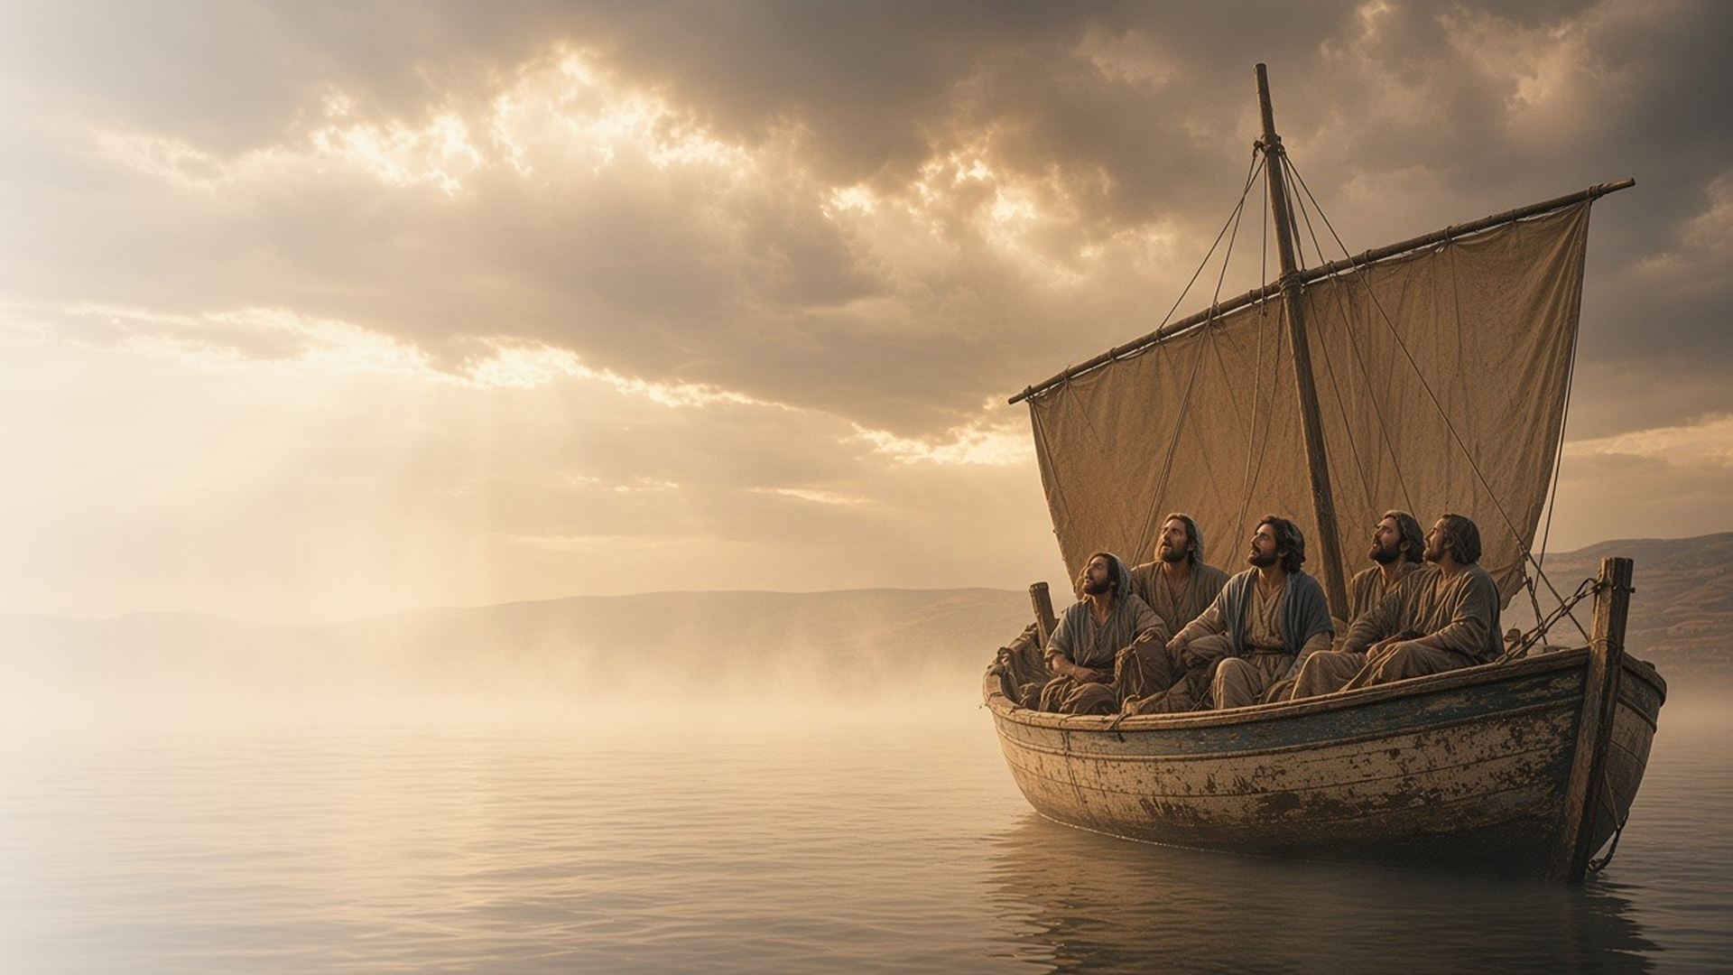
COME, FOLLOW ME · NEW TESTAMENT 2027
Thy Faith Hath
Saved Thee
February 22–28
Matthew 8; Mark 2–4; Luke 7
Notes:
TEACHING
These chapters are full of healings: a leper, a centurion's servant, a paralyzed man lowered through a roof, a widow's son, a forgiven woman, and a storm calmed on the sea. Again and again Jesus responds to faith, and again and again He shows that He came to heal bodies, hearts, and sins.
SCRIPTURE (KJV)
Luke 7:48–50
48 And he said unto her, Thy sins are forgiven.
49 And they that sat at meat with him began to say within themselves, Who is this that forgiveth sins also?
50 And he said to the woman, Thy faith hath saved thee; go in peace.
DISCUSSION
• Which healing in these chapters speaks most to you, and why?
• What kind of healing do you seek from the Savior right now?

Slide 2
MATTHEW 8; MARK 2–3; LUKE 7
Jesus Christ is a healer
He healed bodies, and He heals hearts and lives today.
“And Jesus put forth his hand, and touched him, saying, I will; be thou clean.”
MATTHEW 8:3
Notes:
TEACHING
The Savior touched a leper whom others would not approach, healed a servant from a distance because of a centurion's faith, and forgave and healed a man whose friends tore open a roof to reach Him. Each account reveals His power and His compassion. Invite class members to look for what each person did to come to Him and what He did in response.
SCRIPTURE (KJV)
Matthew 8:1–4
1 When he was come down from the mountain, great multitudes followed him.
2 And, behold, there came a leper and worshipped him, saying, Lord, if thou wilt, thou canst make me clean.
3 And Jesus put forth his hand, and touched him, saying, I will; be thou clean. And immediately his leprosy was cleansed.
4 And Jesus saith unto him, See thou tell no man; but go thy way, shew thyself to the priest, and offer the gift that Moses commanded, for a testimony unto them.
Mark 2:1–12
1 And again he entered into Capernaum, after some days; and it was noised that he was in the house.
2 And straightway many were gathered together, insomuch that there was no room to receive them, no, not so much as about the door: and he preached the word unto them.
3 And they come unto him, bringing one sick of the palsy, which was borne of four.
4 And when they could not come nigh unto him for the press, they uncovered the roof where he was: and when they had broken it up, they let down the bed wherein the sick of the palsy lay.
5 When Jesus saw their faith, he said unto the sick of the palsy, Son, thy sins be forgiven thee.
6 But there were certain of the scribes sitting there, and reasoning in their hearts,
7 Why doth this man thus speak blasphemies? who can forgive sins but God only?
8 And immediately when Jesus perceived in his spirit that they so reasoned within themselves, he said unto them, Why reason ye these things in your hearts?
9 Whether is it easier to say to the sick of the palsy, Thy sins be forgiven thee; or to say, Arise, and take up thy bed, and walk?
10 But that ye may know that the Son of man hath power on earth to forgive sins, (he saith to the sick of the palsy,)
11 I say unto thee, Arise, and take up thy bed, and go thy way into thine house.
12 And immediately he arose, took up the bed, and went forth before them all; insomuch that they were all amazed, and glorified God, saying, We never saw it on this fashion.
DISCUSSION (questions quoted from the manual)
• “What others do you find?”
• “You might ask yourself: What does the account teach about the Savior?”
• “What does it teach about exercising faith in Him?”
• “What does He want me to learn from this miracle?”

Slide 3
MARK 2:15–17; LUKE 7:36–50
He came to heal sinners
Jesus welcomed sinners and forgave the woman who loved much.
“They that are whole have no need of the physician, but they that are sick.”
MARK 2:17
Notes:
TEACHING
When critics objected that Jesus ate with sinners, He compared Himself to a physician who goes to the sick. At Simon the Pharisee's house, a woman known as a sinner washed His feet with her tears. Jesus taught that those who are forgiven much love much. He came not to condemn but to heal, and He invites us to see others the same way.
SCRIPTURE (KJV)
Mark 2:15–17
15 And it came to pass, that, as Jesus sat at meat in his house, many publicans and sinners sat also together with Jesus and his disciples: for there were many, and they followed him.
16 And when the scribes and Pharisees saw him eat with publicans and sinners, they said unto his disciples, How is it that he eateth and drinketh with publicans and sinners?
17 When Jesus heard it, he saith unto them, They that are whole have no need of the physician, but they that are sick: I came not to call the righteous, but sinners to repentance.
Luke 7:36–50
36 And one of the Pharisees desired him that he would eat with him. And he went into the Pharisee’s house, and sat down to meat.
37 And, behold, a woman in the city, which was a sinner, when she knew that Jesus sat at meat in the Pharisee’s house, brought an alabaster box of ointment,
38 And stood at his feet behind him weeping, and began to wash his feet with tears, and did wipe them with the hairs of her head, and kissed his feet, and anointed them with the ointment.
39 Now when the Pharisee which had bidden him saw it, he spake within himself, saying, This man, if he were a prophet, would have known who and what manner of woman this is that toucheth him: for she is a sinner.
40 And Jesus answering said unto him, Simon, I have somewhat to say unto thee. And he saith, Master, say on.
41 There was a certain creditor which had two debtors: the one owed five hundred pence, and the other fifty.
42 And when they had nothing to pay, he frankly forgave them both. Tell me therefore, which of them will love him most?
43 Simon answered and said, I suppose that he, to whom he forgave most. And he said unto him, Thou hast rightly judged.
44 And he turned to the woman, and said unto Simon, Seest thou this woman? I entered into thine house, thou gavest me no water for my feet: but she hath washed my feet with tears, and wiped them with the hairs of her head.
45 Thou gavest me no kiss: but this woman since the time I came in hath not ceased to kiss my feet.
46 My head with oil thou didst not anoint: but this woman hath anointed my feet with ointment.
47 Wherefore I say unto thee, Her sins, which are many, are forgiven; for she loved much: but to whom little is forgiven, the same loveth little.
48 And he said unto her, Thy sins are forgiven.
49 And they that sat at meat with him began to say within themselves, Who is this that forgiveth sins also?
50 And he said to the woman, Thy faith hath saved thee; go in peace.
DISCUSSION (questions quoted from the manual)
• “Can you see yourself in Mark 2:15–17 and Luke 7:36–50?”
• “For example, are your thoughts and actions ever like those of Simon the Pharisee?”
• “How would you describe the difference between the way Jesus saw sinners and the way Pharisees like Simon saw them?”
• “How do they feel when they are with you?”
• “When have you experienced tenderness and mercy similar to what the Savior showed her?”
• “What do you learn from her about faith, love, and humility?”
(+1 more in the manual)

Slide 4
MATTHEW 8:18–22; MARK 3:31–35
Putting Him first
True disciples follow Him before every other claim on their lives.
“For whosoever shall do the will of God, the same is my brother, and my sister, and mother.”
MARK 3:35
Notes:
TEACHING
Some who wanted to follow Jesus first wanted to settle other matters. His responses sound stark, but they teach that discipleship must come first, not after everything else is arranged. He also taught that those who do the will of God become His family. Discuss what competes for first place in our lives and how we keep Him there.
SCRIPTURE (KJV)
Matthew 8:18–22
18 Now when Jesus saw great multitudes about him, he gave commandment to depart unto the other side.
19 And a certain scribe came, and said unto him, Master, I will follow thee whithersoever thou goest.
20 And Jesus saith unto him, The foxes have holes, and the birds of the air have nests; but the Son of man hath not where to lay his head.
21 And another of his disciples said unto him, Lord, suffer me first to go and bury my father.
22 But Jesus said unto him, Follow me; and let the dead bury their dead.
Mark 3:31–35
31 There came then his brethren and his mother, and, standing without, sent unto him, calling him.
32 And the multitude sat about him, and they said unto him, Behold, thy mother and thy brethren without seek for thee.
33 And he answered them, saying, Who is my mother, or my brethren?
34 And he looked round about on them which sat about him, and said, Behold my mother and my brethren!
35 For whosoever shall do the will of God, the same is my brother, and my sister, and mother.
DISCUSSION (questions quoted from the manual)
• “What do the accounts in Matthew 8:18–22 and Mark 3:31–35 imply about discipleship?”
• “Why must disciples be willing to put the Savior first, even before other things we value?”
• “What might you need to give up in order to put Jesus first in your life?”

Slide 5
MATTHEW 8:23–27; MARK 4:35–41
Peace in life’s storms
The winds obeyed Him, and He can calm the storms within us.
“Peace, be still. And the wind ceased, and there was a great calm.”
MARK 4:39
Notes:
TEACHING
Experienced fishermen feared for their lives while Jesus slept in the stern. Their question, "Master, carest thou not that we perish?" is one we may ask in our own storms. He rose, rebuked the wind, and there was a great calm. He does not always calm the outward storm right away, but He can always bring peace to those who turn to Him.
SCRIPTURE (KJV)
Mark 4:35–41
35 And the same day, when the even was come, he saith unto them, Let us pass over unto the other side.
36 And when they had sent away the multitude, they took him even as he was in the ship. And there were also with him other little ships.
37 And there arose a great storm of wind, and the waves beat into the ship, so that it was now full.
38 And he was in the hinder part of the ship, asleep on a pillow: and they awake him, and say unto him, Master, carest thou not that we perish?
39 And he arose, and rebuked the wind, and said unto the sea, Peace, be still. And the wind ceased, and there was a great calm.
40 And he said unto them, Why are ye so fearful? how is it that ye have no faith?
41 And they feared exceedingly, and said one to another, What manner of man is this, that even the wind and the sea obey him?
DISCUSSION (questions quoted from the manual)
• “Have you ever felt the way Jesus’s disciples did in the storm at sea—watching the waves fill the boat and wondering, “Master, carest thou not that we perish?””
• “How does the Savior bring peace to the storms of your life?”
• “What spiritual impressions come as you include these works of art in your scripture study?”

Slide 6
LUKE 7:50
“And he said to the woman,
Thy faith hath saved thee; go in peace.”
This week, bring one burden to the Healer in faith.
Notes:
TEACHING
Jesus sent the forgiven woman away with peace, crediting her faith. His healing power responds to faith, whatever form our need takes: physical, emotional, or spiritual. Close by inviting each person to bring one specific burden to the Savior this week in prayer, and to watch for how He responds.
SCRIPTURE (KJV)
Luke 7:47–50
47 Wherefore I say unto thee, Her sins, which are many, are forgiven; for she loved much: but to whom little is forgiven, the same loveth little.
48 And he said unto her, Thy sins are forgiven.
49 And they that sat at meat with him began to say within themselves, Who is this that forgiveth sins also?
50 And he said to the woman, Thy faith hath saved thee; go in peace.
DISCUSSION
• What burden will you bring to the Savior this week?
• How has faith in Christ brought you peace before?

