Slide 1
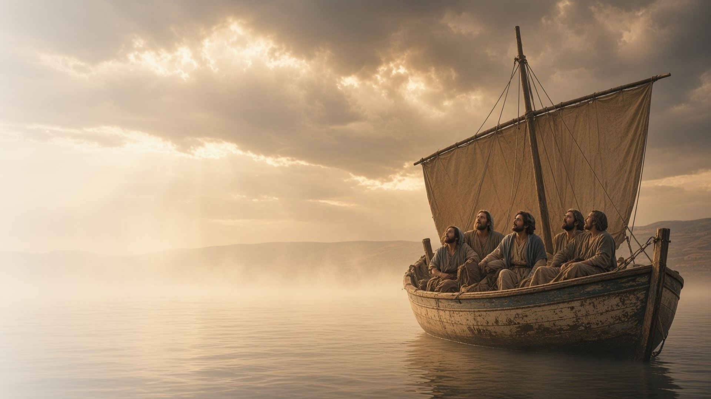
COME, FOLLOW ME · FOR CHILDREN
Thy Faith Hath
Saved Thee
February 22–28
Matthew 8; Mark 2–4; Luke 7
Notes:
TEACHING
This week children learn that Jesus healed many people, that He loves us and forgives us when we repent, and that He can help us feel peace when we are scared.
SCRIPTURE (KJV)
Mark 4:39
39 And he arose, and rebuked the wind, and said unto the sea, Peace, be still. And the wind ceased, and there was a great calm.
DISCUSSION
• What are some people Jesus healed?
• How can Jesus help us when we're afraid?

Slide 2
MATTHEW 8; MARK 2–3; LUKE 7
Jesus is a healer
Jesus healed the sick because He loves everyone.
“I say unto thee, Arise, and take up thy bed, and go thy way into thine house.”
MARK 2:11
Notes:
TEACHING
Tell the story of the four friends who carried a man who couldn't walk to Jesus and lowered him through the roof. Jesus forgave him and told him to arise and walk. Talk about other people Jesus healed and how He can help us when we are sick or hurt.
SCRIPTURE (KJV)
Mark 2:4–5, 11–12
4 And when they could not come nigh unto him for the press, they uncovered the roof where he was: and when they had broken it up, they let down the bed wherein the sick of the palsy lay.
5 When Jesus saw their faith, he said unto the sick of the palsy, Son, thy sins be forgiven thee.
11 I say unto thee, Arise, and take up thy bed, and go thy way into thine house.
12 And immediately he arose, took up the bed, and went forth before them all; insomuch that they were all amazed, and glorified God, saying, We never saw it on this fashion.
Full passage: Mark 2:1–12
DISCUSSION (questions quoted from the manual)
• “How can we be like the friends of the man who couldn’t walk?”
• “Who has been that kind of friend to us?”
• “What do we learn about Jesus Christ’s power from this story?”

Slide 3
MARK 2:15–17; LUKE 7:36–50
Jesus forgives me
When I repent, Jesus forgives me because He loves me.
“And he said unto her, Thy sins are forgiven.”
LUKE 7:48
Notes:
TEACHING
A woman came to Jesus feeling sorry for her sins. She washed His feet with her tears, and Jesus kindly told her that her sins were forgiven. Help children understand that everyone makes mistakes, and when we say sorry and try to do better, Jesus forgives us and still loves us.
SCRIPTURE (KJV)
Luke 7:47–48, 50
47 Wherefore I say unto thee, Her sins, which are many, are forgiven; for she loved much: but to whom little is forgiven, the same loveth little.
48 And he said unto her, Thy sins are forgiven.
50 And he said to the woman, Thy faith hath saved thee; go in peace.
Full passage: Luke 7:44–50
DISCUSSION (questions quoted from the manual)
• “Here are some questions you and your children could think about as you read Mark 2:15–17 or Luke 7:36–50: How does Jesus feel about sin?”
• “How does Jesus feel about us when we sin (or do something we know we shouldn’t)?”
• “How can we show our love for Him?”

Slide 4
MARK 4:35–41
Jesus helps me feel peace
When I am scared, I can pray and remember Jesus.
“Peace, be still. And the wind ceased, and there was a great calm.”
MARK 4:39
Notes:
TEACHING
Act out the storm on the sea: children can make wind and wave sounds, then become still when you say, "Peace, be still." Talk about things that make us scared and how praying and remembering Jesus can help us feel calm.
SCRIPTURE (KJV)
Mark 4:37–39
37 And there arose a great storm of wind, and the waves beat into the ship, so that it was now full.
38 And he was in the hinder part of the ship, asleep on a pillow: and they awake him, and say unto him, Master, carest thou not that we perish?
39 And he arose, and rebuked the wind, and said unto the sea, Peace, be still. And the wind ceased, and there was a great calm.
Full passage: Mark 4:35–41
DISCUSSION (questions quoted from the manual)
• (The manual gives no direct questions for this section.)
Suggested: What can you do when you feel scared?

Slide 5
LUKE 7:50
“And he said to the woman,
Thy faith hath saved thee; go in peace.”
This week, when you feel scared or sad, pray and remember Jesus.
Notes:
TEACHING
Jesus told the woman to go in peace. Jesus wants us to feel peace too. Help children plan what they will do this week if they feel scared or sad: say a prayer, sing a Primary song, or look at a picture of Jesus.
SCRIPTURE (KJV)
Luke 7:50
50 And he said to the woman, Thy faith hath saved thee; go in peace.
DISCUSSION
• What did Jesus tell the woman?
• What can you do to feel peace?

