Slide 1
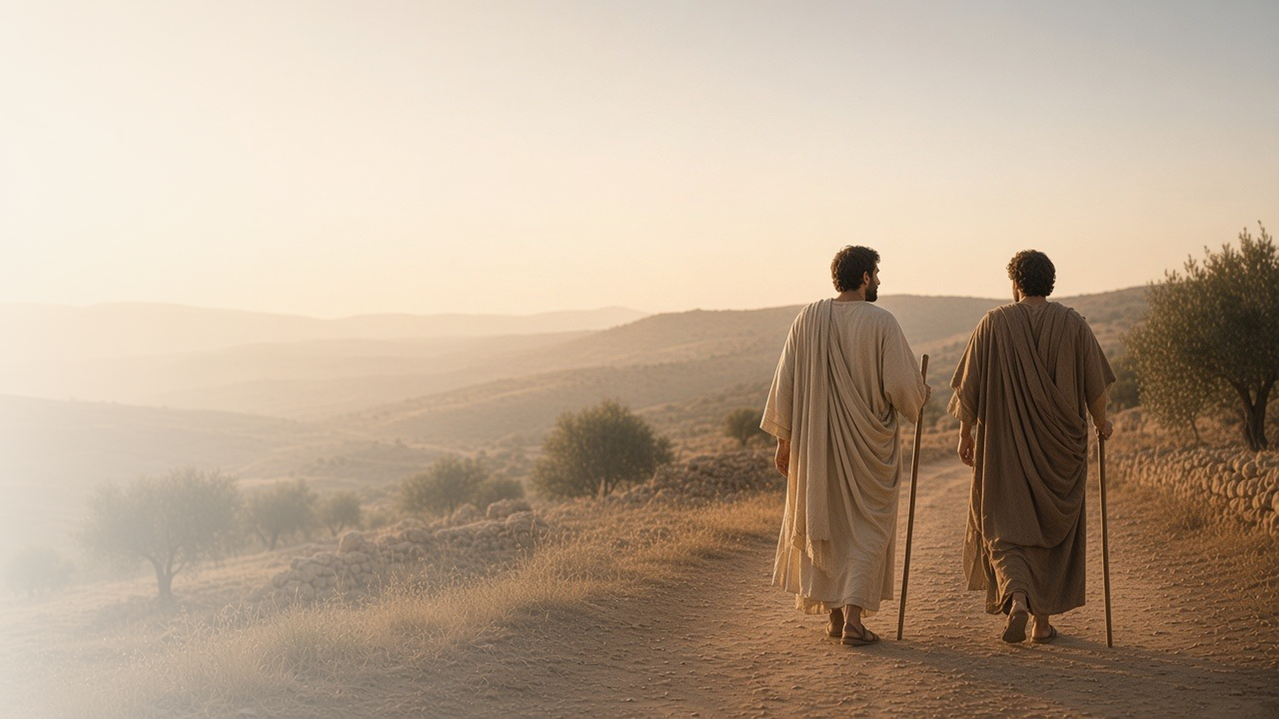
COME, FOLLOW ME · NEW TESTAMENT 2027
These Twelve
Jesus Sent Forth
March 1–7
Matthew 9–10; Mark 5; Luke 9
Notes:
TEACHING
These chapters pair dramatic miracles with a turning point in the Savior's ministry: He calls twelve Apostles, gives them His power, and sends them out to preach and heal. Along the way He teaches that faith overcomes fear, that reaching for Him takes effort, and that discipleship always involves sacrifice.
SCRIPTURE (KJV)
Matthew 10:1
1 And when he had called unto him his twelve disciples, he gave them power against unclean spirits, to cast them out, and to heal all manner of sickness and all manner of disease.
Matthew 10:5–8
5 These twelve Jesus sent forth, and commanded them, saying, Go not into the way of the Gentiles, and into any city of the Samaritans enter ye not:
6 But go rather to the lost sheep of the house of Israel.
7 And as ye go, preach, saying, The kingdom of heaven is at hand.
8 Heal the sick, cleanse the lepers, raise the dead, cast out devils: freely ye have received, freely give.
DISCUSSION
• What does it mean to you that the Lord calls Apostles today?
• Where do you need faith instead of fear this week?

Slide 2
MARK 5:22–24, 35–43
Faith amid fear
When word came that his daughter had died, Jesus said: only believe.
“Be not afraid, only believe.”
MARK 5:36
Notes:
TEACHING
Jairus was a respected ruler who humbled himself at Jesus's feet. Then the worst news arrived: his daughter was dead. Before fear could take hold, Jesus spoke to him directly: be not afraid, only believe. He took the girl by the hand and raised her. In seasons of uncertainty, the Savior invites us to keep believing even when circumstances seem final.
SCRIPTURE (KJV)
Mark 5:22–24
22 And, behold, there cometh one of the rulers of the synagogue, Jairus by name; and when he saw him, he fell at his feet,
23 And besought him greatly, saying, My little daughter lieth at the point of death: I pray thee, come and lay thy hands on her, that she may be healed; and she shall live.
24 And Jesus went with him; and much people followed him, and thronged him.
Mark 5:35–43
35 While he yet spake, there came from the ruler of the synagogue’s house certain which said, Thy daughter is dead: why troublest thou the Master any further?
36 As soon as Jesus heard the word that was spoken, he saith unto the ruler of the synagogue, Be not afraid, only believe.
37 And he suffered no man to follow him, save Peter, and James, and John the brother of James.
38 And he cometh to the house of the ruler of the synagogue, and seeth the tumult, and them that wept and wailed greatly.
39 And when he was come in, he saith unto them, Why make ye this ado, and weep? the damsel is not dead, but sleepeth.
40 And they laughed him to scorn. But when he had put them all out, he taketh the father and the mother of the damsel, and them that were with him, and entereth in where the damsel was lying.
41 And he took the damsel by the hand, and said unto her, Talitha cumi; which is, being interpreted, Damsel, I say unto thee, arise.
42 And straightway the damsel arose, and walked; for she was of the age of twelve years. And they were astonished with a great astonishment.
43 And he charged them straitly that no man should know it; and commanded that something should be given her to eat.
DISCUSSION (questions quoted from the manual)
• “What impresses you about Jairus’s expression of faith in Mark 5:22–24?”
• “How do you think Jairus might have felt as he watched Jesus talk with the woman in verses 25–34 and then as he received the news in verse 35?”
• “How do you think the Savior’s words in verse 36 would have helped Jairus in this moment?”
• “What do you know about Jesus Christ that helps you believe in Him, even in times of fear?”
• “How can you follow the Savior’s invitation to “be not afraid, only believe”?”

Slide 3
MATTHEW 9:20–22; MARK 5:25–34
Reaching for His power
The woman pressed through the crowd to touch His garment.
“Daughter, thy faith hath made thee whole; go in peace.”
MARK 5:34
Notes:
TEACHING
After twelve years of suffering and spending all she had on physicians, the woman pushed through a crowd to touch the hem of His clothes. Jesus felt power go out of Him and stopped to find her, then called her "Daughter." The manual calls her effort spiritual stretching: accessing the Savior's power often requires us to reach beyond our comfort to come to Him.
SCRIPTURE (KJV)
Mark 5:25–34
25 And a certain woman, which had an issue of blood twelve years,
26 And had suffered many things of many physicians, and had spent all that she had, and was nothing bettered, but rather grew worse,
27 When she had heard of Jesus, came in the press behind, and touched his garment.
28 For she said, If I may touch but his clothes, I shall be whole.
29 And straightway the fountain of her blood was dried up; and she felt in her body that she was healed of that plague.
30 And Jesus, immediately knowing in himself that virtue had gone out of him, turned him about in the press, and said, Who touched my clothes?
31 And his disciples said unto him, Thou seest the multitude thronging thee, and sayest thou, Who touched me?
32 And he looked round about to see her that had done this thing.
33 But the woman fearing and trembling, knowing what was done in her, came and fell down before him, and told him all the truth.
34 And he said unto her, Daughter, thy faith hath made thee whole; go in peace, and be whole of thy plague.
DISCUSSION (questions quoted from the manual)
• “What obstacles do you need to overcome as you reach out to the Savior in faith?”
• “What do you learn about Jesus Christ from the way He responded to this woman’s faith?”

Slide 4
MATTHEW 10; LUKE 9:1–6
Apostles as special witnesses
Jesus called and empowered the Twelve, as He does today.
“And when he had called unto him his twelve disciples, he gave them power.”
MATTHEW 10:1
Notes:
TEACHING
Jesus called twelve men by name, gave them power, and sent them out with specific instructions. They were ordinary people, fishermen, a tax collector, and others, made into special witnesses of His name. The Lord has restored this pattern: living Apostles today testify of Him and hold the keys to direct His work. Discuss how their counsel has blessed us.
SCRIPTURE (KJV)
Matthew 10:1–8
1 And when he had called unto him his twelve disciples, he gave them power against unclean spirits, to cast them out, and to heal all manner of sickness and all manner of disease.
2 Now the names of the twelve apostles are these; The first, Simon, who is called Peter, and Andrew his brother; James the son of Zebedee, and John his brother;
3 Philip, and Bartholomew; Thomas, and Matthew the publican; James the son of Alphaeus, and Lebbaeus, whose surname was Thaddaeus;
4 Simon the Canaanite, and Judas Iscariot, who also betrayed him.
5 These twelve Jesus sent forth, and commanded them, saying, Go not into the way of the Gentiles, and into any city of the Samaritans enter ye not:
6 But go rather to the lost sheep of the house of Israel.
7 And as ye go, preach, saying, The kingdom of heaven is at hand.
8 Heal the sick, cleanse the lepers, raise the dead, cast out devils: freely ye have received, freely give.
DISCUSSION (questions quoted from the manual)
• “What do you learn from these verses about the role of an Apostle?”
• “How have you seen today’s Apostles fulfilling their role?”
• “How has He empowered you?”

Slide 5
MATTHEW 10:39; LUKE 9:23–26
Discipleship requires sacrifice
We find our lives by losing them in His service.
“If any man will come after me, let him deny himself, and take up his cross daily, and follow me.”
LUKE 9:23
Notes:
TEACHING
Taking up a cross daily is a striking image of commitment: the disciple sets aside personal ambition and follows the Savior wherever He leads. The paradox is that those who lose their lives for His sake actually find them. Invite class members to share how a sacrifice made for the Lord turned out to be a gain.
SCRIPTURE (KJV)
Luke 9:23–26
23 And he said to them all, If any man will come after me, let him deny himself, and take up his cross daily, and follow me.
24 For whosoever will save his life shall lose it: but whosoever will lose his life for my sake, the same shall save it.
25 For what is a man advantaged, if he gain the whole world, and lose himself, or be cast away?
26 For whosoever shall be ashamed of me and of my words, of him shall the Son of man be ashamed, when he shall come in his own glory, and in his Father’s, and of the holy angels.
Matthew 10:39
39 He that findeth his life shall lose it: and he that loseth his life for my sake shall find it.
DISCUSSION (questions quoted from the manual)
• “What does Luke 9:23–25, 57–62 teach you about the sacrifices that come with being a disciple of Jesus Christ?”
• “What do you think it means to save your life by losing it for Christ? (see Joseph Smith Translation, Matthew 16:26 [in Matthew 16:24, footnote e ]).”
• “What sacrifices have you made to follow Jesus Christ?”
• “How would you explain to someone why you made those sacrifices?”

Slide 6
MATTHEW 9:37
“The harvest truly is plenteous,
but the labourers are few.”
This week, be one of the labourers: serve or share in one way.
Notes:
TEACHING
Moved with compassion for the multitudes, Jesus saw a great harvest and too few workers, and He asked His disciples to pray for more. Then He sent them. Close by inviting each person to answer that call this week through one specific act of ministering, service, or sharing their witness.
SCRIPTURE (KJV)
Matthew 9:35–38
35 And Jesus went about all the cities and villages, teaching in their synagogues, and preaching the gospel of the kingdom, and healing every sickness and every disease among the people.
36 But when he saw the multitudes, he was moved with compassion on them, because they fainted, and were scattered abroad, as sheep having no shepherd.
37 Then saith he unto his disciples, The harvest truly is plenteous, but the labourers are few;
38 Pray ye therefore the Lord of the harvest, that he will send forth labourers into his harvest.
DISCUSSION
• Who in your circle needs the Savior's compassion right now?
• What is one way you can labour in His harvest this week?

