Slide 1
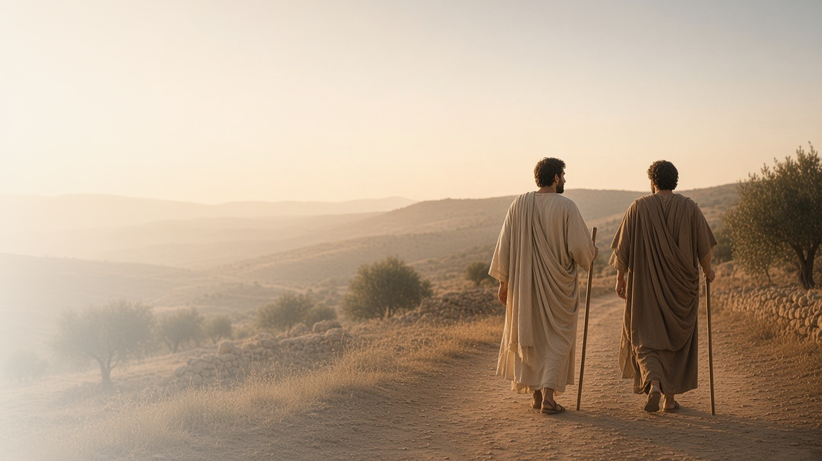
COME, FOLLOW ME · FOR CHILDREN
These Twelve
Jesus Sent Forth
March 1–7
Matthew 9–10; Mark 5; Luke 9
Notes:
TEACHING
This week children learn that Jesus has power to heal, that He called twelve Apostles and gave them power to do His work, that Heavenly Father notices and cares for each of us, and that following Jesus sometimes means giving something up.
SCRIPTURE (KJV)
Matthew 10:29–31
29 Are not two sparrows sold for a farthing? and one of them shall not fall on the ground without your Father.
30 But the very hairs of your head are all numbered.
31 Fear ye not therefore, ye are of more value than many sparrows.
DISCUSSION
• How many Apostles did Jesus call?
• How do you know Heavenly Father cares about you?

Slide 2
MATTHEW 9:18–30; MARK 5:22–43
Jesus has power to heal
Jesus healed a sick woman and raised Jairus’s daughter.
“Damsel, I say unto thee, arise.”
MARK 5:41
Notes:
TEACHING
Read Mark 5:22–43 and ask children to listen for what Jesus said, such as "Be not afraid, only believe" and "Damsel, arise." Help them memorize a phrase. Talk about how Jesus loved the sick woman and the little girl and how He can help us when we are sick or hurting.
SCRIPTURE (KJV)
Mark 5:36, 41–42
36 As soon as Jesus heard the word that was spoken, he saith unto the ruler of the synagogue, Be not afraid, only believe.
41 And he took the damsel by the hand, and said unto her, Talitha cumi; which is, being interpreted, Damsel, I say unto thee, arise.
42 And straightway the damsel arose, and walked; for she was of the age of twelve years. And they were astonished with a great astonishment.
Full passage: Mark 5:35–43
DISCUSSION (questions quoted from the manual)
• “What do we learn about the power of Jesus Christ from these stories?”

Slide 3
MATTHEW 10:1–10
Jesus called twelve Apostles
He gave them power to teach and bless people, like Apostles today.
“And as ye go, preach, saying, The kingdom of heaven is at hand.”
MATTHEW 10:7
Notes:
TEACHING
Share the story of Jesus choosing His Apostles and have children count to twelve. Show pictures of the living Apostles today and help children learn a few names. Explain that Apostles teach about Jesus and help lead His Church, just like the first Twelve.
SCRIPTURE (KJV)
Matthew 10:1, 7–8
1 And when he had called unto him his twelve disciples, he gave them power against unclean spirits, to cast them out, and to heal all manner of sickness and all manner of disease.
7 And as ye go, preach, saying, The kingdom of heaven is at hand.
8 Heal the sick, cleanse the lepers, raise the dead, cast out devils: freely ye have received, freely give.
Full passage: Matthew 10:1–8
DISCUSSION (questions quoted from the manual)
• “Are your children familiar with the twelve Apostles we have today?”

Slide 4
MATTHEW 10:29–31
Heavenly Father cares for me
He notices every sparrow, and He knows and loves me.
“Fear ye not therefore, ye are of more value than many sparrows.”
MATTHEW 10:31
Notes:
TEACHING
Show a picture of a little bird and read Matthew 10:29–31. Explain that Heavenly Father notices even a small sparrow, and we are worth much more to Him. He even knows how many hairs are on our heads. Children could try to count a few hairs and marvel that Heavenly Father knows them all.
SCRIPTURE (KJV)
Matthew 10:29–31
29 Are not two sparrows sold for a farthing? and one of them shall not fall on the ground without your Father.
30 But the very hairs of your head are all numbered.
31 Fear ye not therefore, ye are of more value than many sparrows.
DISCUSSION (questions quoted from the manual)
• (The manual gives no direct questions for this section.)
Suggested: How do you know Heavenly Father cares about you?

Slide 5
LUKE 9:23–25
Following Jesus is worth it
Sometimes I give up something good to follow Jesus.
“Whosoever will lose his life for my sake, the same shall save it.”
LUKE 9:24
Notes:
TEACHING
Share a time when you gave up something to get something better. Read Luke 9:23–25 and talk about small sacrifices children can make to follow Jesus, such as turning off a show to help at home or giving some of their money to help others. Think of scripture heroes who gave things up to follow Him.
SCRIPTURE (KJV)
Luke 9:23–25
23 And he said to them all, If any man will come after me, let him deny himself, and take up his cross daily, and follow me.
24 For whosoever will save his life shall lose it: but whosoever will lose his life for my sake, the same shall save it.
25 For what is a man advantaged, if he gain the whole world, and lose himself, or be cast away?
DISCUSSION (questions quoted from the manual)
• “Why are we willing to make these sacrifices?”

Slide 6
MATTHEW 9:37
“The harvest truly is plenteous,
but the labourers are few.”
This week, help someone the way Jesus’s Apostles did.
Notes:
TEACHING
Jesus needed helpers to share His love, so He sent His Apostles. Children can be His helpers too. Plan one way each child can help someone this week, like a kind note, a helping hand, or inviting a friend to Primary.
SCRIPTURE (KJV)
Matthew 9:37–38
37 Then saith he unto his disciples, The harvest truly is plenteous, but the labourers are few;
38 Pray ye therefore the Lord of the harvest, that he will send forth labourers into his harvest.
DISCUSSION
• Why did Jesus need helpers?
• How can you be one of Jesus's helpers?

