Slide 1
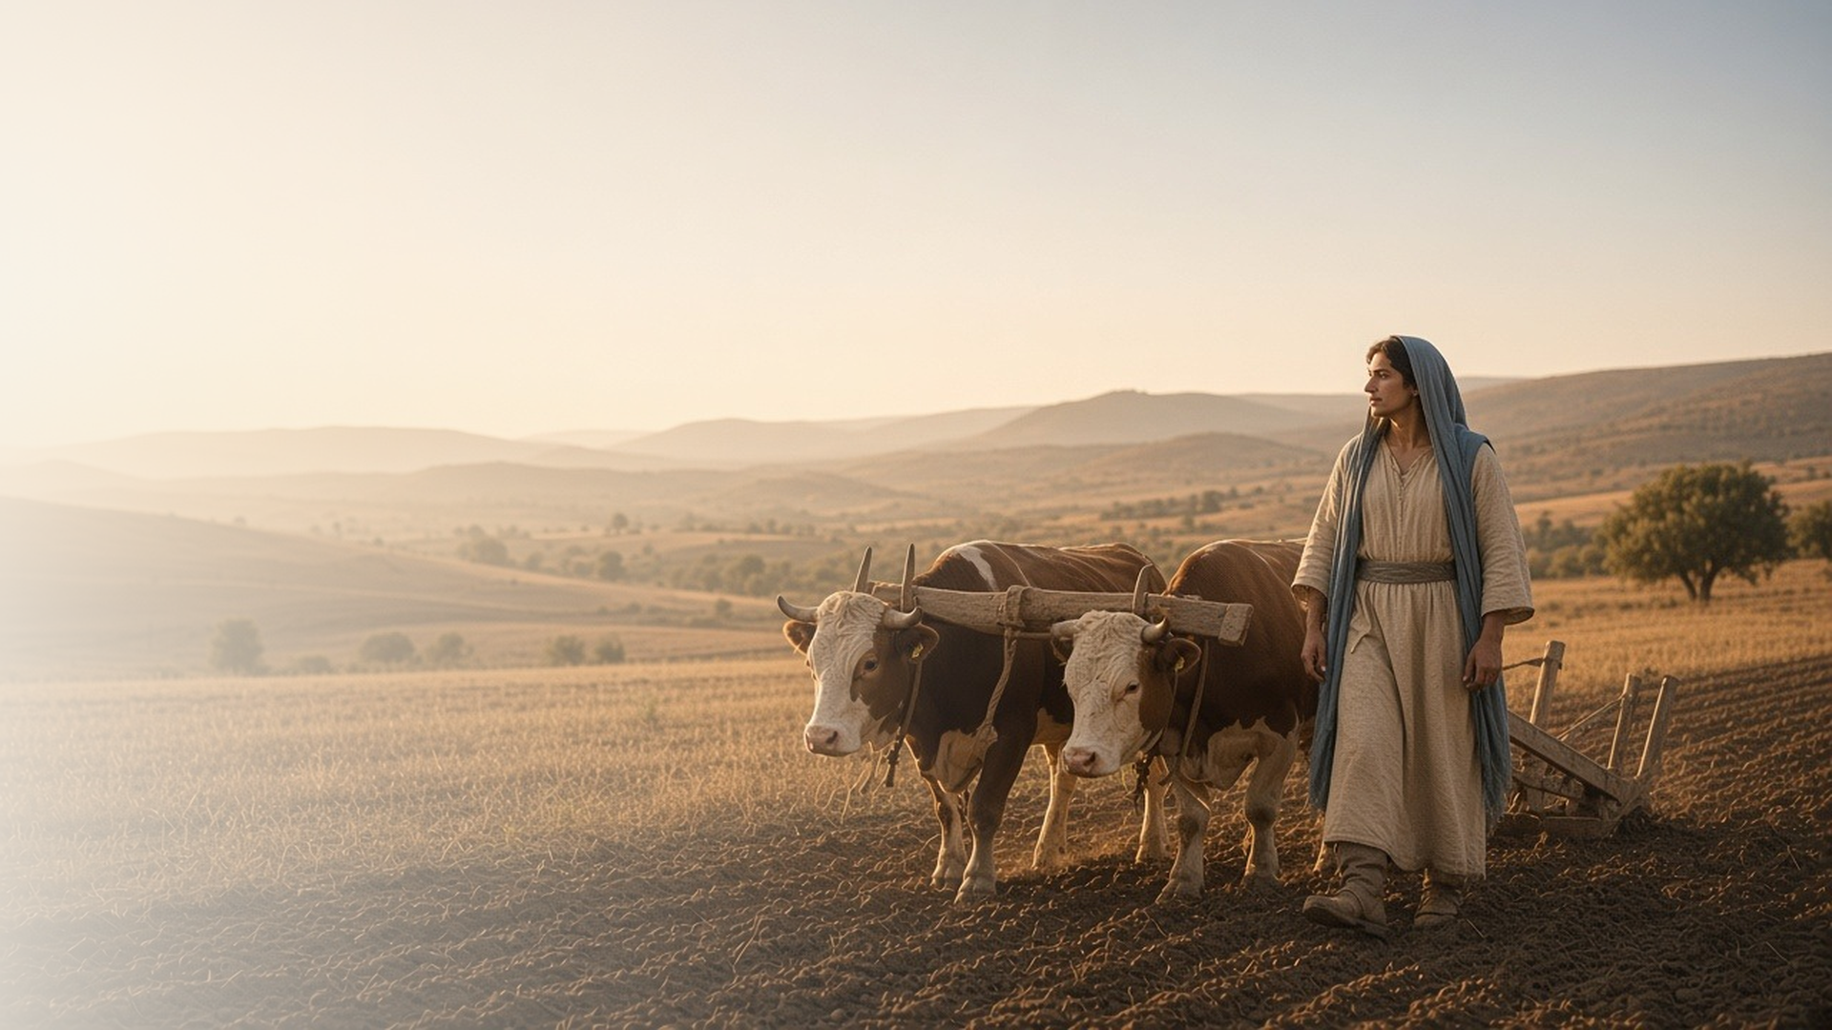
COME, FOLLOW ME · NEW TESTAMENT 2027
I Will Give You Rest
March 8–14
Matthew 11–12; Luke 11
Notes:
TEACHING
In these chapters Jesus offers rest to the weary, teaches the true purpose of the Sabbath, warns that our words reveal our hearts, and teaches His disciples to pray. Running through them is a contrast between outward religious performance and inward devotion, and an invitation to come to Him.
SCRIPTURE (KJV)
Matthew 11:28–30
28 Come unto me, all ye that labour and are heavy laden, and I will give you rest.
29 Take my yoke upon you, and learn of me; for I am meek and lowly in heart: and ye shall find rest unto your souls.
30 For my yoke is easy, and my burden is light.
DISCUSSION
• What burdens are you carrying that you could bring to the Savior?
• How is His yoke different from the burdens we place on ourselves?

Slide 2
MATTHEW 11:28–30
Rest through His yoke
Yoked to Christ, our burdens become bearable and light.
“Come unto me, all ye that labour and are heavy laden, and I will give you rest.”
MATTHEW 11:28
Notes:
TEACHING
A yoke joins two animals so they can pull a load together. Jesus does not promise a life without burdens; He invites us to be yoked with Him so He shares the weight. Read the invitation as though He were speaking to you: come, take, learn, find. His rest is not idleness but the peace of walking with Him, whose yoke is easy and burden light.
SCRIPTURE (KJV)
Matthew 11:28–30
28 Come unto me, all ye that labour and are heavy laden, and I will give you rest.
29 Take my yoke upon you, and learn of me; for I am meek and lowly in heart: and ye shall find rest unto your souls.
30 For my yoke is easy, and my burden is light.
DISCUSSION (questions quoted from the manual)
• “When the Savior says, “Come unto me,” what do you think He’s asking you to do?”
• “What do you think Jesus means by “rest”?”
• “Why do you think Jesus uses the word “yoke” to describe the help He offers?”
• “How would you describe His yoke? (See Emily Belle Freeman, “Walking in Covenant Relationship with Christ,””
• “What have you learned of the Savior (see verse 29) as you’ve been yoked with Him through your covenants?”

Slide 3
MATTHEW 12:1–13
The Sabbath is for doing good
Jesus taught that mercy and healing honor the Sabbath.
“Wherefore it is lawful to do well on the sabbath days.”
MATTHEW 12:12
Notes:
TEACHING
The Pharisees had surrounded the Sabbath with rules that made plucking grain or healing a withered hand look like sins. Jesus, the Lord of the Sabbath, quoted Hosea: "I will have mercy, and not sacrifice." The day is meant to draw us to God and to bless people. Invite class members to consider whether their Sabbath attitudes look more like the Pharisees' or the Savior's.
SCRIPTURE (KJV)
Matthew 12:1–13
1 At that time Jesus went on the sabbath day through the corn; and his disciples were an hungred, and began to pluck the ears of corn, and to eat.
2 But when the Pharisees saw it, they said unto him, Behold, thy disciples do that which is not lawful to do upon the sabbath day.
3 But he said unto them, Have ye not read what David did, when he was an hungred, and they that were with him;
4 How he entered into the house of God, and did eat the shewbread, which was not lawful for him to eat, neither for them which were with him, but only for the priests?
5 Or have ye not read in the law, how that on the sabbath days the priests in the temple profane the sabbath, and are blameless?
6 But I say unto you, That in this place is one greater than the temple.
7 But if ye had known what this meaneth, I will have mercy, and not sacrifice, ye would not have condemned the guiltless.
8 For the Son of man is Lord even of the sabbath day.
9 And when he was departed thence, he went into their synagogue:
10 And, behold, there was a man which had his hand withered. And they asked him, saying, Is it lawful to heal on the sabbath days? that they might accuse him.
11 And he said unto them, What man shall there be among you, that shall have one sheep, and if it fall into a pit on the sabbath day, will he not lay hold on it, and lift it out?
12 How much then is a man better than a sheep? Wherefore it is lawful to do well on the sabbath days.
13 Then saith he to the man, Stretch forth thine hand. And he stretched it forth; and it was restored whole, like as the other.
DISCUSSION (questions quoted from the manual)
• “How might these teachings influence the way you approach the Sabbath?”
• “How has honoring the Sabbath affected your relationship with the Savior?”

Slide 4
MATTHEW 12:34–37; LUKE 11:33–44
Words reveal the heart
What fills our hearts eventually shows in our words and deeds.
“Out of the abundance of the heart the mouth speaketh.”
MATTHEW 12:34
Notes:
TEACHING
Jesus compared people to trees: good trees bring good fruit, and what is stored in the heart eventually comes out in speech. He warned the Pharisees that cleaning the outside of a cup while leaving the inside filthy is hypocrisy. Discipleship is not image management; it is a change of heart that naturally shows in kind, honest words and good works.
SCRIPTURE (KJV)
Matthew 12:33–37
33 Either make the tree good, and his fruit good; or else make the tree corrupt, and his fruit corrupt: for the tree is known by his fruit.
34 O generation of vipers, how can ye, being evil, speak good things? for out of the abundance of the heart the mouth speaketh.
35 A good man out of the good treasure of the heart bringeth forth good things: and an evil man out of the evil treasure bringeth forth evil things.
36 But I say unto you, That every idle word that men shall speak, they shall give account thereof in the day of judgment.
37 For by thy words thou shalt be justified, and by thy words thou shalt be condemned.
Luke 11:39–42
39 And the Lord said unto him, Now do ye Pharisees make clean the outside of the cup and the platter; but your inward part is full of ravening and wickedness.
40 Ye fools, did not he that made that which is without make that which is within also?
41 But rather give alms of such things as ye have; and, behold, all things are clean unto you.
42 But woe unto you, Pharisees! for ye tithe mint and rue and all manner of herbs, and pass over judgment and the love of God: these ought ye to have done, and not to leave the other undone.
DISCUSSION (questions quoted from the manual)
• “What does the phrase “good treasure of the heart” mean to you? (Matthew 12:35).”
• “How do our words justify or condemn us? (see Matthew 12:37).”
• “What might it mean for your eye to be “single”? (Luke 11:34).”

Slide 5
LUKE 11:1–13
My prayers matter to God
Jesus taught persistence in prayer and promised the Spirit.
“Lord, teach us to pray, as John also taught his disciples.”
LUKE 11:1
Notes:
TEACHING
After watching Jesus pray, a disciple asked Him to teach them. He gave a model prayer, told of a friend who kept knocking at midnight until his request was granted, and promised that the Father will give the Holy Spirit to those who ask. Invite class members to list truths about prayer in these verses and choose one to apply.
SCRIPTURE (KJV)
Luke 11:1–13
1 And it came to pass, that, as he was praying in a certain place, when he ceased, one of his disciples said unto him, Lord, teach us to pray, as John also taught his disciples.
2 And he said unto them, When ye pray, say, Our Father which art in heaven, Hallowed be thy name. Thy kingdom come. Thy will be done, as in heaven, so in earth.
3 Give us day by day our daily bread.
4 And forgive us our sins; for we also forgive every one that is indebted to us. And lead us not into temptation; but deliver us from evil.
5 And he said unto them, Which of you shall have a friend, and shall go unto him at midnight, and say unto him, Friend, lend me three loaves;
6 For a friend of mine in his journey is come to me, and I have nothing to set before him?
7 And he from within shall answer and say, Trouble me not: the door is now shut, and my children are with me in bed; I cannot rise and give thee.
8 I say unto you, Though he will not rise and give him, because he is his friend, yet because of his importunity he will rise and give him as many as he needeth.
9 And I say unto you, Ask, and it shall be given you; seek, and ye shall find; knock, and it shall be opened unto you.
10 For every one that asketh receiveth; and he that seeketh findeth; and to him that knocketh it shall be opened.
11 If a son shall ask bread of any of you that is a father, will he give him a stone? or if he ask a fish, will he for a fish give him a serpent?
12 Or if he shall ask an egg, will he offer him a scorpion?
13 If ye then, being evil, know how to give good gifts unto your children: how much more shall your heavenly Father give the Holy Spirit to them that ask him?
DISCUSSION (questions quoted from the manual)
• “How might these truths affect the way you pray?”

Slide 6
MATTHEW 11:29
“Take my yoke upon you, and learn of me.”
This week, take one burden to the Savior and let Him share it.
Notes:
TEACHING
The Savior's invitation is personal and present tense. Close by inviting each person to name one specific burden, bring it to Him in prayer this week, and look for how being yoked with Him changes the way they carry it.
SCRIPTURE (KJV)
Matthew 11:28–30
28 Come unto me, all ye that labour and are heavy laden, and I will give you rest.
29 Take my yoke upon you, and learn of me; for I am meek and lowly in heart: and ye shall find rest unto your souls.
30 For my yoke is easy, and my burden is light.
DISCUSSION
• What burden will you bring to the Savior this week?
• What do you learn about Him when you are yoked with Him?

