Slide 1
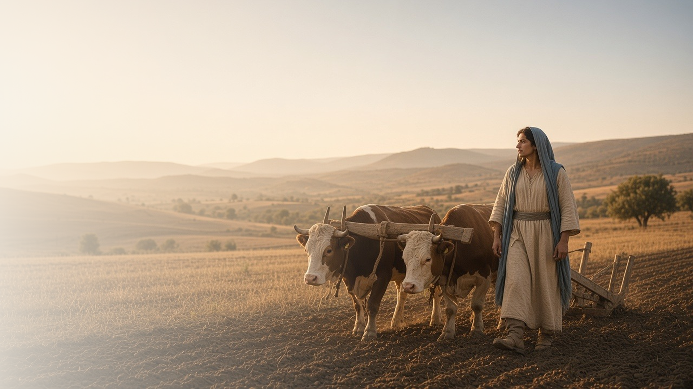
COME, FOLLOW ME · FOR CHILDREN
I Will Give You Rest
March 8–14
Matthew 11–12; Luke 11
Notes:
TEACHING
This week children learn that Jesus helps us when we come to Him, that the Sabbath is a day to do good things, that Heavenly Father gives the Holy Ghost to those who ask, and that both our actions and our hearts should be good.
SCRIPTURE (KJV)
Matthew 11:28
28 Come unto me, all ye that labour and are heavy laden, and I will give you rest.
DISCUSSION
• What does Jesus promise to those who come to Him?
• What good things can we do on the Sabbath?

Slide 2
MATTHEW 11:28–30
Jesus helps me
When things feel heavy, Jesus helps me carry them.
“Come unto me, all ye that labour and are heavy laden, and I will give you rest.”
MATTHEW 11:28
Notes:
TEACHING
Show a picture of oxen under a yoke and explain how a yoke helps two animals share a heavy load. Let one child try to carry something heavy alone, then with a helper. Explain that Jesus invites us to come to Him so He can help us with hard things.
SCRIPTURE (KJV)
Matthew 11:28–30
28 Come unto me, all ye that labour and are heavy laden, and I will give you rest.
29 Take my yoke upon you, and learn of me; for I am meek and lowly in heart: and ye shall find rest unto your souls.
30 For my yoke is easy, and my burden is light.
DISCUSSION (questions quoted from the manual)
• “What are some of the burdens we carry?”
• “How does Jesus help us?”
• “What does this story teach us about the rest Jesus offers?”

Slide 3
MATTHEW 12:1–13
Doing good on the Sabbath
On the Sabbath I can do things that bring me closer to God.
“Wherefore it is lawful to do well on the sabbath days.”
MATTHEW 12:12
Notes:
TEACHING
Tell how Jesus healed a man's hand on the Sabbath. Make a list together of good things to do on Sunday: going to church, visiting someone, writing a note, reading scripture stories. Show a calendar and talk about how the Sabbath can feel different from other days.
SCRIPTURE (KJV)
Matthew 12:9–13
9 And when he was departed thence, he went into their synagogue:
10 And, behold, there was a man which had his hand withered. And they asked him, saying, Is it lawful to heal on the sabbath days? that they might accuse him.
11 And he said unto them, What man shall there be among you, that shall have one sheep, and if it fall into a pit on the sabbath day, will he not lay hold on it, and lift it out?
12 How much then is a man better than a sheep? Wherefore it is lawful to do well on the sabbath days.
13 Then saith he to the man, Stretch forth thine hand. And he stretched it forth; and it was restored whole, like as the other.
DISCUSSION (questions quoted from the manual)
• “What do we do on other days of the week?”
• “What can we do to make the Sabbath different from other days? (see Isaiah 58:13–14).”
• “How can we explain to other people why the Sabbath day is special to us?”

Slide 4
LUKE 11:11–13
Ask for the Holy Ghost
Heavenly Father gives good gifts, like the Holy Ghost.
“How much more shall your heavenly Father give the Holy Spirit to them that ask him?”
LUKE 11:13
Notes:
TEACHING
Put a stone in a bread bag and ask whether a loving parent would give a child a stone instead of bread. Read Luke 11:11–13 and explain that Heavenly Father always wants to give us good gifts, and one of the best is the Holy Ghost. We can ask for His Spirit when we pray.
SCRIPTURE (KJV)
Luke 11:11–13
11 If a son shall ask bread of any of you that is a father, will he give him a stone? or if he ask a fish, will he for a fish give him a serpent?
12 Or if he shall ask an egg, will he offer him a scorpion?
13 If ye then, being evil, know how to give good gifts unto your children: how much more shall your heavenly Father give the Holy Spirit to them that ask him?
DISCUSSION (questions quoted from the manual)
• “What did He want us to understand?”

Slide 5
LUKE 11:37–42
Clean inside and out
Jesus wants my actions and my heart to be good.
“Did not he that made that which is without make that which is within also?”
LUKE 11:40
Notes:
TEACHING
While washing dishes together, talk about why it would be silly to wash only the outside of a cup. Read Luke 11:37–42 and explain that Jesus wants both what we do and what we feel inside to be good, like being kind because we really love others.
SCRIPTURE (KJV)
Luke 11:39–41
39 And the Lord said unto him, Now do ye Pharisees make clean the outside of the cup and the platter; but your inward part is full of ravening and wickedness.
40 Ye fools, did not he that made that which is without make that which is within also?
41 But rather give alms of such things as ye have; and, behold, all things are clean unto you.
Full passage: Luke 11:37–42
DISCUSSION (questions quoted from the manual)
• (The manual gives no direct questions for this section.)
Suggested: How can you make your heart as good as your actions?

Slide 6
MATTHEW 11:29
“Take my yoke upon you, and learn of me.”
This week, ask Heavenly Father to help you with something hard.
Notes:
TEACHING
Jesus wants to help us with hard things. Invite children to think of one hard thing in their lives and to pray to Heavenly Father for help with it each day this week.
SCRIPTURE (KJV)
Matthew 11:28–29
28 Come unto me, all ye that labour and are heavy laden, and I will give you rest.
29 Take my yoke upon you, and learn of me; for I am meek and lowly in heart: and ye shall find rest unto your souls.
DISCUSSION
• What hard thing can you ask for help with?
• How does Jesus help us?

