Slide 1
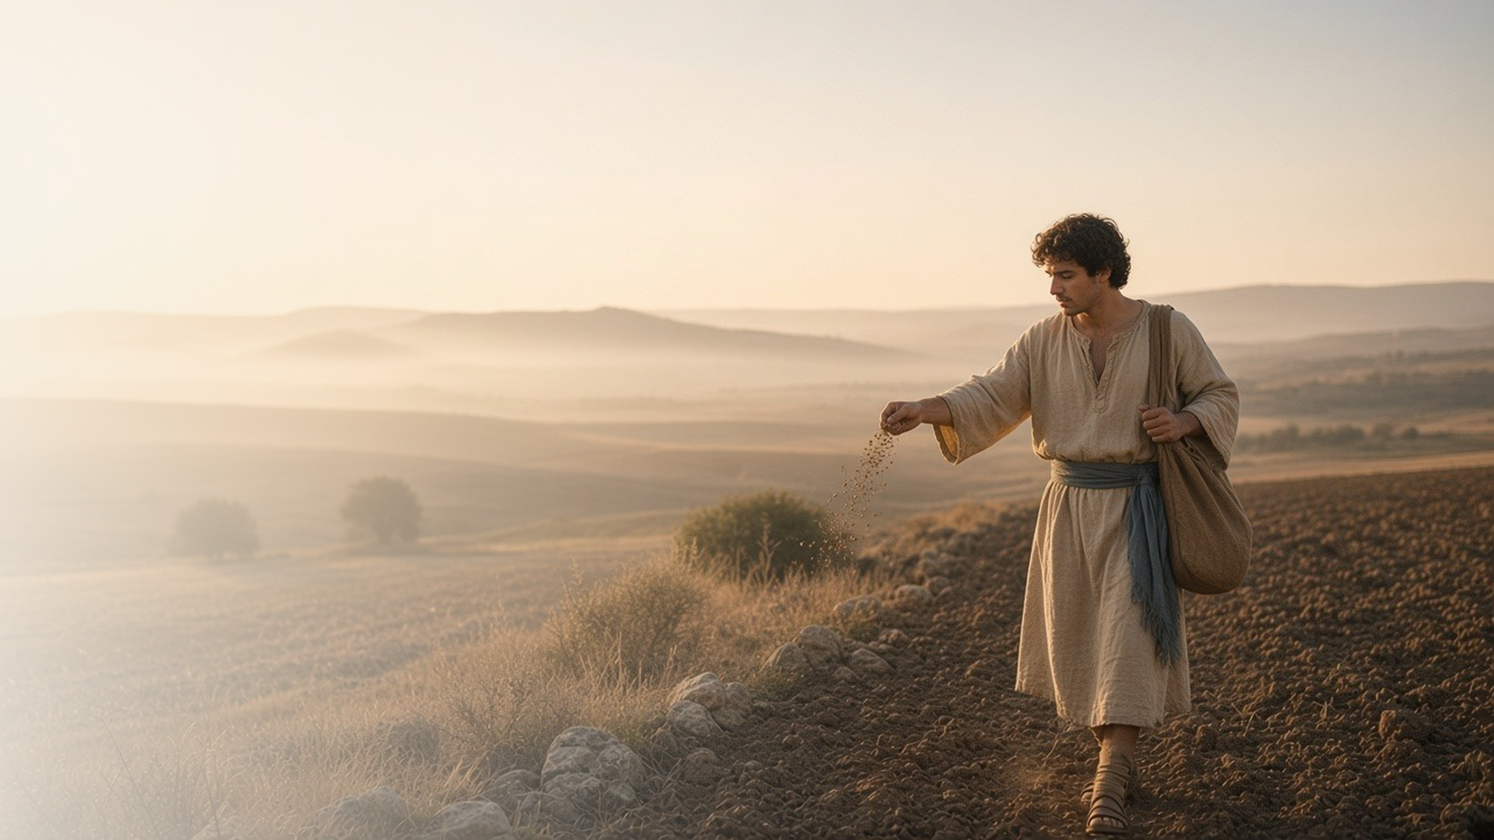
COME, FOLLOW ME · NEW TESTAMENT 2027
What Is the Kingdom
of God Like?
March 15–21
Matthew 13; Luke 8; 13
Notes:
TEACHING
Jesus often taught in parables, everyday stories of seeds, soil, weeds, bread, treasure, pearls, and nets that reveal truths about God and His kingdom to those prepared to hear. This week we study what the parables teach and how to prepare our hearts to receive them.
SCRIPTURE (KJV)
Matthew 13:10–11
10 And the disciples came, and said unto him, Why speakest thou unto them in parables?
11 He answered and said unto them, Because it is given unto you to know the mysteries of the kingdom of heaven, but to them it is not given.
DISCUSSION
• Why do you think Jesus taught in parables?
• Which parable in Matthew 13 speaks to you most this week?

Slide 2
MATTHEW 13:3–23; LUKE 8:4–15; 13:6–9
Preparing good ground
Our hearts determine how deeply the word takes root.
“But he that received seed into the good ground is he that heareth the word, and understandeth it.”
MATTHEW 13:23
Notes:
TEACHING
The sower and the seed are the same in every case; the difference is the soil. Hard paths, shallow rocky ground, and thorny ground represent hearts that are closed, quick to give up, or crowded by cares and riches. Our hearts can change from one kind of soil to another. Invite class members to consider what kind of ground they are offering the word this season.
SCRIPTURE (KJV)
Matthew 13:3–9
3 And he spake many things unto them in parables, saying, Behold, a sower went forth to sow;
4 And when he sowed, some seeds fell by the way side, and the fowls came and devoured them up:
5 Some fell upon stony places, where they had not much earth: and forthwith they sprung up, because they had no deepness of earth:
6 And when the sun was up, they were scorched; and because they had no root, they withered away.
7 And some fell among thorns; and the thorns sprung up, and choked them:
8 But other fell into good ground, and brought forth fruit, some an hundredfold, some sixtyfold, some thirtyfold.
9 Who hath ears to hear, let him hear.
Matthew 13:18–23
18 Hear ye therefore the parable of the sower.
19 When any one heareth the word of the kingdom, and understandeth it not, then cometh the wicked one, and catcheth away that which was sown in his heart. This is he which received seed by the way side.
20 But he that received the seed into stony places, the same is he that heareth the word, and anon with joy receiveth it;
21 Yet hath he not root in himself, but dureth for a while: for when tribulation or persecution ariseth because of the word, by and by he is offended.
22 He also that received seed among the thorns is he that heareth the word; and the care of this world, and the deceitfulness of riches, choke the word, and he becometh unfruitful.
23 But he that received seed into the good ground is he that heareth the word, and understandeth it; which also beareth fruit, and bringeth forth, some an hundredfold, some sixty, some thirty.
DISCUSSION (questions quoted from the manual)
• “Why is it that sometimes our hearts are receptive to truth, while at other times we’re tempted to resist it?”
• “What can you do to make your heart like the “good ground” to receive God’s word? (see Matthew 13:8, 23; Luke 8:8, 15).”
• “What do you feel the roots represent in Matthew 13:6, 21? (see also Luke 8:6, 13).”
• “What might be some “thorns” that keep you from hearing and following His word? (see Matthew 13:7, 22; Luke 8:7, 14).”
• “What is the “fruit” that the Lord seeks from you?”
• “Is there anything “cumbering” your ground that could be replaced with something more likely to “bear fruit”?”

Slide 3
MATTHEW 13:24–30, 36–43
Wheat and tares
Good and evil grow together until the Lord’s harvest.
“Let both grow together until the harvest.”
MATTHEW 13:30
Notes:
TEACHING
An enemy sowed tares among the wheat, and the servants wanted to pull them up immediately. The master told them to wait so the wheat would not be harmed. Jesus explained that the field is the world and the harvest is the end of the world. The parable teaches patience in a mixed world and assures us that the Lord will gather and separate in His time.
SCRIPTURE (KJV)
Matthew 13:24–30
24 Another parable put he forth unto them, saying, The kingdom of heaven is likened unto a man which sowed good seed in his field:
25 But while men slept, his enemy came and sowed tares among the wheat, and went his way.
26 But when the blade was sprung up, and brought forth fruit, then appeared the tares also.
27 So the servants of the householder came and said unto him, Sir, didst not thou sow good seed in thy field? from whence then hath it tares?
28 He said unto them, An enemy hath done this. The servants said unto him, Wilt thou then that we go and gather them up?
29 But he said, Nay; lest while ye gather up the tares, ye root up also the wheat with them.
30 Let both grow together until the harvest: and in the time of harvest I will say to the reapers, Gather ye together first the tares, and bind them in bundles to burn them: but gather the wheat into my barn.
Matthew 13:37–43
37 He answered and said unto them, He that soweth the good seed is the Son of man;
38 The field is the world; the good seed are the children of the kingdom; but the tares are the children of the wicked one;
39 The enemy that sowed them is the devil; the harvest is the end of the world; and the reapers are the angels.
40 As therefore the tares are gathered and burned in the fire; so shall it be in the end of this world.
41 The Son of man shall send forth his angels, and they shall gather out of his kingdom all things that offend, and them which do iniquity;
42 And shall cast them into a furnace of fire: there shall be wailing and gnashing of teeth.
43 Then shall the righteous shine forth as the sun in the kingdom of their Father. Who hath ears to hear, let him hear.
DISCUSSION (questions quoted from the manual)
• “What do you feel the Lord is teaching you with this parable?”

Slide 4
MATTHEW 13:31–33, 44–52; LUKE 13:18–21
What the kingdom is like
Mustard seed, leaven, treasure, pearl: small beginnings, great worth.
“The kingdom of heaven is like to a grain of mustard seed, which a man took, and sowed in his field.”
MATTHEW 13:31
Notes:
TEACHING
Each short parable shows a different side of God's kingdom. A tiny mustard seed becomes a tree; a little leaven raises the whole loaf; a man sells everything for a hidden treasure; a merchant gives all for one pearl. The kingdom starts small, grows quietly, and is worth any sacrifice. Ask what each image suggests about God and about the Church today.
SCRIPTURE (KJV)
Matthew 13:31–33
31 Another parable put he forth unto them, saying, The kingdom of heaven is like to a grain of mustard seed, which a man took, and sowed in his field:
32 Which indeed is the least of all seeds: but when it is grown, it is the greatest among herbs, and becometh a tree, so that the birds of the air come and lodge in the branches thereof.
33 Another parable spake he unto them; The kingdom of heaven is like unto leaven, which a woman took, and hid in three measures of meal, till the whole was leavened.
Matthew 13:44–46
44 Again, the kingdom of heaven is like unto treasure hid in a field; the which when a man hath found, he hideth, and for joy thereof goeth and selleth all that he hath, and buyeth that field.
45 Again, the kingdom of heaven is like unto a merchant man, seeking goodly pearls:
46 Who, when he had found one pearl of great price, went and sold all that he had, and bought it.
DISCUSSION (questions quoted from the manual)
• (The manual gives no direct questions for this section.)
Suggested: Which of these images best describes how the gospel has grown in your life?

Slide 5
LUKE 13:11–17
He can lift me up
Jesus loosed a woman bound eighteen years, on the Sabbath.
“Woman, thou art loosed from thine infirmity.”
LUKE 13:12
Notes:
TEACHING
For eighteen years this woman was bent over and "could in no wise lift up herself." Jesus called her, laid His hands on her, and she stood straight and glorified God. When the synagogue ruler complained that it was the Sabbath, Jesus called her a daughter of Abraham who deserved to be loosed. Invite class members to look for themselves in her story.
SCRIPTURE (KJV)
Luke 13:11–17
11 And, behold, there was a woman which had a spirit of infirmity eighteen years, and was bowed together, and could in no wise lift up herself.
12 And when Jesus saw her, he called her to him, and said unto her, Woman, thou art loosed from thine infirmity.
13 And he laid his hands on her: and immediately she was made straight, and glorified God.
14 And the ruler of the synagogue answered with indignation, because that Jesus had healed on the sabbath day, and said unto the people, There are six days in which men ought to work: in them therefore come and be healed, and not on the sabbath day.
15 The Lord then answered him, and said, Thou hypocrite, doth not each one of you on the sabbath loose his ox or his ass from the stall, and lead him away to watering?
16 And ought not this woman, being a daughter of Abraham, whom Satan hath bound, lo, these eighteen years, be loosed from this bond on the sabbath day?
17 And when he had said these things, all his adversaries were ashamed: and all the people rejoiced for all the glorious things that were done by him.
DISCUSSION (questions quoted from the manual)
• “How are you like the woman?”
• “How has the Savior helped you when something limited you?”
• “How are you like those who witnessed her healing?”
• “What “glorious things … done by [Jesus]” cause you to rejoice? (Luke 13:17).”

Slide 6
LUKE 13:23–30
Enter at the strait gate
Asked if few are saved, Jesus called on us to strive.
“Strive to enter in at the strait gate: for many, I say unto you, will seek to enter in, and shall not be able.”
LUKE 13:24
Notes:
TEACHING
When asked whether few would be saved, Jesus did not give a number. He turned the question back to the listener: strive to enter. Simply having been near Him, eating and drinking in His presence, is not enough. Yet people will come from east and west, north and south, and many who seem last will be first.
SCRIPTURE (KJV)
Luke 13:23–30
23 Then said one unto him, Lord, are there few that be saved? And he said unto them,
24 Strive to enter in at the strait gate: for many, I say unto you, will seek to enter in, and shall not be able.
25 When once the master of the house is risen up, and hath shut to the door, and ye begin to stand without, and to knock at the door, saying, Lord, Lord, open unto us; and he shall answer and say unto you, I know you not whence ye are:
26 Then shall ye begin to say, We have eaten and drunk in thy presence, and thou hast taught in our streets.
27 But he shall say, I tell you, I know you not whence ye are; depart from me, all ye workers of iniquity.
28 There shall be weeping and gnashing of teeth, when ye shall see Abraham, and Isaac, and Jacob, and all the prophets, in the kingdom of God, and you yourselves thrust out.
29 And they shall come from the east, and from the west, and from the north, and from the south, and shall sit down in the kingdom of God.
30 And, behold, there are last which shall be first, and there are first which shall be last.
DISCUSSION (questions quoted from the manual)
• “When someone asked, “Lord, are there few that be saved?””
• “After pondering Luke 13:23–30, how would you summarize His answer about who will be saved?”

Slide 7
MATTHEW 13:16
“But blessed are your eyes, for they see:
and your ears, for they hear.”
This week, prepare your heart before you read the word.
Notes:
TEACHING
Jesus told His disciples they were blessed to see and hear what prophets and righteous people had long desired. We are blessed with the same word. Close by inviting each person to pause before scripture study this week, pray for a prepared heart, and look for one truth the Lord wants them to receive.
SCRIPTURE (KJV)
Matthew 13:16–17
16 But blessed are your eyes, for they see: and your ears, for they hear.
17 For verily I say unto you, That many prophets and righteous men have desired to see those things which ye see, and have not seen them; and to hear those things which ye hear, and have not heard them.
DISCUSSION
• What helps you prepare your heart to receive the word?
• What truth do you hope the Lord will teach you this week?

