Slide 1
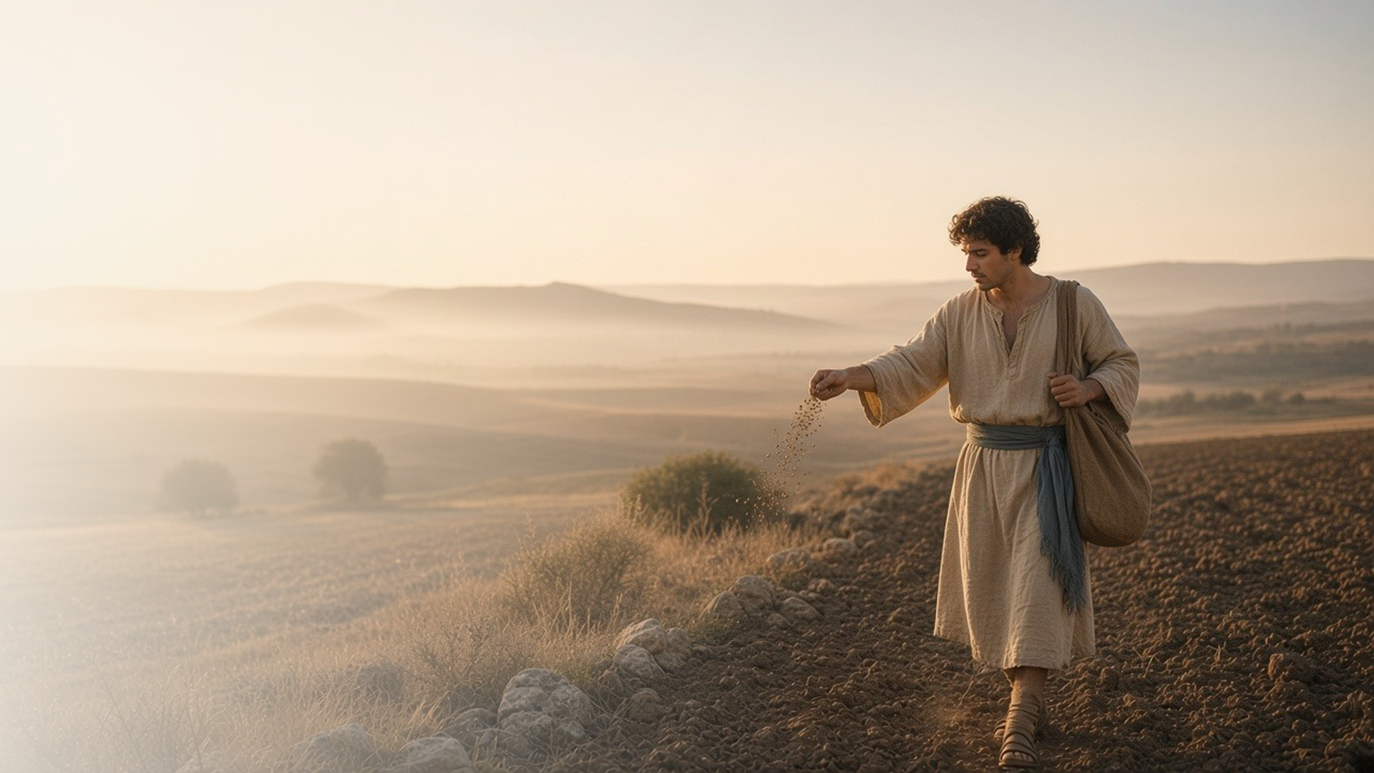
COME, FOLLOW ME · FOR CHILDREN
What Is the Kingdom
of God Like?
March 15–21
Matthew 13; Luke 8; 13
Notes:
TEACHING
This week children learn that Jesus's parables teach about God, that we need to prepare our hearts to receive His teachings, that the gospel is a treasure, and that Jesus can lift us up.
SCRIPTURE (KJV)
Matthew 13:3–4, 8
3 And he spake many things unto them in parables, saying, Behold, a sower went forth to sow;
4 And when he sowed, some seeds fell by the way side, and the fowls came and devoured them up:
8 But other fell into good ground, and brought forth fruit, some an hundredfold, some sixtyfold, some thirtyfold.
Full passage: Matthew 13:3–8
DISCUSSION
• What happened to the seeds in the story?
• How can our hearts be like good soil?

Slide 2
MATTHEW 13
Parables teach about God
Jesus used seeds, bread, and pearls to teach about God.
“Behold, a sower went forth to sow.”
MATTHEW 13:3
Notes:
TEACHING
Gather items from Jesus's parables, or pictures of them: a seed, bread, a pearl, a net. As you show each one, tell the parable and ask what it might teach about Heavenly Father or His kingdom. Explain that a parable is a story with a hidden lesson.
SCRIPTURE (KJV)
Matthew 13:31, 33
31 Another parable put he forth unto them, saying, The kingdom of heaven is like to a grain of mustard seed, which a man took, and sowed in his field:
33 Another parable spake he unto them; The kingdom of heaven is like unto leaven, which a woman took, and hid in three measures of meal, till the whole was leavened.
Full passage: Matthew 13:31–33
Matthew 13:45–46
45 Again, the kingdom of heaven is like unto a merchant man, seeking goodly pearls:
46 Who, when he had found one pearl of great price, went and sold all that he had, and bought it.
Full passage: Matthew 13:44–46
DISCUSSION (questions quoted from the manual)
• “What does Jesus want us to learn from these parables?”

Slide 3
MATTHEW 13:1–23; LUKE 8:4–15
A heart ready to learn
I can be good ground for Jesus’s teachings.
“Who hath ears to hear, let him hear.”
MATTHEW 13:9
Notes:
TEACHING
Go for a walk or look at different kinds of soil and notice where plants grow. Read Matthew 13:3–8 and let children point to their ears, eyes, and heart when you read Matthew 13:9 and 15. Talk about how we can use our ears, eyes, and hearts to learn from Jesus.
SCRIPTURE (KJV)
Matthew 13:3, 8–9
3 And he spake many things unto them in parables, saying, Behold, a sower went forth to sow;
8 But other fell into good ground, and brought forth fruit, some an hundredfold, some sixtyfold, some thirtyfold.
9 Who hath ears to hear, let him hear.
Full passage: Matthew 13:3–9
DISCUSSION (questions quoted from the manual)
• “How do we help our testimony “seeds” grow?”
• “How can we use these body parts to learn the teachings of Jesus?”

Slide 4
MATTHEW 13:44–46
The gospel is a treasure
The gospel is worth more than anything I own.
“Who, when he had found one pearl of great price, went and sold all that he had, and bought it.”
MATTHEW 13:46
Notes:
TEACHING
Hide pictures of a treasure chest and a pearl for children to find, then read Matthew 13:44–46. Children could write or draw things they love about the gospel on paper "coins" and put them in a treasure box. Explain that the gospel is the greatest treasure because it helps us return to Heavenly Father.
SCRIPTURE (KJV)
Matthew 13:44–46
44 Again, the kingdom of heaven is like unto treasure hid in a field; the which when a man hath found, he hideth, and for joy thereof goeth and selleth all that he hath, and buyeth that field.
45 Again, the kingdom of heaven is like unto a merchant man, seeking goodly pearls:
46 Who, when he had found one pearl of great price, went and sold all that he had, and bought it.
DISCUSSION (questions quoted from the manual)
• “What could help your children visualize the parables in Matthew 13:44–46?”
• “Why would someone give up everything they have for a beautiful pearl or a treasure in a field?”

Slide 5
LUKE 13:11–17
Jesus can lift me up
Jesus helped a woman stand up straight again.
“And he laid his hands on her: and immediately she was made straight, and glorified God.”
LUKE 13:13
Notes:
TEACHING
Ask children to walk bent over for a moment and imagine doing that for eighteen years. Read Luke 13:11–17 and have them stand up straight when Jesus heals the woman. Talk about times we feel sad or weighed down and how Jesus can lift us up.
SCRIPTURE (KJV)
Luke 13:11–13
11 And, behold, there was a woman which had a spirit of infirmity eighteen years, and was bowed together, and could in no wise lift up herself.
12 And when Jesus saw her, he called her to him, and said unto her, Woman, thou art loosed from thine infirmity.
13 And he laid his hands on her: and immediately she was made straight, and glorified God.
DISCUSSION (questions quoted from the manual)
• “How does the Savior “loose” us from our burdens?”

Slide 6
MATTHEW 13:16
“But blessed are your eyes, for they see:
and your ears, for they hear.”
This week, listen carefully when you hear about Jesus.
Notes:
TEACHING
Jesus said that people who really listen and look are blessed. Invite children to listen carefully during scripture stories, Primary, and family prayer this week, and to share one thing they learned about Jesus.
SCRIPTURE (KJV)
Matthew 13:16
16 But blessed are your eyes, for they see: and your ears, for they hear.
DISCUSSION
• How can we use our ears and eyes to learn about Jesus?
• What is one thing you learned about Jesus today?

