Slide 1
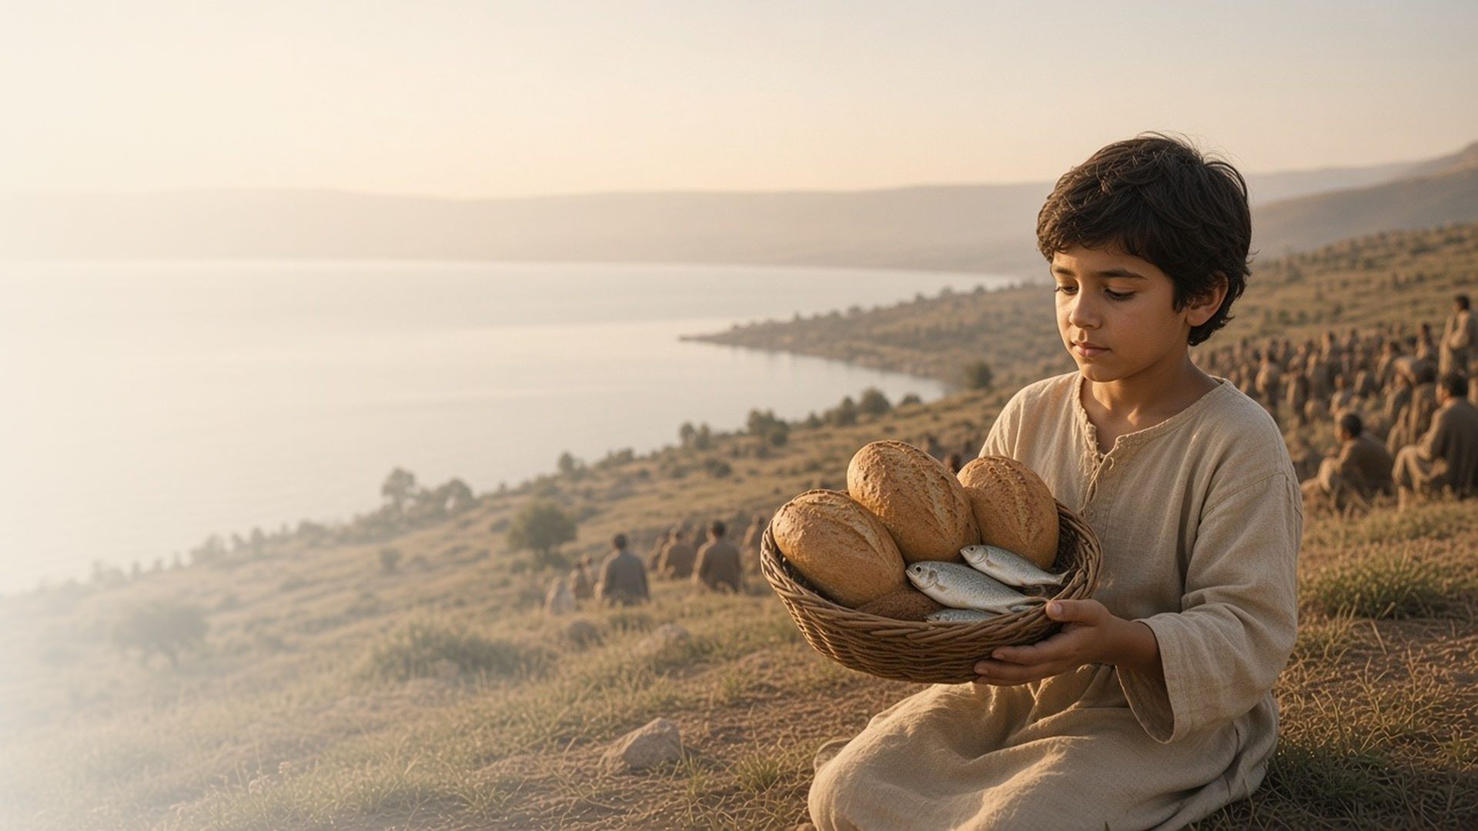
COME, FOLLOW ME · NEW TESTAMENT 2027
Be Not Afraid
March 29–April 4
Matthew 14; Mark 6; John 5–6
Notes:
TEACHING
These chapters bring together some of the Savior's best-known miracles: healing a man who had waited for thirty-eight years at Bethesda, feeding five thousand with a boy's lunch, and walking on the stormy sea. They end with a hard sermon on the bread of life, after which many disciples leave, and Peter declares that there is nowhere else to go.
SCRIPTURE (KJV)
Matthew 14:27
27 But straightway Jesus spake unto them, saying, Be of good cheer; it is I; be not afraid.
DISCUSSION
• Where in your life do you need to hear "be not afraid"?
• What helps you keep your eyes on the Savior?

Slide 2
JOHN 5:1–16
He can make me whole
At Bethesda, Jesus asked, “Wilt thou be made whole?”
“Wilt thou be made whole?”
JOHN 5:6
Notes:
TEACHING
The man at the pool had waited thirty-eight years, always just out of reach of relief, with no one to help him. The Savior's question seems obvious, but it invites the man, and us, to want healing and to look to the right source. Jesus offers wholeness that is physical, emotional, and spiritual. Discuss what kinds of wholeness we seek from Him and how we show we want it.
SCRIPTURE (KJV)
John 5:1–9
1 After this there was a feast of the Jews; and Jesus went up to Jerusalem.
2 Now there is at Jerusalem by the sheep market a pool, which is called in the Hebrew tongue Bethesda, having five porches.
3 In these lay a great multitude of impotent folk, of blind, halt, withered, waiting for the moving of the water.
4 For an angel went down at a certain season into the pool, and troubled the water: whosoever then first after the troubling of the water stepped in was made whole of whatsoever disease he had.
5 And a certain man was there, which had an infirmity thirty and eight years.
6 When Jesus saw him lie, and knew that he had been now a long time in that case, he saith unto him, Wilt thou be made whole?
7 The impotent man answered him, Sir, I have no man, when the water is troubled, to put me into the pool: but while I am coming, another steppeth down before me.
8 Jesus saith unto him, Rise, take up thy bed, and walk.
9 And immediately the man was made whole, and took up his bed, and walked: and on the same day was the sabbath.
DISCUSSION (questions quoted from the manual)
• “Have you ever felt incomplete or broken emotionally, spiritually, or physically, and it seemed like relief was always just out of reach?”
• “The question “Wilt thou be made whole?” seems rather obvious.”
• “Why do you suppose Jesus asked it?”
• “What kinds of “wholeness” does the Savior offer you?”
• “How can you show your willingness to be made whole?”
• “Has that ever happened to you?”
(+1 more in the manual)

Slide 3
MATTHEW 14:15–21; MARK 6:33–44; JOHN 6:5–14
He magnifies small offerings
Five loaves and two fishes fed thousands in His hands.
“There is a lad here, which hath five barley loaves, and two small fishes: but what are they among so many?”
JOHN 6:9
Notes:
TEACHING
Facing a crowd of thousands, the disciples saw only how little they had. A boy offered five barley loaves and two small fishes. Jesus gave thanks, distributed them, and there were twelve baskets left over. When we feel inadequate to the needs around us, in our homes, callings, or communities, the Lord asks us to bring what we have and lets Him magnify it.
SCRIPTURE (KJV)
John 6:5–13
5 When Jesus then lifted up his eyes, and saw a great company come unto him, he saith unto Philip, Whence shall we buy bread, that these may eat?
6 And this he said to prove him: for he himself knew what he would do.
7 Philip answered him, Two hundred pennyworth of bread is not sufficient for them, that every one of them may take a little.
8 One of his disciples, Andrew, Simon Peter’s brother, saith unto him,
9 There is a lad here, which hath five barley loaves, and two small fishes: but what are they among so many?
10 And Jesus said, Make the men sit down. Now there was much grass in the place. So the men sat down, in number about five thousand.
11 And Jesus took the loaves; and when he had given thanks, he distributed to the disciples, and the disciples to them that were set down; and likewise of the fishes as much as they would.
12 When they were filled, he said unto his disciples, Gather up the fragments that remain, that nothing be lost.
13 Therefore they gathered them together, and filled twelve baskets with the fragments of the five barley loaves, which remained over and above unto them that had eaten.
DISCUSSION (questions quoted from the manual)
• “Have you ever felt inadequate to meet all the needs you see around you—in your home, in your relationships, in your calling, or in society?”

Slide 4
MATTHEW 14:22–33; MARK 6:45–52; JOHN 6:15–21
Eyes on the Savior
Peter walked on water while he looked to Jesus.
“Be of good cheer; it is I; be not afraid.”
MATTHEW 14:27
Notes:
TEACHING
In the dark, on a stormy sea, the disciples saw Jesus walking toward them and were terrified. He calmed them, and Peter stepped out of the boat. While he focused on the Savior, he walked; when he looked at the wind, he began to sink and cried out, "Lord, save me." Jesus immediately caught him. Fear and doubt grow when our focus drifts, and faith grows as we look to Him.
SCRIPTURE (KJV)
Matthew 14:22–33
22 And straightway Jesus constrained his disciples to get into a ship, and to go before him unto the other side, while he sent the multitudes away.
23 And when he had sent the multitudes away, he went up into a mountain apart to pray: and when the evening was come, he was there alone.
24 But the ship was now in the midst of the sea, tossed with waves: for the wind was contrary.
25 And in the fourth watch of the night Jesus went unto them, walking on the sea.
26 And when the disciples saw him walking on the sea, they were troubled, saying, It is a spirit; and they cried out for fear.
27 But straightway Jesus spake unto them, saying, Be of good cheer; it is I; be not afraid.
28 And Peter answered him and said, Lord, if it be thou, bid me come unto thee on the water.
29 And he said, Come. And when Peter was come down out of the ship, he walked on the water, to go to Jesus.
30 But when he saw the wind boisterous, he was afraid; and beginning to sink, he cried, saying, Lord, save me.
31 And immediately Jesus stretched forth his hand, and caught him, and said unto him, O thou of little faith, wherefore didst thou doubt?
32 And when they were come into the ship, the wind ceased.
33 Then they that were in the ship came and worshipped him, saying, Of a truth thou art the Son of God.
DISCUSSION (questions quoted from the manual)
• “Have you ever felt like Peter when he cried out, “Lord, save me”? (verse 30).”
• “What do you think would have given Peter the faith and courage to leave the boat?”
• “What does the Savior invite you to do that might be like stepping out of a boat?”
• “What gives you the faith to do it?”
• “Why do you think Peter started sinking?”
• “What do you learn from this?”
(+3 more in the manual)

Slide 5
JOHN 6:22–71
Staying when others leave
When many turned away, Peter asked, “To whom shall we go?”
“Lord, to whom shall we go? thou hast the words of eternal life.”
JOHN 6:68
Notes:
TEACHING
After Jesus taught that He is the bread of life, many disciples found the teaching too hard and walked away. Jesus asked the Twelve if they would leave too. Peter's answer was not that everything made sense, but that only Christ has the words of eternal life. His example helps when people we love stop following the Savior, or when we face hard questions ourselves.
SCRIPTURE (KJV)
John 6:35
35 And Jesus said unto them, I am the bread of life: he that cometh to me shall never hunger; and he that believeth on me shall never thirst.
John 6:66–69
66 From that time many of his disciples went back, and walked no more with him.
67 Then said Jesus unto the twelve, Will ye also go away?
68 Then Simon Peter answered him, Lord, to whom shall we go? thou hast the words of eternal life.
69 And we believe and are sure that thou art that Christ, the Son of the living God.
DISCUSSION (questions quoted from the manual)
• “What do you think Jesus was trying to teach about physical and spiritual nourishment in verses 27–58?”
• “What do you think was “hard” to some disciples about Jesus’s “sayings” in these verses?”
• “Why do you choose not to “also go away”?”
• “What are some of the “words of eternal life” that are found only in Christ’s restored Church?”
• “Russell Ballard, “To Whom Shall We Go?,””

Slide 6
JOHN 6:35
“I am the bread of life:
he that cometh to me shall never hunger.”
This week, bring Him your loaves and fishes.
Notes:
TEACHING
The crowd that had eaten the loaves wanted more bread; Jesus offered Himself. He is the bread of life who satisfies the deepest hunger. Close by inviting each person to bring Him one small offering this week, an hour of service, a sincere prayer, a hard conversation, and trust Him to make it enough.
SCRIPTURE (KJV)
John 6:32–35
32 Then Jesus said unto them, Verily, verily, I say unto you, Moses gave you not that bread from heaven; but my Father giveth you the true bread from heaven.
33 For the bread of God is he which cometh down from heaven, and giveth life unto the world.
34 Then said they unto him, Lord, evermore give us this bread.
35 And Jesus said unto them, I am the bread of life: he that cometh to me shall never hunger; and he that believeth on me shall never thirst.
DISCUSSION
• What small offering could you bring to the Savior this week?
• How has He satisfied a hunger in your life that nothing else could?

