Slide 1
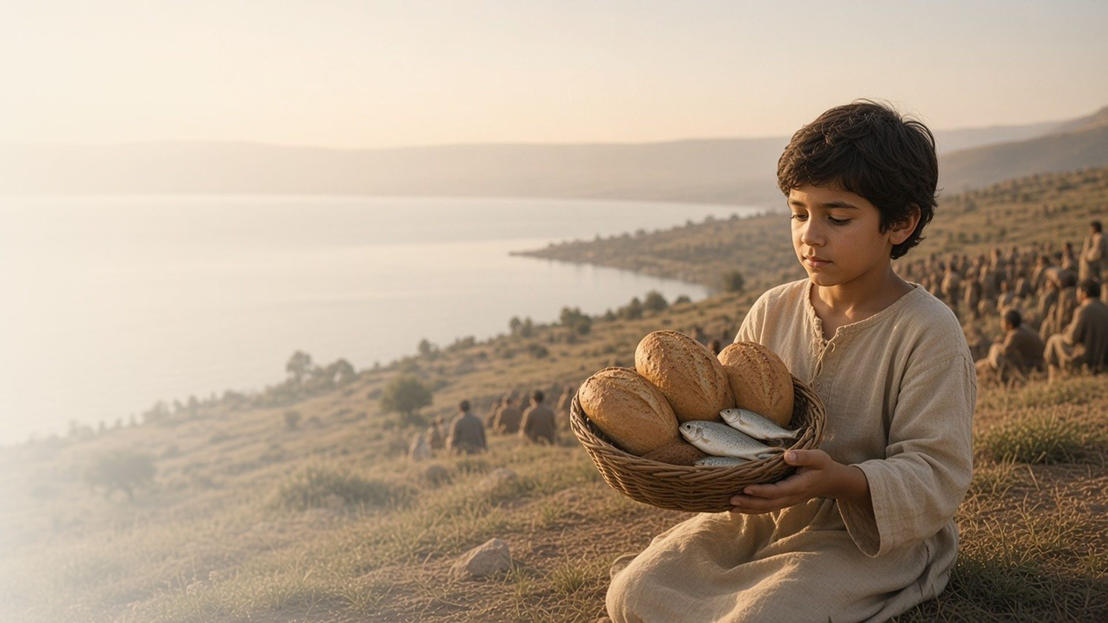
COME, FOLLOW ME · FOR CHILDREN
Be Not Afraid
March 29–April 4
Matthew 14; Mark 6; John 5–6
Notes:
TEACHING
This week children learn that Jesus knows what we need and can help us, that He can do great things with our small efforts to serve, and that faith in Him helps us not be afraid.
SCRIPTURE (KJV)
John 6:9–11
9 There is a lad here, which hath five barley loaves, and two small fishes: but what are they among so many?
10 And Jesus said, Make the men sit down. Now there was much grass in the place. So the men sat down, in number about five thousand.
11 And Jesus took the loaves; and when he had given thanks, he distributed to the disciples, and the disciples to them that were set down; and likewise of the fishes as much as they would.
DISCUSSION
• What did the boy share with Jesus?
• How did Jesus help Peter on the water?

Slide 2
JOHN 5:1–9
Jesus knows what I need
Jesus saw the man at the pool and helped him walk.
“Jesus saith unto him, Rise, take up thy bed, and walk.”
JOHN 5:8
Notes:
TEACHING
Read John 5:1–9 and ask children to listen for how Jesus showed love. The man had been sick for a very long time and had no one to help him, but Jesus noticed him. Sing "He Cares for Me" and testify that Jesus knows our problems and wants to help.
SCRIPTURE (KJV)
John 5:5–6, 8–9
5 And a certain man was there, which had an infirmity thirty and eight years.
6 When Jesus saw him lie, and knew that he had been now a long time in that case, he saith unto him, Wilt thou be made whole?
8 Jesus saith unto him, Rise, take up thy bed, and walk.
9 And immediately the man was made whole, and took up his bed, and walked: and on the same day was the sabbath.
Full passage: John 5:1–9
DISCUSSION (questions quoted from the manual)
• “How does Jesus show us His love during those times?”

Slide 3
MATTHEW 14:15–21; JOHN 6:5–13
Small efforts, big blessings
Jesus fed thousands with one boy’s small lunch.
“There is a lad here, which hath five barley loaves, and two small fishes: but what are they among so many?”
JOHN 6:9
Notes:
TEACHING
Help children picture five thousand people by comparing it to a crowd they know. Then show five small pieces of bread and two crackers shaped like fish. Read John 6:5–13 and explain how Jesus took the boy's small gift and blessed many people. Talk about small ways children can serve, which Jesus can make into big blessings.
SCRIPTURE (KJV)
John 6:9, 11, 13
9 There is a lad here, which hath five barley loaves, and two small fishes: but what are they among so many?
11 And Jesus took the loaves; and when he had given thanks, he distributed to the disciples, and the disciples to them that were set down; and likewise of the fishes as much as they would.
13 Therefore they gathered them together, and filled twelve baskets with the fragments of the five barley loaves, which remained over and above unto them that had eaten.
Full passage: John 6:5–13
DISCUSSION (questions quoted from the manual)
• “How much bread and fish would be needed to feed them?”
• “What did Jesus do with the child’s small offering?”

Slide 4
MATTHEW 14:22–33
Faith helps me not be afraid
Peter walked on water when he looked at Jesus.
“And immediately Jesus stretched forth his hand, and caught him.”
MATTHEW 14:31
Notes:
TEACHING
Let children pretend to be Peter as you read Matthew 14:22–33, or "walk" their fingers across a bowl of water. Ask them to notice when Peter had faith and when he felt afraid. Explain that when we feel scared, we can remember Jesus and ask for help, and He will reach out to us.
SCRIPTURE (KJV)
Matthew 14:27, 29–31
27 But straightway Jesus spake unto them, saying, Be of good cheer; it is I; be not afraid.
29 And he said, Come. And when Peter was come down out of the ship, he walked on the water, to go to Jesus.
30 But when he saw the wind boisterous, he was afraid; and beginning to sink, he cried, saying, Lord, save me.
31 And immediately Jesus stretched forth his hand, and caught him, and said unto him, O thou of little faith, wherefore didst thou doubt?
Full passage: Matthew 14:25–33
DISCUSSION (questions quoted from the manual)
• “What did Jesus do to help when people were afraid?”
• “What do we learn from Peter’s example? (See Elder Alvin F.”

Slide 5
MATTHEW 14:27
“Be of good cheer; it is I; be not afraid.”
This week, remember Jesus when you feel afraid.
Notes:
TEACHING
Jesus told His disciples to be of good cheer and not to be afraid, because He was with them. Help children plan what they can do when they feel afraid this week: say a prayer, sing a Primary song, or remember the story of Peter.
SCRIPTURE (KJV)
Matthew 14:27
27 But straightway Jesus spake unto them, saying, Be of good cheer; it is I; be not afraid.
DISCUSSION
• What did Jesus say to His disciples in the storm?
• What can you do when you feel afraid?

