Slide 1
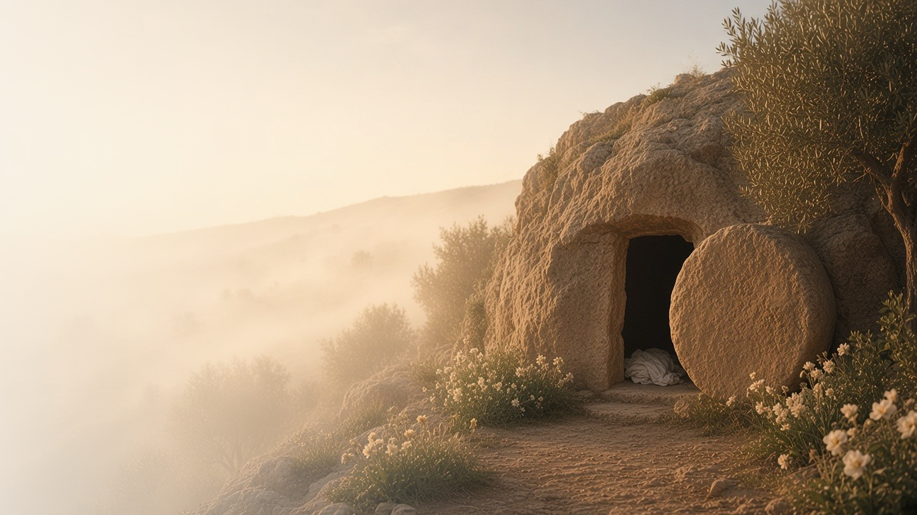
COME, FOLLOW ME · FOR CHILDREN
O Grave, Where Is
Thy Victory?
March 22–28
Easter Week
Notes:
TEACHING
This week we remember the last week of Jesus's life and celebrate Easter. Children will learn that people welcomed Jesus as King, that serving others is serving Him, that He gave us the sacrament, that He suffered and died for us because He loves us, and that He rose again on Easter morning. The manual has no separate children's section for Easter week, so these slides are drawn from the daily sections.
SCRIPTURE (KJV)
Luke 24:5–6
5 And as they were afraid, and bowed down their faces to the earth, they said unto them, Why seek ye the living among the dead?
6 He is not here, but is risen: remember how he spake unto you when he was yet in Galilee,
DISCUSSION
• What happened on the first Easter morning?
• Why do we celebrate Easter?

Slide 2
MATTHEW 21:1–11
People welcomed Jesus as King
They waved palm branches and shouted “Hosanna!”
“Hosanna to the Son of David.”
MATTHEW 21:9
Notes:
TEACHING
Let children wave paper palm branches as you tell how Jesus rode into Jerusalem on a donkey. People were so happy to see Him that they put branches and coats on the road and shouted Hosanna. Talk about ways we can show Jesus we are glad He is our King. (Note: the manual has no children's section for Easter week; this slide is distilled from the daily sections.)
SCRIPTURE (KJV)
Matthew 21:8–9, 11
8 And a very great multitude spread their garments in the way; others cut down branches from the trees, and strawed them in the way.
9 And the multitudes that went before, and that followed, cried, saying, Hosanna to the Son of David: Blessed is he that cometh in the name of the Lord; Hosanna in the highest.
11 And the multitude said, This is Jesus the prophet of Nazareth of Galilee.
Full passage: Matthew 21:6–11
DISCUSSION
• What did the people do when Jesus came to Jerusalem?
• How can we show Jesus that we love Him?

Slide 3
MATTHEW 25:31–46
Helping others is helping Jesus
Jesus said that serving others is like serving Him.
“Inasmuch as ye have done it unto one of the least of these my brethren, ye have done it unto me.”
MATTHEW 25:40
Notes:
TEACHING
Read Matthew 25:35–40 and help children name the kind acts Jesus mentions: feeding the hungry, giving a drink, visiting the sick. Explain that when we help anyone, Jesus counts it as helping Him. Plan one small way to help someone this week. (Note: the manual has no children's section for Easter week; this slide is distilled from the daily sections.)
SCRIPTURE (KJV)
Matthew 25:35–36, 40
35 For I was an hungred, and ye gave me meat: I was thirsty, and ye gave me drink: I was a stranger, and ye took me in:
36 Naked, and ye clothed me: I was sick, and ye visited me: I was in prison, and ye came unto me.
40 And the King shall answer and say unto them, Verily I say unto you, Inasmuch as ye have done it unto one of the least of these my brethren, ye have done it unto me.
Full passage: Matthew 25:35–40
DISCUSSION
• Who can you help this week?
• How does it make Jesus feel when we help others?

Slide 4
MATTHEW 26
Jesus gave us the sacrament
At the Last Supper, Jesus gave bread to help us remember Him.
“Take, eat; this is my body.”
MATTHEW 26:26
Notes:
TEACHING
Tell how Jesus ate a last supper with His Apostles and gave them bread and wine to help them remember Him. Today we take the sacrament each Sunday to remember Jesus. Talk about what children can think about during the sacrament. (Note: the manual has no children's section for Easter week; this slide is distilled from the daily sections.)
SCRIPTURE (KJV)
Matthew 26:26–28
26 And as they were eating, Jesus took bread, and blessed it, and brake it, and gave it to the disciples, and said, Take, eat; this is my body.
27 And he took the cup, and gave thanks, and gave it to them, saying, Drink ye all of it;
28 For this is my blood of the new testament, which is shed for many for the remission of sins.
DISCUSSION
• What did Jesus give His Apostles at the Last Supper?
• What can you think about during the sacrament?

Slide 5
MATTHEW 26
Jesus suffered for me
In Gethsemane, Jesus prayed and suffered because He loves us.
“Nevertheless not as I will, but as thou wilt.”
MATTHEW 26:39
Notes:
TEACHING
Explain simply that in the Garden of Gethsemane, Jesus felt the pain of everyone's sins and sorrows so that He can help us and forgive us. It was very hard, but He chose to do what Heavenly Father wanted. Testify that He did this because He loves each of us. (Note: the manual has no children's section for Easter week; this slide is distilled from the daily sections.)
SCRIPTURE (KJV)
Matthew 26:36–39
36 Then cometh Jesus with them unto a place called Gethsemane, and saith unto the disciples, Sit ye here, while I go and pray yonder.
37 And he took with him Peter and the two sons of Zebedee, and began to be sorrowful and very heavy.
38 Then saith he unto them, My soul is exceeding sorrowful, even unto death: tarry ye here, and watch with me.
39 And he went a little farther, and fell on his face, and prayed, saying, O my Father, if it be possible, let this cup pass from me: nevertheless not as I will, but as thou wilt.
DISCUSSION
• Why did Jesus go to the Garden of Gethsemane?
• How can Jesus help us when we feel sad or make mistakes?

Slide 6
MATTHEW 27
Jesus gave His life for me
Jesus died on the cross because He loves us.
“Truly this was the Son of God.”
MATTHEW 27:54
Notes:
TEACHING
Gently explain that Jesus died on the cross. When He died, the earth shook, and a soldier who saw it said that Jesus truly was the Son of God. Help children feel that Jesus loves them so much that He gave His life for them, and that the story does not end here. (Note: the manual has no children's section for Easter week; this slide is distilled from the daily sections.)
SCRIPTURE (KJV)
Matthew 27:50–54
50 Jesus, when he had cried again with a loud voice, yielded up the ghost.
51 And, behold, the veil of the temple was rent in twain from the top to the bottom; and the earth did quake, and the rocks rent;
52 And the graves were opened; and many bodies of the saints which slept arose,
53 And came out of the graves after his resurrection, and went into the holy city, and appeared unto many.
54 Now when the centurion, and they that were with him, watching Jesus, saw the earthquake, and those things that were done, they feared greatly, saying, Truly this was the Son of God.
DISCUSSION
• What did the soldier say about Jesus?
• How do you know Jesus loves you?

Slide 7
MATTHEW 28:1–10; LUKE 24:13–48; JOHN 20; 3 NEPHI 11:1–17
Jesus is alive!
On Easter morning, Jesus rose from the tomb.
“He is not here: for he is risen, as he said.”
MATTHEW 28:6
Notes:
TEACHING
Tell the Easter story: the women went to the tomb and found the stone rolled away. An angel told them Jesus was risen. Later Jesus spoke to Mary and showed Himself to His disciples. Because Jesus was resurrected, everyone will live again. Celebrate together with an Easter song. (Note: the manual has no children's section for Easter week; this slide is distilled from the daily sections.)
SCRIPTURE (KJV)
Matthew 28:1, 5–6, 8
1 In the end of the sabbath, as it began to dawn toward the first day of the week, came Mary Magdalene and the other Mary to see the sepulchre.
5 And the angel answered and said unto the women, Fear not ye: for I know that ye seek Jesus, which was crucified.
6 He is not here: for he is risen, as he said. Come, see the place where the Lord lay.
8 And they departed quickly from the sepulchre with fear and great joy; and did run to bring his disciples word.
Full passage: Matthew 28:1–8
DISCUSSION
• What did the angel tell the women?
• Because Jesus rose again, what will happen to us?

Slide 8
LUKE 24:6
“He is not here, but is risen.”
This Easter, tell someone that Jesus is alive!
Notes:
TEACHING
The angels told the women the happiest news ever: Jesus is not in the tomb, He is risen! Invite children to share this good news with a family member or friend this Easter.
SCRIPTURE (KJV)
Luke 24:1, 3, 5–6
1 Now upon the first day of the week, very early in the morning, they came unto the sepulchre, bringing the spices which they had prepared, and certain others with them.
3 And they entered in, and found not the body of the Lord Jesus.
5 And as they were afraid, and bowed down their faces to the earth, they said unto them, Why seek ye the living among the dead?
6 He is not here, but is risen: remember how he spake unto you when he was yet in Galilee,
Full passage: Luke 24:1–6
DISCUSSION
• Where was Jesus on Easter morning?
• Who will you tell the Easter story to?

