Slide 1
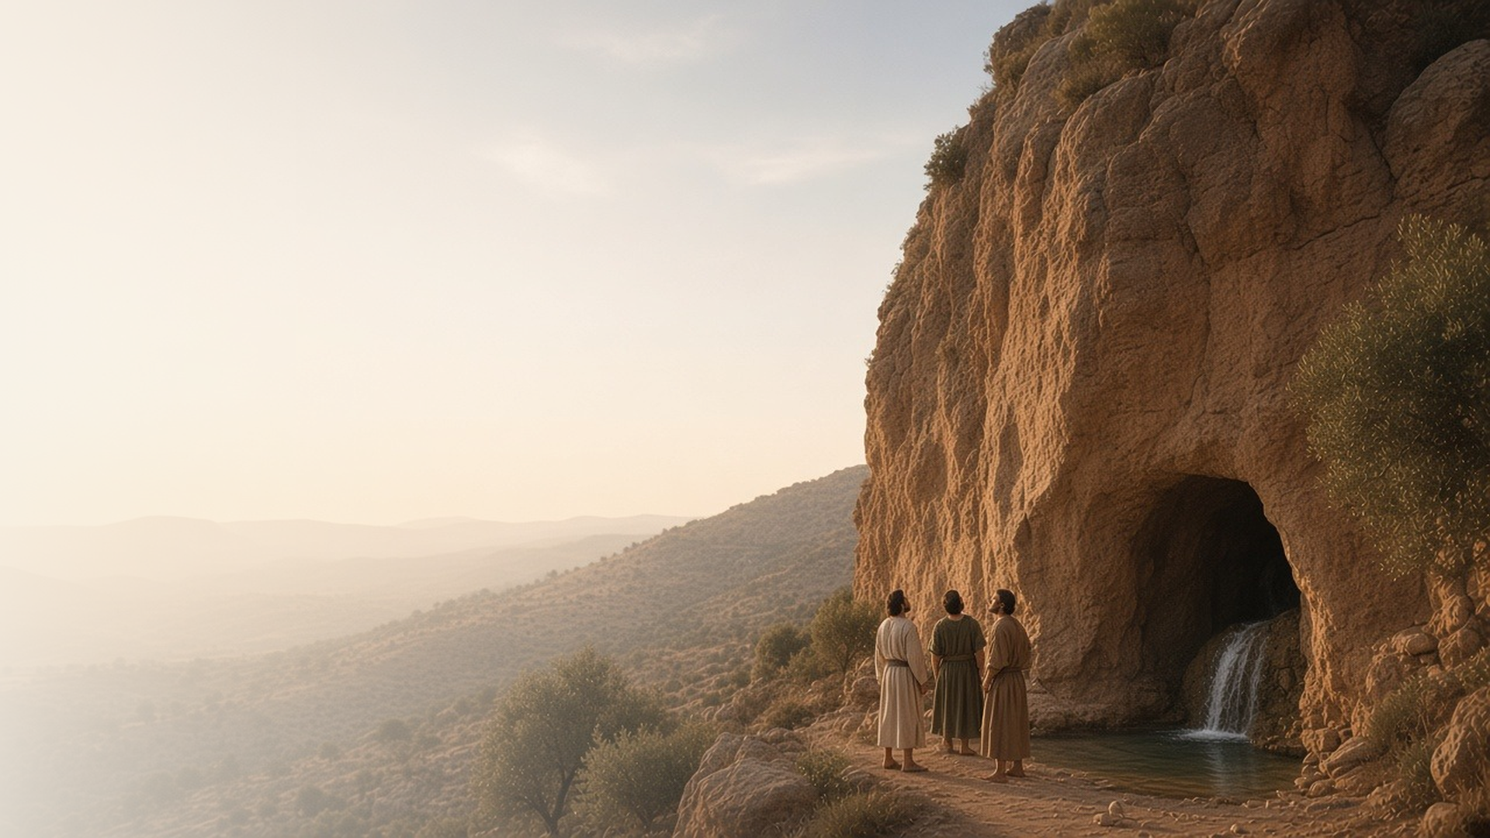
COME, FOLLOW ME · NEW TESTAMENT 2027
Thou Art
the Christ
April 5–11
Matthew 15–17; Mark 7–9
Notes:
TEACHING
These chapters gather around one great question Jesus asked His disciples: "Whom say ye that I am?" Peter's answer, revealed by the Father, becomes the rock on which the Church is built. Jesus then gives priesthood keys and is transfigured before Peter, James, and John, while a struggling father shows that faith can grow from whatever we bring.
SCRIPTURE (KJV)
Matthew 16:13–17
13 When Jesus came into the coasts of Caesarea Philippi, he asked his disciples, saying, Whom do men say that I the Son of man am?
14 And they said, Some say that thou art John the Baptist: some, Elias; and others, Jeremias, or one of the prophets.
15 He saith unto them, But whom say ye that I am?
16 And Simon Peter answered and said, Thou art the Christ, the Son of the living God.
17 And Jesus answered and said unto him, Blessed art thou, Simon Barjona: for flesh and blood hath not revealed it unto thee, but my Father which is in heaven.
DISCUSSION
• How would you answer the Savior's question, "Whom say ye that I am?"
• How did you first come to know that Jesus is the Christ?

Slide 2
MATTHEW 15:7–9, 17–20; MARK 7:6–7, 18–23
Honor God with the heart
True worship flows from a pure heart, not outward ritual.
“This people draweth nigh unto me with their mouth, and honoureth me with their lips; but their heart is far from me.”
MATTHEW 15:8
Notes:
TEACHING
The Pharisees criticized the disciples for not washing their hands by tradition. Jesus answered with Isaiah: lips can honor God while the heart stays far away. What defiles us comes from within, from evil thoughts and desires. Invite class members to consider what it means to honor God with the heart and not only with outward performance.
SCRIPTURE (KJV)
Matthew 15:7–9
7 Ye hypocrites, well did Esaias prophesy of you, saying,
8 This people draweth nigh unto me with their mouth, and honoureth me with their lips; but their heart is far from me.
9 But in vain they do worship me, teaching for doctrines the commandments of men.
Matthew 15:17–20
17 Do not ye yet understand, that whatsoever entereth in at the mouth goeth into the belly, and is cast out into the draught?
18 But those things which proceed out of the mouth come forth from the heart; and they defile the man.
19 For out of the heart proceed evil thoughts, murders, adulteries, fornications, thefts, false witness, blasphemies:
20 These are the things which defile a man: but to eat with unwashen hands defileth not a man.
DISCUSSION (questions quoted from the manual)
• “What is the difference between honoring God with your lips and honoring Him with your heart?”
• “How can you show even more care about what you put into your heart?”

Slide 3
MATTHEW 16:13–17
Revealed by the Father
Peter’s testimony came not from men but from heaven.
“Thou art the Christ, the Son of the living God.”
MATTHEW 16:16
Notes:
TEACHING
People had many opinions about Jesus: John the Baptist, Elijah, Jeremiah. But Jesus wanted to know what His disciples believed. Peter's bold answer did not come from reasoning or from others; it was revealed by the Father. A testimony of Christ is a gift of revelation that each of us can seek and receive.
SCRIPTURE (KJV)
Matthew 16:13–17
13 When Jesus came into the coasts of Caesarea Philippi, he asked his disciples, saying, Whom do men say that I the Son of man am?
14 And they said, Some say that thou art John the Baptist: some, Elias; and others, Jeremias, or one of the prophets.
15 He saith unto them, But whom say ye that I am?
16 And Simon Peter answered and said, Thou art the Christ, the Son of the living God.
17 And Jesus answered and said unto him, Blessed art thou, Simon Barjona: for flesh and blood hath not revealed it unto thee, but my Father which is in heaven.
DISCUSSION (questions quoted from the manual)
• “How would you answer these questions?”
• “How do you explain to people how you know the gospel is true?”
• “What do you think Peter or Alma or Oliver Cowdery might say if someone asked them how they know the gospel is true?”
• “What experiences would you share in your own video?”

Slide 4
MATTHEW 16:18–19; 17:1–9; MARK 9:2–9
The keys of the kingdom
Jesus gave Peter keys to lead His Church on earth.
“And I will give unto thee the keys of the kingdom of heaven.”
MATTHEW 16:19
Notes:
TEACHING
Jesus promised Peter the keys of the kingdom, the authority to direct the Lord's work and to bind on earth and in heaven. On the mount of transfiguration, Peter, James, and John received those keys and heard the Father's voice. Those same keys have been restored and are held by living prophets and apostles today.
SCRIPTURE (KJV)
Matthew 16:18–19
18 And I say also unto thee, That thou art Peter, and upon this rock I will build my church; and the gates of hell shall not prevail against it.
19 And I will give unto thee the keys of the kingdom of heaven: and whatsoever thou shalt bind on earth shall be bound in heaven: and whatsoever thou shalt loose on earth shall be loosed in heaven.
Matthew 17:1–9
1 And after six days Jesus taketh Peter, James, and John his brother, and bringeth them up into an high mountain apart,
2 And was transfigured before them: and his face did shine as the sun, and his raiment was white as the light.
3 And, behold, there appeared unto them Moses and Elias talking with him.
4 Then answered Peter, and said unto Jesus, Lord, it is good for us to be here: if thou wilt, let us make here three tabernacles; one for thee, and one for Moses, and one for Elias.
5 While he yet spake, behold, a bright cloud overshadowed them: and behold a voice out of the cloud, which said, This is my beloved Son, in whom I am well pleased; hear ye him.
6 And when the disciples heard it, they fell on their face, and were sore afraid.
7 And Jesus came and touched them, and said, Arise, and be not afraid.
8 And when they had lifted up their eyes, they saw no man, save Jesus only.
9 And as they came down from the mountain, Jesus charged them, saying, Tell the vision to no man, until the Son of man be risen again from the dead.
DISCUSSION (questions quoted from the manual)
• “But what are priesthood keys?”
• “Why do we need priesthood keys?”
• “Why do you think a key is a good symbol for directing priesthood organization and service?”

Slide 5
MATTHEW 17:14–21; MARK 9:14–29
Help thou mine unbelief
A father brought the faith he had, and asked for more.
“Lord, I believe; help thou mine unbelief.”
MARK 9:24
Notes:
TEACHING
A father whose son suffered terribly came to Jesus after the disciples could not help. When Jesus said all things are possible to those who believe, the father cried out with honest tears: he believed, and needed help with his unbelief. Jesus healed the boy. We can start with the faith we have and ask the Lord to increase it.
SCRIPTURE (KJV)
Mark 9:17–27
17 And one of the multitude answered and said, Master, I have brought unto thee my son, which hath a dumb spirit;
18 And wheresoever he taketh him, he teareth him: and he foameth, and gnasheth with his teeth, and pineth away: and I spake to thy disciples that they should cast him out; and they could not.
19 He answereth him, and saith, O faithless generation, how long shall I be with you? how long shall I suffer you? bring him unto me.
20 And they brought him unto him: and when he saw him, straightway the spirit tare him; and he fell on the ground, and wallowed foaming.
21 And he asked his father, How long is it ago since this came unto him? And he said, Of a child.
22 And ofttimes it hath cast him into the fire, and into the waters, to destroy him: but if thou canst do any thing, have compassion on us, and help us.
23 Jesus said unto him, If thou canst believe, all things are possible to him that believeth.
24 And straightway the father of the child cried out, and said with tears, Lord, I believe; help thou mine unbelief.
25 When Jesus saw that the people came running together, he rebuked the foul spirit, saying unto him, Thou dumb and deaf spirit, I charge thee, come out of him, and enter no more into him.
26 And the spirit cried, and rent him sore, and came out of him: and he was as one dead; insomuch that many said, He is dead.
27 But Jesus took him by the hand, and lifted him up; and he arose.
DISCUSSION (questions quoted from the manual)
• “What does the Spirit teach you about faith as you read about this miracle?”
• “How has Heavenly Father helped you build the faith you already have?”
• “What can you do to build upon that faith?”
• “How might his counsel apply to you?”

Slide 6
MARK 9:23
“If thou canst believe,
all things are possible to him that believeth.”
Share how you came to know that Jesus is the Christ.
Notes:
TEACHING
The Savior's promise to the struggling father is a promise to us. Faith can begin small and honest, and He will strengthen it. Close by inviting class members to share how their own testimony of Christ came, or is still coming.
SCRIPTURE (KJV)
Mark 9:23–24
23 Jesus said unto him, If thou canst believe, all things are possible to him that believeth.
24 And straightway the father of the child cried out, and said with tears, Lord, I believe; help thou mine unbelief.
DISCUSSION
• What helps your faith in Christ grow when it feels small?
• Whom could you strengthen by sharing your testimony this week?

