Slide 1
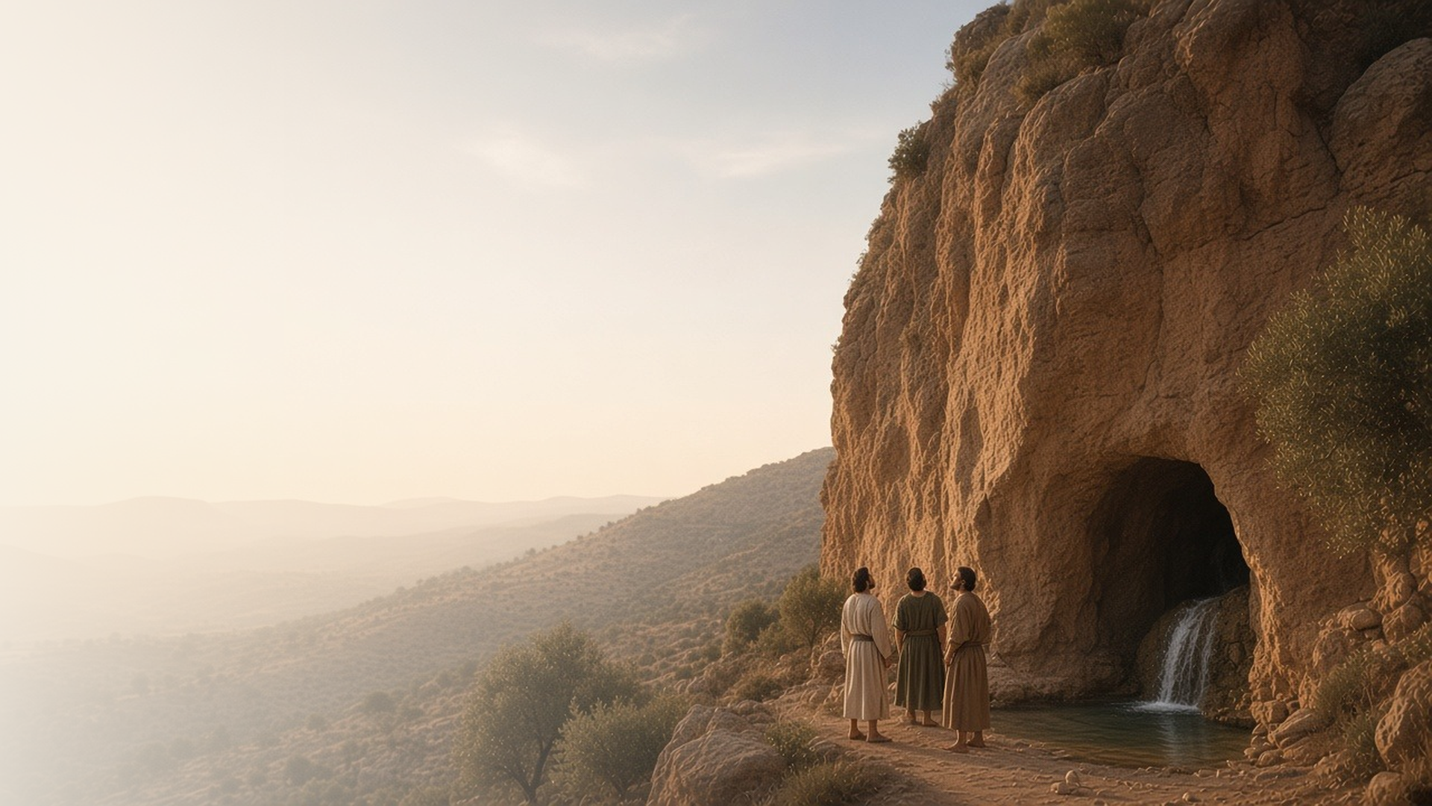
COME, FOLLOW ME · FOR CHILDREN
Thou Art
the Christ
April 5–11
Matthew 15–17; Mark 7–9
Notes:
TEACHING
This week children learn that Heavenly Father helped Peter know that Jesus is the Christ, that Jesus leads His Church through prophets who hold priesthood keys, and that even small faith can do great things.
SCRIPTURE (KJV)
Matthew 16:15–16
15 He saith unto them, But whom say ye that I am?
16 And Simon Peter answered and said, Thou art the Christ, the Son of the living God.
DISCUSSION
• Who is Jesus?
• How can we come to know that Jesus is real?

Slide 2
MATTHEW 16:13–17
I can know Jesus is the Christ
Heavenly Father helped Peter know who Jesus is.
“Thou art the Christ, the Son of the living God.”
MATTHEW 16:16
Notes:
TEACHING
Ask children who Jesus is. Read how Jesus asked His disciples the same question, and Peter answered that He is the Christ, the Son of God. Explain that Heavenly Father helped Peter know this through the Holy Ghost, and He can help us know it too.
SCRIPTURE (KJV)
Matthew 16:13–17
13 When Jesus came into the coasts of Caesarea Philippi, he asked his disciples, saying, Whom do men say that I the Son of man am?
14 And they said, Some say that thou art John the Baptist: some, Elias; and others, Jeremias, or one of the prophets.
15 He saith unto them, But whom say ye that I am?
16 And Simon Peter answered and said, Thou art the Christ, the Son of the living God.
17 And Jesus answered and said unto him, Blessed art thou, Simon Barjona: for flesh and blood hath not revealed it unto thee, but my Father which is in heaven.
DISCUSSION (questions quoted from the manual)
• “You could ask your children what they would say if someone asked them, “Who is Jesus?””

Slide 3
MATTHEW 16:15–19
Jesus leads His Church
Jesus guides His Church through revelation to prophets.
“Upon this rock I will build my church; and the gates of hell shall not prevail against it.”
MATTHEW 16:18
Notes:
TEACHING
Build a small tower of blocks on a solid base and talk about why a strong foundation matters. Jesus said He would build His Church on the rock of revelation. Today He still tells His prophets what He wants us to know.
SCRIPTURE (KJV)
Matthew 16:15–19
15 He saith unto them, But whom say ye that I am?
16 And Simon Peter answered and said, Thou art the Christ, the Son of the living God.
17 And Jesus answered and said unto him, Blessed art thou, Simon Barjona: for flesh and blood hath not revealed it unto thee, but my Father which is in heaven.
18 And I say also unto thee, That thou art Peter, and upon this rock I will build my church; and the gates of hell shall not prevail against it.
19 And I will give unto thee the keys of the kingdom of heaven: and whatsoever thou shalt bind on earth shall be bound in heaven: and whatsoever thou shalt loose on earth shall be loosed in heaven.
DISCUSSION (questions quoted from the manual)
• (The manual gives no direct questions for this section.)
Suggested: What does Jesus tell us through His prophet today?

Slide 4
MATTHEW 16:19; 17:1–9
Prophets hold priesthood keys
Jesus gave Peter, James, and John keys to lead.
“This is my beloved Son, in whom I am well pleased; hear ye him.”
MATTHEW 17:5
Notes:
TEACHING
Show a set of keys and ask what keys do. Explain that Jesus gave His Apostles priesthood keys, the right to lead His Church. On a high mountain, Heavenly Father's voice told them to listen to His Son. Our prophet and apostles hold those keys today.
SCRIPTURE (KJV)
Matthew 17:1–3, 5
1 And after six days Jesus taketh Peter, James, and John his brother, and bringeth them up into an high mountain apart,
2 And was transfigured before them: and his face did shine as the sun, and his raiment was white as the light.
3 And, behold, there appeared unto them Moses and Elias talking with him.
5 While he yet spake, behold, a bright cloud overshadowed them: and behold a voice out of the cloud, which said, This is my beloved Son, in whom I am well pleased; hear ye him.
Full passage: Matthew 17:1–9
DISCUSSION (questions quoted from the manual)
• “What blessings do priesthood keys unlock for us?”

Slide 5
MATTHEW 17:19–20
Faith like a mustard seed
Even a little faith in Jesus can do great things.
“If ye have faith as a grain of mustard seed, ye shall say unto this mountain, Remove hence to yonder place; and it shall remove.”
MATTHEW 17:20
Notes:
TEACHING
Show something very tiny, like a seed or a grain of salt. Jesus said that even faith that small can move mountains. Share a time when faith in Jesus helped you, and invite children to pray with faith this week.
SCRIPTURE (KJV)
Matthew 17:19–21
19 Then came the disciples to Jesus apart, and said, Why could not we cast him out?
20 And Jesus said unto them, Because of your unbelief: for verily I say unto you, If ye have faith as a grain of mustard seed, ye shall say unto this mountain, Remove hence to yonder place; and it shall remove; and nothing shall be impossible unto you.
21 Howbeit this kind goeth not out but by prayer and fasting.
DISCUSSION (questions quoted from the manual)
• (The manual gives no direct questions for this section.)
Suggested: What is one way you can show faith in Jesus this week?

Slide 6
MATTHEW 16:16
“Thou art the Christ,
the Son of the living God.”
Tell your family one thing you know about Jesus.
Notes:
TEACHING
Peter knew that Jesus is the Christ. Invite children to share at home one thing they know about Jesus.
SCRIPTURE (KJV)
Matthew 16:15–17
15 He saith unto them, But whom say ye that I am?
16 And Simon Peter answered and said, Thou art the Christ, the Son of the living God.
17 And Jesus answered and said unto him, Blessed art thou, Simon Barjona: for flesh and blood hath not revealed it unto thee, but my Father which is in heaven.
DISCUSSION
• What do you know about Jesus?
• Who can you tell about Him this week?

