Slide 1
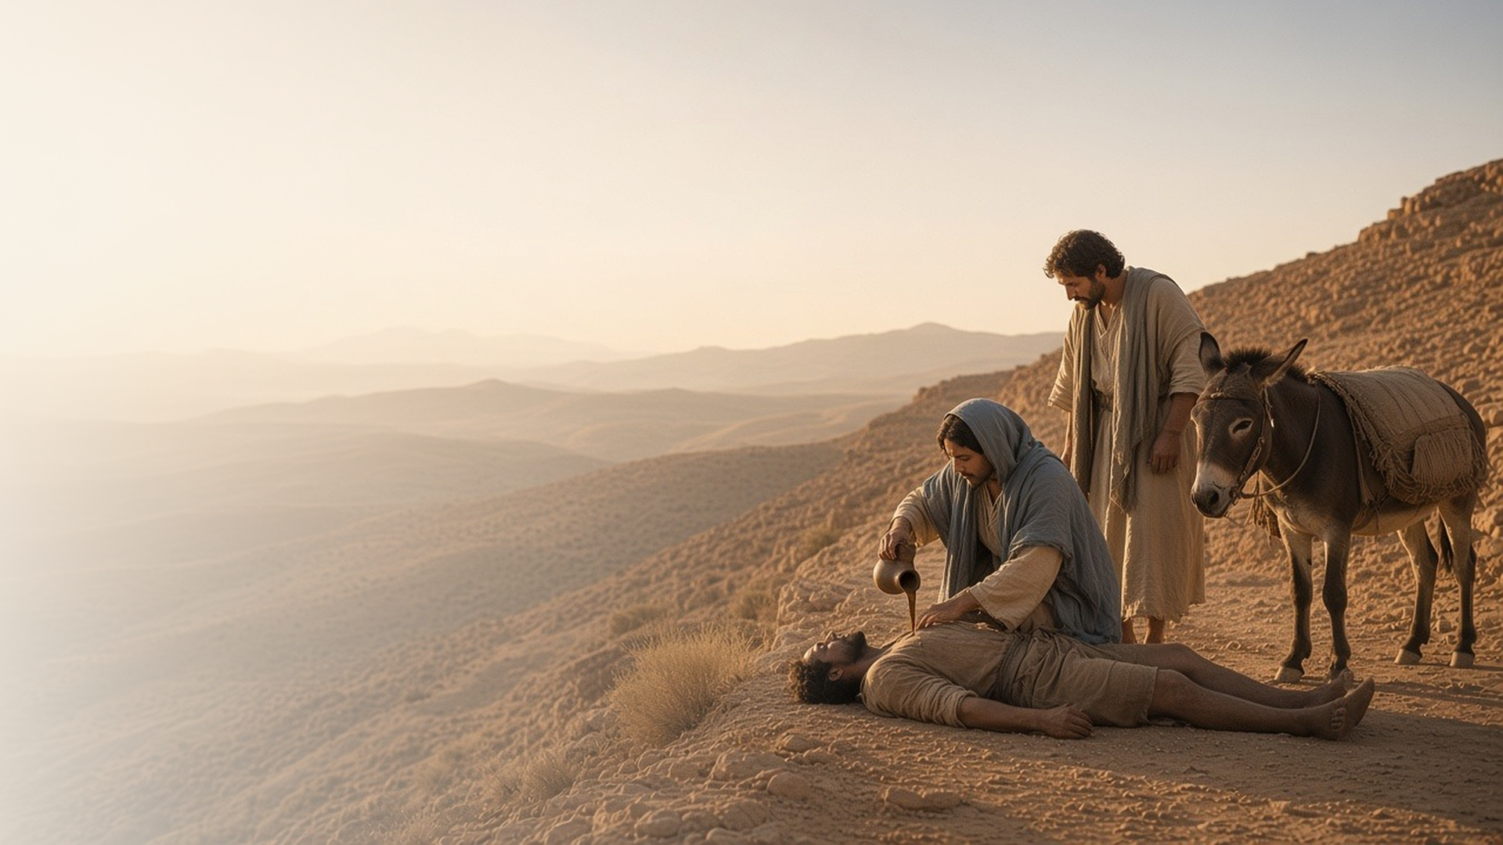
COME, FOLLOW ME · NEW TESTAMENT 2027
What Shall I Do to
Inherit Eternal Life?
April 12–18
Matthew 18; Luke 10
Notes:
TEACHING
A lawyer asked Jesus how to inherit eternal life, and Jesus answered with a parable about a Samaritan on the road to Jericho. These chapters also teach humility like a child's, forgiveness without limit, the calling of the Seventy, and Mary's choice to sit at the Savior's feet. Together they show what a disciple's life looks like day to day.
SCRIPTURE (KJV)
Luke 10:25–28
25 And, behold, a certain lawyer stood up, and tempted him, saying, Master, what shall I do to inherit eternal life?
26 He said unto him, What is written in the law? how readest thou?
27 And he answering said, Thou shalt love the Lord thy God with all thy heart, and with all thy soul, and with all thy strength, and with all thy mind; and thy neighbour as thyself.
28 And he said unto him, Thou hast answered right: this do, and thou shalt live.
DISCUSSION
• How would you answer the lawyer's question in your own words?
• Which of this week's teachings do you most need right now?

Slide 2
MATTHEW 18:1–5
Become as little children
Humility like a child’s opens the kingdom of heaven.
“Except ye be converted, and become as little children, ye shall not enter into the kingdom of heaven.”
MATTHEW 18:3
Notes:
TEACHING
The disciples asked who would be greatest in the kingdom. Jesus answered by placing a little child among them. Greatness in His kingdom comes through humility, teachableness, and trust like a child's. Invite class members to think about which childlike qualities they want to recover or strengthen.
SCRIPTURE (KJV)
Matthew 18:1–5
1 At the same time came the disciples unto Jesus, saying, Who is the greatest in the kingdom of heaven?
2 And Jesus called a little child unto him, and set him in the midst of them,
3 And said, Verily I say unto you, Except ye be converted, and become as little children, ye shall not enter into the kingdom of heaven.
4 Whosoever therefore shall humble himself as this little child, the same is greatest in the kingdom of heaven.
5 And whoso shall receive one such little child in my name receiveth me.
DISCUSSION (questions quoted from the manual)
• “What is it about children that makes them “the greatest in the kingdom of heaven”?”

Slide 3
MATTHEW 18:21–35
Until seventy times seven
The forgiven servant was asked to forgive in turn.
“I say not unto thee, Until seven times: but, Until seventy times seven.”
MATTHEW 18:22
Notes:
TEACHING
Peter offered seven times as a generous limit for forgiveness; Jesus answered seventy times seven. Then He told of a servant forgiven an enormous debt who would not forgive a small one. Remembering how much the Savior has forgiven us can soften our hearts toward those who have hurt us.
SCRIPTURE (KJV)
Matthew 18:21–35
21 Then came Peter to him, and said, Lord, how oft shall my brother sin against me, and I forgive him? till seven times?
22 Jesus saith unto him, I say not unto thee, Until seven times: but, Until seventy times seven.
23 Therefore is the kingdom of heaven likened unto a certain king, which would take account of his servants.
24 And when he had begun to reckon, one was brought unto him, which owed him ten thousand talents.
25 But forasmuch as he had not to pay, his lord commanded him to be sold, and his wife, and children, and all that he had, and payment to be made.
26 The servant therefore fell down, and worshipped him, saying, Lord, have patience with me, and I will pay thee all.
27 Then the lord of that servant was moved with compassion, and loosed him, and forgave him the debt.
28 But the same servant went out, and found one of his fellowservants, which owed him an hundred pence: and he laid hands on him, and took him by the throat, saying, Pay me that thou owest.
29 And his fellowservant fell down at his feet, and besought him, saying, Have patience with me, and I will pay thee all.
30 And he would not: but went and cast him into prison, till he should pay the debt.
31 So when his fellowservants saw what was done, they were very sorry, and came and told unto their lord all that was done.
32 Then his lord, after that he had called him, said unto him, O thou wicked servant, I forgave thee all that debt, because thou desiredst me:
33 Shouldest not thou also have had compassion on thy fellowservant, even as I had pity on thee?
34 And his lord was wroth, and delivered him to the tormentors, till he should pay all that was due unto him.
35 So likewise shall my heavenly Father do also unto you, if ye from your hearts forgive not every one his brother their trespasses.
DISCUSSION (questions quoted from the manual)
• “Who could the king, the unmerciful servant, and the fellow servant represent?”
• “What could the debts represent?”
• “When have you felt God’s mercy and compassion?”
• “Is there someone who needs to feel mercy and compassion from you?”

Slide 4
LUKE 10:1–24
Laborers into the harvest
Jesus sent the Seventy two by two to prepare His way.
“The harvest truly is great, but the labourers are few.”
LUKE 10:2
Notes:
TEACHING
Jesus called seventy others and sent them two by two into every city He would visit. They returned with joy at what the Lord had done through them, and He reminded them to rejoice most that their names were written in heaven. The Lord still calls Seventies and every disciple to help gather His harvest.
SCRIPTURE (KJV)
Luke 10:1–9
1 After these things the Lord appointed other seventy also, and sent them two and two before his face into every city and place, whither he himself would come.
2 Therefore said he unto them, The harvest truly is great, but the labourers are few: pray ye therefore the Lord of the harvest, that he would send forth labourers into his harvest.
3 Go your ways: behold, I send you forth as lambs among wolves.
4 Carry neither purse, nor scrip, nor shoes: and salute no man by the way.
5 And into whatsoever house ye enter, first say, Peace be to this house.
6 And if the son of peace be there, your peace shall rest upon it: if not, it shall turn to you again.
7 And in the same house remain, eating and drinking such things as they give: for the labourer is worthy of his hire. Go not from house to house.
8 And into whatsoever city ye enter, and they receive you, eat such things as are set before you:
9 And heal the sick that are therein, and say unto them, The kingdom of God is come nigh unto you.
Luke 10:17–20
17 And the seventy returned again with joy, saying, Lord, even the devils are subject unto us through thy name.
18 And he said unto them, I beheld Satan as lightning fall from heaven.
19 Behold, I give unto you power to tread on serpents and scorpions, and over all the power of the enemy: and nothing shall by any means hurt you.
20 Notwithstanding in this rejoice not, that the spirits are subject unto you; but rather rejoice, because your names are written in heaven.
DISCUSSION (questions quoted from the manual)
• “What do you learn about the Seventy from Jesus’s instruction to them in Luke 10:1–24?”
• “Do you see any principles that could apply to you and your service in the Church?”
• “How would you explain to someone why it’s a blessing to have Seventies in the Church today?”

Slide 5
LUKE 10:25–37
Who is my neighbour?
A Samaritan showed what loving our neighbor truly means.
“Go, and do thou likewise.”
LUKE 10:37
Notes:
TEACHING
The lawyer wanted to limit whom he had to love. Jesus told of a man beaten and left on the road, passed by a priest and a Levite, and rescued by a Samaritan, someone the lawyer's people despised. The question changes from "Who is my neighbour?" to "Am I being a neighbour?" Many also see the Savior Himself in the Samaritan who rescues us.
SCRIPTURE (KJV)
Luke 10:25–37
25 And, behold, a certain lawyer stood up, and tempted him, saying, Master, what shall I do to inherit eternal life?
26 He said unto him, What is written in the law? how readest thou?
27 And he answering said, Thou shalt love the Lord thy God with all thy heart, and with all thy soul, and with all thy strength, and with all thy mind; and thy neighbour as thyself.
28 And he said unto him, Thou hast answered right: this do, and thou shalt live.
29 But he, willing to justify himself, said unto Jesus, And who is my neighbour?
30 And Jesus answering said, A certain man went down from Jerusalem to Jericho, and fell among thieves, which stripped him of his raiment, and wounded him, and departed, leaving him half dead.
31 And by chance there came down a certain priest that way: and when he saw him, he passed by on the other side.
32 And likewise a Levite, when he was at the place, came and looked on him, and passed by on the other side.
33 But a certain Samaritan, as he journeyed, came where he was: and when he saw him, he had compassion on him,
34 And went to him, and bound up his wounds, pouring in oil and wine, and set him on his own beast, and brought him to an inn, and took care of him.
35 And on the morrow when he departed, he took out two pence, and gave them to the host, and said unto him, Take care of him; and whatsoever thou spendest more, when I come again, I will repay thee.
36 Which now of these three, thinkest thou, was neighbour unto him that fell among the thieves?
37 And he said, He that shewed mercy on him. Then said Jesus unto him, Go, and do thou likewise.
DISCUSSION (questions quoted from the manual)
• “As you study Luke 10:25–37, consider asking yourself, “Who is my neighbor?”
• “How are the commandments to love God and love my neighbor related?””
• “Why do you think Jesus chose a priest, a Levite, and a Samaritan to illustrate the commandments to love God and to love our neighbor?”
• “How would you have reacted to this parable if you were the lawyer?”
• “What other aspects of “our eternal journey” do you see in this parable?”
• “How would you summarize what the Lord is teaching you in this parable?”
(+1 more in the manual)

Slide 6
LUKE 10:38–42
The good part
Martha served; Mary sat at His feet. Both loved Him.
“But one thing is needful: and Mary hath chosen that good part, which shall not be taken away from her.”
LUKE 10:42
Notes:
TEACHING
Martha welcomed Jesus into her home and worked hard to serve Him, while Mary sat and listened to His word. Jesus gently told the anxious Martha that Mary had chosen the good part. Invite class members to consider what distracts them from the Savior and how they can choose the good part each day.
SCRIPTURE (KJV)
Luke 10:38–42
38 Now it came to pass, as they went, that he entered into a certain village: and a certain woman named Martha received him into her house.
39 And she had a sister called Mary, which also sat at Jesus’ feet, and heard his word.
40 But Martha was cumbered about much serving, and came to him, and said, Lord, dost thou not care that my sister hath left me to serve alone? bid her therefore that she help me.
41 And Jesus answered and said unto her, Martha, Martha, thou art careful and troubled about many things:
42 But one thing is needful: and Mary hath chosen that good part, which shall not be taken away from her.
DISCUSSION (questions quoted from the manual)
• “Have you ever felt the way Martha did?”
• “What evidence do you see of His love and understanding for Martha?”
• “What was Mary doing that Jesus called “that good part”?”
• “What could the “good part” mean in your life?”
• “Is there something “needful” that might deserve more of your focus and attention?”

Slide 7
MATTHEW 18:20
“For where two or three are gathered together
in my name, there am I in the midst of them.”
This week, show mercy to someone who needs a neighbour.
Notes:
TEACHING
Eternal life is lived in relationships: with God, and with the people we forgive, serve, and gather with. Close by inviting class members to look for one person this week who needs a neighbour.
SCRIPTURE (KJV)
Matthew 18:19–20
19 Again I say unto you, That if two of you shall agree on earth as touching any thing that they shall ask, it shall be done for them of my Father which is in heaven.
20 For where two or three are gathered together in my name, there am I in the midst of them.
DISCUSSION
• Whom might the Lord be asking you to see as your neighbour?
• What would help you choose "the good part" more often?

