Slide 1
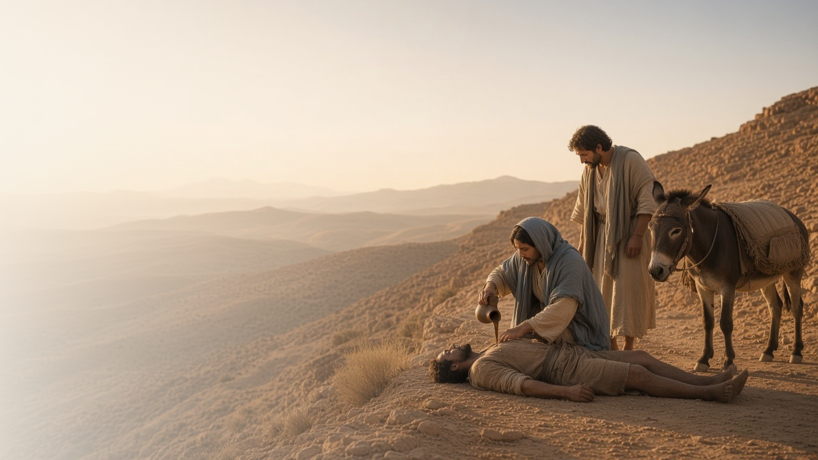
COME, FOLLOW ME · FOR CHILDREN
What Shall I Do to
Inherit Eternal Life?
April 12–18
Matthew 18; Luke 10
Notes:
TEACHING
This week children learn that because Jesus forgives us we can forgive others, that everyone is our neighbor, and that we can take time each day to come closer to Jesus like Mary did.
SCRIPTURE (KJV)
Luke 10:36–37
36 Which now of these three, thinkest thou, was neighbour unto him that fell among the thieves?
37 And he said, He that shewed mercy on him. Then said Jesus unto him, Go, and do thou likewise.
DISCUSSION
• Who is your neighbor?
• How can you be kind like the good Samaritan?

Slide 2
MATTHEW 18:21–35
I can forgive like Jesus
Because Jesus forgives me, I can forgive others.
“Until seventy times seven.”
MATTHEW 18:22
Notes:
TEACHING
Ask children how many times they should forgive someone. Peter thought seven times was a lot, but Jesus said seventy times seven, meaning we should keep on forgiving. Tell the story of the servant who was forgiven a big debt. Jesus forgives us, and He helps us forgive others.
SCRIPTURE (KJV)
Matthew 18:21–22
21 Then came Peter to him, and said, Lord, how oft shall my brother sin against me, and I forgive him? till seven times?
22 Jesus saith unto him, I say not unto thee, Until seven times: but, Until seventy times seven.
DISCUSSION (questions quoted from the manual)
• “Which debt would be easier to forgive?”
• “What does Jesus want us to learn from this story?”
• “How did the Savior help you in these situations?”

Slide 3
LUKE 10:25–37
Everyone is my neighbor
Jesus wants me to be kind to everyone, like the Samaritan.
“Go, and do thou likewise.”
LUKE 10:37
Notes:
TEACHING
Act out the story of the good Samaritan with simple props. Two people walked past the hurt man, but the Samaritan stopped, bandaged his wounds, and took care of him. Jesus wants us to help everyone, even people who are different from us.
SCRIPTURE (KJV)
Luke 10:30, 33–34, 37
30 And Jesus answering said, A certain man went down from Jerusalem to Jericho, and fell among thieves, which stripped him of his raiment, and wounded him, and departed, leaving him half dead.
33 But a certain Samaritan, as he journeyed, came where he was: and when he saw him, he had compassion on him,
34 And went to him, and bound up his wounds, pouring in oil and wine, and set him on his own beast, and brought him to an inn, and took care of him.
37 And he said, He that shewed mercy on him. Then said Jesus unto him, Go, and do thou likewise.
Full passage: Luke 10:30–37
DISCUSSION (questions quoted from the manual)
• “You could begin a discussion about Luke 10:25–37 by asking your children, “Who is your neighbor?””
• “How can we follow the example of the good Samaritan?”

Slide 4
LUKE 10:38–42
Time each day with Jesus
Like Mary, I can take time to listen to Jesus.
“Mary hath chosen that good part.”
LUKE 10:42
Notes:
TEACHING
Tell how Mary sat at Jesus's feet and listened to Him while Martha was busy. Help children think of ways to listen to Jesus every day: praying, reading scriptures, and singing Primary songs.
SCRIPTURE (KJV)
Luke 10:38–42
38 Now it came to pass, as they went, that he entered into a certain village: and a certain woman named Martha received him into her house.
39 And she had a sister called Mary, which also sat at Jesus’ feet, and heard his word.
40 But Martha was cumbered about much serving, and came to him, and said, Lord, dost thou not care that my sister hath left me to serve alone? bid her therefore that she help me.
41 And Jesus answered and said unto her, Martha, Martha, thou art careful and troubled about many things:
42 But one thing is needful: and Mary hath chosen that good part, which shall not be taken away from her.
DISCUSSION (questions quoted from the manual)
• “You could ask questions like these: Who are the three people in the picture?”
• “What is each person doing?”
• “What do Martha and Mary seem to be focusing on?”

Slide 5
LUKE 10:27
“Thou shalt love the Lord thy God
with all thy heart.”
Find one way to be a good neighbor this week.
Notes:
TEACHING
Jesus taught us to love God and love our neighbors. Invite children to choose one kind act to do for someone this week.
SCRIPTURE (KJV)
Luke 10:27
27 And he answering said, Thou shalt love the Lord thy God with all thy heart, and with all thy soul, and with all thy strength, and with all thy mind; and thy neighbour as thyself.
DISCUSSION
• How can you show love to God?
• Who can you help this week?

