Slide 1
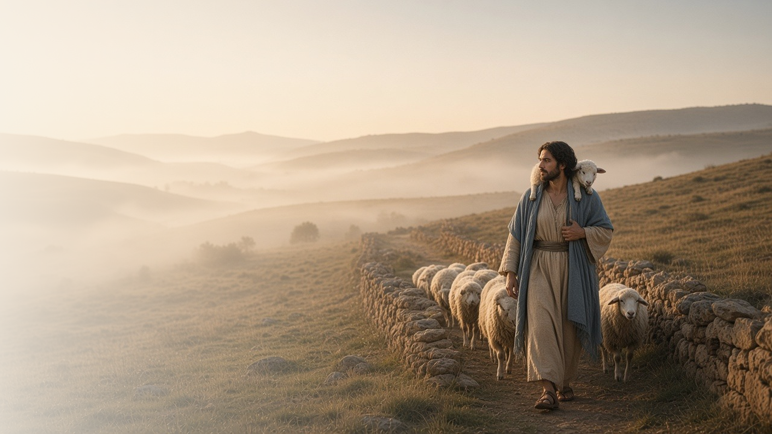
COME, FOLLOW ME · NEW TESTAMENT 2027
I Am the
Good Shepherd
April 19–25
John 7–10
Notes:
TEACHING
In John 7–10, opinions about Jesus divide the people of Jerusalem. Through it all, John testifies that Jesus is the Son of God: He teaches with authority, shows mercy to the accused, frees us with truth, opens blind eyes, and calls Himself the Good Shepherd who knows His sheep and lays down His life for them.
SCRIPTURE (KJV)
John 10:11–14
11 I am the good shepherd: the good shepherd giveth his life for the sheep.
12 But he that is an hireling, and not the shepherd, whose own the sheep are not, seeth the wolf coming, and leaveth the sheep, and fleeth: and the wolf catcheth them, and scattereth the sheep.
13 The hireling fleeth, because he is an hireling, and careth not for the sheep.
14 I am the good shepherd, and know my sheep, and am known of mine.
DISCUSSION
• What does it mean to you that Jesus is your Shepherd?
• Where in these chapters do you see the Savior's mercy most clearly?

Slide 2
JOHN 7–10
Never man spake like this
Each chapter testifies that Jesus is the Son of God.
“Never man spake like this man.”
JOHN 7:46
Notes:
TEACHING
Officers sent to arrest Jesus came back empty-handed, saying no one had ever spoken as He did. Throughout these chapters Jesus declares who He is: the living water, the light of the world, the great I AM, one with the Father. Invite class members to note each statement that witnesses of His divinity.
SCRIPTURE (KJV)
John 7:45–46
45 Then came the officers to the chief priests and Pharisees; and they said unto them, Why have ye not brought him?
46 The officers answered, Never man spake like this man.
John 8:58
58 Jesus said unto them, Verily, verily, I say unto you, Before Abraham was, I am.
John 10:30
30 I and my Father are one.
DISCUSSION (questions quoted from the manual)
• (The manual gives no direct questions for this section.)
Suggested: As you read John 7–10, which words of Jesus testify to you that He is the Son of God?

Slide 3
JOHN 7:14–17
Do His will and know
Living His teachings is how we learn they are true.
“If any man will do his will, he shall know of the doctrine, whether it be of God, or whether I speak of myself.”
JOHN 7:17
Notes:
TEACHING
People marveled that Jesus taught so well without formal schooling. He explained that His doctrine came from the Father, and that anyone could test it: do His will and you will know. A testimony grows by living the gospel, not only by studying it.
SCRIPTURE (KJV)
John 7:14–17
14 Now about the midst of the feast Jesus went up into the temple, and taught.
15 And the Jews marvelled, saying, How knoweth this man letters, having never learned?
16 Jesus answered them, and said, My doctrine is not mine, but his that sent me.
17 If any man will do his will, he shall know of the doctrine, whether it be of God, or whether I speak of myself.
DISCUSSION (questions quoted from the manual)
• “What do you learn from John 7:14–17 about the Savior’s way of learning doctrine?”
• “How has living a gospel principle helped you know it is true?”

Slide 4
JOHN 8:1–11
Go, and sin no more
Jesus met an accused woman with mercy, not condemnation.
“Neither do I condemn thee: go, and sin no more.”
JOHN 8:11
Notes:
TEACHING
Leaders brought a woman taken in adultery to trap Jesus. He invited the one without sin to cast the first stone, and one by one the accusers left. Jesus did not excuse sin, but He offered her mercy and a new beginning. His mercy is available to each of us too.
SCRIPTURE (KJV)
John 8:1–11
1 Jesus went unto the mount of Olives.
2 And early in the morning he came again into the temple, and all the people came unto him; and he sat down, and taught them.
3 And the scribes and Pharisees brought unto him a woman taken in adultery; and when they had set her in the midst,
4 They say unto him, Master, this woman was taken in adultery, in the very act.
5 Now Moses in the law commanded us, that such should be stoned: but what sayest thou?
6 This they said, tempting him, that they might have to accuse him. But Jesus stooped down, and with his finger wrote on the ground, as though he heard them not.
7 So when they continued asking him, he lifted up himself, and said unto them, He that is without sin among you, let him first cast a stone at her.
8 And again he stooped down, and wrote on the ground.
9 And they which heard it, being convicted by their own conscience, went out one by one, beginning at the eldest, even unto the last: and Jesus was left alone, and the woman standing in the midst.
10 When Jesus had lifted up himself, and saw none but the woman, he said unto her, Woman, where are those thine accusers? hath no man condemned thee?
11 She said, No man, Lord. And Jesus said unto her, Neither do I condemn thee: go, and sin no more.
DISCUSSION (questions quoted from the manual)
• “What do you learn about the Savior from how He handled this situation?”
• “How has Jesus Christ been your answer?”
• “How has He shown that He understands your capabilities and vulnerabilities?”
• “How can you follow His example?”

Slide 5
JOHN 8:31–36
The truth shall make you free
Continuing in His word brings freedom from sin.
“And ye shall know the truth, and the truth shall make you free.”
JOHN 8:32
Notes:
TEACHING
Jesus taught that those who continue in His word are His disciples indeed, and the truth makes them free. His listeners insisted they had never been in bondage, but He explained that sin enslaves, and only the Son can make us truly free. Discuss which truths have brought freedom into our lives.
SCRIPTURE (KJV)
John 8:31–36
31 Then said Jesus to those Jews which believed on him, If ye continue in my word, then are ye my disciples indeed;
32 And ye shall know the truth, and the truth shall make you free.
33 They answered him, We be Abraham’s seed, and were never in bondage to any man: how sayest thou, Ye shall be made free?
34 Jesus answered them, Verily, verily, I say unto you, Whosoever committeth sin is the servant of sin.
35 And the servant abideth not in the house for ever: but the Son abideth ever.
36 If the Son therefore shall make you free, ye shall be free indeed.
DISCUSSION (questions quoted from the manual)
• “What happens if you skip a step or an ingredient?”
• “How does truth make you free?”

Slide 6
JOHN 9
Now I see
The blind man’s sight and faith grew as he acted.
“One thing I know, that, whereas I was blind, now I see.”
JOHN 9:25
Notes:
TEACHING
Jesus anointed a blind man's eyes with clay and told him to wash in the pool of Siloam. He went, washed, and came back seeing. Under pressure from the Pharisees, his understanding of Jesus grew from "a man" to "a prophet" to the Son of God, whom he worshipped. Acting in faith opens our eyes to the Savior.
SCRIPTURE (KJV)
John 9:1–7
1 And as Jesus passed by, he saw a man which was blind from his birth.
2 And his disciples asked him, saying, Master, who did sin, this man, or his parents, that he was born blind?
3 Jesus answered, Neither hath this man sinned, nor his parents: but that the works of God should be made manifest in him.
4 I must work the works of him that sent me, while it is day: the night cometh, when no man can work.
5 As long as I am in the world, I am the light of the world.
6 When he had thus spoken, he spat on the ground, and made clay of the spittle, and he anointed the eyes of the blind man with the clay,
7 And said unto him, Go, wash in the pool of Siloam, (which is by interpretation, Sent.) He went his way therefore, and washed, and came seeing.
John 9:24–38
24 Then again called they the man that was blind, and said unto him, Give God the praise: we know that this man is a sinner.
25 He answered and said, Whether he be a sinner or no, I know not: one thing I know, that, whereas I was blind, now I see.
26 Then said they to him again, What did he to thee? how opened he thine eyes?
27 He answered them, I have told you already, and ye did not hear: wherefore would ye hear it again? will ye also be his disciples?
28 Then they reviled him, and said, Thou art his disciple; but we are Moses’ disciples.
29 We know that God spake unto Moses: as for this fellow, we know not from whence he is.
30 The man answered and said unto them, Why herein is a marvellous thing, that ye know not from whence he is, and yet he hath opened mine eyes.
31 Now we know that God heareth not sinners: but if any man be a worshipper of God, and doeth his will, him he heareth.
32 Since the world began was it not heard that any man opened the eyes of one that was born blind.
33 If this man were not of God, he could do nothing.
34 They answered and said unto him, Thou wast altogether born in sins, and dost thou teach us? And they cast him out.
35 Jesus heard that they had cast him out; and when he had found him, he said unto him, Dost thou believe on the Son of God?
36 He answered and said, Who is he, Lord, that I might believe on him?
37 And Jesus said unto him, Thou hast both seen him, and it is he that talketh with thee.
38 And he said, Lord, I believe. And he worshipped him.
DISCUSSION (questions quoted from the manual)
• “Why do you think He did this?”
• “When have you had to act in faith like this man did?”
• “What evidence do you find of the man’s faith?”
• “What do you find that indicates he gained spiritual sight as well as physical sight?”
• “What do you learn about the Savior from verses 35–38?”

Slide 7
JOHN 10:1–30
The Good Shepherd
He knows His sheep by name and gives His life for them.
“I am the good shepherd: the good shepherd giveth his life for the sheep.”
JOHN 10:11
Notes:
TEACHING
A hireling runs when the wolf comes, but the good shepherd stays and gives his life. Jesus calls His own sheep by name, they know His voice, and He leads them. He also spoke of other sheep, not of this fold, who would hear His voice. Invite class members to share how they recognize the Shepherd's voice.
SCRIPTURE (KJV)
John 10:1–16
1 Verily, verily, I say unto you, He that entereth not by the door into the sheepfold, but climbeth up some other way, the same is a thief and a robber.
2 But he that entereth in by the door is the shepherd of the sheep.
3 To him the porter openeth; and the sheep hear his voice: and he calleth his own sheep by name, and leadeth them out.
4 And when he putteth forth his own sheep, he goeth before them, and the sheep follow him: for they know his voice.
5 And a stranger will they not follow, but will flee from him: for they know not the voice of strangers.
6 This parable spake Jesus unto them: but they understood not what things they were which he spake unto them.
7 Then said Jesus unto them again, Verily, verily, I say unto you, I am the door of the sheep.
8 All that ever came before me are thieves and robbers: but the sheep did not hear them.
9 I am the door: by me if any man enter in, he shall be saved, and shall go in and out, and find pasture.
10 The thief cometh not, but for to steal, and to kill, and to destroy: I am come that they might have life, and that they might have it more abundantly.
11 I am the good shepherd: the good shepherd giveth his life for the sheep.
12 But he that is an hireling, and not the shepherd, whose own the sheep are not, seeth the wolf coming, and leaveth the sheep, and fleeth: and the wolf catcheth them, and scattereth the sheep.
13 The hireling fleeth, because he is an hireling, and careth not for the sheep.
14 I am the good shepherd, and know my sheep, and am known of mine.
15 As the Father knoweth me, even so know I the Father: and I lay down my life for the sheep.
16 And other sheep I have, which are not of this fold: them also I must bring, and they shall hear my voice; and there shall be one fold, and one shepherd.
John 10:27–30
27 My sheep hear my voice, and I know them, and they follow me:
28 And I give unto them eternal life; and they shall never perish, neither shall any man pluck them out of my hand.
29 My Father, which gave them me, is greater than all; and no man is able to pluck them out of my Father’s hand.
30 I and my Father are one.
DISCUSSION (questions quoted from the manual)
• “What do you learn about Jesus Christ?”
• “What helps you want to follow Him?”
• “How has Christ given you “life … more abundantly”? (verse 10).”
• “How has He shown that He knows you personally? (see verse 14).”
• “How do you hear the Good Shepherd’s voice? (see verse 27).”

Slide 8
JOHN 10:27
“My sheep hear my voice,
and I know them, and they follow me.”
Listen this week for the Shepherd’s voice, and follow.
Notes:
TEACHING
The Good Shepherd promises to know us, lead us, and hold us so that no one can pluck us out of His hand. Close by inviting class members to listen for His voice this week and act on what they hear.
SCRIPTURE (KJV)
John 10:27–28
27 My sheep hear my voice, and I know them, and they follow me:
28 And I give unto them eternal life; and they shall never perish, neither shall any man pluck them out of my hand.
DISCUSSION
• How do you recognize the Savior's voice in your life?
• What will you do to follow Him more closely this week?

