Slide 1
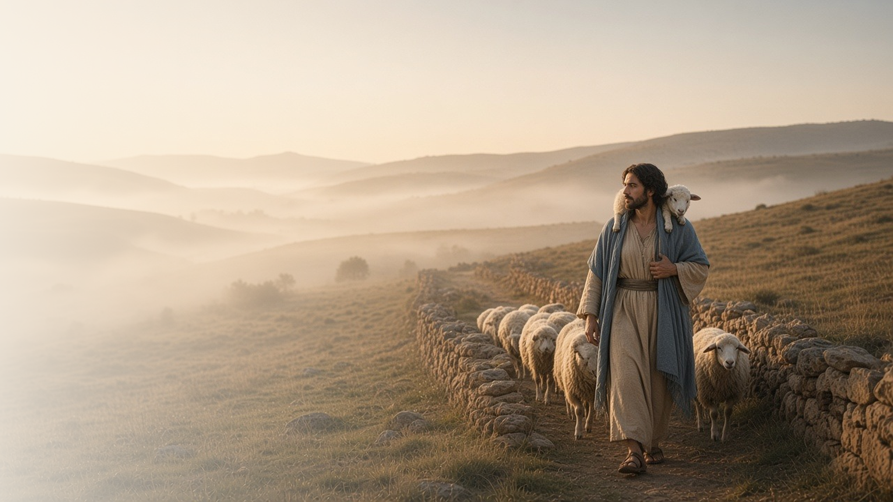
COME, FOLLOW ME · FOR CHILDREN
I Am the
Good Shepherd
April 19–25
John 7–10
Notes:
TEACHING
This week children learn that keeping the commandments helps us know they are true, that we can obey Heavenly Father like Jesus did, that Jesus can help us see, and that Jesus is like a shepherd who knows and cares for each of us.
SCRIPTURE (KJV)
John 10:14
14 I am the good shepherd, and know my sheep, and am known of mine.
DISCUSSION
• What does a shepherd do?
• How is Jesus like a shepherd to you?

Slide 2
JOHN 7:14–17
Obeying helps me know
When I keep the commandments, I learn they are true.
“If any man will do his will, he shall know of the doctrine.”
JOHN 7:17
Notes:
TEACHING
Share an example: we know a seed grows by planting it and watching. Jesus taught that we can know His teachings are true by living them. Talk about a commandment children can keep this week and how they feel when they obey.
SCRIPTURE (KJV)
John 7:16–17
16 Jesus answered them, and said, My doctrine is not mine, but his that sent me.
17 If any man will do his will, he shall know of the doctrine, whether it be of God, or whether I speak of myself.
DISCUSSION (questions quoted from the manual)
• (The manual gives no direct questions for this section.)
Suggested: What commandment can you keep this week? How do you feel when you obey?

Slide 3
JOHN 8:29
I can obey like Jesus
Jesus always did what pleased Heavenly Father.
“For I do always those things that please him.”
JOHN 8:29
Notes:
TEACHING
Explain that Jesus always did what Heavenly Father wanted, and Heavenly Father was always with Him. Play a simple game of following directions, then talk about how we can follow Heavenly Father's directions too.
SCRIPTURE (KJV)
John 8:28–29
28 Then said Jesus unto them, When ye have lifted up the Son of man, then shall ye know that I am he, and that I do nothing of myself; but as my Father hath taught me, I speak these things.
29 And he that sent me is with me: the Father hath not left me alone; for I do always those things that please him.
DISCUSSION (questions quoted from the manual)
• (The manual gives no direct questions for this section.)
Suggested: What are some things Heavenly Father wants us to do?

Slide 4
JOHN 9
Jesus can help me see
Jesus healed a blind man, and his faith grew.
“Whereas I was blind, now I see.”
JOHN 9:25
Notes:
TEACHING
Have children close their eyes and then open them. Tell how Jesus put clay on a blind man's eyes and told him to wash. When he obeyed, he could see. Jesus can also help us see the good in our lives and see how much He loves us.
SCRIPTURE (KJV)
John 9:1, 6–7
1 And as Jesus passed by, he saw a man which was blind from his birth.
6 When he had thus spoken, he spat on the ground, and made clay of the spittle, and he anointed the eyes of the blind man with the clay,
7 And said unto him, Go, wash in the pool of Siloam, (which is by interpretation, Sent.) He went his way therefore, and washed, and came seeing.
Full passage: John 9:1–7
DISCUSSION (questions quoted from the manual)
• “How did Jesus help the man who was blind? (see verses 6–7, 35–38).”
• “How can He help us?”

Slide 5
JOHN 10:1–18
Jesus is my shepherd
Jesus knows me and takes care of me.
“I am the good shepherd, and know my sheep, and am known of mine.”
JOHN 10:14
Notes:
TEACHING
Show a picture or toy of a sheep. A good shepherd knows each sheep, keeps them safe, and finds them when they are lost. Jesus is our Good Shepherd: He knows each of us by name and loves us.
SCRIPTURE (KJV)
John 10:11–14
11 I am the good shepherd: the good shepherd giveth his life for the sheep.
12 But he that is an hireling, and not the shepherd, whose own the sheep are not, seeth the wolf coming, and leaveth the sheep, and fleeth: and the wolf catcheth them, and scattereth the sheep.
13 The hireling fleeth, because he is an hireling, and careth not for the sheep.
14 I am the good shepherd, and know my sheep, and am known of mine.
DISCUSSION (questions quoted from the manual)
• “His door?”

Slide 6
JOHN 10:11
“I am the good shepherd.”
Tell someone how Jesus takes care of you.
Notes:
TEACHING
Jesus is our Good Shepherd. Invite children to tell someone at home how Jesus takes care of them.
SCRIPTURE (KJV)
John 10:11
11 I am the good shepherd: the good shepherd giveth his life for the sheep.
DISCUSSION
• How does Jesus take care of you?
• How can you help take care of others like a shepherd?

