Slide 1
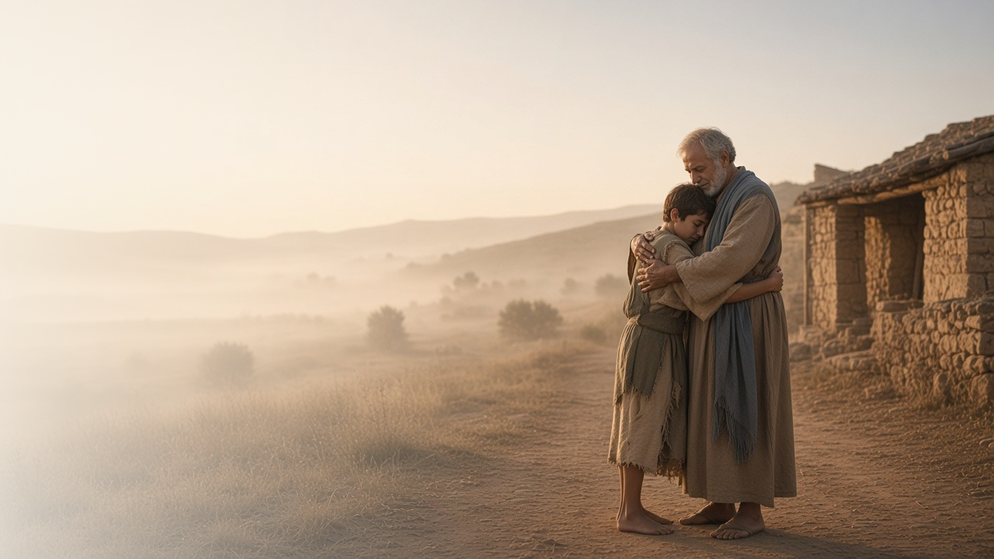
COME, FOLLOW ME · NEW TESTAMENT 2027
Rejoice with Me; for I
Have Found My Sheep
Which Was Lost
April 26–May 2
Luke 12–17; John 11
Notes:
TEACHING
Luke 12–17 gathers many of the Savior's parables about what matters most: treasure in heaven, the lost sheep, the lost coin, and the prodigal son. In each, heaven rejoices when someone comes home. The week closes with ten healed lepers, one grateful, and with Jesus raising Lazarus as the Resurrection and the Life.
SCRIPTURE (KJV)
Luke 15:4–7
4 What man of you, having an hundred sheep, if he lose one of them, doth not leave the ninety and nine in the wilderness, and go after that which is lost, until he find it?
5 And when he hath found it, he layeth it on his shoulders, rejoicing.
6 And when he cometh home, he calleth together his friends and neighbours, saying unto them, Rejoice with me; for I have found my sheep which was lost.
7 I say unto you, that likewise joy shall be in heaven over one sinner that repenteth, more than over ninety and nine just persons, which need no repentance.
DISCUSSION
• When have you felt found by the Lord?
• Which parable in Luke 15 speaks most to you right now, and why?

Slide 2
LUKE 12; 14–16
Treasure in heaven
Where our treasure is, there our heart will be also.
“For where your treasure is, there will your heart be also.”
LUKE 12:34
Notes:
TEACHING
A rich man built bigger barns and planned to take his ease, but his life ended that very night. Jesus warned against covetousness and invited His followers to seek the kingdom and lay up treasure that does not fail. Invite class members to consider where their hearts are set, and on what eternal things they want to set them.
SCRIPTURE (KJV)
Luke 12:15–21
15 And he said unto them, Take heed, and beware of covetousness: for a man’s life consisteth not in the abundance of the things which he possesseth.
16 And he spake a parable unto them, saying, The ground of a certain rich man brought forth plentifully:
17 And he thought within himself, saying, What shall I do, because I have no room where to bestow my fruits?
18 And he said, This will I do: I will pull down my barns, and build greater; and there will I bestow all my fruits and my goods.
19 And I will say to my soul, Soul, thou hast much goods laid up for many years; take thine ease, eat, drink, and be merry.
20 But God said unto him, Thou fool, this night thy soul shall be required of thee: then whose shall those things be, which thou hast provided?
21 So is he that layeth up treasure for himself, and is not rich toward God.
Luke 12:32–34
32 Fear not, little flock; for it is your Father’s good pleasure to give you the kingdom.
33 Sell that ye have, and give alms; provide yourselves bags which wax not old, a treasure in the heavens that faileth not, where no thief approacheth, neither moth corrupteth.
34 For where your treasure is, there will your heart be also.
DISCUSSION (questions quoted from the manual)
• “Why would God say “Thou fool” to a hardworking, successful man who had built great barns and filled them with the fruits of his labors? (see Luke 12:16–21).”
• “How would you summarize the message of each?”
• “What do you think the Lord is telling you?”

Slide 3
LUKE 15
Lost and found
A sheep, a coin, a son: heaven rejoices at each return.
“Joy shall be in heaven over one sinner that repenteth.”
LUKE 15:7
Notes:
TEACHING
When Pharisees complained that Jesus ate with sinners, He told three stories. A shepherd leaves ninety-nine to find one sheep, a woman sweeps her house for one coin, and a father runs to embrace a returning son. Each ends in celebration. Heavenly Father rejoices over every one of His children who comes home, and invites us to rejoice with Him.
SCRIPTURE (KJV)
Luke 15:4–10
4 What man of you, having an hundred sheep, if he lose one of them, doth not leave the ninety and nine in the wilderness, and go after that which is lost, until he find it?
5 And when he hath found it, he layeth it on his shoulders, rejoicing.
6 And when he cometh home, he calleth together his friends and neighbours, saying unto them, Rejoice with me; for I have found my sheep which was lost.
7 I say unto you, that likewise joy shall be in heaven over one sinner that repenteth, more than over ninety and nine just persons, which need no repentance.
8 Either what woman having ten pieces of silver, if she lose one piece, doth not light a candle, and sweep the house, and seek diligently till she find it?
9 And when she hath found it, she calleth her friends and her neighbours together, saying, Rejoice with me; for I have found the piece which I had lost.
10 Likewise, I say unto you, there is joy in the presence of the angels of God over one sinner that repenteth.
Luke 15:20–24
20 And he arose, and came to his father. But when he was yet a great way off, his father saw him, and had compassion, and ran, and fell on his neck, and kissed him.
21 And the son said unto him, Father, I have sinned against heaven, and in thy sight, and am no more worthy to be called thy son.
22 But the father said to his servants, Bring forth the best robe, and put it on him; and put a ring on his hand, and shoes on his feet:
23 And bring hither the fatted calf, and kill it; and let us eat, and be merry:
24 For this my son was dead, and is alive again; he was lost, and is found. And they began to be merry.
DISCUSSION (questions quoted from the manual)
• “How should we feel toward someone who has sinned or is otherwise “lost”?”
• “What do you learn about Heavenly Father from these parables?”
• “What messages does Jesus have for those who are “lost”?”
• “What messages does He have for people who seek those who are lost?”

Slide 4
LUKE 17:11–19
Where are the nine?
Ten lepers were healed; one returned to give thanks.
“Were there not ten cleansed? but where are the nine?”
LUKE 17:17
Notes:
TEACHING
Ten lepers cried for mercy, and Jesus sent them to the priests. As they went, they were cleansed. Only one, a Samaritan, turned back, fell at His feet, and gave thanks, and Jesus told him his faith had made him whole. Gratitude turns a blessing into a relationship with the Giver.
SCRIPTURE (KJV)
Luke 17:11–19
11 And it came to pass, as he went to Jerusalem, that he passed through the midst of Samaria and Galilee.
12 And as he entered into a certain village, there met him ten men that were lepers, which stood afar off:
13 And they lifted up their voices, and said, Jesus, Master, have mercy on us.
14 And when he saw them, he said unto them, Go shew yourselves unto the priests. And it came to pass, that, as they went, they were cleansed.
15 And one of them, when he saw that he was healed, turned back, and with a loud voice glorified God,
16 And fell down on his face at his feet, giving him thanks: and he was a Samaritan.
17 And Jesus answering said, Were there not ten cleansed? but where are the nine?
18 There are not found that returned to give glory to God, save this stranger.
19 And he said unto him, Arise, go thy way: thy faith hath made thee whole.
DISCUSSION (questions quoted from the manual)
• “Why do you think nine of the lepers didn’t return to thank the Savior?”
• “What additional blessings did the leper who returned receive because he gave thanks?”
• “In your opinion, how are gratitude and faith related?”
• “How do both help us become whole?”

Slide 5
JOHN 11:1–46
The resurrection and the life
Jesus wept with Mary and Martha, then raised Lazarus.
“I am the resurrection, and the life: he that believeth in me, though he were dead, yet shall he live.”
JOHN 11:25
Notes:
TEACHING
Jesus waited until Lazarus had been dead four days, removing all doubt about what He would do. Martha testified that He was the Christ; Mary wept at His feet; and Jesus wept with them. Then He called Lazarus out of the tomb. The Savior who mourns with us also has power over death.
SCRIPTURE (KJV)
John 11:20–27
20 Then Martha, as soon as she heard that Jesus was coming, went and met him: but Mary sat still in the house.
21 Then said Martha unto Jesus, Lord, if thou hadst been here, my brother had not died.
22 But I know, that even now, whatsoever thou wilt ask of God, God will give it thee.
23 Jesus saith unto her, Thy brother shall rise again.
24 Martha saith unto him, I know that he shall rise again in the resurrection at the last day.
25 Jesus said unto her, I am the resurrection, and the life: he that believeth in me, though he were dead, yet shall he live:
26 And whosoever liveth and believeth in me shall never die. Believest thou this?
27 She saith unto him, Yea, Lord: I believe that thou art the Christ, the Son of God, which should come into the world.
John 11:32–44
32 Then when Mary was come where Jesus was, and saw him, she fell down at his feet, saying unto him, Lord, if thou hadst been here, my brother had not died.
33 When Jesus therefore saw her weeping, and the Jews also weeping which came with her, he groaned in the spirit, and was troubled,
34 And said, Where have ye laid him? They said unto him, Lord, come and see.
35 Jesus wept.
36 Then said the Jews, Behold how he loved him!
37 And some of them said, Could not this man, which opened the eyes of the blind, have caused that even this man should not have died?
38 Jesus therefore again groaning in himself cometh to the grave. It was a cave, and a stone lay upon it.
39 Jesus said, Take ye away the stone. Martha, the sister of him that was dead, saith unto him, Lord, by this time he stinketh: for he hath been dead four days.
40 Jesus saith unto her, Said I not unto thee, that, if thou wouldest believe, thou shouldest see the glory of God?
41 Then they took away the stone from the place where the dead was laid. And Jesus lifted up his eyes, and said, Father, I thank thee that thou hast heard me.
42 And I knew that thou hearest me always: but because of the people which stand by I said it, that they may believe that thou hast sent me.
43 And when he thus had spoken, he cried with a loud voice, Lazarus, come forth.
44 And he that was dead came forth, bound hand and foot with graveclothes: and his face was bound about with a napkin. Jesus saith unto them, Loose him, and let him go.
DISCUSSION (questions quoted from the manual)
• “What do you learn from each of them?”
• “When has a trial strengthened your faith?”
• “What does it mean to you that Jesus is “the resurrection, and the life”?”
• “What else do you learn about the Savior from these verses?”

Slide 6
LUKE 15:20
“But when he was yet a great way off,
his father saw him, and had compassion.”
Reach out this week to someone who has wandered.
Notes:
TEACHING
The father in the parable did not wait at the door; he saw his son far off and ran. That is how Heavenly Father responds to every return. Close by inviting class members to reach out to someone who may feel far away.
SCRIPTURE (KJV)
Luke 15:20–24
20 And he arose, and came to his father. But when he was yet a great way off, his father saw him, and had compassion, and ran, and fell on his neck, and kissed him.
21 And the son said unto him, Father, I have sinned against heaven, and in thy sight, and am no more worthy to be called thy son.
22 But the father said to his servants, Bring forth the best robe, and put it on him; and put a ring on his hand, and shoes on his feet:
23 And bring hither the fatted calf, and kill it; and let us eat, and be merry:
24 For this my son was dead, and is alive again; he was lost, and is found. And they began to be merry.
DISCUSSION
• What does the running father teach you about God?
• Whom could you reach out to this week?

