Slide 1
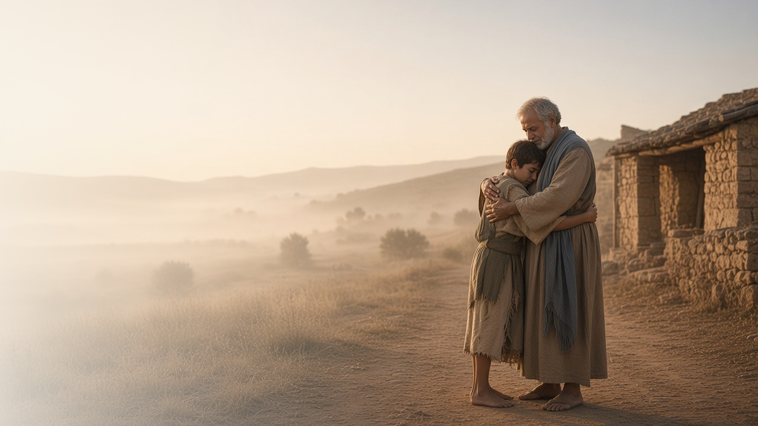
COME, FOLLOW ME · FOR CHILDREN
Rejoice with Me; for I
Have Found My Sheep
Which Was Lost
April 26–May 2
Luke 12–17; John 11
Notes:
TEACHING
This week children learn that Jesus looks for everyone who is lost and that we can help, that we can show love to Heavenly Father by being grateful, and that Jesus has power over death.
SCRIPTURE (KJV)
Luke 15:4–6
4 What man of you, having an hundred sheep, if he lose one of them, doth not leave the ninety and nine in the wilderness, and go after that which is lost, until he find it?
5 And when he hath found it, he layeth it on his shoulders, rejoicing.
6 And when he cometh home, he calleth together his friends and neighbours, saying unto them, Rejoice with me; for I have found my sheep which was lost.
DISCUSSION
• How did the shepherd feel when he found his sheep?
• How can you help someone feel loved?

Slide 2
LUKE 15
I can help find the lost
Jesus searches for everyone, and I can help Him.
“Rejoice with me; for I have found my sheep which was lost.”
LUKE 15:6
Notes:
TEACHING
Hide a paper sheep in the room and let children search for it. Tell how a shepherd left ninety-nine sheep to find the one that was lost, and how happy he was. Jesus loves everyone who feels lost or left out, and we can help by being kind and including others.
SCRIPTURE (KJV)
Luke 15:4–6
4 What man of you, having an hundred sheep, if he lose one of them, doth not leave the ninety and nine in the wilderness, and go after that which is lost, until he find it?
5 And when he hath found it, he layeth it on his shoulders, rejoicing.
6 And when he cometh home, he calleth together his friends and neighbours, saying unto them, Rejoice with me; for I have found my sheep which was lost.
DISCUSSION (questions quoted from the manual)
• “How did they feel?”
• “How else can we help these children feel Heavenly Father’s love?”
• “What are some ways people can feel “lost” like the coin or the sheep?”
• “For ideas, see “How Did the Savior Minister?” (Hymns—For Home and Church, Gospel Library) or Elder Gerrit W.”

Slide 3
LUKE 17:11–19
I can be grateful
One healed leper came back to thank Jesus.
“And one of them, when he saw that he was healed, turned back, and with a loud voice glorified God.”
LUKE 17:15
Notes:
TEACHING
Have children count to ten on their fingers as you tell how Jesus healed ten lepers. Then fold down nine: only one came back to say thank you. Help children name blessings they are grateful for and say thank you to Heavenly Father in prayer.
SCRIPTURE (KJV)
Luke 17:13–16
13 And they lifted up their voices, and said, Jesus, Master, have mercy on us.
14 And when he saw them, he said unto them, Go shew yourselves unto the priests. And it came to pass, that, as they went, they were cleansed.
15 And one of them, when he saw that he was healed, turned back, and with a loud voice glorified God,
16 And fell down on his face at his feet, giving him thanks: and he was a Samaritan.
Full passage: Luke 17:11–19
DISCUSSION (questions quoted from the manual)
• “How can we show Heavenly Father that we are thankful for these blessings?”

Slide 4
JOHN 11:1–46
Jesus has power over death
Jesus brought His friend Lazarus back to life.
“Lazarus, come forth.”
JOHN 11:43
Notes:
TEACHING
Tell how Jesus's friend Lazarus died and his sisters were very sad. Jesus cried with them because He loved them. Then He called, "Lazarus, come forth," and Lazarus came out alive. Because of Jesus, everyone will live again after they die.
SCRIPTURE (KJV)
John 11:41, 43–44
41 Then they took away the stone from the place where the dead was laid. And Jesus lifted up his eyes, and said, Father, I thank thee that thou hast heard me.
43 And when he thus had spoken, he cried with a loud voice, Lazarus, come forth.
44 And he that was dead came forth, bound hand and foot with graveclothes: and his face was bound about with a napkin. Jesus saith unto them, Loose him, and let him go.
Full passage: John 11:38–44
DISCUSSION (questions quoted from the manual)
• “How can believing in Jesus help us when we are sad or scared?”

Slide 5
JOHN 11:25
“I am the resurrection, and the life.”
Thank Heavenly Father for three blessings today.
Notes:
TEACHING
Jesus loves us, finds us, and will help us live again. Invite children to thank Heavenly Father for three blessings today.
SCRIPTURE (KJV)
John 11:25–26
25 Jesus said unto her, I am the resurrection, and the life: he that believeth in me, though he were dead, yet shall he live:
26 And whosoever liveth and believeth in me shall never die. Believest thou this?
DISCUSSION
• What blessings are you thankful for?
• How does Jesus show He loves you?

