Slide 1
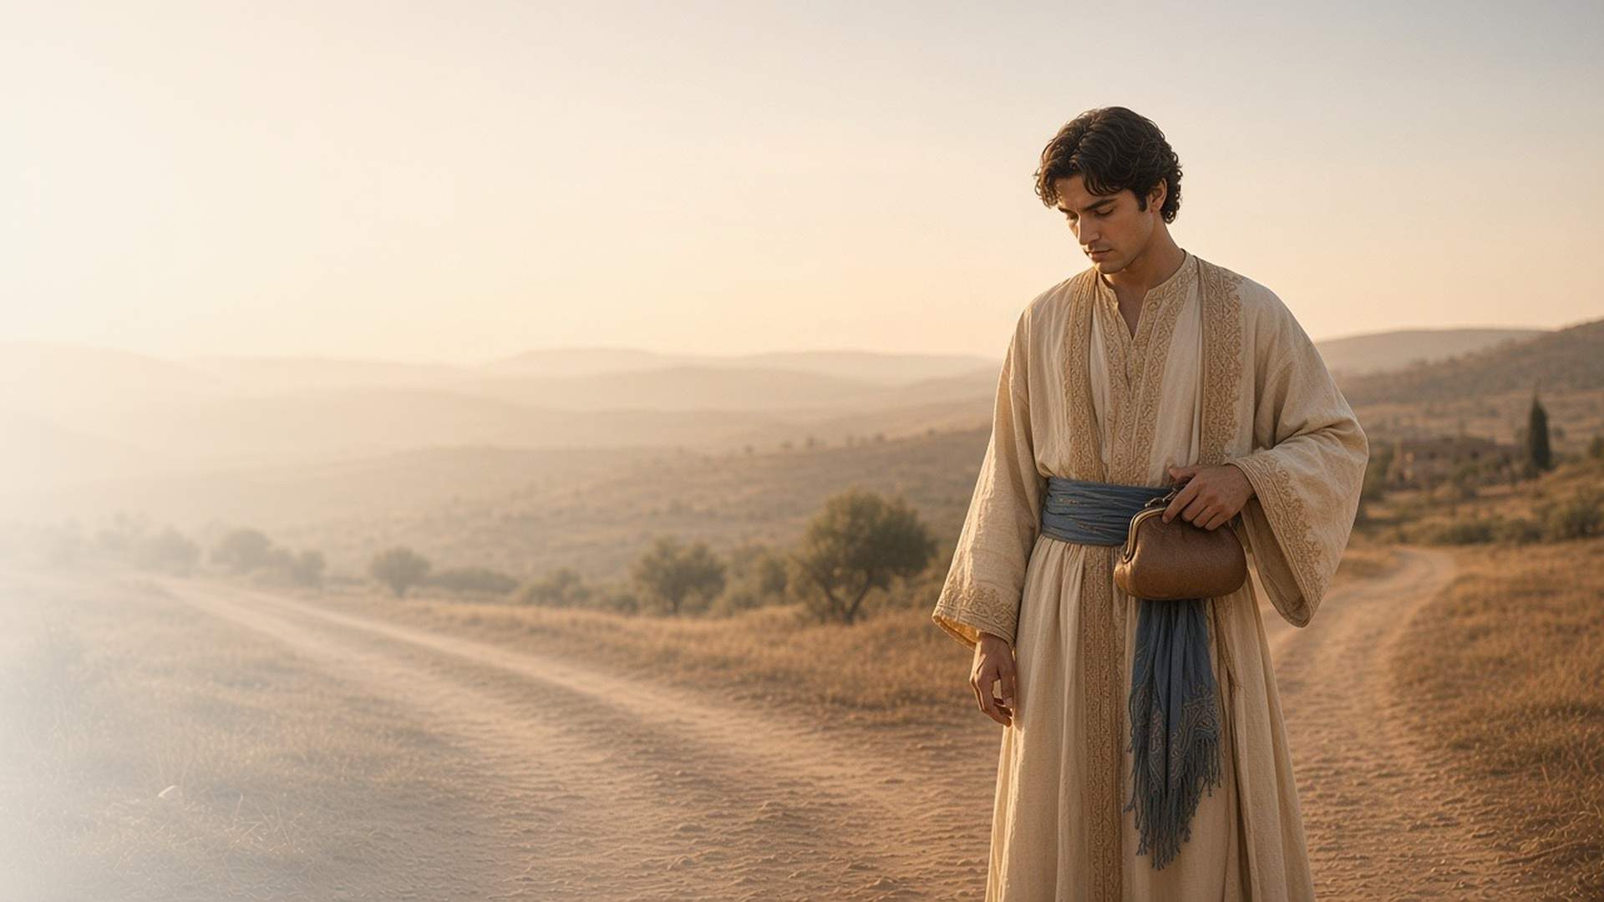
COME, FOLLOW ME · FOR CHILDREN
What Lack
I Yet?
May 3–9
Matthew 19–20; Mark 10; Luke 18
Notes:
TEACHING
This week children learn that Heavenly Father wants families to last forever, that Jesus loves little children and wants them to come to Him, that Jesus can help us know how to follow Him, and that Heavenly Father offers His blessings to all.
SCRIPTURE (KJV)
Mark 10:13–16
13 And they brought young children to him, that he should touch them: and his disciples rebuked those that brought them.
14 But when Jesus saw it, he was much displeased, and said unto them, Suffer the little children to come unto me, and forbid them not: for of such is the kingdom of God.
15 Verily I say unto you, Whosoever shall not receive the kingdom of God as a little child, he shall not enter therein.
16 And he took them up in his arms, put his hands upon them, and blessed them.
DISCUSSION
• How did Jesus treat the little children?
• How can you come closer to Jesus?

Slide 2
MARK 10:6–9
Families can last forever
Heavenly Father wants marriages and families to last.
“What therefore God hath joined together, let not man put asunder.”
MARK 10:9
Notes:
TEACHING
Show a picture of a family, perhaps your own. Explain that Heavenly Father created families and wants them to be together forever. Talk about things children can do to help their families be happy, like being kind and helping at home.
SCRIPTURE (KJV)
Mark 10:6–9
6 But from the beginning of the creation God made them male and female.
7 For this cause shall a man leave his father and mother, and cleave to his wife;
8 And they twain shall be one flesh: so then they are no more twain, but one flesh.
9 What therefore God hath joined together, let not man put asunder.
DISCUSSION (questions quoted from the manual)
• “Do you have a wedding picture you could show your children—your own or from someone in your family?”
• “Why does Heavenly Father want men and women to get married?”
• “What do we learn from these songs about how families can last forever?”

Slide 3
MARK 10:13–16
Jesus loves little children
Jesus took the children in His arms and blessed them.
“Suffer the little children to come unto me.”
MARK 10:14
Notes:
TEACHING
Tell how parents brought their children to Jesus and the disciples tried to send them away. Jesus said to let the children come, took them in His arms, and blessed them. Help each child feel that Jesus loves them.
SCRIPTURE (KJV)
Mark 10:13–16
13 And they brought young children to him, that he should touch them: and his disciples rebuked those that brought them.
14 But when Jesus saw it, he was much displeased, and said unto them, Suffer the little children to come unto me, and forbid them not: for of such is the kingdom of God.
15 Verily I say unto you, Whosoever shall not receive the kingdom of God as a little child, he shall not enter therein.
16 And he took them up in his arms, put his hands upon them, and blessed them.
DISCUSSION (questions quoted from the manual)
• “What would they say to Jesus?”
• “What do we learn about Jesus from this story?”

Slide 4
MATTHEW 19:16–22
Jesus helps me follow Him
Jesus can show me what I need to do to follow Him.
“Come and follow me.”
MATTHEW 19:21
Notes:
TEACHING
Play follow the leader. Tell how a young man asked Jesus what he needed to do, and Jesus told him to follow Him. Explain that we can pray and ask Jesus what we can do to follow Him better.
SCRIPTURE (KJV)
Matthew 19:16, 21–22
16 And, behold, one came and said unto him, Good Master, what good thing shall I do, that I may have eternal life?
21 Jesus said unto him, If thou wilt be perfect, go and sell that thou hast, and give to the poor, and thou shalt have treasure in heaven: and come and follow me.
22 But when the young man heard that saying, he went away sorrowful: for he had great possessions.
Full passage: Matthew 19:16–22
DISCUSSION (questions quoted from the manual)
• “To help your children personalize the story, you could give each of them a piece of paper that says What lack I yet?”

Slide 5
MATTHEW 20:1–16
Blessings for everyone
Heavenly Father wants to give His blessings to all His children.
“Go ye also into the vineyard, and whatsoever is right I will give you.”
MATTHEW 20:4
Notes:
TEACHING
Tell the story of the workers in the vineyard simply: some came early and some came late, but the master gave each the same reward. Heavenly Father loves all His children and wants to give everyone His blessings.
SCRIPTURE (KJV)
Matthew 20:1, 4, 9
1 For the kingdom of heaven is like unto a man that is an householder, which went out early in the morning to hire labourers into his vineyard.
4 And said unto them; Go ye also into the vineyard, and whatsoever is right I will give you. And they went their way.
9 And when they came that were hired about the eleventh hour, they received every man a penny.
Full passage: Matthew 20:1–9
DISCUSSION (questions quoted from the manual)
• “For example, how should we react when someone else receives a generous blessing from the Lord?”

Slide 6
MARK 10:14
“Suffer the little children to come unto me,
and forbid them not.”
Remember that Jesus loves you and wants you near.
Notes:
TEACHING
Jesus wants every child to come to Him. Invite children to remember all week that He loves them.
SCRIPTURE (KJV)
Mark 10:14–16
14 But when Jesus saw it, he was much displeased, and said unto them, Suffer the little children to come unto me, and forbid them not: for of such is the kingdom of God.
15 Verily I say unto you, Whosoever shall not receive the kingdom of God as a little child, he shall not enter therein.
16 And he took them up in his arms, put his hands upon them, and blessed them.
DISCUSSION
• How can you come to Jesus?
• How did Jesus show He loved the children?

