Slide 1
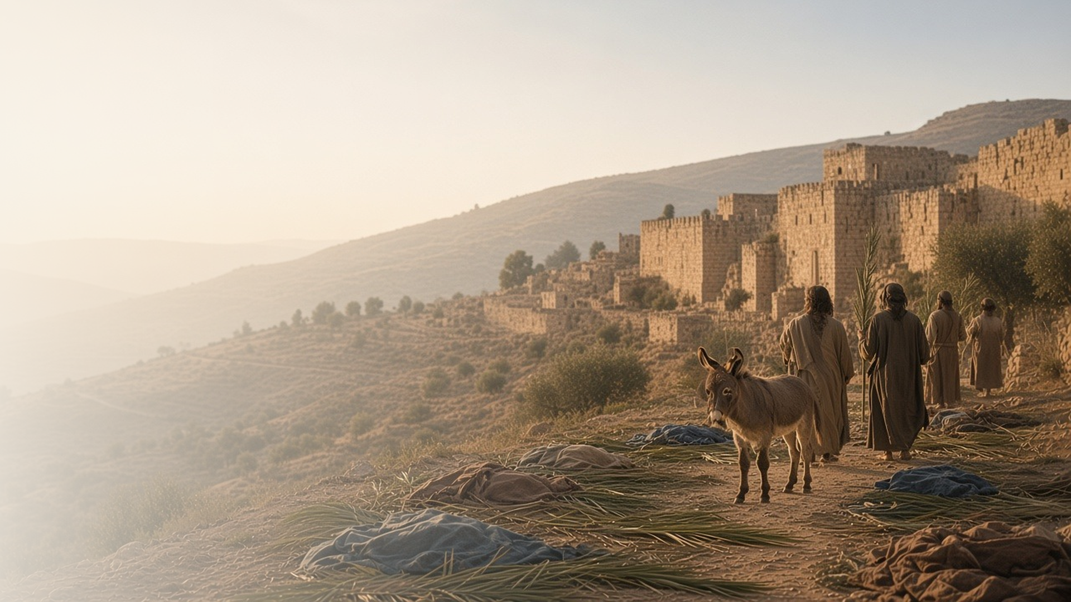
COME, FOLLOW ME · NEW TESTAMENT 2027
Behold, Thy King
Cometh
May 10–16
Matthew 21–23; Mark 11; Luke 19–20; John 12
Notes:
TEACHING
Jesus enters Jerusalem as the meek King foretold by Zechariah. Along the way He calls Zacchaeus down from a tree, and in the city He answers trick questions about taxes and the greatest commandment, then condemns hypocrisy that cleans only the outside of the cup. These chapters invite us to receive Him as our King with our whole hearts.
SCRIPTURE (KJV)
Matthew 21:4–9
4 All this was done, that it might be fulfilled which was spoken by the prophet, saying,
5 Tell ye the daughter of Sion, Behold, thy King cometh unto thee, meek, and sitting upon an ass, and a colt the foal of an ass.
6 And the disciples went, and did as Jesus commanded them,
7 And brought the ass, and the colt, and put on them their clothes, and they set him thereon.
8 And a very great multitude spread their garments in the way; others cut down branches from the trees, and strawed them in the way.
9 And the multitudes that went before, and that followed, cried, saying, Hosanna to the Son of David: Blessed is he that cometh in the name of the Lord; Hosanna in the highest.
DISCUSSION
• What does it mean to you to make Jesus your King?
• Where do you see the Savior looking on the heart in these chapters?

Slide 2
LUKE 19:1–10
Zacchaeus, come down
Jesus saw past a tax collector’s reputation to his heart.
“For the Son of man is come to seek and to save that which was lost.”
LUKE 19:10
Notes:
TEACHING
Zacchaeus was a chief publican, rich and disliked, and too short to see over the crowd. Jesus stopped beneath his tree, called him by name, and invited Himself to his house. The crowd murmured, but Zacchaeus pledged to give half his goods to the poor and repay fourfold. The Lord judges by the heart and came to seek and save the lost.
SCRIPTURE (KJV)
Luke 19:1–10
1 And Jesus entered and passed through Jericho.
2 And, behold, there was a man named Zacchaeus, which was the chief among the publicans, and he was rich.
3 And he sought to see Jesus who he was; and could not for the press, because he was little of stature.
4 And he ran before, and climbed up into a sycomore tree to see him: for he was to pass that way.
5 And when Jesus came to the place, he looked up, and saw him, and said unto him, Zacchaeus, make haste, and come down; for to day I must abide at thy house.
6 And he made haste, and came down, and received him joyfully.
7 And when they saw it, they all murmured, saying, That he was gone to be guest with a man that is a sinner.
8 And Zacchaeus stood, and said unto the Lord; Behold, Lord, the half of my goods I give to the poor; and if I have taken any thing from any man by false accusation, I restore him fourfold.
9 And Jesus said unto him, This day is salvation come to this house, forsomuch as he also is a son of Abraham.
10 For the Son of man is come to seek and to save that which was lost.
DISCUSSION (questions quoted from the manual)
• “What do you notice about Zacchaeus’s heart in Luke 19:1–10?”
• “What evidence do you see of his commitment to the Savior?”
• “What do you think Zacchaeus learned about the Savior from his experience?”
• “What does the Savior understand about you that might not be obvious to others?”

Slide 3
MATTHEW 21:1–11; MARK 11:1–11; LUKE 19:29–44; JOHN 12:1–8, 12–16
My Savior and my King
Crowds hailed Him, and He wept over the city He came to save.
“Hosanna: Blessed is the King of Israel that cometh in the name of the Lord.”
JOHN 12:13
Notes:
TEACHING
Days before His death, Mary anointed Jesus at Bethany, and crowds met Him with palm branches crying hosanna. Yet as He came near Jerusalem, He wept over a city that did not recognize its time of visitation. Invite class members to consider how they welcome Him as both Savior and King.
SCRIPTURE (KJV)
John 12:12–16
12 On the next day much people that were come to the feast, when they heard that Jesus was coming to Jerusalem,
13 Took branches of palm trees, and went forth to meet him, and cried, Hosanna: Blessed is the King of Israel that cometh in the name of the Lord.
14 And Jesus, when he had found a young ass, sat thereon; as it is written,
15 Fear not, daughter of Sion: behold, thy King cometh, sitting on an ass’s colt.
16 These things understood not his disciples at the first: but when Jesus was glorified, then remembered they that these things were written of him, and that they had done these things unto him.
Luke 19:41–42
41 And when he was come near, he beheld the city, and wept over it,
42 Saying, If thou hadst known, even thou, at least in this thy day, the things which belong unto thy peace! but now they are hid from thine eyes.
DISCUSSION (questions quoted from the manual)
• “How can you receive the Savior as your King?”

Slide 4
MATTHEW 22:15–22; LUKE 20:21–26
Render unto God
We bear His image, so we give ourselves to Him.
“Render therefore unto Caesar the things which are Caesar’s; and unto God the things that are God’s.”
MATTHEW 22:21
Notes:
TEACHING
Pharisees and Herodians tried to trap Jesus with a question about tribute. He asked whose image was on the coin. Caesar's image was on the money; God's image is on us. Discuss what it means to give God the things that are His, including our hearts, time, and lives.
SCRIPTURE (KJV)
Matthew 22:15–22
15 Then went the Pharisees, and took counsel how they might entangle him in his talk.
16 And they sent out unto him their disciples with the Herodians, saying, Master, we know that thou art true, and teachest the way of God in truth, neither carest thou for any man: for thou regardest not the person of men.
17 Tell us therefore, What thinkest thou? Is it lawful to give tribute unto Caesar, or not?
18 But Jesus perceived their wickedness, and said, Why tempt ye me, ye hypocrites?
19 Shew me the tribute money. And they brought unto him a penny.
20 And he saith unto them, Whose is this image and superscription?
21 They say unto him, Caesar’s. Then saith he unto them, Render therefore unto Caesar the things which are Caesar’s; and unto God the things that are God’s.
22 When they had heard these words, they marvelled, and left him, and went their way.
DISCUSSION (questions quoted from the manual)
• “What are “the things that are God’s”?”
• “God, or give Him, those things?”

Slide 5
MATTHEW 22:35–40
The two great commandments
All the law hangs on love for God and for our neighbor.
“Thou shalt love the Lord thy God with all thy heart, and with all thy soul, and with all thy mind.”
MATTHEW 22:37
Notes:
TEACHING
A lawyer asked which commandment is the greatest. Jesus named two: love God with all your heart, soul, and mind, and love your neighbor as yourself. Every other commandment hangs on these. Invite class members to consider how loving God and loving others strengthen each other.
SCRIPTURE (KJV)
Matthew 22:35–40
35 Then one of them, which was a lawyer, asked him a question, tempting him, and saying,
36 Master, which is the great commandment in the law?
37 Jesus said unto him, Thou shalt love the Lord thy God with all thy heart, and with all thy soul, and with all thy mind.
38 This is the first and great commandment.
39 And the second is like unto it, Thou shalt love thy neighbour as thyself.
40 On these two commandments hang all the law and the prophets.
DISCUSSION (questions quoted from the manual)
• “An example can be found in His response to the question “Which is the great commandment in the law?” (Matthew 22:36).”
• “Have you ever faced a situation where it felt difficult to keep both of the two great commandments?”
• “What do you do in those situations?”

Slide 6
MATTHEW 23; LUKE 20:45–47
Clean within
Jesus condemned hypocrisy that polishes only the outside.
“Thou blind Pharisee, cleanse first that which is within the cup and platter, that the outside of them may be clean also.”
MATTHEW 23:26
Notes:
TEACHING
In Matthew 23 Jesus pronounced woes on scribes and Pharisees who tithed spices but neglected justice, mercy, and faith, and who cleaned the outside of the cup while the inside was full of excess. True discipleship begins within. Invite class members to look honestly at their motives with the Savior's help.
SCRIPTURE (KJV)
Matthew 23:23–28
23 Woe unto you, scribes and Pharisees, hypocrites! for ye pay tithe of mint and anise and cummin, and have omitted the weightier matters of the law, judgment, mercy, and faith: these ought ye to have done, and not to leave the other undone.
24 Ye blind guides, which strain at a gnat, and swallow a camel.
25 Woe unto you, scribes and Pharisees, hypocrites! for ye make clean the outside of the cup and of the platter, but within they are full of extortion and excess.
26 Thou blind Pharisee, cleanse first that which is within the cup and platter, that the outside of them may be clean also.
27 Woe unto you, scribes and Pharisees, hypocrites! for ye are like unto whited sepulchres, which indeed appear beautiful outward, but are within full of dead men’s bones, and of all uncleanness.
28 Even so ye also outwardly appear righteous unto men, but within ye are full of hypocrisy and iniquity.
DISCUSSION (questions quoted from the manual)
• “What is the difference between hypocrisy and the human weaknesses we all deal with as we try to live the gospel?”
• “What are you inspired to do differently because of the Savior’s teachings in Matthew 23 and Luke 20:45–47?”

Slide 7
MATTHEW 22:39
“And the second is like unto it,
Thou shalt love thy neighbour as thyself.”
Give God one more thing that is His this week.
Notes:
TEACHING
The King who entered Jerusalem asks for our whole hearts: love for God and love for each other. Close by inviting class members to give the Lord one more thing that is His this week.
SCRIPTURE (KJV)
Matthew 22:37–40
37 Jesus said unto him, Thou shalt love the Lord thy God with all thy heart, and with all thy soul, and with all thy mind.
38 This is the first and great commandment.
39 And the second is like unto it, Thou shalt love thy neighbour as thyself.
40 On these two commandments hang all the law and the prophets.
DISCUSSION
• What is one thing you could give more fully to God?
• How will you show love to a neighbor this week?

