Slide 1
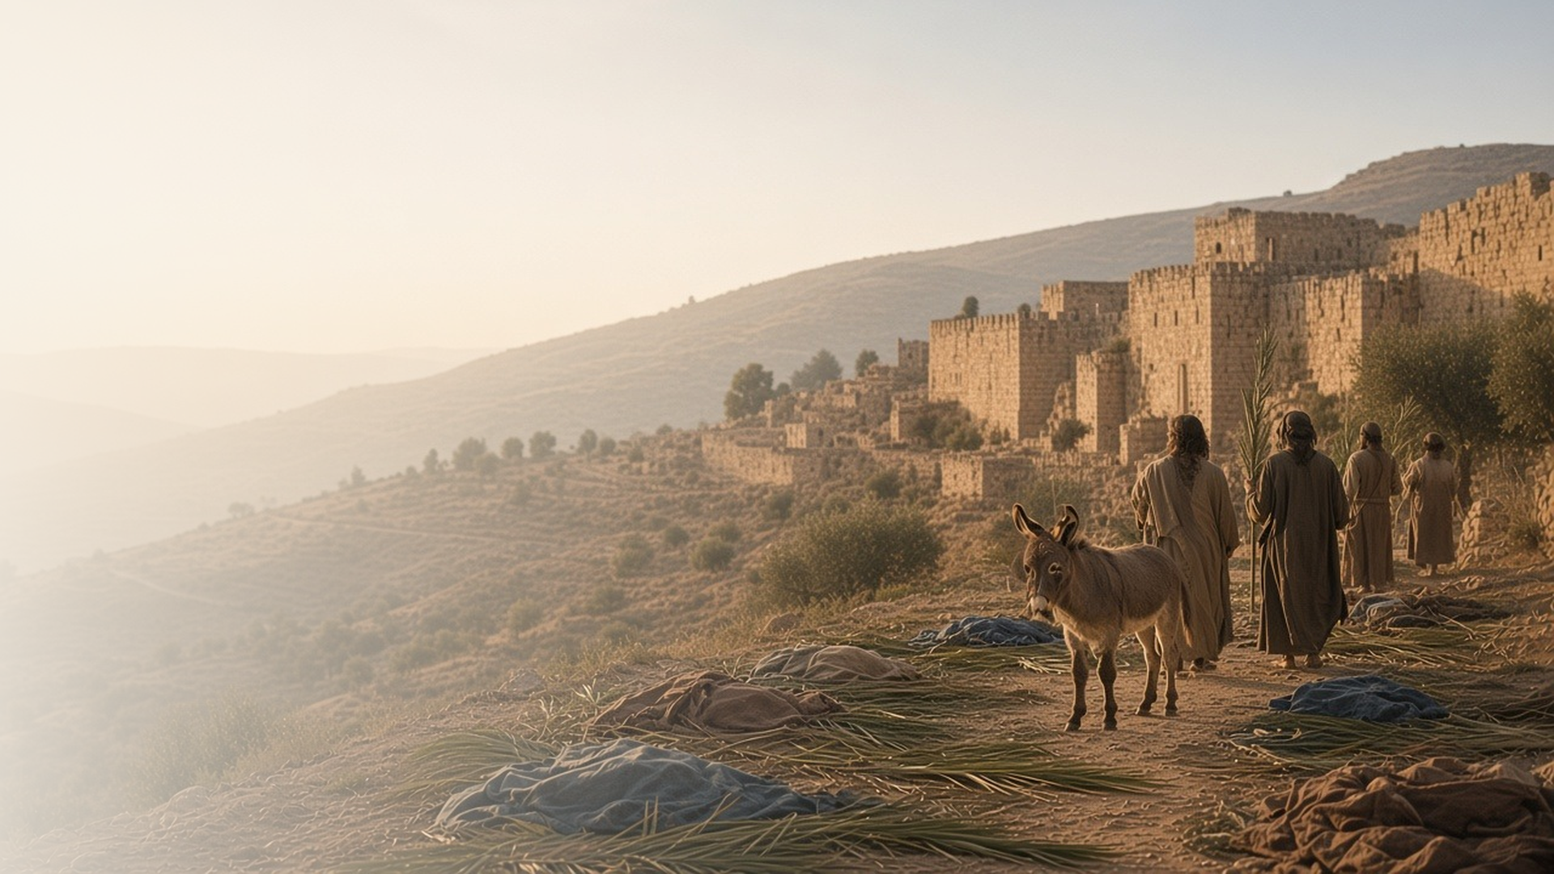
COME, FOLLOW ME · FOR CHILDREN
Behold, Thy King
Cometh
May 10–16
Matthew 21–23; Mark 11; Luke 19–20; John 12
Notes:
TEACHING
This week children learn that Jesus knows each of us by name, that Jesus is our King, that the temple is a sacred place, and that Jesus wants us to be good for the right reasons.
SCRIPTURE (KJV)
Luke 19:5–6
5 And when Jesus came to the place, he looked up, and saw him, and said unto him, Zacchaeus, make haste, and come down; for to day I must abide at thy house.
6 And he made haste, and came down, and received him joyfully.
DISCUSSION
• How did Jesus treat Zacchaeus?
• How can we welcome Jesus as our King?

Slide 2
LUKE 19:1–10
Jesus knows my name
Jesus called Zacchaeus by name and came to his house.
“Zacchaeus, make haste, and come down; for to day I must abide at thy house.”
LUKE 19:5
Notes:
TEACHING
Have a child stand on a chair like Zacchaeus in the tree. Tell how Jesus stopped, looked up, and called him by name. Say each child's name and testify that Jesus knows and loves each of them personally.
SCRIPTURE (KJV)
Luke 19:3–6
3 And he sought to see Jesus who he was; and could not for the press, because he was little of stature.
4 And he ran before, and climbed up into a sycomore tree to see him: for he was to pass that way.
5 And when Jesus came to the place, he looked up, and saw him, and said unto him, Zacchaeus, make haste, and come down; for to day I must abide at thy house.
6 And he made haste, and came down, and received him joyfully.
Full passage: Luke 19:1–6
DISCUSSION (questions quoted from the manual)
• “What can we do to, like Zacchaeus, get closer to Jesus or learn more about Him?”

Slide 3
MATTHEW 21:1–11, 15–16
Jesus is my King
People sang “Hosanna” to welcome Jesus as their King.
“Hosanna to the Son of David.”
MATTHEW 21:9
Notes:
TEACHING
Let children wave paper palm leaves and say hosanna. Explain that people welcomed Jesus as their King, and even children in the temple praised Him. Talk about how we can show Jesus that He is our King.
SCRIPTURE (KJV)
Matthew 21:8–9
8 And a very great multitude spread their garments in the way; others cut down branches from the trees, and strawed them in the way.
9 And the multitudes that went before, and that followed, cried, saying, Hosanna to the Son of David: Blessed is he that cometh in the name of the Lord; Hosanna in the highest.
Matthew 21:15–16
15 And when the chief priests and scribes saw the wonderful things that he did, and the children crying in the temple, and saying, Hosanna to the Son of David; they were sore displeased,
16 And said unto him, Hearest thou what these say? And Jesus saith unto them, Yea; have ye never read, Out of the mouth of babes and sucklings thou hast perfected praise?
DISCUSSION (questions quoted from the manual)
• “How can we show that we want Jesus to be our King?”

Slide 4
MATTHEW 21:12–14
The temple is sacred
Jesus taught that the temple is a house of prayer.
“My house shall be called the house of prayer.”
MATTHEW 21:13
Notes:
TEACHING
Show a picture of a temple. Explain that Jesus cleared people out of the temple who were not treating it with respect, and then He healed the blind and the lame there. The temple is Heavenly Father's house, and we can prepare to go there someday.
SCRIPTURE (KJV)
Matthew 21:12–14
12 And Jesus went into the temple of God, and cast out all them that sold and bought in the temple, and overthrew the tables of the moneychangers, and the seats of them that sold doves,
13 And said unto them, It is written, My house shall be called the house of prayer; but ye have made it a den of thieves.
14 And the blind and the lame came to him in the temple; and he healed them.
DISCUSSION (questions quoted from the manual)
• “How can we help Jesus keep the temple holy or sacred?”

Slide 5
MATTHEW 23:25–28
Good for the right reasons
Jesus wants me to be good inside, not just to look good.
“Cleanse first that which is within the cup and platter.”
MATTHEW 23:26
Notes:
TEACHING
Show a cup that is clean outside and dirty inside. Ask which part matters most. Jesus wants us to be good in our hearts, doing kind things because we love Him, not just so others will see.
SCRIPTURE (KJV)
Matthew 23:25–28
25 Woe unto you, scribes and Pharisees, hypocrites! for ye make clean the outside of the cup and of the platter, but within they are full of extortion and excess.
26 Thou blind Pharisee, cleanse first that which is within the cup and platter, that the outside of them may be clean also.
27 Woe unto you, scribes and Pharisees, hypocrites! for ye are like unto whited sepulchres, which indeed appear beautiful outward, but are within full of dead men’s bones, and of all uncleanness.
28 Even so ye also outwardly appear righteous unto men, but within ye are full of hypocrisy and iniquity.
DISCUSSION (questions quoted from the manual)
• “How is the dirty cup like a hypocrite?”
• “How can we ensure we are clean and pure on the inside?”

Slide 6
JOHN 12:13
“Blessed is the King of Israel
that cometh in the name of the Lord.”
Sing a song this week to praise Jesus, our King.
Notes:
TEACHING
Jesus is our King. Invite children to sing a favorite song about Jesus this week.
SCRIPTURE (KJV)
John 12:12–13
12 On the next day much people that were come to the feast, when they heard that Jesus was coming to Jerusalem,
13 Took branches of palm trees, and went forth to meet him, and cried, Hosanna: Blessed is the King of Israel that cometh in the name of the Lord.
DISCUSSION
• What song can you sing to praise Jesus?
• How can you show Jesus you love Him?

