Slide 1
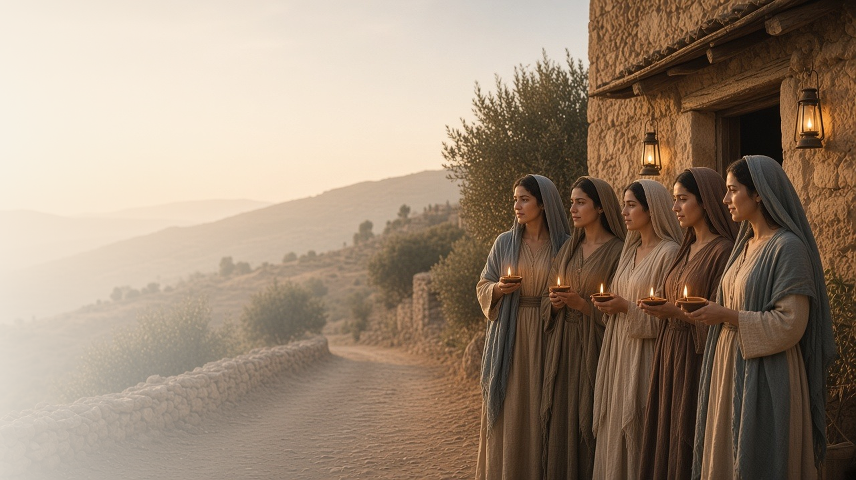
COME, FOLLOW ME · NEW TESTAMENT 2027
The Son of Man
Shall Come
May 17–23
Joseph Smith—Matthew 1; Matthew 24–25;
Mark 12–13; Luke 21
Notes:
TEACHING
On the Mount of Olives, Jesus told His disciples about the destruction of the temple and the signs of His Second Coming. Joseph Smith's inspired revision of Matthew 24 (Joseph Smith—Matthew 1 in the Pearl of Great Price) clarifies these teachings. Through parables of ten virgins and talents, and the example of a widow's mites, Jesus teaches us to watch, prepare, and give our all.
SCRIPTURE (KJV)
Matthew 24:36–44
36 But of that day and hour knoweth no man, no, not the angels of heaven, but my Father only.
37 But as the days of Noe were, so shall also the coming of the Son of man be.
38 For as in the days that were before the flood they were eating and drinking, marrying and giving in marriage, until the day that Noe entered into the ark,
39 And knew not until the flood came, and took them all away; so shall also the coming of the Son of man be.
40 Then shall two be in the field; the one shall be taken, and the other left.
41 Two women shall be grinding at the mill; the one shall be taken, and the other left.
42 Watch therefore: for ye know not what hour your Lord doth come.
43 But know this, that if the goodman of the house had known in what watch the thief would come, he would have watched, and would not have suffered his house to be broken up.
44 Therefore be ye also ready: for in such an hour as ye think not the Son of man cometh.
Restoration scripture (public-domain text: bcbooks/scriptures-json)
Joseph Smith—Matthew 1:4, 22–23, 29, 31, 33, 36–37, 40, 46, 48, 50 (Pearl of Great Price)
4 And Jesus left them, and went upon the Mount of Olives. And as he sat upon the Mount of Olives, the disciples came unto him privately, saying: Tell us when shall these things be which thou hast said concerning the destruction of the temple, and the Jews; and what is the sign of thy coming, and of the end of the world, or the destruction of the wicked, which is the end of the world?
22 For in those days there shall also arise false Christs, and false prophets, and shall show great signs and wonders, insomuch, that, if possible, they shall deceive the very elect, who are the elect according to the covenant.
23 Behold, I speak these things unto you for the elect's sake; and you also shall hear of wars, and rumors of wars; see that ye be not troubled, for all I have told you must come to pass; but the end is not yet.
29 Behold I speak for mine elect's sake; for nation shall rise against nation, and kingdom against kingdom; there shall be famines, and pestilences, and earthquakes, in divers places.
31 And again, this Gospel of the Kingdom shall be preached in all the world, for a witness unto all nations, and then shall the end come, or the destruction of the wicked;
33 And immediately after the tribulation of those days, the sun shall be darkened, and the moon shall not give her light, and the stars shall fall from heaven, and the powers of heaven shall be shaken.
36 And, as I said before, after the tribulation of those days, and the powers of the heavens shall be shaken, then shall appear the sign of the Son of Man in heaven, and then shall all the tribes of the earth mourn; and they shall see the Son of Man coming in the clouds of heaven, with power and great glory;
37 And whoso treasureth up my word, shall not be deceived, for the Son of Man shall come, and he shall send his angels before him with the great sound of a trumpet, and they shall gather together the remainder of his elect from the four winds, from one end of heaven to the other.
40 But of that day, and hour, no one knoweth; no, not the angels of God in heaven, but my Father only.
46 And what I say unto one, I say unto all men; watch, therefore, for you know not at what hour your Lord doth come.
48 Therefore be ye also ready, for in such an hour as ye think not, the Son of Man cometh.
50 Blessed is that servant whom his lord, when he cometh, shall find so doing; and verily I say unto you, he shall make him ruler over all his goods.
Full passage: Joseph Smith—Matthew 1
DISCUSSION
• Do you think about the Second Coming with hope or with worry? Why?
• What is one way you are preparing to meet the Savior?

Slide 2
JOSEPH SMITH—MATTHEW 1:22–37; MATTHEW 24:24–31; MARK 13:22–27; LUKE 21:25–28
Look up with hope
Signs of His coming are reasons for faith, not fear.
“Then look up, and lift up your heads; for your redemption draweth nigh.”
LUKE 21:28
Notes:
TEACHING
Jesus described wars, earthquakes, and signs in the heavens, but He also told His disciples to look up and lift up their heads, because their redemption was near. The manual pairs these passages with Joseph Smith—Matthew 1:22–37. Joseph Smith—Matthew (Pearl of Great Price) is included in the scripture section below. The last days are a time for faith and hope in the Redeemer.
SCRIPTURE (KJV)
Matthew 24:29–31
29 Immediately after the tribulation of those days shall the sun be darkened, and the moon shall not give her light, and the stars shall fall from heaven, and the powers of the heavens shall be shaken:
30 And then shall appear the sign of the Son of man in heaven: and then shall all the tribes of the earth mourn, and they shall see the Son of man coming in the clouds of heaven with power and great glory.
31 And he shall send his angels with a great sound of a trumpet, and they shall gather together his elect from the four winds, from one end of heaven to the other.
Luke 21:25–28
25 And there shall be signs in the sun, and in the moon, and in the stars; and upon the earth distress of nations, with perplexity; the sea and the waves roaring;
26 Men’s hearts failing them for fear, and for looking after those things which are coming on the earth: for the powers of heaven shall be shaken.
27 And then shall they see the Son of man coming in a cloud with power and great glory.
28 And when these things begin to come to pass, then look up, and lift up your heads; for your redemption draweth nigh.
Restoration scripture (public-domain text: bcbooks/scriptures-json)
Joseph Smith—Matthew 1:22–23, 26, 28–31, 33–37 (Pearl of Great Price)
22 For in those days there shall also arise false Christs, and false prophets, and shall show great signs and wonders, insomuch, that, if possible, they shall deceive the very elect, who are the elect according to the covenant.
23 Behold, I speak these things unto you for the elect's sake; and you also shall hear of wars, and rumors of wars; see that ye be not troubled, for all I have told you must come to pass; but the end is not yet.
26 For as the light of the morning cometh out of the east, and shineth even unto the west, and covereth the whole earth, so shall also the coming of the Son of Man be.
28 And they shall hear of wars, and rumors of wars.
29 Behold I speak for mine elect's sake; for nation shall rise against nation, and kingdom against kingdom; there shall be famines, and pestilences, and earthquakes, in divers places.
30 And again, because iniquity shall abound, the love of men shall wax cold; but he that shall not be overcome, the same shall be saved.
31 And again, this Gospel of the Kingdom shall be preached in all the world, for a witness unto all nations, and then shall the end come, or the destruction of the wicked;
33 And immediately after the tribulation of those days, the sun shall be darkened, and the moon shall not give her light, and the stars shall fall from heaven, and the powers of heaven shall be shaken.
34 Verily, I say unto you, this generation, in which these things shall be shown forth, shall not pass away until all I have told you shall be fulfilled.
35 Although, the days will come, that heaven and earth shall pass away; yet my words shall not pass away, but all shall be fulfilled.
36 And, as I said before, after the tribulation of those days, and the powers of the heavens shall be shaken, then shall appear the sign of the Son of Man in heaven, and then shall all the tribes of the earth mourn; and they shall see the Son of Man coming in the clouds of heaven, with power and great glory;
37 And whoso treasureth up my word, shall not be deceived, for the Son of Man shall come, and he shall send his angels before him with the great sound of a trumpet, and they shall gather together the remainder of his elect from the four winds, from one end of heaven to the other.
Full passage: Joseph Smith—Matthew 1:22–37
DISCUSSION (questions quoted from the manual)
• “As the Savior’s coming approaches, what will we see, hear, and feel?”
• “What should we watch for, prepare for, or guard against?”
• “What reasons do you find to be hopeful in these verses?”

Slide 3
JOSEPH SMITH—MATTHEW 1:26–27, 38–55; MATTHEW 25:1–13; MARK 13:21–37; LUKE 21:29–36
Watch and be ready
Five wise virgins kept oil in their lamps; five did not.
“Watch therefore, for ye know neither the day nor the hour wherein the Son of man cometh.”
MATTHEW 25:13
Notes:
TEACHING
Ten virgins waited for the bridegroom. When he came at midnight, five had oil and five had none, and oil could not be borrowed at the last moment. Preparation for the Lord's coming happens drop by drop, through daily faithfulness. The manual also points to Joseph Smith—Matthew 1:26–27, 38–55. Joseph Smith—Matthew (Pearl of Great Price) is included in the scripture section below.
SCRIPTURE (KJV)
Matthew 25:1–13
1 Then shall the kingdom of heaven be likened unto ten virgins, which took their lamps, and went forth to meet the bridegroom.
2 And five of them were wise, and five were foolish.
3 They that were foolish took their lamps, and took no oil with them:
4 But the wise took oil in their vessels with their lamps.
5 While the bridegroom tarried, they all slumbered and slept.
6 And at midnight there was a cry made, Behold, the bridegroom cometh; go ye out to meet him.
7 Then all those virgins arose, and trimmed their lamps.
8 And the foolish said unto the wise, Give us of your oil; for our lamps are gone out.
9 But the wise answered, saying, Not so; lest there be not enough for us and you: but go ye rather to them that sell, and buy for yourselves.
10 And while they went to buy, the bridegroom came; and they that were ready went in with him to the marriage: and the door was shut.
11 Afterward came also the other virgins, saying, Lord, Lord, open to us.
12 But he answered and said, Verily I say unto you, I know you not.
13 Watch therefore, for ye know neither the day nor the hour wherein the Son of man cometh.
Restoration scripture (public-domain text: bcbooks/scriptures-json)
Joseph Smith—Matthew 1:26, 38–41, 43, 46–50, 53 (Pearl of Great Price)
26 For as the light of the morning cometh out of the east, and shineth even unto the west, and covereth the whole earth, so shall also the coming of the Son of Man be.
38 Now learn a parable of the fig tree—When its branches are yet tender, and it begins to put forth leaves, you know that summer is nigh at hand;
39 So likewise, mine elect, when they shall see all these things, they shall know that he is near, even at the doors;
40 But of that day, and hour, no one knoweth; no, not the angels of God in heaven, but my Father only.
41 But as it was in the days of Noah, so it shall be also at the coming of the Son of Man;
43 And knew not until the flood came, and took them all away; so shall also the coming of the Son of Man be.
46 And what I say unto one, I say unto all men; watch, therefore, for you know not at what hour your Lord doth come.
47 But know this, if the good man of the house had known in what watch the thief would come, he would have watched, and would not have suffered his house to have been broken up, but would have been ready.
48 Therefore be ye also ready, for in such an hour as ye think not, the Son of Man cometh.
49 Who, then, is a faithful and wise servant, whom his lord hath made ruler over his household, to give them meat in due season?
50 Blessed is that servant whom his lord, when he cometh, shall find so doing; and verily I say unto you, he shall make him ruler over all his goods.
53 The lord of that servant shall come in a day when he looketh not for him, and in an hour that he is not aware of,
Full passage: Joseph Smith—Matthew 1:26–27, 38–55
DISCUSSION (questions quoted from the manual)
• “What is the Savior trying to teach me?”
• “What should I do?”
• “How do the Savior’s teachings in these parables help you prepare to receive Him?”
• “What does it mean to be prepared for the Savior’s return?”

Slide 4
MATTHEW 25:14–30
Use what He has given
The servants who invested their talents heard “well done.”
“Well done, thou good and faithful servant: thou hast been faithful over a few things, I will make thee ruler over many things.”
MATTHEW 25:21
Notes:
TEACHING
A master entrusted talents to three servants. Two put theirs to work and doubled them; the third, afraid, buried his. Heavenly Father expects us to use and develop the gifts He gives, not to hide them out of fear. Invite class members to name gifts the Lord has given them and how they might use them.
SCRIPTURE (KJV)
Matthew 25:14–30
14 For the kingdom of heaven is as a man travelling into a far country, who called his own servants, and delivered unto them his goods.
15 And unto one he gave five talents, to another two, and to another one; to every man according to his several ability; and straightway took his journey.
16 Then he that had received the five talents went and traded with the same, and made them other five talents.
17 And likewise he that had received two, he also gained other two.
18 But he that had received one went and digged in the earth, and hid his lord’s money.
19 After a long time the lord of those servants cometh, and reckoneth with them.
20 And so he that had received five talents came and brought other five talents, saying, Lord, thou deliveredst unto me five talents: behold, I have gained beside them five talents more.
21 His lord said unto him, Well done, thou good and faithful servant: thou hast been faithful over a few things, I will make thee ruler over many things: enter thou into the joy of thy lord.
22 He also that had received two talents came and said, Lord, thou deliveredst unto me two talents: behold, I have gained two other talents beside them.
23 His lord said unto him, Well done, good and faithful servant; thou hast been faithful over a few things, I will make thee ruler over many things: enter thou into the joy of thy lord.
24 Then he which had received the one talent came and said, Lord, I knew thee that thou art an hard man, reaping where thou hast not sown, and gathering where thou hast not strawed:
25 And I was afraid, and went and hid thy talent in the earth: lo, there thou hast that is thine.
26 His lord answered and said unto him, Thou wicked and slothful servant, thou knewest that I reap where I sowed not, and gather where I have not strawed:
27 Thou oughtest therefore to have put my money to the exchangers, and then at my coming I should have received mine own with usury.
28 Take therefore the talent from him, and give it unto him which hath ten talents.
29 For unto every one that hath shall be given, and he shall have abundance: but from him that hath not shall be taken away even that which he hath.
30 And cast ye the unprofitable servant into outer darkness: there shall be weeping and gnashing of teeth.
DISCUSSION (questions quoted from the manual)
• “Who could you bless with what God has given you?”
• “What stops you from using these gifts or blessings the way God intends?”
• “What can you do to ensure they are not “buried”?”
• “Why would magnifying your gifts and blessings help prepare you to “enter … into the joy of thy lord”? (verse 21).”

Slide 5
MARK 12:38–44; LUKE 21:1–4
The widow’s two mites
The Savior saw that her small gift was all she had.
“This poor widow hath cast more in, than all they which have cast into the treasury.”
MARK 12:43
Notes:
TEACHING
Jesus sat near the temple treasury and watched rich people give large sums. Then a poor widow cast in two mites, almost nothing. Jesus said she had given more than all the others, because she gave all she had. The Savior sees and honors humble, wholehearted sacrifice.
SCRIPTURE (KJV)
Mark 12:41–44
41 And Jesus sat over against the treasury, and beheld how the people cast money into the treasury: and many that were rich cast in much.
42 And there came a certain poor widow, and she threw in two mites, which make a farthing.
43 And he called unto him his disciples, and saith unto them, Verily I say unto you, That this poor widow hath cast more in, than all they which have cast into the treasury:
44 For all they did cast in of their abundance; but she of her want did cast in all that she had, even all her living.
DISCUSSION (questions quoted from the manual)
• “What do these verses teach you about how the Savior views your offerings?”
• “How do your offerings show your love for Him?”

Slide 6
MATTHEW 24:44
“Therefore be ye also ready: for in such an hour
as ye think not the Son of man cometh.”
Add one drop of oil to your lamp each day this week.
Notes:
TEACHING
The Lord does not ask us to know the day or hour, only to be ready. Close by inviting class members to choose one daily act of preparation, one drop of oil at a time.
SCRIPTURE (KJV)
Matthew 24:42–44
42 Watch therefore: for ye know not what hour your Lord doth come.
43 But know this, that if the goodman of the house had known in what watch the thief would come, he would have watched, and would not have suffered his house to be broken up.
44 Therefore be ye also ready: for in such an hour as ye think not the Son of man cometh.
DISCUSSION
• What daily habit adds oil to your lamp?
• How can you help others prepare to meet the Savior?

