Slide 1
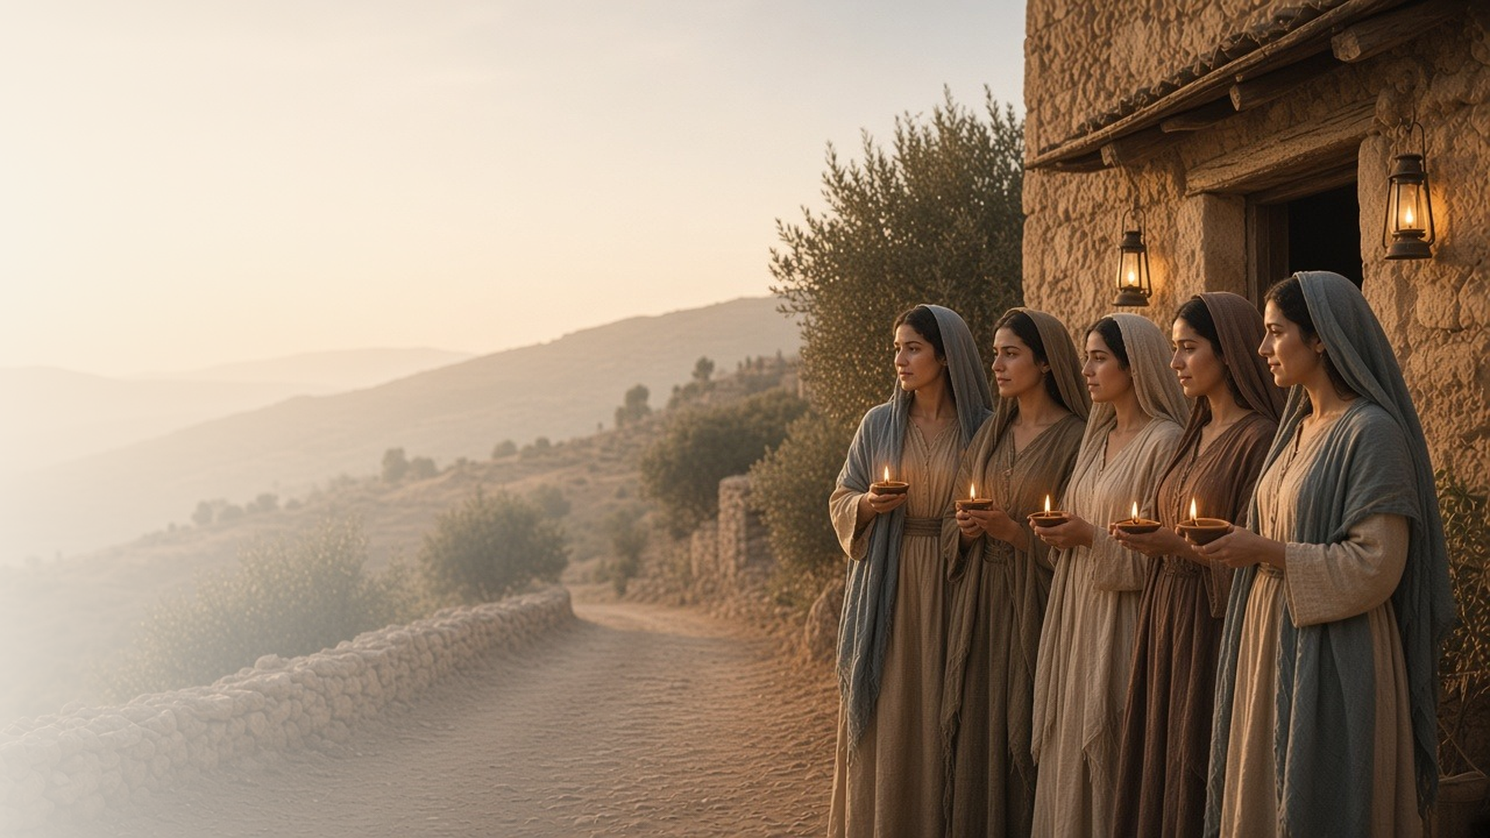
COME, FOLLOW ME · FOR CHILDREN
The Son of Man
Shall Come
May 17–23
Joseph Smith—Matthew 1; Matthew 24–25;
Mark 12–13; Luke 21
Notes:
TEACHING
This week children learn that they can treasure God's word, help prepare the world for Jesus's Second Coming, use the gifts God gave them, serve the Lord by serving others, and give their all to Jesus. Joseph Smith—Matthew (Pearl of Great Price) is named here only; its text is not included because the KJV source covers only the Bible.
SCRIPTURE (KJV)
Matthew 25:13
13 Watch therefore, for ye know neither the day nor the hour wherein the Son of man cometh.
DISCUSSION
• What will it be like when Jesus comes again?
• How can we get ready for Him?

Slide 2
JOSEPH SMITH—MATTHEW 1:22, 37
I can treasure God’s word
Jesus taught that His words will never pass away.
“Heaven and earth shall pass away, but my words shall not pass away.”
MATTHEW 24:35
Notes:
TEACHING
Show a treasure box and talk about what people keep in one. Explain that Jesus's words are a treasure that will last forever. The manual uses Joseph Smith—Matthew 1:22, 37 for this idea. Joseph Smith—Matthew (Pearl of Great Price) is included in the scripture section below. Help children choose a favorite scripture to remember.
SCRIPTURE (KJV)
Matthew 24:35
35 Heaven and earth shall pass away, but my words shall not pass away.
Restoration scripture (public-domain text: bcbooks/scriptures-json)
Joseph Smith—Matthew 1:22, 37 (Pearl of Great Price)
22 For in those days there shall also arise false Christs, and false prophets, and shall show great signs and wonders, insomuch, that, if possible, they shall deceive the very elect, who are the elect according to the covenant.
37 And whoso treasureth up my word, shall not be deceived, for the Son of Man shall come, and he shall send his angels before him with the great sound of a trumpet, and they shall gather together the remainder of his elect from the four winds, from one end of heaven to the other.
DISCUSSION (questions quoted from the manual)
• “How can we show that we treasure the word of God?”

Slide 3
JOSEPH SMITH—MATTHEW 1:31, 36–37; MATTHEW 25:1–13
I can help prepare for Jesus
Like the wise virgins, I can get ready for Jesus to come.
“Watch therefore, for ye know neither the day nor the hour.”
MATTHEW 25:13
Notes:
TEACHING
Tell the parable of the ten virgins with a simple lamp. The wise ones were ready because they had oil. We get ready for Jesus's Second Coming by praying, keeping commandments, and sharing the gospel. The manual also uses Joseph Smith—Matthew 1:31, 36–37. Joseph Smith—Matthew (Pearl of Great Price) is included in the scripture section below.
SCRIPTURE (KJV)
Matthew 25:4, 10, 13
4 But the wise took oil in their vessels with their lamps.
10 And while they went to buy, the bridegroom came; and they that were ready went in with him to the marriage: and the door was shut.
13 Watch therefore, for ye know neither the day nor the hour wherein the Son of man cometh.
Full passage: Matthew 25:1–13
Restoration scripture (public-domain text: bcbooks/scriptures-json)
Joseph Smith—Matthew 1:37 (Pearl of Great Price)
37 And whoso treasureth up my word, shall not be deceived, for the Son of Man shall come, and he shall send his angels before him with the great sound of a trumpet, and they shall gather together the remainder of his elect from the four winds, from one end of heaven to the other.
Full passage: Joseph Smith—Matthew 1:31, 36–37
DISCUSSION (questions quoted from the manual)
• (The manual gives no direct questions for this section.)
Suggested: What can you do each day to be ready for Jesus to come again?

Slide 4
MATTHEW 25:14–30
I can use my gifts
God gives each of us gifts to use and share.
“Well done, thou good and faithful servant.”
MATTHEW 25:21
Notes:
TEACHING
Tell the story of the talents simply. Two servants used what their master gave them, and he said well done. Help children name gifts God has given them, like being kind, singing, or helping, and ways they can use them.
SCRIPTURE (KJV)
Matthew 25:15, 20–21
15 And unto one he gave five talents, to another two, and to another one; to every man according to his several ability; and straightway took his journey.
20 And so he that had received five talents came and brought other five talents, saying, Lord, thou deliveredst unto me five talents: behold, I have gained beside them five talents more.
21 His lord said unto him, Well done, thou good and faithful servant: thou hast been faithful over a few things, I will make thee ruler over many things: enter thou into the joy of thy lord.
Full passage: Matthew 25:14–21
DISCUSSION (questions quoted from the manual)
• “How does God want us to use these talents?”

Slide 5
MATTHEW 25:34–40
Serving others serves the Lord
When I help others, I am helping Jesus.
“Inasmuch as ye have done it unto one of the least of these my brethren, ye have done it unto me.”
MATTHEW 25:40
Notes:
TEACHING
Read Matthew 25:35–40 and act out helping someone hungry, thirsty, or sick. Jesus said that when we help others, it is like helping Him. Plan a simple act of service together.
SCRIPTURE (KJV)
Matthew 25:35–36, 40
35 For I was an hungred, and ye gave me meat: I was thirsty, and ye gave me drink: I was a stranger, and ye took me in:
36 Naked, and ye clothed me: I was sick, and ye visited me: I was in prison, and ye came unto me.
40 And the King shall answer and say unto them, Verily I say unto you, Inasmuch as ye have done it unto one of the least of these my brethren, ye have done it unto me.
Full passage: Matthew 25:35–40
DISCUSSION (questions quoted from the manual)
• (The manual gives no direct questions for this section.)
Suggested: Who can you serve this week? How will that help Jesus?

Slide 6
MARK 12:38–44
I can give my all to Jesus
A poor widow gave all she had to God.
“She of her want did cast in all that she had, even all her living.”
MARK 12:44
Notes:
TEACHING
Show two small coins. Tell how a poor widow gave her last two coins at the temple, and Jesus said she gave more than anyone. Jesus loves it when we give our best, even if it seems small.
SCRIPTURE (KJV)
Mark 12:41–44
41 And Jesus sat over against the treasury, and beheld how the people cast money into the treasury: and many that were rich cast in much.
42 And there came a certain poor widow, and she threw in two mites, which make a farthing.
43 And he called unto him his disciples, and saith unto them, Verily I say unto you, That this poor widow hath cast more in, than all they which have cast into the treasury:
44 For all they did cast in of their abundance; but she of her want did cast in all that she had, even all her living.
DISCUSSION (questions quoted from the manual)
• “Why was the widow’s offering so valuable?”
• “How can we give our all to Jesus like she did?”

Slide 7
LUKE 21:28
“Look up, and lift up your heads.”
Do one thing this week to get ready for Jesus.
Notes:
TEACHING
When Jesus comes again, it will be a happy day for those who are ready. Invite children to do one thing this week to get ready.
SCRIPTURE (KJV)
Luke 21:28
28 And when these things begin to come to pass, then look up, and lift up your heads; for your redemption draweth nigh.
DISCUSSION
• What will you do to get ready for Jesus?
• How do you feel when you think about Jesus coming again?

