Slide 1
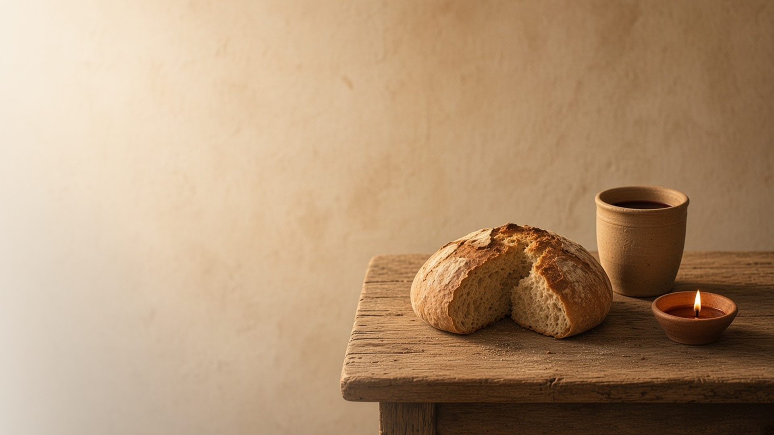
COME, FOLLOW ME · NEW TESTAMENT 2027
In
Remembrance
May 24–30
Matthew 26; Mark 14; John 13
Notes:
TEACHING
In the last hours before Gethsemane, a woman anointed Jesus at Bethany, the disciples asked "Lord, is it I?", and Jesus gave the sacrament as a way to remember Him always. He knelt to wash His disciples' feet and gave a new commandment to love one another as He loved them. This lesson centers on remembering Him and becoming like Him.
SCRIPTURE (KJV)
Luke 22:19–20
19 And he took bread, and gave thanks, and brake it, and gave unto them, saying, This is my body which is given for you: this do in remembrance of me.
20 Likewise also the cup after supper, saying, This cup is the new testament in my blood, which is shed for you.
DISCUSSION
• What helps you truly remember the Savior during the sacrament?
• Which scene from that evening touches you most?

Slide 2
MATTHEW 26:6–13; MARK 14:3–9
She hath done what she could
A woman anointed Jesus, honoring Him before His death.
“She hath done what she could: she is come aforehand to anoint my body to the burying.”
MARK 14:8
Notes:
TEACHING
At Bethany a woman broke an alabaster box of costly ointment and poured it on Jesus's head. Some called it waste, but Jesus defended her: she had prepared His body for burial, and her act would be told wherever the gospel was preached. She seemed to understand what the others did not. Invite class members to consider how they show their devotion to the Savior.
SCRIPTURE (KJV)
Mark 14:3–9
3 And being in Bethany in the house of Simon the leper, as he sat at meat, there came a woman having an alabaster box of ointment of spikenard very precious; and she brake the box, and poured it on his head.
4 And there were some that had indignation within themselves, and said, Why was this waste of the ointment made?
5 For it might have been sold for more than three hundred pence, and have been given to the poor. And they murmured against her.
6 And Jesus said, Let her alone; why trouble ye her? she hath wrought a good work on me.
7 For ye have the poor with you always, and whensoever ye will ye may do them good: but me ye have not always.
8 She hath done what she could: she is come aforehand to anoint my body to the burying.
9 Verily I say unto you, Wheresoever this gospel shall be preached throughout the whole world, this also that she hath done shall be spoken of for a memorial of her.
DISCUSSION (questions quoted from the manual)
• “Why do you think her actions were so meaningful to the Savior? (see verse 13).”
• “What impresses you about the woman and her faith?”

Slide 3
MATTHEW 26:20–22; MARK 14:17–19
Lord, is it I?
Each disciple looked inward rather than accusing another.
“Lord, is it I?”
MATTHEW 26:22
Notes:
TEACHING
When Jesus said one of them would betray Him, the disciples did not look around in suspicion. Each one asked, "Lord, is it I?" Their humble question models honest self-examination. Invite class members to consider how asking this question can help them grow, especially as they prepare for the sacrament.
SCRIPTURE (KJV)
Matthew 26:20–25
20 Now when the even was come, he sat down with the twelve.
21 And as they did eat, he said, Verily I say unto you, that one of you shall betray me.
22 And they were exceeding sorrowful, and began every one of them to say unto him, Lord, is it I?
23 And he answered and said, He that dippeth his hand with me in the dish, the same shall betray me.
24 The Son of man goeth as it is written of him: but woe unto that man by whom the Son of man is betrayed! it had been good for that man if he had not been born.
25 Then Judas, which betrayed him, answered and said, Master, is it I? He said unto him, Thou hast said.
DISCUSSION (questions quoted from the manual)
• “What would you have thought or done if you had been there?”
• “What do you learn about the disciples from their question to the Lord in these verses?”
• “Consider situations or relationships in your life in which you should ask, “Lord, is it I?””
• “Uchtdorf, “Lord, Is It I?,””

Slide 4
MATTHEW 26:26–29; MARK 14:22–25
In remembrance of me
Bread and cup help us remember His body and blood.
“For this is my blood of the new testament, which is shed for many for the remission of sins.”
MATTHEW 26:28
Notes:
TEACHING
During the Passover meal, Jesus took bread, blessed it, and gave it to His disciples as His body; then He gave the cup as His blood of the new testament, shed for the remission of sins. The sacrament became a weekly way to remember Him and renew our covenants. Discuss what helps make the sacrament a time of real remembrance.
SCRIPTURE (KJV)
Matthew 26:26–29
26 And as they were eating, Jesus took bread, and blessed it, and brake it, and gave it to the disciples, and said, Take, eat; this is my body.
27 And he took the cup, and gave thanks, and gave it to them, saying, Drink ye all of it;
28 For this is my blood of the new testament, which is shed for many for the remission of sins.
29 But I say unto you, I will not drink henceforth of this fruit of the vine, until that day when I drink it new with you in my Father’s kingdom.
Mark 14:22–25
22 And as they did eat, Jesus took bread, and blessed, and brake it, and gave to them, and said, Take, eat: this is my body.
23 And he took the cup, and when he had given thanks, he gave it to them: and they all drank of it.
24 And he said unto them, This is my blood of the new testament, which is shed for many.
25 Verily I say unto you, I will drink no more of the fruit of the vine, until that day that I drink it new in the kingdom of God.
DISCUSSION (questions quoted from the manual)
• “How would you explain the sacred ordinance of the sacrament to someone who isn’t familiar with it?”
• “Why do you think Jesus chose the sacrament for us to remember Him?”
• “Why are bread and water such powerful symbols of Jesus Christ?”
• “What do you promise as you partake of the sacrament?”
• “What promise are you offered?”
• “How do you make the sacrament a meaningful experience?”

Slide 5
JOHN 13:1–17
He washed their feet
The Master knelt to serve, and asked us to do the same.
“For I have given you an example, that ye should do as I have done to you.”
JOHN 13:15
Notes:
TEACHING
Jesus rose from supper, laid aside His garments, and washed His disciples' feet, a servant's task. Peter protested until Jesus explained that without it Peter could have no part with Him. Then Jesus asked them to follow His example. Invite class members to look for humble, unseen ways to serve this week.
SCRIPTURE (KJV)
John 13:4–17
4 He riseth from supper, and laid aside his garments; and took a towel, and girded himself.
5 After that he poureth water into a bason, and began to wash the disciples’ feet, and to wipe them with the towel wherewith he was girded.
6 Then cometh he to Simon Peter: and Peter saith unto him, Lord, dost thou wash my feet?
7 Jesus answered and said unto him, What I do thou knowest not now; but thou shalt know hereafter.
8 Peter saith unto him, Thou shalt never wash my feet. Jesus answered him, If I wash thee not, thou hast no part with me.
9 Simon Peter saith unto him, Lord, not my feet only, but also my hands and my head.
10 Jesus saith to him, He that is washed needeth not save to wash his feet, but is clean every whit: and ye are clean, but not all.
11 For he knew who should betray him; therefore said he, Ye are not all clean.
12 So after he had washed their feet, and had taken his garments, and was set down again, he said unto them, Know ye what I have done to you?
13 Ye call me Master and Lord: and ye say well; for so I am.
14 If I then, your Lord and Master, have washed your feet; ye also ought to wash one another’s feet.
15 For I have given you an example, that ye should do as I have done to you.
16 Verily, verily, I say unto you, The servant is not greater than his lord; neither he that is sent greater than he that sent him.
17 If ye know these things, happy are ye if ye do them.
DISCUSSION (questions quoted from the manual)
• “What messages do you find in the Savior’s words and actions in John 13:1–17?”
• “What do you know and feel that inspires you to serve others?”

Slide 6
JOHN 13:34–35
Love one another
Our love for others is how the world knows we are His.
“By this shall all men know that ye are my disciples, if ye have love one to another.”
JOHN 13:35
Notes:
TEACHING
Jesus gave a new commandment: love one another as He has loved us. The standard is no longer "as thyself" but as He loved, fully and sacrificially. This love is the mark by which others will recognize His true disciples. Discuss how people have seen Christ's love in the members around them.
SCRIPTURE (KJV)
John 13:34–35
34 A new commandment I give unto you, That ye love one another; as I have loved you, that ye also love one another.
35 By this shall all men know that ye are my disciples, if ye have love one to another.
DISCUSSION (questions quoted from the manual)
• “What is the difference between these commandments?”
• “What do you think it means to love others as Jesus loves you?”
• “How is His love different from other kinds of love? (See President Jeffrey R.”
• “Holland’s answer to the question “How did Jesus love?” in “I Am He,””
• “You might also ask yourself, “Do people know I am a disciple of Jesus Christ?”
• “How can I make Christlike love my defining characteristic?””

Slide 7
LUKE 22:19
“This do in remembrance of me.”
Prepare this week for a more sacred sacrament.
Notes:
TEACHING
On the night before His death, the Savior asked to be remembered. Close by inviting class members to prepare during the week so that next Sunday's sacrament is a time of deep remembrance.
SCRIPTURE (KJV)
Luke 22:19–20
19 And he took bread, and gave thanks, and brake it, and gave unto them, saying, This is my body which is given for you: this do in remembrance of me.
20 Likewise also the cup after supper, saying, This cup is the new testament in my blood, which is shed for you.
DISCUSSION
• What will you do this week to prepare for the sacrament?
• How does remembering Him change the way you treat others?

