Slide 1
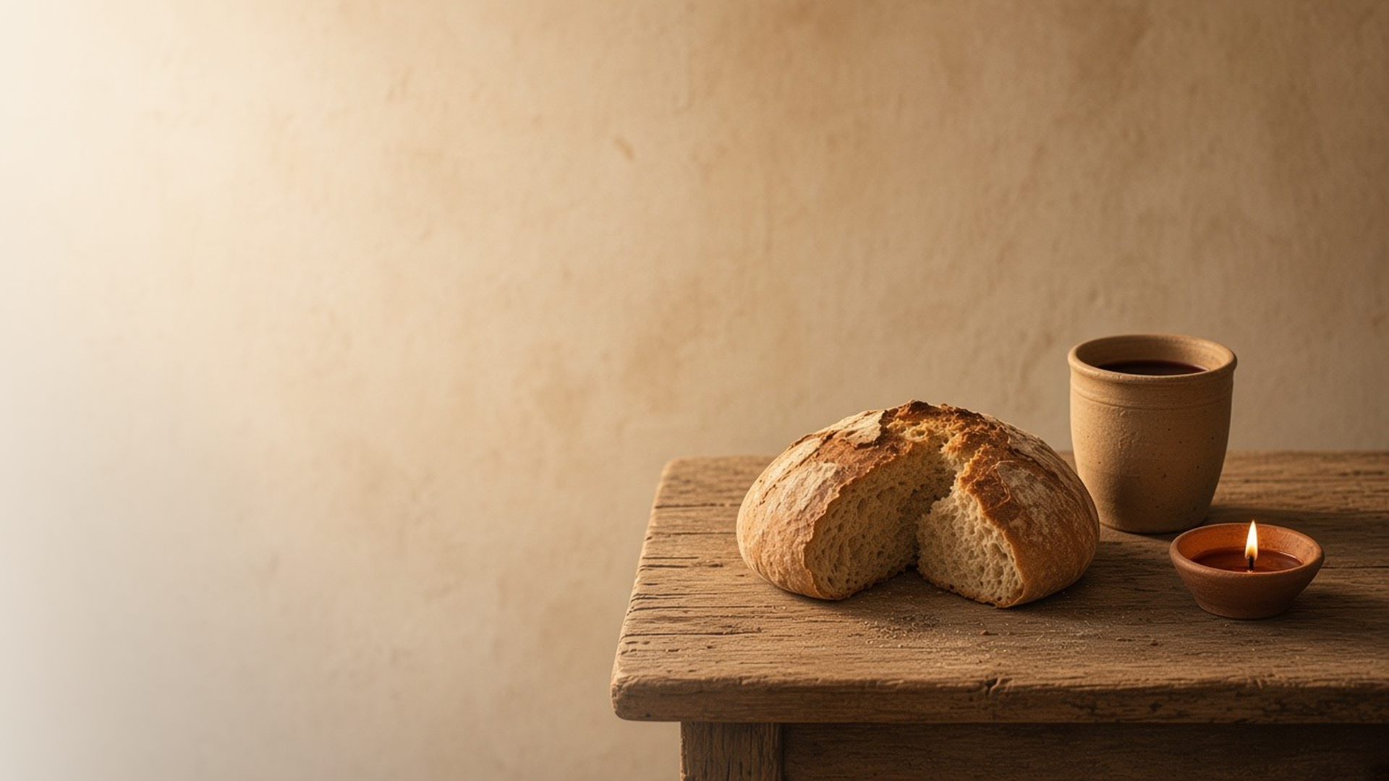
COME, FOLLOW ME · FOR CHILDREN
In
Remembrance
May 24–30
Matthew 26; Mark 14; John 13
Notes:
TEACHING
This week children learn that the sacrament helps us think about Jesus, that Jesus is our example of serving others, and that His disciples love others as He did.
SCRIPTURE (KJV)
John 13:34–35
34 A new commandment I give unto you, That ye love one another; as I have loved you, that ye also love one another.
35 By this shall all men know that ye are my disciples, if ye have love one to another.
DISCUSSION
• What can we think about during the sacrament?
• How did Jesus show love to His disciples?

Slide 2
MATTHEW 26:26–29; MARK 14:22–24
The sacrament helps me remember
Jesus gave bread and wine so we would remember Him.
“Take, eat; this is my body.”
MATTHEW 26:26
Notes:
TEACHING
Show a picture of the Last Supper. Explain that Jesus gave His Apostles bread and wine and asked them to remember Him. Each Sunday we take the sacrament to remember Jesus. Help children think of one thing about Jesus to remember during the sacrament.
SCRIPTURE (KJV)
Matthew 26:26–28
26 And as they were eating, Jesus took bread, and blessed it, and brake it, and gave it to the disciples, and said, Take, eat; this is my body.
27 And he took the cup, and gave thanks, and gave it to them, saying, Drink ye all of it;
28 For this is my blood of the new testament, which is shed for many for the remission of sins.
DISCUSSION (questions quoted from the manual)
• “What do we promise when we take the sacrament?”
• “What does Heavenly Father promise?”

Slide 3
JOHN 13:1–17
Jesus served others
Jesus washed His disciples’ feet to show how to serve.
“For I have given you an example, that ye should do as I have done to you.”
JOHN 13:15
Notes:
TEACHING
Use a bowl of water and a towel to show how Jesus washed His disciples' feet. Even though He was the Son of God, He served them in a humble way. Talk about how children can serve their families this week.
SCRIPTURE (KJV)
John 13:4–5, 14–15
4 He riseth from supper, and laid aside his garments; and took a towel, and girded himself.
5 After that he poureth water into a bason, and began to wash the disciples’ feet, and to wipe them with the towel wherewith he was girded.
14 If I then, your Lord and Master, have washed your feet; ye also ought to wash one another’s feet.
15 For I have given you an example, that ye should do as I have done to you.
Full passage: John 13:4–15
DISCUSSION (questions quoted from the manual)
• “What was the Savior trying to teach Peter and the other Apostles?”
• “What do we learn from this story about giving Christlike service?”

Slide 4
JOHN 13:34–35
I can love others like Jesus
Jesus asked His disciples to love each other as He loves them.
“A new commandment I give unto you, That ye love one another; as I have loved you.”
JOHN 13:34
Notes:
TEACHING
Ask children how Jesus showed love to people. Explain that He asked us to love others the same way. When we are kind, people can see that we follow Jesus.
SCRIPTURE (KJV)
John 13:34–35
34 A new commandment I give unto you, That ye love one another; as I have loved you, that ye also love one another.
35 By this shall all men know that ye are my disciples, if ye have love one to another.
DISCUSSION (questions quoted from the manual)
• “How do people know that we follow Jesus Christ?”
• “How does He want His followers to be known?”
• “How can we share His love with them?”

Slide 5
JOHN 13:34
“A new commandment I give unto you,
That ye love one another; as I have loved you.”
Show love to someone in your family this week.
Notes:
TEACHING
Jesus asked us to love one another as He loves us. Invite children to show love to someone in their family this week.
SCRIPTURE (KJV)
John 13:34
34 A new commandment I give unto you, That ye love one another; as I have loved you, that ye also love one another.
DISCUSSION
• Who can you show love to this week?
• How does Jesus show He loves you?

