Slide 1
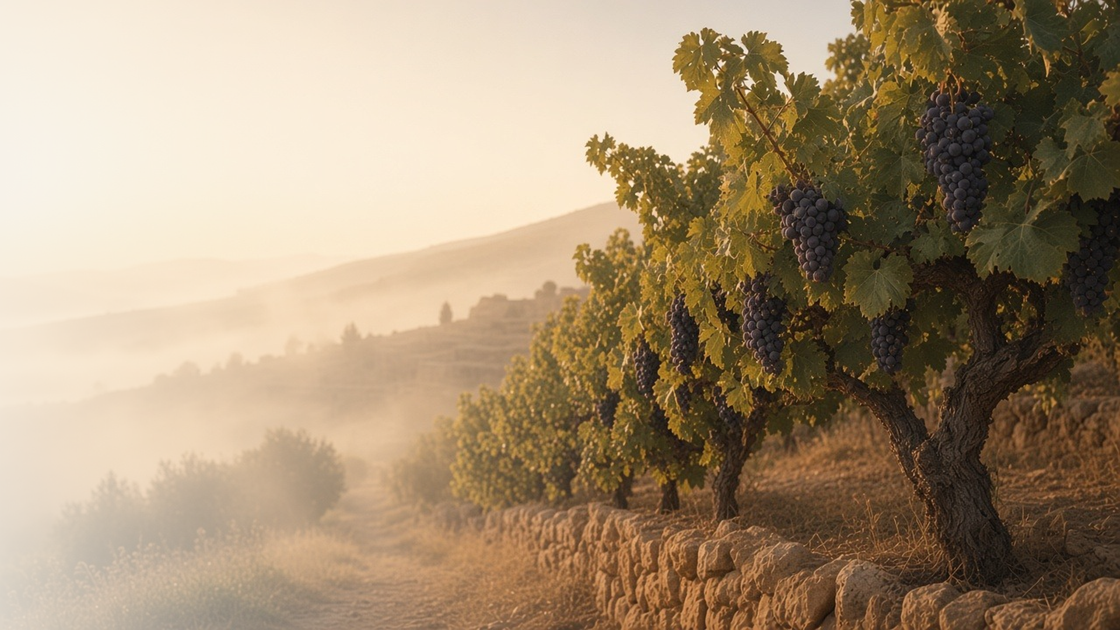
COME, FOLLOW ME · FOR CHILDREN
Continue Ye
in My Love
May 31–June 6
John 14–17
Notes:
TEACHING
This week children learn that Jesus is the way back to Heavenly Father, that we show love for Jesus by keeping His commandments, that the Holy Ghost guides and comforts us, that we can stay close to Heavenly Father and Jesus, and that They are perfectly united.
SCRIPTURE (KJV)
John 14:15
15 If ye love me, keep my commandments.
DISCUSSION
• How can you show Jesus that you love Him?
• How does the Holy Ghost help you?

Slide 2
JOHN 14:6
Jesus is the way
Following Jesus leads me back to Heavenly Father.
“I am the way, the truth, and the life.”
JOHN 14:6
Notes:
TEACHING
Draw a simple path on paper leading to a picture of a home. Explain that Jesus is the way back to Heavenly Father, and following Him is like following the path home.
SCRIPTURE (KJV)
John 14:1–2, 6
1 Let not your heart be troubled: ye believe in God, believe also in me.
2 In my Father’s house are many mansions: if it were not so, I would have told you. I go to prepare a place for you.
6 Jesus saith unto him, I am the way, the truth, and the life: no man cometh unto the Father, but by me.
Full passage: John 14:1–6
DISCUSSION (questions quoted from the manual)
• “How is Jesus like a “way” or a path?”
• “Where does He lead us?”

Slide 3
JOHN 14:15
I keep His commandments
I show I love Jesus when I obey Him.
“If ye love me, keep my commandments.”
JOHN 14:15
Notes:
TEACHING
Help children list commandments they know, like praying, being honest, and being kind. Explain that keeping commandments is one way to tell Jesus we love Him.
SCRIPTURE (KJV)
John 14:15
15 If ye love me, keep my commandments.
DISCUSSION (questions quoted from the manual)
• (The manual gives no direct questions for this section.)
Suggested: Which commandment will you keep this week to show Jesus you love Him?

Slide 4
JOHN 14:26–27; 15:26; 16:13–14
The Holy Ghost helps me
The Holy Ghost comforts me and helps me know what is true.
“Peace I leave with you, my peace I give unto you.”
JOHN 14:27
Notes:
TEACHING
Explain that Jesus promised to send the Holy Ghost to comfort and teach His followers. Share a time when the Holy Ghost helped you feel peace, and invite children to share times they have felt peaceful and safe.
SCRIPTURE (KJV)
John 14:26–27
26 But the Comforter, which is the Holy Ghost, whom the Father will send in my name, he shall teach you all things, and bring all things to your remembrance, whatsoever I have said unto you.
27 Peace I leave with you, my peace I give unto you: not as the world giveth, give I unto you. Let not your heart be troubled, neither let it be afraid.
DISCUSSION (questions quoted from the manual)
• “Stevenson’s message “How Does the Holy Ghost Help You?” (Ensign or Liahona, May 2017, 117–20).”

Slide 5
JOHN 15:1–9; 17:3
I can stay close to Jesus
Like a branch on a vine, I grow when I stay close to Him.
“I am the vine, ye are the branches.”
JOHN 15:5
Notes:
TEACHING
Show a branch that is attached to a plant and one that has been cut off. Ask which one can grow fruit. We stay close to Jesus by praying, reading scriptures, and following Him.
SCRIPTURE (KJV)
John 15:1–5
1 I am the true vine, and my Father is the husbandman.
2 Every branch in me that beareth not fruit he taketh away: and every branch that beareth fruit, he purgeth it, that it may bring forth more fruit.
3 Now ye are clean through the word which I have spoken unto you.
4 Abide in me, and I in you. As the branch cannot bear fruit of itself, except it abide in the vine; no more can ye, except ye abide in me.
5 I am the vine, ye are the branches: He that abideth in me, and I in him, the same bringeth forth much fruit: for without me ye can do nothing.
DISCUSSION (questions quoted from the manual)
• “What happens to a branch when it is removed from the plant?”
• “How do we get to know Heavenly Father and Jesus better?”

Slide 6
JOHN 17:11, 21–23
They are perfectly united
Heavenly Father and Jesus always work together in love.
“As thou, Father, art in me, and I in thee.”
JOHN 17:21
Notes:
TEACHING
Have children work together to finish a simple task, like a puzzle. Explain that Heavenly Father and Jesus are two separate beings who always work together and want the same things. Jesus prayed that we would be united too.
SCRIPTURE (KJV)
John 17:21
21 That they all may be one; as thou, Father, art in me, and I in thee, that they also may be one in us: that the world may believe that thou hast sent me.
DISCUSSION (questions quoted from the manual)
• “What would help your children understand what Jesus taught about being “one”?”

Slide 7
JOHN 14:15
“If ye love me,
keep my commandments.”
Choose one commandment to keep with extra love this week.
Notes:
TEACHING
We show Jesus we love Him by keeping His commandments. Invite children to pick one commandment to keep with extra love this week.
SCRIPTURE (KJV)
John 14:15
15 If ye love me, keep my commandments.
DISCUSSION
• What commandment did you choose?
• How will keeping it show your love for Jesus?

