Slide 1
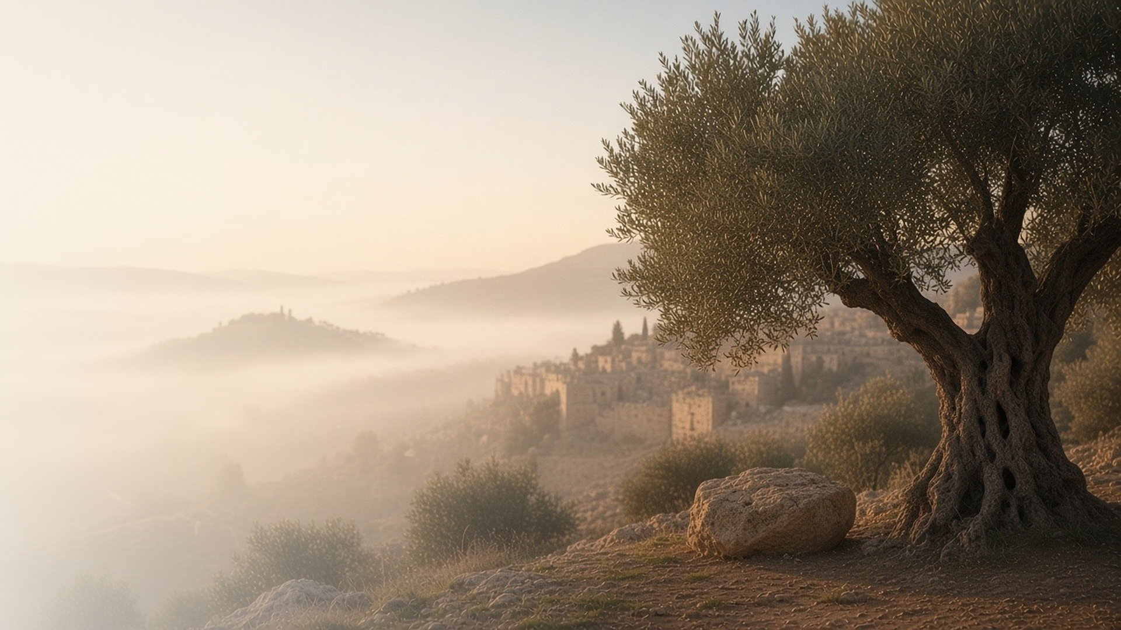
COME, FOLLOW ME · NEW TESTAMENT 2027
Not My Will,
but Thine, Be Done
June 7–13
Luke 22; John 18
Notes:
TEACHING
Luke 22 and John 18 take us from the upper room to Gethsemane, the betrayal, Peter's denials, and the trials before the high priest and Pilate. At the center is the Savior's prayer in the garden: not my will, but thine, be done. Throughout, He meets fear, betrayal, and hostility with submission, patience, and healing.
SCRIPTURE (KJV)
Luke 22:41–44
41 And he was withdrawn from them about a stone’s cast, and kneeled down, and prayed,
42 Saying, Father, if thou be willing, remove this cup from me: nevertheless not my will, but thine, be done.
43 And there appeared an angel unto him from heaven, strengthening him.
44 And being in an agony he prayed more earnestly: and his sweat was as it were great drops of blood falling down to the ground.
DISCUSSION
• What does the Savior's prayer in Gethsemane teach you about submitting to God?
• Where do you see His patience and kindness in these chapters?

Slide 2
LUKE 22:31–34, 54–62; JOHN 18:17–27
When thou art converted
Peter’s denial was not the end of his discipleship.
“But I have prayed for thee, that thy faith fail not: and when thou art converted, strengthen thy brethren.”
LUKE 22:32
Notes:
TEACHING
Jesus warned Peter that he would deny Him, yet He had already prayed that Peter's faith would not fail and spoke of the day he would be converted and strengthen others. When the cock crowed, the Lord turned and looked at Peter, and Peter wept bitterly. Conversion is a lifetime of learning, and the Savior does not give up on us.
SCRIPTURE (KJV)
Luke 22:31–34
31 And the Lord said, Simon, Simon, behold, Satan hath desired to have you, that he may sift you as wheat:
32 But I have prayed for thee, that thy faith fail not: and when thou art converted, strengthen thy brethren.
33 And he said unto him, Lord, I am ready to go with thee, both into prison, and to death.
34 And he said, I tell thee, Peter, the cock shall not crow this day, before that thou shalt thrice deny that thou knowest me.
Luke 22:54–62
54 Then took they him, and led him, and brought him into the high priest’s house. And Peter followed afar off.
55 And when they had kindled a fire in the midst of the hall, and were set down together, Peter sat down among them.
56 But a certain maid beheld him as he sat by the fire, and earnestly looked upon him, and said, This man was also with him.
57 And he denied him, saying, Woman, I know him not.
58 And after a little while another saw him, and said, Thou art also of them. And Peter said, Man, I am not.
59 And about the space of one hour after another confidently affirmed, saying, Of a truth this fellow also was with him: for he is a Galilaean.
60 And Peter said, Man, I know not what thou sayest. And immediately, while he yet spake, the cock crew.
61 And the Lord turned, and looked upon Peter. And Peter remembered the word of the Lord, how he had said unto him, Before the cock crow, thou shalt deny me thrice.
62 And Peter went out, and wept bitterly.
DISCUSSION (questions quoted from the manual)
• “Why then would the Savior say to Peter, “When thou art converted, strengthen thy brethren”? (Luke 22:32; emphasis added).”
• “Have you ever felt so committed that, like Peter, you were “ready to go with [the Savior], both into prison, and to death”? (Luke 22:33).”
• “Why do those feelings sometimes fade?”
• “There are daily opportunities to either deny or witness of the Savior; what will you do to be a daily witness of Him?”
• “What other lessons do you learn from Peter’s experience?”

Slide 3
LUKE 22:39–46
He prayed more earnestly
In Gethsemane, He suffered for us in great agony.
“And being in an agony he prayed more earnestly: and his sweat was as it were great drops of blood falling down to the ground.”
LUKE 22:44
Notes:
TEACHING
Only Luke records the angel who came to strengthen Jesus and the sweat that fell like great drops of blood. In His agony He prayed more earnestly, and He submitted fully to the Father's will. He took upon Himself our sins, pains, and sorrows so that He could succor us. Invite class members to ponder what His suffering means to them personally.
SCRIPTURE (KJV)
Luke 22:39–46
39 And he came out, and went, as he was wont, to the mount of Olives; and his disciples also followed him.
40 And when he was at the place, he said unto them, Pray that ye enter not into temptation.
41 And he was withdrawn from them about a stone’s cast, and kneeled down, and prayed,
42 Saying, Father, if thou be willing, remove this cup from me: nevertheless not my will, but thine, be done.
43 And there appeared an angel unto him from heaven, strengthening him.
44 And being in an agony he prayed more earnestly: and his sweat was as it were great drops of blood falling down to the ground.
45 And when he rose up from prayer, and was come to his disciples, he found them sleeping for sorrow,
46 And said unto them, Why sleep ye? rise and pray, lest ye enter into temptation.
Restoration scripture (public-domain text: bcbooks/scriptures-json)
2 Nephi 2:8 (Book of Mormon)
8 Wherefore, how great the importance to make these things known unto the inhabitants of the earth, that they may know that there is no flesh that can dwell in the presence of God, save it be through the merits, and mercy, and grace of the Holy Messiah, who layeth down his life according to the flesh, and taketh it again by the power of the Spirit, that he may bring to pass the resurrection of the dead, being the first that should rise.
Full passage: 2 Nephi 2:5–10, 17–26
2 Nephi 9:21 (Book of Mormon)
21 And he cometh into the world that he may save all men if they will hearken unto his voice; for behold, he suffereth the pains of all men, yea, the pains of every living creature, both men, women, and children, who belong to the family of Adam.
Full passage: 2 Nephi 9:5–26
Alma 34:9 (Book of Mormon)
9 For it is expedient that an atonement should be made; for according to the great plan of the Eternal God there must be an atonement made, or else all mankind must unavoidably perish; yea, all are hardened; yea, all are fallen and are lost, and must perish except it be through the atonement which it is expedient should be made.
Full passage: Alma 34:8–16
Alma 42:15 (Book of Mormon)
15 And now, the plan of mercy could not be brought about except an atonement should be made; therefore God himself atoneth for the sins of the world, to bring about the plan of mercy, to appease the demands of justice, that God might be a perfect, just God, and a merciful God also.
Full passage: Alma 42:9–26
Mosiah 3:7 (Book of Mormon)
7 And lo, he shall suffer temptations, and pain of body, hunger, thirst, and fatigue, even more than man can suffer, except it be unto death; for behold, blood cometh from every pore, so great shall be his anguish for the wickedness and the abominations of his people.
Alma 7:11–12 (Book of Mormon)
11 And he shall go forth, suffering pains and afflictions and temptations of every kind; and this that the word might be fulfilled which saith he will take upon him the pains and the sicknesses of his people.
12 And he will take upon him death, that he may loose the bands of death which bind his people; and he will take upon him their infirmities, that his bowels may be filled with mercy, according to the flesh, that he may know according to the flesh how to succor his people according to their infirmities.
Full passage: Alma 7:11–13
Doctrine and Covenants 19:16, 18–19 (Doctrine and Covenants)
16 For behold, I, God, have suffered these things for all, that they might not suffer if they would repent;
18 Which suffering caused myself, even God, the greatest of all, to tremble because of pain, and to bleed at every pore, and to suffer both body and spirit—and would that I might not drink the bitter cup, and shrink—
19 Nevertheless, glory be to the Father, and I partook and finished my preparations unto the children of men.
Full passage: Doctrine and Covenants 19:16–19
Alma 34:31 (Book of Mormon)
31 Yea, I would that ye would come forth and harden not your hearts any longer; for behold, now is the time and the day of your salvation; and therefore, if ye will repent and harden not your hearts, immediately shall the great plan of redemption be brought about unto you.
Moroni 10:32 (Book of Mormon)
32 Yea, come unto Christ, and be perfected in him, and deny yourselves of all ungodliness; and if ye shall deny yourselves of all ungodliness, and love God with all your might, mind and strength, then is his grace sufficient for you, that by his grace ye may be perfect in Christ; and if by the grace of God ye are perfect in Christ, ye can in nowise deny the power of God.
Full passage: Moroni 10:32–33
DISCUSSION (questions quoted from the manual)
• “Why did the Savior suffer? (See 2 Nephi 2:5–10, 17–26; 9:5–26; Alma 34:8–16; 42:9–26.)”
• “What did the Savior experience as He suffered? (See Isaiah 53:3–5; Mosiah 3:7; Alma 7:11–13; Doctrine and Covenants 19:16–19.)”
• “How does Christ’s suffering affect my life? (See John 10:10–11; Hebrews 4:14–16; 1 John 1:7; Alma 34:31; Moroni 10:32–33; Dallin H.”
• “Oaks, “What Has Our Savior Done for Us?,””
• “What other questions do you have about the Atonement of Jesus Christ?”
• “How might the process of extracting olive oil symbolize what the Savior did for us in Gethsemane?”

Slide 4
LUKE 22:47–53, 63-71; JOHN 18:1–12; 19–24
He touched his ear
Even when betrayed, Jesus answered violence with healing.
“Suffer ye thus far. And he touched his ear, and healed him.”
LUKE 22:51
Notes:
TEACHING
When soldiers came with Judas to arrest Jesus, Peter drew a sword and cut off the ear of the high priest's servant. Jesus stopped him and healed the man. Before the council He endured mocking and blows with dignity. His example shows how to respond to contention with patience and kindness.
SCRIPTURE (KJV)
Luke 22:47–53
47 And while he yet spake, behold a multitude, and he that was called Judas, one of the twelve, went before them, and drew near unto Jesus to kiss him.
48 But Jesus said unto him, Judas, betrayest thou the Son of man with a kiss?
49 When they which were about him saw what would follow, they said unto him, Lord, shall we smite with the sword?
50 And one of them smote the servant of the high priest, and cut off his right ear.
51 And Jesus answered and said, Suffer ye thus far. And he touched his ear, and healed him.
52 Then Jesus said unto the chief priests, and captains of the temple, and the elders, which were come to him, Be ye come out, as against a thief, with swords and staves?
53 When I was daily with you in the temple, ye stretched forth no hands against me: but this is your hour, and the power of darkness.
John 18:10–11
10 Then Simon Peter having a sword drew it, and smote the high priest’s servant, and cut off his right ear. The servant’s name was Malchus.
11 Then said Jesus unto Peter, Put up thy sword into the sheath: the cup which my Father hath given me, shall I not drink it?
DISCUSSION (questions quoted from the manual)
• (The manual gives no direct questions for this section.)
Suggested: When you face contention, what can you learn from how Jesus responded in these verses?

Slide 5
JOHN 18:28–38
Not of this world
Before Pilate, Jesus witnessed of a kingdom not of this world.
“My kingdom is not of this world.”
JOHN 18:36
Notes:
TEACHING
Pilate asked Jesus whether He was a king. Jesus answered that His kingdom was not of this world, and that He had come to bear witness of the truth. Pilate asked, "What is truth?" while Truth stood before him. Discuss what it means to belong to a kingdom not of this world while living in it.
SCRIPTURE (KJV)
John 18:33–38
33 Then Pilate entered into the judgment hall again, and called Jesus, and said unto him, Art thou the King of the Jews?
34 Jesus answered him, Sayest thou this thing of thyself, or did others tell it thee of me?
35 Pilate answered, Am I a Jew? Thine own nation and the chief priests have delivered thee unto me: what hast thou done?
36 Jesus answered, My kingdom is not of this world: if my kingdom were of this world, then would my servants fight, that I should not be delivered to the Jews: but now is my kingdom not from hence.
37 Pilate therefore said unto him, Art thou a king then? Jesus answered, Thou sayest that I am a king. To this end was I born, and for this cause came I into the world, that I should bear witness unto the truth. Every one that is of the truth heareth my voice.
38 Pilate saith unto him, What is truth? And when he had said this, he went out again unto the Jews, and saith unto them, I find in him no fault at all.
DISCUSSION (questions quoted from the manual)
• “What evidence have you seen that the Lord’s “kingdom is not of this world”? (John 18:36).”
• “What else stands out to you about Jesus’s words to Pilate?”

Slide 6
LUKE 22:42
“Nevertheless not my will, but thine, be done.”
Bring one hard thing to the Father this week: “Thy will be done.”
Notes:
TEACHING
The Savior's prayer in Gethsemane is the pattern for every hard prayer we offer. Close by inviting class members to bring one difficult matter to the Father this week and to pray, as Jesus did, for His will to be done.
SCRIPTURE (KJV)
Luke 22:42
42 Saying, Father, if thou be willing, remove this cup from me: nevertheless not my will, but thine, be done.
DISCUSSION
• What makes it hard to say "thy will be done"?
• How has submitting to God's will blessed you?

