Slide 1
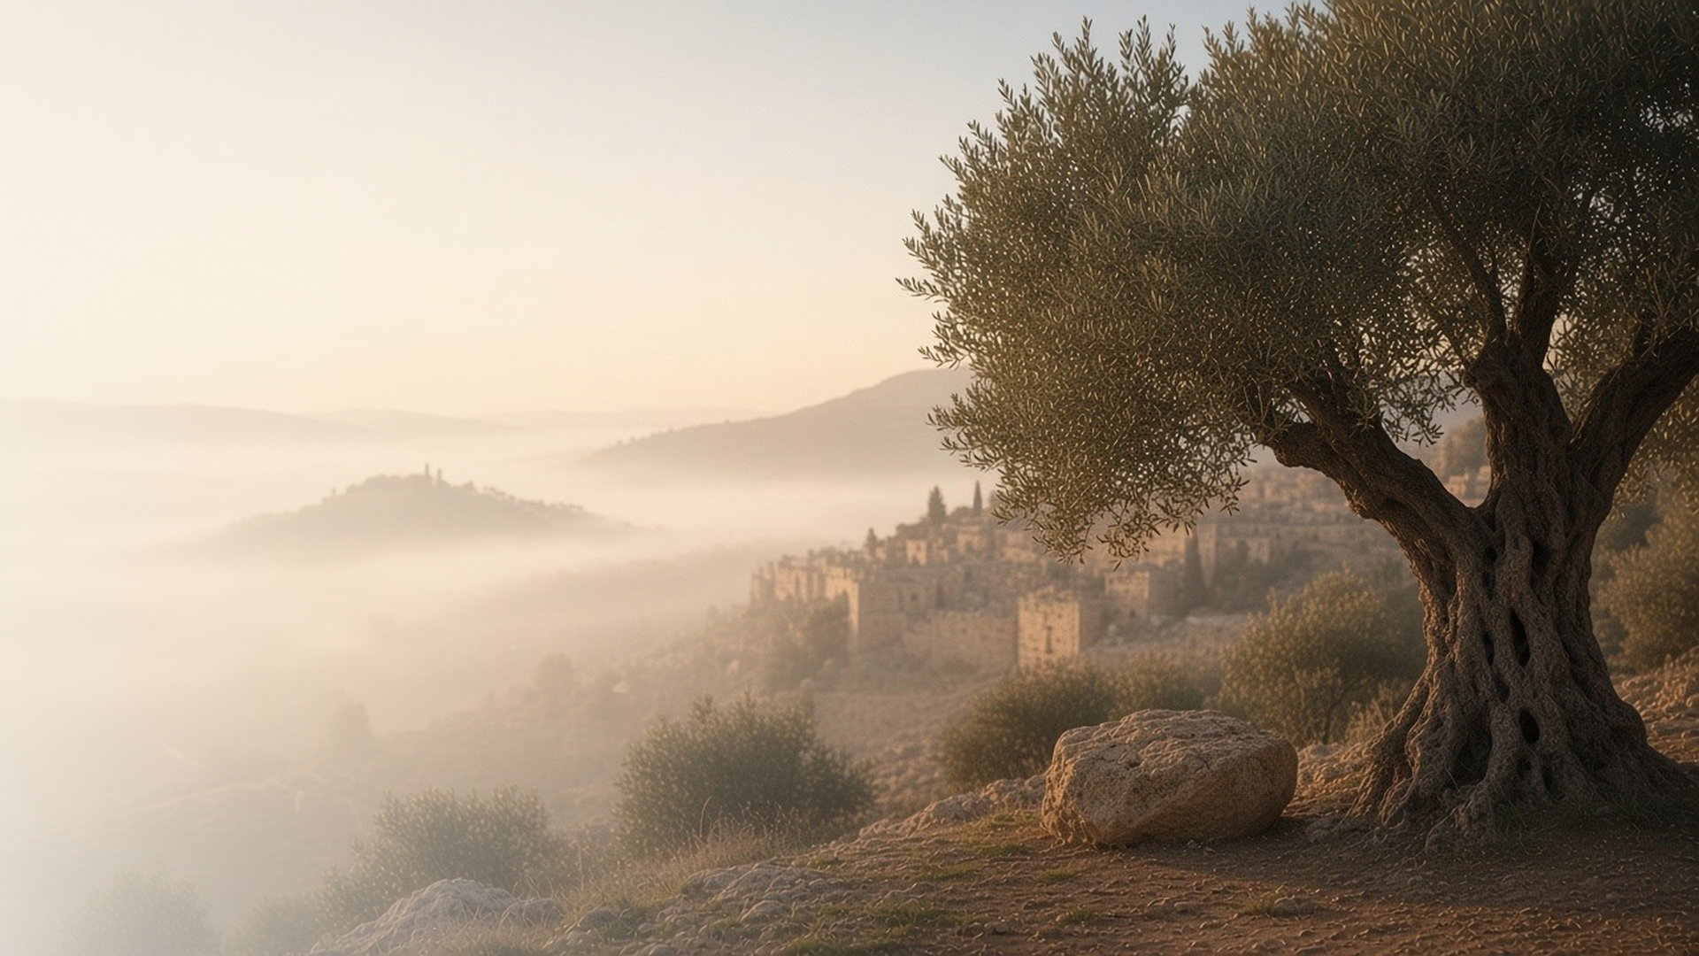
COME, FOLLOW ME · FOR CHILDREN
Not My Will,
but Thine, Be Done
June 7–13
Luke 22; John 18
Notes:
TEACHING
This week children learn that they can follow Jesus by doing what Heavenly Father wants even when it is hard, that Jesus suffered for them because He loves them, and that they can be peacemakers like Jesus.
SCRIPTURE (KJV)
Luke 22:42
42 Saying, Father, if thou be willing, remove this cup from me: nevertheless not my will, but thine, be done.
DISCUSSION
• What did Jesus pray in the garden?
• How can you be a peacemaker?

Slide 2
LUKE 22:39–44
Doing what Heavenly Father wants
Jesus obeyed Heavenly Father, even when it was very hard.
“Nevertheless not my will, but thine, be done.”
LUKE 22:42
Notes:
TEACHING
Tell how Jesus went to the Garden of Gethsemane and prayed. What He had to do was very hard, but He told Heavenly Father He would do what He wanted. Talk about times when it is hard to choose the right and how we can pray for help.
SCRIPTURE (KJV)
Luke 22:41–44
41 And he was withdrawn from them about a stone’s cast, and kneeled down, and prayed,
42 Saying, Father, if thou be willing, remove this cup from me: nevertheless not my will, but thine, be done.
43 And there appeared an angel unto him from heaven, strengthening him.
44 And being in an agony he prayed more earnestly: and his sweat was as it were great drops of blood falling down to the ground.
Full passage: Luke 22:39–44
DISCUSSION (questions quoted from the manual)
• “Why was Jesus willing to suffer for us?”

Slide 3
LUKE 22:39–46
Jesus suffered for me
In Gethsemane, an angel came to strengthen Jesus.
“And there appeared an angel unto him from heaven, strengthening him.”
LUKE 22:43
Notes:
TEACHING
Explain simply that in Gethsemane, Jesus felt the pain and sadness of everyone so that He could help us when we feel sad, sick, or sorry. Heavenly Father sent an angel to strengthen Him. Testify that Jesus did this because He loves each child.
SCRIPTURE (KJV)
Luke 22:41–44
41 And he was withdrawn from them about a stone’s cast, and kneeled down, and prayed,
42 Saying, Father, if thou be willing, remove this cup from me: nevertheless not my will, but thine, be done.
43 And there appeared an angel unto him from heaven, strengthening him.
44 And being in an agony he prayed more earnestly: and his sweat was as it were great drops of blood falling down to the ground.
DISCUSSION (questions quoted from the manual)
• (The manual gives no direct questions for this section.)
Suggested: How can Jesus help you when you feel sad or make a mistake?

Slide 4
LUKE 22:47–51; JOHN 18:1–12
I can be a peacemaker
Jesus healed a man’s ear instead of fighting back.
“And he touched his ear, and healed him.”
LUKE 22:51
Notes:
TEACHING
Tell how Peter cut off a soldier's ear when they came to take Jesus, and how Jesus healed the man instead of fighting. Role-play a few situations where children can choose peace instead of anger.
SCRIPTURE (KJV)
Luke 22:49–51
49 When they which were about him saw what would follow, they said unto him, Lord, shall we smite with the sword?
50 And one of them smote the servant of the high priest, and cut off his right ear.
51 And Jesus answered and said, Suffer ye thus far. And he touched his ear, and healed him.
DISCUSSION (questions quoted from the manual)
• “What do we learn about Jesus from this story?”
• “How can we be like Jesus Christ when we face a difficult situation?”

Slide 5
LUKE 22:42
“Not my will, but thine, be done.”
When something is hard, say a prayer like Jesus did.
Notes:
TEACHING
Jesus prayed when things were hard. Invite children to remember to pray when they need help this week.
SCRIPTURE (KJV)
Luke 22:42
42 Saying, Father, if thou be willing, remove this cup from me: nevertheless not my will, but thine, be done.
DISCUSSION
• When can you pray for help?
• How did Heavenly Father help Jesus?

