Slide 1
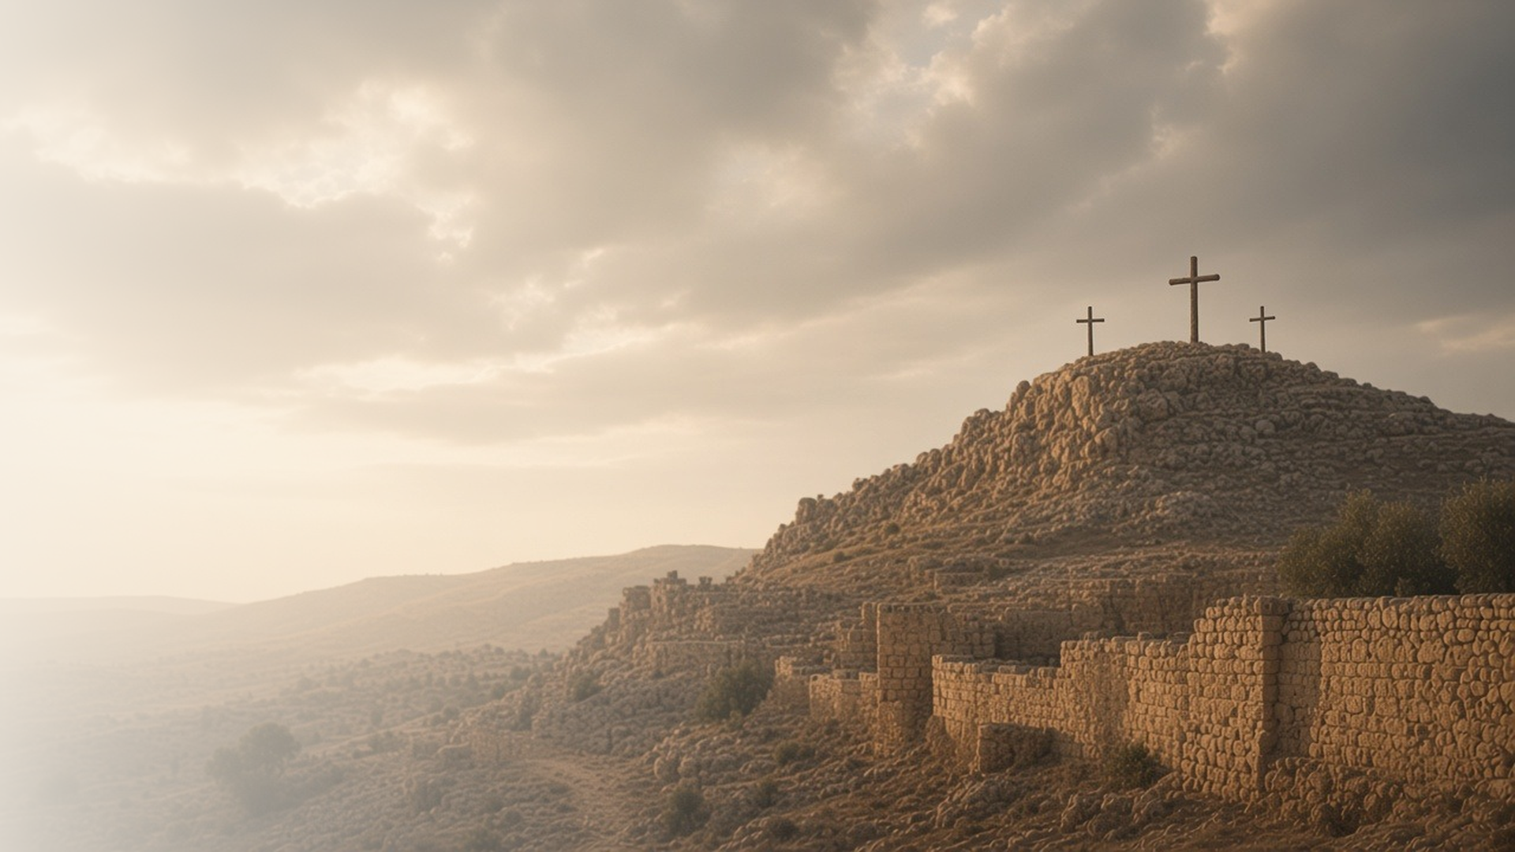
COME, FOLLOW ME · NEW TESTAMENT 2027
It Is Finished
June 14–20
Matthew 27; Mark 15; Luke 23; John 19
Notes:
TEACHING
All four Gospels record the trial, scourging, and Crucifixion of Jesus Christ. His willingness to die shows His love for the Father and for each of us. We see the devotion of the women and of John at the cross, Simon bearing the cross, the veil of the temple torn in two, and the Savior forgiving those who crucified Him, until His final words: "It is finished."
SCRIPTURE (KJV)
John 19:28–30
28 After this, Jesus knowing that all things were now accomplished, that the scripture might be fulfilled, saith, I thirst.
29 Now there was set a vessel full of vinegar: and they filled a spunge with vinegar, and put it upon hyssop, and put it to his mouth.
30 When Jesus therefore had received the vinegar, he said, It is finished: and he bowed his head, and gave up the ghost.
DISCUSSION
• What does the Savior's death on the cross teach you about His love?
• What do you feel as you read His final words?

Slide 2
MATTHEW 27; MARK 15; LUKE 23; JOHN 19
He laid down His life
His death on the cross shows His love for the Father and us.
“It is finished: and he bowed his head, and gave up the ghost.”
JOHN 19:30
Notes:
TEACHING
The Savior's life was not taken from Him; He gave it. Through mocking, scourging, and the agony of the cross, He finished the work the Father sent Him to do. Invite class members to look in the four accounts for evidence of His love for the Father and for all of us.
SCRIPTURE (KJV)
John 19:28–30
28 After this, Jesus knowing that all things were now accomplished, that the scripture might be fulfilled, saith, I thirst.
29 Now there was set a vessel full of vinegar: and they filled a spunge with vinegar, and put it upon hyssop, and put it to his mouth.
30 When Jesus therefore had received the vinegar, he said, It is finished: and he bowed his head, and gave up the ghost.
Matthew 27:50
50 Jesus, when he had cried again with a loud voice, yielded up the ghost.
Restoration scripture (public-domain text: bcbooks/scriptures-json)
3 Nephi 27:13–15 (Book of Mormon)
13 Behold I have given unto you my gospel, and this is the gospel which I have given unto you—that I came into the world to do the will of my Father, because my Father sent me.
14 And my Father sent me that I might be lifted up upon the cross; and after that I had been lifted up upon the cross, that I might draw all men unto me, that as I have been lifted up by men even so should men be lifted up by the Father, to stand before me, to be judged of their works, whether they be good or whether they be evil—
15 And for this cause have I been lifted up; therefore, according to the power of the Father I will draw all men unto me, that they may be judged according to their works.
Doctrine and Covenants 76:40–42 (Doctrine and Covenants)
40 And this is the gospel, the glad tidings, which the voice out of the heavens bore record unto us—
41 That he came into the world, even Jesus, to be crucified for the world, and to bear the sins of the world, and to sanctify the world, and to cleanse it from all unrighteousness;
42 That through him all might be saved whom the Father had put into his power and made by him;
DISCUSSION (questions quoted from the manual)
• “Where in Matthew 27; Mark 15; Luke 23; and John 19 do you find examples of each thing that Nephi said Jesus would suffer?”
• “Why was the Crucifixion important to the Savior’s mission? (see 3 Nephi 27:13–15; Doctrine and Covenants 76:40–42).”
• “What effect does the Savior’s Crucifixion have on your life? (see Romans 6:6; Galatians 2:20; 1 Peter 2:21–25; “When I Survey the Wondrous Cross,””

Slide 3
MATTHEW 27:11–29, 55–61; MARK 15:1–15, 40–47; LUKE 23:12–25, 49–56; JOHN 19:1–16, 25–27
Devoted to the end
His mother, Mary Magdalene, and others stayed near the cross.
“Now there stood by the cross of Jesus his mother, and his mother’s sister, Mary the wife of Cleophas, and Mary Magdalene.”
JOHN 19:25
Notes:
TEACHING
Many disciples had fled, but faithful women stayed by the cross and later watched where He was laid. Jesus, in His own agony, gave His mother into John's care. Joseph of Arimathaea and Nicodemus stepped forward to bury Him. Discuss what devotion to Christ looks like when circumstances are dark.
SCRIPTURE (KJV)
John 19:25–27
25 Now there stood by the cross of Jesus his mother, and his mother’s sister, Mary the wife of Cleophas, and Mary Magdalene.
26 When Jesus therefore saw his mother, and the disciple standing by, whom he loved, he saith unto his mother, Woman, behold thy son!
27 Then saith he to the disciple, Behold thy mother! And from that hour that disciple took her unto his own home.
Matthew 27:55–61
55 And many women were there beholding afar off, which followed Jesus from Galilee, ministering unto him:
56 Among which was Mary Magdalene, and Mary the mother of James and Joses, and the mother of Zebedee’s children.
57 When the even was come, there came a rich man of Arimathaea, named Joseph, who also himself was Jesus’ disciple:
58 He went to Pilate, and begged the body of Jesus. Then Pilate commanded the body to be delivered.
59 And when Joseph had taken the body, he wrapped it in a clean linen cloth,
60 And laid it in his own new tomb, which he had hewn out in the rock: and he rolled a great stone to the door of the sepulchre, and departed.
61 And there was Mary Magdalene, and the other Mary, sitting over against the sepulchre.
DISCUSSION (questions quoted from the manual)
• “What lessons do you learn from this story about the importance of standing for what is right, even when it is not popular?”
• “What did you learn from your experience?”
• “How did it bring you closer to God?”
• “What do you learn in Matthew 27:55–61; Mark 15:40–47; Luke 23:49–56; and John 19:25–27 about the women who were present during the Savior’s Crucifixion?”
• “How can you be like them in your discipleship?”

Slide 4
MATTHEW 27:27–49; MARK 15:16–36; LUKE 23:33–43; JOHN 19:1–5, 25–29
Take up the cross
Simon carried His cross; we too are invited to follow.
“And on him they laid the cross, that he might bear it after Jesus.”
LUKE 23:26
Notes:
TEACHING
On the road to Golgotha, soldiers compelled Simon of Cyrene to carry the Savior's cross. Earlier Jesus had taught that disciples must take up their cross and follow Him. Invite class members to consider what crosses they are asked to bear, and how the Savior bears them with us.
SCRIPTURE (KJV)
Luke 23:26
26 And as they led him away, they laid hold upon one Simon, a Cyrenian, coming out of the country, and on him they laid the cross, that he might bear it after Jesus.
Mark 15:21
21 And they compel one Simon a Cyrenian, who passed by, coming out of the country, the father of Alexander and Rufus, to bear his cross.
DISCUSSION (questions quoted from the manual)
• “He surely didn’t mean all His followers would be crucified too—so what did He mean?”
• “What do you learn from the way Jesus bore His suffering? (For example, what do you learn about Him from Luke 23:39–43 and John 19:26–27?)”
• “What does this tell you about what it means to be a disciple of Christ?”
• “What additional insights do you gain from Elder Ulisses Soares’s message “Take Up Our Cross”? (Ensign or Liahona, Nov. 2019, 113–16).”

Slide 5
MATTHEW 27:46, 50–51; MARK 15:34, 38; LUKE 23:45
The veil was rent
His death opened the way back to the Father’s presence.
“The veil of the temple was rent in twain from the top to the bottom.”
MATTHEW 27:51
Notes:
TEACHING
When Jesus died, the veil of the temple that separated the Holy of Holies was torn from top to bottom. The symbol is powerful: through His sacrifice, the way into God's presence is opened to all who come to Him. Discuss how His Atonement opens the way for us to return to Heavenly Father.
SCRIPTURE (KJV)
Matthew 27:46–51
46 And about the ninth hour Jesus cried with a loud voice, saying, Eli, Eli, lama sabachthani? that is to say, My God, my God, why hast thou forsaken me?
47 Some of them that stood there, when they heard that, said, This man calleth for Elias.
48 And straightway one of them ran, and took a spunge, and filled it with vinegar, and put it on a reed, and gave him to drink.
49 The rest said, Let be, let us see whether Elias will come to save him.
50 Jesus, when he had cried again with a loud voice, yielded up the ghost.
51 And, behold, the veil of the temple was rent in twain from the top to the bottom; and the earth did quake, and the rocks rent;
Mark 15:34–38
34 And at the ninth hour Jesus cried with a loud voice, saying, Eloi, Eloi, lama sabachthani? which is, being interpreted, My God, my God, why hast thou forsaken me?
35 And some of them that stood by, when they heard it, said, Behold, he calleth Elias.
36 And one ran and filled a spunge full of vinegar, and put it on a reed, and gave him to drink, saying, Let alone; let us see whether Elias will come to take him down.
37 And Jesus cried with a loud voice, and gave up the ghost.
38 And the veil of the temple was rent in twain from the top to the bottom.
DISCUSSION (questions quoted from the manual)
• “Perhaps the Savior’s most poignant moment on the cross came when He cried out, “My God, my God, why hast thou forsaken me?” (Matthew 27:46; Mark 15:34).”
• “What can you do to receive this gift the Savior has given you?”

Slide 6
LUKE 23:34
Father, forgive them
On the cross, Jesus prayed for those who crucified Him.
“Father, forgive them; for they know not what they do.”
LUKE 23:34
Notes:
TEACHING
As soldiers nailed Him to the cross and divided His clothing, Jesus prayed for His Father to forgive them. In His greatest suffering He showed perfect mercy. His example and His grace can help us forgive those who have hurt us.
SCRIPTURE (KJV)
Luke 23:33–34
33 And when they were come to the place, which is called Calvary, there they crucified him, and the malefactors, one on the right hand, and the other on the left.
34 Then said Jesus, Father, forgive them; for they know not what they do. And they parted his raiment, and cast lots.
DISCUSSION (questions quoted from the manual)
• “How do you feel when you read the Savior’s words in Luke 23:34? (see also the Joseph Smith Translation in footnote c).”
• “How can this verse help you if you have trouble forgiving someone?”

Slide 7
JOHN 15:13
“Greater love hath no man than this,
that a man lay down his life for his friends.”
Ponder the cross this week, and thank Him for His love.
Notes:
TEACHING
Jesus had taught His disciples, the night before (John 15:13), that no love is greater than laying down one's life for friends. On the cross, He did exactly that. Close by inviting class members to ponder His sacrifice this week and express gratitude for it.
SCRIPTURE (KJV)
John 15:13
13 Greater love hath no man than this, that a man lay down his life for his friends.
John 19:30
30 When Jesus therefore had received the vinegar, he said, It is finished: and he bowed his head, and gave up the ghost.
DISCUSSION
• How will you express gratitude for His sacrifice this week?
• How does His love change the way you see your own trials?

