Slide 1
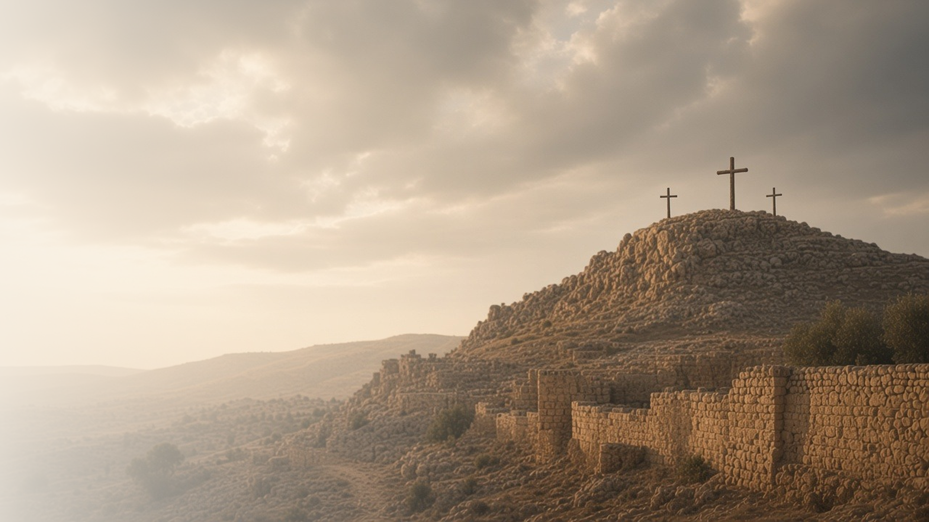
COME, FOLLOW ME · FOR CHILDREN
It Is Finished
June 14–20
Matthew 27; Mark 15; Luke 23; John 19
Notes:
TEACHING
This week children learn that because Jesus died for them they can repent and improve, that He died because He loves them, and that they can forgive others as He did. Teach these events gently and point forward to the joy of the Resurrection.
SCRIPTURE (KJV)
Luke 23:34
34 Then said Jesus, Father, forgive them; for they know not what they do. And they parted his raiment, and cast lots.
DISCUSSION
• Why did Jesus give His life?
• How can we show Jesus thank you?

Slide 2
MATTHEW 27; MARK 15; LUKE 23; JOHN 19
Because of Jesus, I can repent
Jesus died so that I can be forgiven and keep trying.
“Verily I say unto thee, To day shalt thou be with me in paradise.”
LUKE 23:43
Notes:
TEACHING
Tell how a man on a cross next to Jesus asked Jesus to remember him, and Jesus spoke kindly to him. Because Jesus died for us, we can say sorry, be forgiven, and try again. Repenting is a happy gift from Jesus.
SCRIPTURE (KJV)
Luke 23:39–43
39 And one of the malefactors which were hanged railed on him, saying, If thou be Christ, save thyself and us.
40 But the other answering rebuked him, saying, Dost not thou fear God, seeing thou art in the same condemnation?
41 And we indeed justly; for we receive the due reward of our deeds: but this man hath done nothing amiss.
42 And he said unto Jesus, Lord, remember me when thou comest into thy kingdom.
43 And Jesus said unto him, Verily I say unto thee, To day shalt thou be with me in paradise.
DISCUSSION (questions quoted from the manual)
• “Why did Jesus suffer for us?”

Slide 3
MATTHEW 27:11–66; LUKE 23; JOHN 19
Jesus died because He loves me
Jesus gave His life for everyone because He loves us.
“It is finished.”
JOHN 19:30
Notes:
TEACHING
Gently explain that Jesus died on the cross. He chose to do this because He loves Heavenly Father and loves us. Remind children that this sad day was followed by the happiest day of all, when He rose again.
SCRIPTURE (KJV)
John 19:28–30
28 After this, Jesus knowing that all things were now accomplished, that the scripture might be fulfilled, saith, I thirst.
29 Now there was set a vessel full of vinegar: and they filled a spunge with vinegar, and put it upon hyssop, and put it to his mouth.
30 When Jesus therefore had received the vinegar, he said, It is finished: and he bowed his head, and gave up the ghost.
DISCUSSION (questions quoted from the manual)
• “Oaks’s message “What Has Our Savior Done for Us?” looking for answers to the question in the message’s title (Liahona, May 2021, 75–77).”
• “How does God show His love for us?”
• “What does He ask of us?”

Slide 4
MATTHEW 27:26–37; LUKE 23:34
I can forgive like Jesus
Jesus forgave even the people who hurt Him.
“Father, forgive them; for they know not what they do.”
LUKE 23:34
Notes:
TEACHING
Explain that even while people were hurting Him, Jesus asked Heavenly Father to forgive them. Talk about how we feel when someone is unkind, and how Jesus can help us forgive.
SCRIPTURE (KJV)
Luke 23:33–34
33 And when they were come to the place, which is called Calvary, there they crucified him, and the malefactors, one on the right hand, and the other on the left.
34 Then said Jesus, Father, forgive them; for they know not what they do. And they parted his raiment, and cast lots.
DISCUSSION (questions quoted from the manual)
• (The manual gives no direct questions for this section.)
Suggested: Is there someone you can forgive, like Jesus did?

Slide 5
LUKE 23:46
“Father, into thy hands I commend my spirit.”
Tell Jesus thank you for His love in your prayers.
Notes:
TEACHING
Jesus trusted Heavenly Father to the very end. Invite children to thank Jesus for His love in their prayers this week.
SCRIPTURE (KJV)
Luke 23:46
46 And when Jesus had cried with a loud voice, he said, Father, into thy hands I commend my spirit: and having said thus, he gave up the ghost.
DISCUSSION
• What can you thank Jesus for?
• How do you know Jesus loves you?

