Slide 1
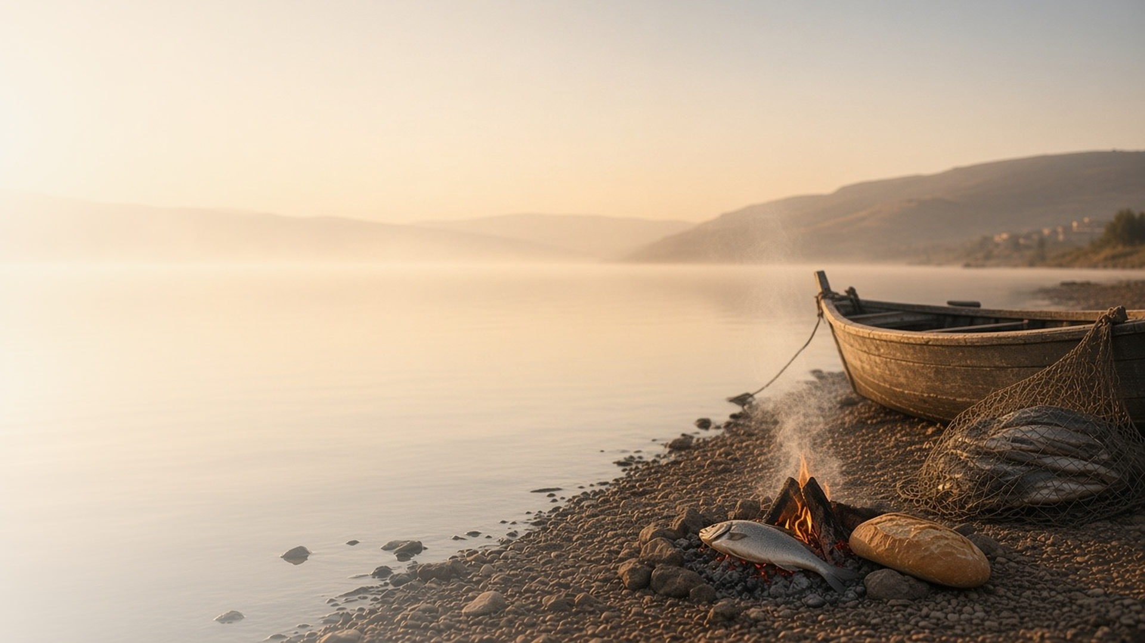
COME, FOLLOW ME · NEW TESTAMENT 2027
He Is Risen
June 21–27
Matthew 28; Mark 16; Luke 24; John 20–21
Notes:
TEACHING
The four Gospels end with the greatest news ever told: the tomb is empty and Jesus Christ lives. Women find the stone rolled away, two disciples walk with Him to Emmaus, Thomas touches His wounds, Peter is invited to feed His sheep, and the Apostles are sent to all the world as witnesses. Because He rose, everyone will live again.
SCRIPTURE (KJV)
Luke 24:1–6
1 Now upon the first day of the week, very early in the morning, they came unto the sepulchre, bringing the spices which they had prepared, and certain others with them.
2 And they found the stone rolled away from the sepulchre.
3 And they entered in, and found not the body of the Lord Jesus.
4 And it came to pass, as they were much perplexed thereabout, behold, two men stood by them in shining garments:
5 And as they were afraid, and bowed down their faces to the earth, they said unto them, Why seek ye the living among the dead?
6 He is not here, but is risen: remember how he spake unto you when he was yet in Galilee,
DISCUSSION
• How does the Resurrection change the way you see life and death?
• Which witness of the risen Lord speaks most to you?

Slide 2
MATTHEW 28; MARK 16; LUKE 24; JOHN 20
Everyone will live again
His Resurrection makes ours certain.
“Behold my hands and my feet, that it is I myself: handle me, and see; for a spirit hath not flesh and bones, as ye see me have.”
LUKE 24:39
Notes:
TEACHING
The risen Lord invited His frightened disciples to handle Him and see that He had flesh and bones; He even ate fish before them. His Resurrection was real and physical, and because of it every person who has lived will be resurrected. Discuss how this assurance brings hope in the face of loss.
SCRIPTURE (KJV)
Luke 24:36–43
36 And as they thus spake, Jesus himself stood in the midst of them, and saith unto them, Peace be unto you.
37 But they were terrified and affrighted, and supposed that they had seen a spirit.
38 And he said unto them, Why are ye troubled? and why do thoughts arise in your hearts?
39 Behold my hands and my feet, that it is I myself: handle me, and see; for a spirit hath not flesh and bones, as ye see me have.
40 And when he had thus spoken, he shewed them his hands and his feet.
41 And while they yet believed not for joy, and wondered, he said unto them, Have ye here any meat?
42 And they gave him a piece of a broiled fish, and of an honeycomb.
43 And he took it, and did eat before them.
Matthew 28:5–7
5 And the angel answered and said unto the women, Fear not ye: for I know that ye seek Jesus, which was crucified.
6 He is not here: for he is risen, as he said. Come, see the place where the Lord lay.
7 And go quickly, and tell his disciples that he is risen from the dead; and, behold, he goeth before you into Galilee; there shall ye see him: lo, I have told you.
DISCUSSION (questions quoted from the manual)
• “If you had the chance to talk to these witnesses, what would you ask them?”
• “What do you imagine they would say to you about the Savior?”
• “What truths do you find in Luke 24:36–43 and John 20 about resurrection?”
• “How is it different from being raised from the dead, like Lazarus was? (see John 11).”

Slide 3
LUKE 24:13–35
Abide with us
On the road to Emmaus, their hearts burned as He taught.
“Abide with us: for it is toward evening, and the day is far spent.”
LUKE 24:29
Notes:
TEACHING
Two disciples walked toward Emmaus, sad and confused, and a stranger joined them and opened the scriptures. They urged Him to stay, and as He broke bread their eyes were opened. Afterward they recognized that their hearts had burned within them. Invite class members to consider how they invite the Savior to abide with them.
SCRIPTURE (KJV)
Luke 24:13–35
13 And, behold, two of them went that same day to a village called Emmaus, which was from Jerusalem about threescore furlongs.
14 And they talked together of all these things which had happened.
15 And it came to pass, that, while they communed together and reasoned, Jesus himself drew near, and went with them.
16 But their eyes were holden that they should not know him.
17 And he said unto them, What manner of communications are these that ye have one to another, as ye walk, and are sad?
18 And the one of them, whose name was Cleopas, answering said unto him, Art thou only a stranger in Jerusalem, and hast not known the things which are come to pass there in these days?
19 And he said unto them, What things? And they said unto him, Concerning Jesus of Nazareth, which was a prophet mighty in deed and word before God and all the people:
20 And how the chief priests and our rulers delivered him to be condemned to death, and have crucified him.
21 But we trusted that it had been he which should have redeemed Israel: and beside all this, to day is the third day since these things were done.
22 Yea, and certain women also of our company made us astonished, which were early at the sepulchre;
23 And when they found not his body, they came, saying, that they had also seen a vision of angels, which said that he was alive.
24 And certain of them which were with us went to the sepulchre, and found it even so as the women had said: but him they saw not.
25 Then he said unto them, O fools, and slow of heart to believe all that the prophets have spoken:
26 Ought not Christ to have suffered these things, and to enter into his glory?
27 And beginning at Moses and all the prophets, he expounded unto them in all the scriptures the things concerning himself.
28 And they drew nigh unto the village, whither they went: and he made as though he would have gone further.
29 But they constrained him, saying, Abide with us: for it is toward evening, and the day is far spent. And he went in to tarry with them.
30 And it came to pass, as he sat at meat with them, he took bread, and blessed it, and brake, and gave to them.
31 And their eyes were opened, and they knew him; and he vanished out of their sight.
32 And they said one to another, Did not our heart burn within us, while he talked with us by the way, and while he opened to us the scriptures?
33 And they rose up the same hour, and returned to Jerusalem, and found the eleven gathered together, and them that were with them,
34 Saying, The Lord is risen indeed, and hath appeared to Simon.
35 And they told what things were done in the way, and how he was known of them in breaking of bread.
DISCUSSION (questions quoted from the manual)
• “How does the Savior walk with you?”
• “How do you invite Him to “abide with” you?”

Slide 4
JOHN 20:19–29
Blessed are they that believe
Thomas saw and believed; we can believe without seeing.
“Thomas, because thou hast seen me, thou hast believed: blessed are they that have not seen, and yet have believed.”
JOHN 20:29
Notes:
TEACHING
Thomas was absent when the risen Lord first appeared and would not believe without touching His wounds. Eight days later Jesus offered exactly that, and Thomas cried, "My Lord and my God." Jesus then blessed all who would believe without seeing, including us. Discuss how faith grows without physical sight.
SCRIPTURE (KJV)
John 20:24–29
24 But Thomas, one of the twelve, called Didymus, was not with them when Jesus came.
25 The other disciples therefore said unto him, We have seen the Lord. But he said unto them, Except I shall see in his hands the print of the nails, and put my finger into the print of the nails, and thrust my hand into his side, I will not believe.
26 And after eight days again his disciples were within, and Thomas with them: then came Jesus, the doors being shut, and stood in the midst, and said, Peace be unto you.
27 Then saith he to Thomas, reach hither thy finger, and behold my hands; and reach hither thy hand, and thrust it into my side: and be not faithless, but believing.
28 And Thomas answered and said unto him, My Lord and my God.
29 Jesus saith unto him, Thomas, because thou hast seen me, thou hast believed: blessed are they that have not seen, and yet have believed.
DISCUSSION (questions quoted from the manual)
• “In your opinion, why can believing without seeing be a blessing? (see John 20:29).”
• “What does God ask you to believe without seeing?”
• “What helps you have faith in those situations?”

Slide 5
JOHN 21:1–17
Feed my sheep
Jesus asked Peter three times: “Lovest thou me?”
“Simon, son of Jonas, lovest thou me? He saith unto him, Yea, Lord; thou knowest that I love thee. He saith unto him, Feed my sheep.”
JOHN 21:16
Notes:
TEACHING
After a night of catching nothing, the disciples followed a stranger's advice and filled their net. Then Jesus fed them breakfast by the fire and asked Peter three times whether he loved Him, each time inviting him to feed His sheep. Love for the Savior is shown by caring for those He loves.
SCRIPTURE (KJV)
John 21:1–17
1 After these things Jesus shewed himself again to the disciples at the sea of Tiberias; and on this wise shewed he himself.
2 There were together Simon Peter, and Thomas called Didymus, and Nathanael of Cana in Galilee, and the sons of Zebedee, and two other of his disciples.
3 Simon Peter saith unto them, I go a fishing. They say unto him, We also go with thee. They went forth, and entered into a ship immediately; and that night they caught nothing.
4 But when the morning was now come, Jesus stood on the shore: but the disciples knew not that it was Jesus.
5 Then Jesus saith unto them, Children, have ye any meat? They answered him, No.
6 And he said unto them, Cast the net on the right side of the ship, and ye shall find. They cast therefore, and now they were not able to draw it for the multitude of fishes.
7 Therefore that disciple whom Jesus loved saith unto Peter, It is the Lord. Now when Simon Peter heard that it was the Lord, he girt his fisher’s coat unto him, (for he was naked,) and did cast himself into the sea.
8 And the other disciples came in a little ship; (for they were not far from land, but as it were two hundred cubits,) dragging the net with fishes.
9 As soon then as they were come to land, they saw a fire of coals there, and fish laid thereon, and bread.
10 Jesus saith unto them, Bring of the fish which ye have now caught.
11 Simon Peter went up, and drew the net to land full of great fishes, and hundred and fifty and three: and for all there were so many, yet was not the net broken.
12 Jesus saith unto them, Come and dine. And none of the disciples durst ask him, Who art thou? knowing that it was the Lord.
13 Jesus then cometh, and taketh bread, and giveth them, and fish likewise.
14 This is now the third time that Jesus shewed himself to his disciples, after that he was risen from the dead.
15 So when they had dined, Jesus saith to Simon Peter, Simon, son of Jonas, lovest thou me more than these? He saith unto him, Yea, Lord; thou knowest that I love thee. He saith unto him, Feed my lambs.
16 He saith to him again the second time, Simon, son of Jonas, lovest thou me? He saith unto him, Yea, Lord; thou knowest that I love thee. He saith unto him, Feed my sheep.
17 He saith unto him the third time, Simon, son of Jonas, lovest thou me? Peter was grieved because he said unto him the third time, Lovest thou me? And he said unto him, Lord, thou knowest all things; thou knowest that I love thee. Jesus saith unto him, Feed my sheep.
DISCUSSION (questions quoted from the manual)
• (The manual gives no direct questions for this section.)
Suggested: How might the Savior be asking you to feed His sheep right now?

Slide 6
MATTHEW 28:16–20; MARK 16:14–20; LUKE 24:44–53
Ye are witnesses
The risen Lord sent His disciples to teach all nations.
“Go ye therefore, and teach all nations, baptizing them in the name of the Father, and of the Son, and of the Holy Ghost.”
MATTHEW 28:19
Notes:
TEACHING
Before His Ascension, Jesus commissioned His Apostles to go into all the world, teach and baptize, and witness of what they had seen. He promised to be with them always. Every disciple today is invited to be a witness of the living Christ.
SCRIPTURE (KJV)
Matthew 28:16–20
16 Then the eleven disciples went away into Galilee, into a mountain where Jesus had appointed them.
17 And when they saw him, they worshipped him: but some doubted.
18 And Jesus came and spake unto them, saying, All power is given unto me in heaven and in earth.
19 Go ye therefore, and teach all nations, baptizing them in the name of the Father, and of the Son, and of the Holy Ghost:
20 Teaching them to observe all things whatsoever I have commanded you: and, lo, I am with you alway, even unto the end of the world. Amen.
Luke 24:46–48
46 And said unto them, Thus it is written, and thus it behoved Christ to suffer, and to rise from the dead the third day:
47 And that repentance and remission of sins should be preached in his name among all nations, beginning at Jerusalem.
48 And ye are witnesses of these things.
DISCUSSION (questions quoted from the manual)
• “What “things” can you be a witness of? (Luke 24:48).”
• “Who can you share your witness with?”
• “How is “the Lord working with [you], and confirming the word” in your life? (Mark 16:20).”

Slide 7
LUKE 24:34
“The Lord is risen indeed.”
Bear witness this week of the living Christ.
Notes:
TEACHING
The disciples in Jerusalem greeted the travelers from Emmaus with joyful news: the Lord is risen indeed. Close by inviting class members to bear their own witness of the living Christ this week.
SCRIPTURE (KJV)
Luke 24:33–35
33 And they rose up the same hour, and returned to Jerusalem, and found the eleven gathered together, and them that were with them,
34 Saying, The Lord is risen indeed, and hath appeared to Simon.
35 And they told what things were done in the way, and how he was known of them in breaking of bread.
DISCUSSION
• How do you know that He lives?
• Who needs to hear your witness this week?

