Slide 1
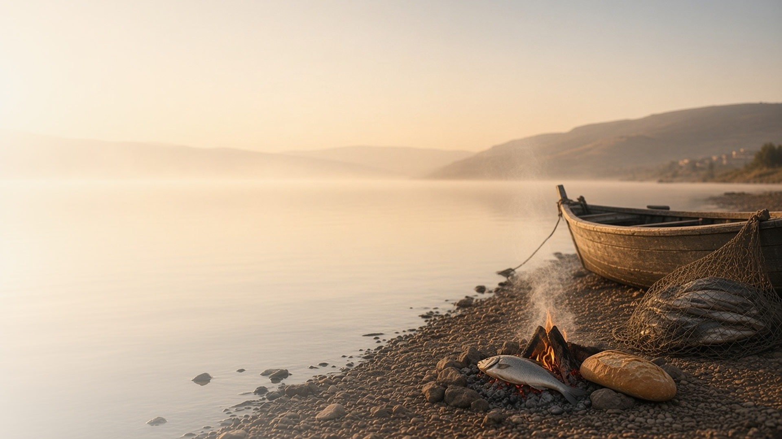
COME, FOLLOW ME · FOR CHILDREN
He Is Risen
June 21–27
Matthew 28; Mark 16; Luke 24; John 20–21
Notes:
TEACHING
This week children learn that because Jesus was resurrected they will live again, that they can have faith in Jesus even though they cannot see Him, that Jesus helps us see His influence in our lives, and that we show love for Jesus by caring for others.
SCRIPTURE (KJV)
Luke 24:5–6
5 And as they were afraid, and bowed down their faces to the earth, they said unto them, Why seek ye the living among the dead?
6 He is not here, but is risen: remember how he spake unto you when he was yet in Galilee,
DISCUSSION
• What happened on the first Easter morning?
• What does it mean that Jesus is alive?

Slide 2
MATTHEW 28; MARK 16; LUKE 24; JOHN 20:1–23
I will live again
Because Jesus was resurrected, I will be too.
“He is not here, but is risen.”
LUKE 24:6
Notes:
TEACHING
Use a glove and a hand to show the body and spirit: when we die, they separate, and when we are resurrected, they come back together forever. Jesus was the first to be resurrected, and because of Him, everyone will live again.
SCRIPTURE (KJV)
Luke 24:1, 3, 5–6
1 Now upon the first day of the week, very early in the morning, they came unto the sepulchre, bringing the spices which they had prepared, and certain others with them.
3 And they entered in, and found not the body of the Lord Jesus.
5 And as they were afraid, and bowed down their faces to the earth, they said unto them, Why seek ye the living among the dead?
6 He is not here, but is risen: remember how he spake unto you when he was yet in Galilee,
Full passage: Luke 24:1–6
DISCUSSION (questions quoted from the manual)
• “They could also sing “Did Jesus Really Live Again?” (Children’s Songbook, 64) and match phrases from the song with phrases in Luke 24:35–43.”
• “The video “What Happens after We Die?” (Gospel Library) could help your children understand what it means to be resurrected.”

Slide 3
JOHN 20:24–29
Faith without seeing
I can believe in Jesus even though I can’t see Him.
“Blessed are they that have not seen, and yet have believed.”
JOHN 20:29
Notes:
TEACHING
Tell how Thomas wanted to see Jesus before he would believe. Jesus showed Himself and said that people who believe without seeing are blessed. We cannot see the wind, but we can feel it; we cannot see Jesus, but we can feel His love.
SCRIPTURE (KJV)
John 20:25, 27–29
25 The other disciples therefore said unto him, We have seen the Lord. But he said unto them, Except I shall see in his hands the print of the nails, and put my finger into the print of the nails, and thrust my hand into his side, I will not believe.
27 Then saith he to Thomas, reach hither thy finger, and behold my hands; and reach hither thy hand, and thrust it into my side: and be not faithless, but believing.
28 And Thomas answered and said unto him, My Lord and my God.
29 Jesus saith unto him, Thomas, because thou hast seen me, thou hast believed: blessed are they that have not seen, and yet have believed.
Full passage: John 20:24–29
DISCUSSION (questions quoted from the manual)
• (The manual gives no direct questions for this section.)
Suggested: How do you know Jesus is real, even though you can't see Him?

Slide 4
LUKE 24:13–35
Jesus is with me
Jesus walked with two friends, and they felt Him near.
“Did not our heart burn within us, while he talked with us by the way.”
LUKE 24:32
Notes:
TEACHING
Take a short walk around the room as you tell how two friends walked with Jesus without knowing who He was. Later they remembered how good they felt as He talked with them. Help children notice ways Jesus blesses them every day.
SCRIPTURE (KJV)
Luke 24:15, 29, 31–32
15 And it came to pass, that, while they communed together and reasoned, Jesus himself drew near, and went with them.
29 But they constrained him, saying, Abide with us: for it is toward evening, and the day is far spent. And he went in to tarry with them.
31 And their eyes were opened, and they knew him; and he vanished out of their sight.
32 And they said one to another, Did not our heart burn within us, while he talked with us by the way, and while he opened to us the scriptures?
Full passage: Luke 24:13–32
DISCUSSION (questions quoted from the manual)
• (The manual gives no direct questions for this section.)
Suggested: When have you felt that Jesus was helping you?

Slide 5
JOHN 21:15–17
I can feed His sheep
I show I love Jesus when I help and care for others.
“Feed my sheep.”
JOHN 21:16
Notes:
TEACHING
Explain that Jesus asked Peter, "Lovest thou me?" and told him to feed His sheep, which means to care for His people. Help children think of ways to care for others: sharing, helping, and being kind.
SCRIPTURE (KJV)
John 21:15–17
15 So when they had dined, Jesus saith to Simon Peter, Simon, son of Jonas, lovest thou me more than these? He saith unto him, Yea, Lord; thou knowest that I love thee. He saith unto him, Feed my lambs.
16 He saith to him again the second time, Simon, son of Jonas, lovest thou me? He saith unto him, Yea, Lord; thou knowest that I love thee. He saith unto him, Feed my sheep.
17 He saith unto him the third time, Simon, son of Jonas, lovest thou me? Peter was grieved because he said unto him the third time, Lovest thou me? And he said unto him, Lord, thou knowest all things; thou knowest that I love thee. Jesus saith unto him, Feed my sheep.
DISCUSSION (questions quoted from the manual)
• “Why is feeding sheep a good way to describe serving God’s children?”
• “For example, how can we do this with people we see in church on Sunday?”

Slide 6
MARK 16:6
“He is risen.”
Share the good news: Jesus lives!
Notes:
TEACHING
The angel told the women the best news ever: He is risen! Invite children to share the good news with someone this week.
SCRIPTURE (KJV)
Mark 16:5–6
5 And entering into the sepulchre, they saw a young man sitting on the right side, clothed in a long white garment; and they were affrighted.
6 And he saith unto them, Be not affrighted: Ye seek Jesus of Nazareth, which was crucified: he is risen; he is not here: behold the place where they laid him.
DISCUSSION
• Who will you tell that Jesus lives?
• How does it make you feel to know Jesus is alive?

