Slide 1
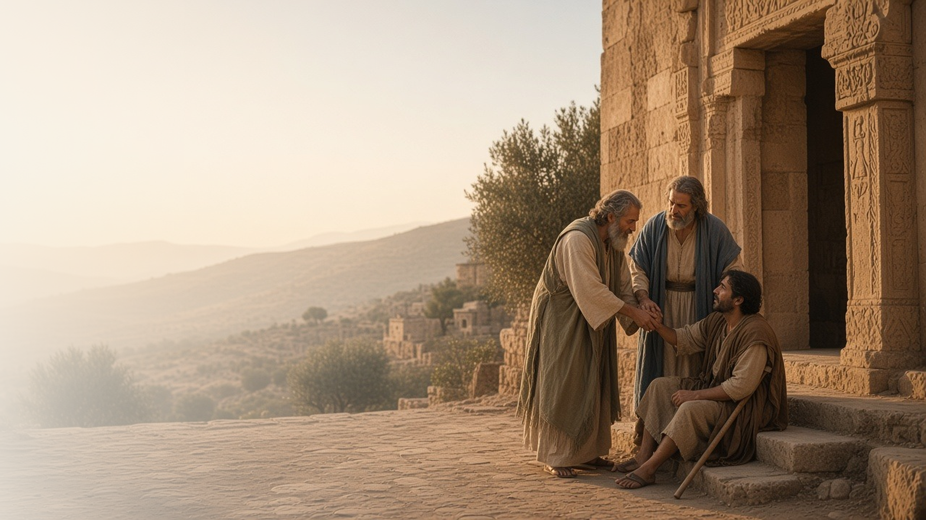
COME, FOLLOW ME · NEW TESTAMENT 2027
Ye Shall Be
Witnesses unto Me
June 28–July 4
Acts 1–5
Notes:
TEACHING
The book of Acts continues Luke's account after the Savior's Ascension. Guided by the Holy Ghost, the Apostles call a new member of the Twelve, preach on the day of Pentecost, heal a lame man in Jesus's name, testify boldly despite threats, and build a community of one heart and one soul. Acts shows the risen Lord leading His Church through His servants.
SCRIPTURE (KJV)
Acts 1:8
8 But ye shall receive power, after that the Holy Ghost is come upon you: and ye shall be witnesses unto me both in Jerusalem, and in all Judaea, and in Samaria, and unto the uttermost part of the earth.
DISCUSSION
• What strikes you about how the early Apostles changed after Pentecost?
• How are you a witness of Christ where you live?

Slide 2
ACTS 1:1–8, 15–26; 2:1–42; 4:1–13, 31–33
Power from on high
The Holy Ghost directed the Church after Jesus ascended.
“But ye shall receive power, after that the Holy Ghost is come upon you.”
ACTS 1:8
Notes:
TEACHING
Before ascending, Jesus promised the Apostles power when the Holy Ghost came upon them. At Pentecost that promise was fulfilled, and throughout these chapters the Holy Ghost guides their decisions, fills their words, and gives them courage. The same Spirit directs the Lord's Church today.
SCRIPTURE (KJV)
Acts 1:1–8
1 The former treatise have I made, O Theophilus, of all that Jesus began both to do and teach,
2 Until the day in which he was taken up, after that he through the Holy Ghost had given commandments unto the apostles whom he had chosen:
3 To whom also he shewed himself alive after his passion by many infallible proofs, being seen of them forty days, and speaking of the things pertaining to the kingdom of God:
4 And, being assembled together with them, commanded them that they should not depart from Jerusalem, but wait for the promise of the Father, which, saith he, ye have heard of me.
5 For John truly baptized with water; but ye shall be baptized with the Holy Ghost not many days hence.
6 When they therefore were come together, they asked of him, saying, Lord, wilt thou at this time restore again the kingdom to Israel?
7 And he said unto them, It is not for you to know the times or the seasons, which the Father hath put in his own power.
8 But ye shall receive power, after that the Holy Ghost is come upon you: and ye shall be witnesses unto me both in Jerusalem, and in all Judaea, and in Samaria, and unto the uttermost part of the earth.
Acts 4:31–33
31 And when they had prayed, the place was shaken where they were assembled together; and they were all filled with the Holy Ghost, and they spake the word of God with boldness.
32 And the multitude of them that believed were of one heart and of one soul: neither said any of them that ought of the things which he possessed was his own; but they had all things common.
33 And with great power gave the apostles witness of the resurrection of the Lord Jesus: and great grace was upon them all.
DISCUSSION (questions quoted from the manual)
• (The manual gives no direct questions for this section.)
Suggested: Where in Acts 1–5 do you see the Holy Ghost directing the Church?

Slide 3
ACTS 1:15–26
Called by revelation
The Apostles prayed and the Lord chose Matthias.
“Thou, Lord, which knowest the hearts of all men, shew whether of these two thou hast chosen.”
ACTS 1:24
Notes:
TEACHING
After Judas's death, the eleven Apostles needed to fill the Quorum. Peter set out the qualifications, they prayed for the Lord to show whom He had chosen, and Matthias was numbered with the Twelve. Apostles today are likewise called by God through revelation.
SCRIPTURE (KJV)
Acts 1:15–26
15 And in those days Peter stood up in the midst of the disciples, and said, (the number of names together were about an hundred and twenty,)
16 Men and brethren, this scripture must needs have been fulfilled, which the Holy Ghost by the mouth of David spake before concerning Judas, which was guide to them that took Jesus.
17 For he was numbered with us, and had obtained part of this ministry.
18 Now this man purchased a field with the reward of iniquity; and falling headlong, he burst asunder in the midst, and all his bowels gushed out.
19 And it was known unto all the dwellers at Jerusalem; insomuch as that field is called in their proper tongue, Aceldama, that is to say, The field of blood.
20 For it is written in the book of Psalms, Let his habitation be desolate, and let no man dwell therein: and his bishoprick let another take.
21 Wherefore of these men which have companied with us all the time that the Lord Jesus went in and out among us,
22 Beginning from the baptism of John, unto that same day that he was taken up from us, must one be ordained to be a witness with us of his resurrection.
23 And they appointed two, Joseph called Barsabas, who was surnamed Justus, and Matthias.
24 And they prayed, and said, Thou, Lord, which knowest the hearts of all men, shew whether of these two thou hast chosen,
25 That he may take part of this ministry and apostleship, from which Judas by transgression fell, that he might go to his own place.
26 And they gave forth their lots; and the lot fell upon Matthias; and he was numbered with the eleven apostles.
DISCUSSION (questions quoted from the manual)
• “How do they choose their leaders?”
• “What qualifications do they look for?”
• “What do you notice about the Lord’s way of choosing leaders?”
• “Under the Lord’s plan, those who have responsibility to select officers are governed by one overriding question: ‘Whom would the Lord have?’ There is quiet and thoughtful deliberation.”
• “How have you gained a witness that today’s Apostles are called by God?”

Slide 4
ACTS 2
What shall we do?
Peter answered: repent, be baptized, receive the Holy Ghost.
“Repent, and be baptized every one of you in the name of Jesus Christ for the remission of sins.”
ACTS 2:38
Notes:
TEACHING
On the day of Pentecost, the Apostles spoke so that people from many nations heard in their own languages. Peter testified of the risen Christ, and his hearers were pricked in their hearts and asked what to do. He taught repentance, baptism, and the gift of the Holy Ghost, and about three thousand were baptized.
SCRIPTURE (KJV)
Acts 2:36–42
36 Therefore let all the house of Israel know assuredly, that God hath made that same Jesus, whom ye have crucified, both Lord and Christ.
37 Now when they heard this, they were pricked in their heart, and said unto Peter and to the rest of the apostles, Men and brethren, what shall we do?
38 Then Peter said unto them, Repent, and be baptized every one of you in the name of Jesus Christ for the remission of sins, and ye shall receive the gift of the Holy Ghost.
39 For the promise is unto you, and to your children, and to all that are afar off, even as many as the Lord our God shall call.
40 And with many other words did he testify and exhort, saying, Save yourselves from this untoward generation.
41 Then they that gladly received his word were baptized: and the same day there were added unto them about three thousand souls.
42 And they continued stedfastly in the apostles’ doctrine and fellowship, and in breaking of bread, and in prayers.
DISCUSSION (questions quoted from the manual)
• “As you read about the outpouring of the Holy Ghost in Acts 2, you might ask yourself the same question the people asked: “What meaneth this?” (verse 12).”
• “Why are the events of this chapter meaningful to you?”
• “How would you summarize his answer?”
• “What does it mean to be “pricked in [your] heart”? (verse 37).”
• “Next, you might ask yourself another question the people asked: “What shall we do?””

Slide 5
ACTS 3:1–16
Such as I have
Peter gave the lame man what he had: the Savior’s power.
“Silver and gold have I none; but such as I have give I thee: In the name of Jesus Christ of Nazareth rise up and walk.”
ACTS 3:6
Notes:
TEACHING
A man lame from birth asked Peter and John for money at the temple gate. Peter had none, but he gave what he did have: healing in the name of Jesus Christ. The man leaped and praised God. The Lord can bless others through us when we offer what we have in His name.
SCRIPTURE (KJV)
Acts 3:1–11
1 Now Peter and John went up together into the temple at the hour of prayer, being the ninth hour.
2 And a certain man lame from his mother’s womb was carried, whom they laid daily at the gate of the temple which is called Beautiful, to ask alms of them that entered into the temple;
3 Who seeing Peter and John about to go into the temple asked an alms.
4 And Peter, fastening his eyes upon him with John, said, Look on us.
5 And he gave heed unto them, expecting to receive something of them.
6 Then Peter said, Silver and gold have I none; but such as I have give I thee: In the name of Jesus Christ of Nazareth rise up and walk.
7 And he took him by the right hand, and lifted him up: and immediately his feet and ankle bones received strength.
8 And he leaping up stood, and walked, and entered with them into the temple, walking, and leaping, and praising God.
9 And all the people saw him walking and praising God:
10 And they knew that it was he which sat for alms at the Beautiful gate of the temple: and they were filled with wonder and amazement at that which had happened unto him.
11 And as the lame man which was healed held Peter and John, all the people ran together unto them in the porch that is called Solomon’s, greatly wondering.
DISCUSSION (questions quoted from the manual)
• “Why is it important to you to know that?”
• “What do you learn from these verses about how the Lord answers our petitions?”
• “What impresses you about the way Peter explained this miracle to others?”

Slide 6
ACTS 3:12–26; 4:1–21; 5:12–42
We cannot but speak
Threatened and beaten, the Apostles kept testifying.
“For we cannot but speak the things which we have seen and heard.”
ACTS 4:20
Notes:
TEACHING
The council arrested Peter and John and commanded them to stop teaching in Jesus's name. They answered that they could not stop speaking of what they had seen and heard. Later, beaten and released, they rejoiced to be counted worthy to suffer for His name. Discuss what helps us share the gospel with courage.
SCRIPTURE (KJV)
Acts 4:13–21
13 Now when they saw the boldness of Peter and John, and perceived that they were unlearned and ignorant men, they marvelled; and they took knowledge of them, that they had been with Jesus.
14 And beholding the man which was healed standing with them, they could say nothing against it.
15 But when they had commanded them to go aside out of the council, they conferred among themselves,
16 Saying, What shall we do to these men? for that indeed a notable miracle hath been done by them is manifest to all them that dwell in Jerusalem; and we cannot deny it.
17 But that it spread no further among the people, let us straitly threaten them, that they speak henceforth to no man in this name.
18 And they called them, and commanded them not to speak at all nor teach in the name of Jesus.
19 But Peter and John answered and said unto them, Whether it be right in the sight of God to hearken unto you more than unto God, judge ye.
20 For we cannot but speak the things which we have seen and heard.
21 So when they had further threatened them, they let them go, finding nothing how they might punish them, because of the people: for all men glorified God for that which was done.
Acts 5:40–42
40 And to him they agreed: and when they had called the apostles, and beaten them, they commanded that they should not speak in the name of Jesus, and let them go.
41 And they departed from the presence of the council, rejoicing that they were counted worthy to suffer shame for his name.
42 And daily in the temple, and in every house, they ceased not to teach and preach Jesus Christ.
DISCUSSION (questions quoted from the manual)
• “Why do you think Peter and John were able to be so bold about their testimonies?”
• “What does it mean to you to speak “the word of God with boldness”? (Acts 4:31).”

Slide 7
ACTS 4:31–37; 5:1–4
One heart and one soul
The believers shared all things and cared for one another.
“And the multitude of them that believed were of one heart and of one soul.”
ACTS 4:32
Notes:
TEACHING
The early Saints were so united that no one among them lacked, as those with property shared freely. Ananias and Sapphira's deception stands in contrast, a reminder that consecration must be honest and from the heart. Invite class members to consider how they can help build a community of one heart.
SCRIPTURE (KJV)
Acts 4:32–35
32 And the multitude of them that believed were of one heart and of one soul: neither said any of them that ought of the things which he possessed was his own; but they had all things common.
33 And with great power gave the apostles witness of the resurrection of the Lord Jesus: and great grace was upon them all.
34 Neither was there any among them that lacked: for as many as were possessors of lands or houses sold them, and brought the prices of the things that were sold,
35 And laid them down at the apostles’ feet: and distribution was made unto every man according as he had need.
Acts 5:1–4
1 But a certain man named Ananias, with Sapphira his wife, sold a possession,
2 And kept back part of the price, his wife also being privy to it, and brought a certain part, and laid it at the apostles’ feet.
3 But Peter said, Ananias, why hath Satan filled thine heart to lie to the Holy Ghost, and to keep back part of the price of the land?
4 Whiles it remained, was it not thine own? and after it was sold, was it not in thine own power? why hast thou conceived this thing in thine heart? thou hast not lied unto men, but unto God.
DISCUSSION (questions quoted from the manual)
• “What does it mean to be “of one heart and of one soul”? (Acts 4:32).”
• “In what ways do we sometimes “[keep] back part” of ourselves? (Acts 5:2).”
• “How does that affect our efforts to be united?”

Slide 8
ACTS 5:42
“They ceased not to teach
and preach Jesus Christ.”
Find one way this week to witness of Christ in word or deed.
Notes:
TEACHING
Acts 5 ends with the Apostles teaching daily, in the temple and in every house. Close by inviting class members to find one opportunity this week to witness of Christ, in word or in deed.
SCRIPTURE (KJV)
Acts 5:41–42
41 And they departed from the presence of the council, rejoicing that they were counted worthy to suffer shame for his name.
42 And daily in the temple, and in every house, they ceased not to teach and preach Jesus Christ.
DISCUSSION
• Where is your "every house" for sharing the gospel?
• What helps you speak of Christ with courage?

