Slide 1
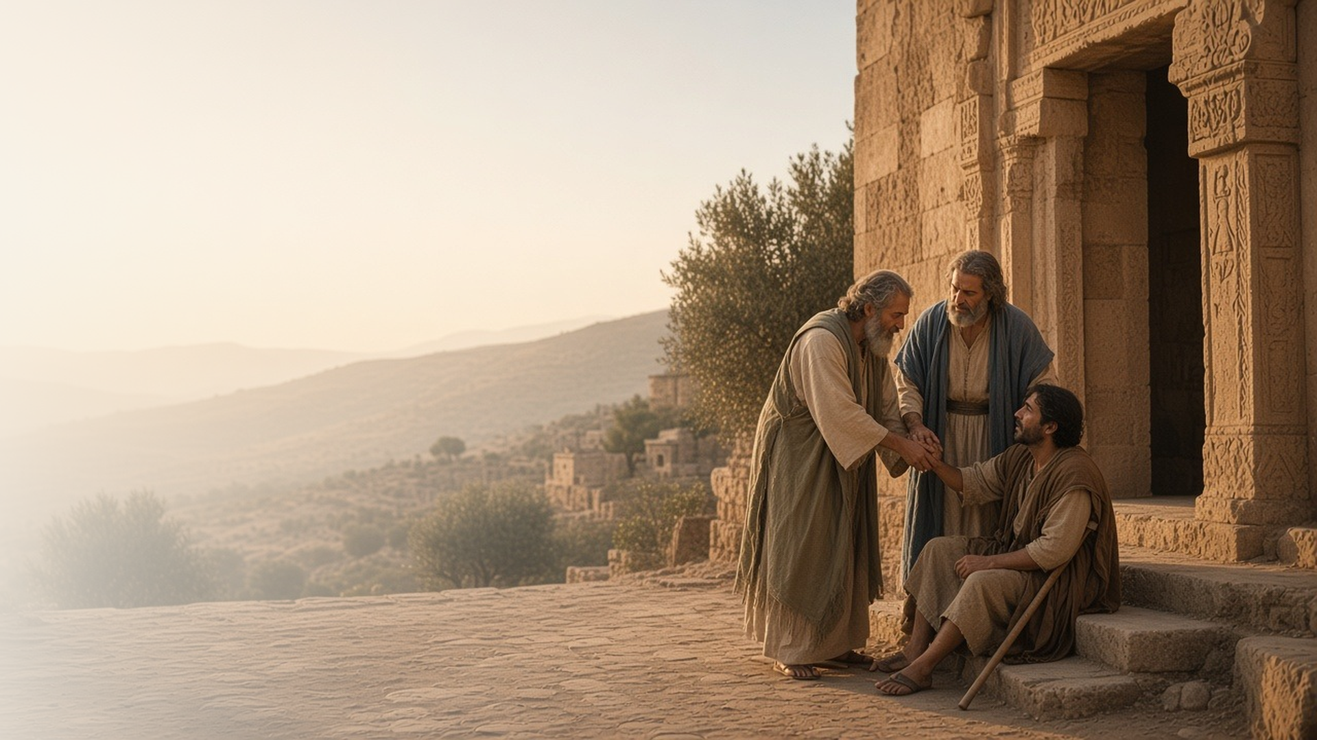
COME, FOLLOW ME · FOR CHILDREN
Ye Shall Be
Witnesses unto Me
June 28–July 4
Acts 1–5
Notes:
TEACHING
This week children learn that Jesus leads His Church through prophets and apostles, that we show faith by repenting, being baptized, and receiving the Holy Ghost, that Jesus can bless others through us, and that His followers are of one heart.
SCRIPTURE (KJV)
Acts 3:6–8
6 Then Peter said, Silver and gold have I none; but such as I have give I thee: In the name of Jesus Christ of Nazareth rise up and walk.
7 And he took him by the right hand, and lifted him up: and immediately his feet and ankle bones received strength.
8 And he leaping up stood, and walked, and entered with them into the temple, walking, and leaping, and praising God.
DISCUSSION
• How did Peter help the lame man?
• How can Jesus help others through you?

Slide 2
ACTS 1:1–11
Jesus leads through apostles
Jesus taught His Apostles before He went up to heaven.
“Ye shall be witnesses unto me.”
ACTS 1:8
Notes:
TEACHING
Show a picture of the Savior's Ascension. Explain that before Jesus went to heaven, He taught His Apostles and told them to tell everyone about Him. Today Jesus leads His Church through a prophet and apostles.
SCRIPTURE (KJV)
Acts 1:8–11
8 But ye shall receive power, after that the Holy Ghost is come upon you: and ye shall be witnesses unto me both in Jerusalem, and in all Judaea, and in Samaria, and unto the uttermost part of the earth.
9 And when he had spoken these things, while they beheld, he was taken up; and a cloud received him out of their sight.
10 And while they looked stedfastly toward heaven as he went up, behold, two men stood by them in white apparel;
11 Which also said, Ye men of Galilee, why stand ye gazing up into heaven? this same Jesus, which is taken up from you into heaven, shall so come in like manner as ye have seen him go into heaven.
Full passage: Acts 1:1–11
DISCUSSION (questions quoted from the manual)
• “What have our Apostles invited us to do?”

Slide 3
ACTS 2
I can follow Jesus
I can repent, be baptized, and receive the Holy Ghost.
“Repent, and be baptized every one of you.”
ACTS 2:38
Notes:
TEACHING
Tell how many people heard Peter teach about Jesus and asked what they should do. Peter told them to repent, be baptized, and receive the Holy Ghost. Show a picture of a baptism and talk about how children can prepare.
SCRIPTURE (KJV)
Acts 2:37–38
37 Now when they heard this, they were pricked in their heart, and said unto Peter and to the rest of the apostles, Men and brethren, what shall we do?
38 Then Peter said unto them, Repent, and be baptized every one of you in the name of Jesus Christ for the remission of sins, and ye shall receive the gift of the Holy Ghost.
DISCUSSION (questions quoted from the manual)
• “After reading together Peter’s answer to the question in verse 37, you and your children could make a poster with the words What shall we do? at the top.”

Slide 4
ACTS 3:1–11
Jesus can bless others through me
Peter helped a man walk again in Jesus’s name.
“Silver and gold have I none; but such as I have give I thee.”
ACTS 3:6
Notes:
TEACHING
Act out the story: the man at the temple gate asked for money, but Peter took his hand and healed him in Jesus's name. The man jumped and praised God. Jesus can help others through us when we are kind and helpful.
SCRIPTURE (KJV)
Acts 3:2, 6–8
2 And a certain man lame from his mother’s womb was carried, whom they laid daily at the gate of the temple which is called Beautiful, to ask alms of them that entered into the temple;
6 Then Peter said, Silver and gold have I none; but such as I have give I thee: In the name of Jesus Christ of Nazareth rise up and walk.
7 And he took him by the right hand, and lifted him up: and immediately his feet and ankle bones received strength.
8 And he leaping up stood, and walked, and entered with them into the temple, walking, and leaping, and praising God.
Full passage: Acts 3:1–8
DISCUSSION (questions quoted from the manual)
• “How can He use us to bless others?”
• “Singing “Have I Done Any Good?” (Hymns, no. 223) might spark some ideas.”

Slide 5
ACTS 4:32
One heart and one soul
Followers of Jesus love and share with one another.
“And the multitude of them that believed were of one heart and of one soul.”
ACTS 4:32
Notes:
TEACHING
Draw one big heart and have each child write or draw their name inside. Explain that Jesus's followers loved each other so much that they shared everything. Talk about ways children can share and help in their family and Primary class.
SCRIPTURE (KJV)
Acts 4:32
32 And the multitude of them that believed were of one heart and of one soul: neither said any of them that ought of the things which he possessed was his own; but they had all things common.
DISCUSSION (questions quoted from the manual)
• “How can we reach out to them?”

Slide 6
ACTS 4:20
“For we cannot but speak
the things which we have seen and heard.”
Tell one friend or family member something you love about Jesus.
Notes:
TEACHING
Peter and John could not stop telling people about Jesus. Invite children to tell someone what they love about Him this week.
SCRIPTURE (KJV)
Acts 4:19–20
19 But Peter and John answered and said unto them, Whether it be right in the sight of God to hearken unto you more than unto God, judge ye.
20 For we cannot but speak the things which we have seen and heard.
DISCUSSION
• What do you love about Jesus?
• Who will you tell about Him?

