Slide 1
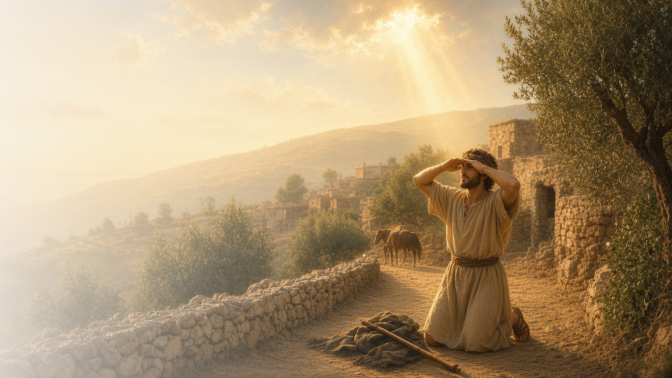
COME, FOLLOW ME · NEW TESTAMENT 2027
What Wilt Thou
Have Me to Do?
July 5–11
Acts 6–9
Notes:
TEACHING
Acts 6–9 follows the Church as it spreads beyond Jerusalem. Stephen bears witness and is martyred, Philip teaches in Samaria and guides an Ethiopian official, Simon tries to buy priesthood power, and Saul, the fiercest persecutor, meets the risen Lord on the road to Damascus and asks, "Lord, what wilt thou have me to do?" Peter heals Aeneas and raises Tabitha.
SCRIPTURE (KJV)
Acts 9:3–6
3 And as he journeyed, he came near Damascus: and suddenly there shined round about him a light from heaven:
4 And he fell to the earth, and heard a voice saying unto him, Saul, Saul, why persecutest thou me?
5 And he said, Who art thou, Lord? And the Lord said, I am Jesus whom thou persecutest: it is hard for thee to kick against the pricks.
6 And he trembling and astonished said, Lord, what wilt thou have me to do? And the Lord said unto him, Arise, and go into the city, and it shall be told thee what thou must do.
DISCUSSION
• What does Saul's question on the road to Damascus teach you about conversion?
• When have you asked the Lord what He would have you do?

Slide 2
ACTS 6–7
Stephen saw the Son of God
Stephen testified boldly and saw Jesus at God’s right hand.
“Behold, I see the heavens opened, and the Son of man standing on the right hand of God.”
ACTS 7:56
Notes:
TEACHING
Stephen, one of seven chosen to serve, was full of faith and the Holy Ghost. Accused before the council, he reviewed Israel's history and showed how they had resisted the prophets and the Holy Ghost. As they stoned him, he saw the heavens open and prayed for his killers. Discuss how the Holy Ghost helps us receive the Savior and His servants rather than resist them.
SCRIPTURE (KJV)
Acts 6:8–10
8 And Stephen, full of faith and power, did great wonders and miracles among the people.
9 Then there arose certain of the synagogue, which is called the synagogue of the Libertines, and Cyrenians, and Alexandrians, and of them of Cilicia and of Asia, disputing with Stephen.
10 And they were not able to resist the wisdom and the spirit by which he spake.
Acts 7:51–60
51 Ye stiffnecked and uncircumcised in heart and ears, ye do always resist the Holy Ghost: as your fathers did, so do ye.
52 Which of the prophets have not your fathers persecuted? and they have slain them which shewed before of the coming of the Just One; of whom ye have been now the betrayers and murderers:
53 Who have received the law by the disposition of angels, and have not kept it.
54 When they heard these things, they were cut to the heart, and they gnashed on him with their teeth.
55 But he, being full of the Holy Ghost, looked up stedfastly into heaven, and saw the glory of God, and Jesus standing on the right hand of God,
56 And said, Behold, I see the heavens opened, and the Son of man standing on the right hand of God.
57 Then they cried out with a loud voice, and stopped their ears, and ran upon him with one accord,
58 And cast him out of the city, and stoned him: and the witnesses laid down their clothes at a young man’s feet, whose name was Saul.
59 And they stoned Stephen, calling upon God, and saying, Lord Jesus, receive my spirit.
60 And he kneeled down, and cried with a loud voice, Lord, lay not this sin to their charge. And when he had said this, he fell asleep.
Restoration scripture (public-domain text: bcbooks/scriptures-json)
Alma 10:5–6 (Book of Mormon)
5 Nevertheless, after all this, I never have known much of the ways of the Lord, and his mysteries and marvelous power. I said I never had known much of these things; but behold, I mistake, for I have seen much of his mysteries and his marvelous power; yea, even in the preservation of the lives of this people.
6 Nevertheless, I did harden my heart, for I was called many times and I would not hear; therefore I knew concerning these things, yet I would not know; therefore I went on rebelling against God, in the wickedness of my heart, even until the fourth day of this seventh month, which is in the tenth year of the reign of the judges.
DISCUSSION (questions quoted from the manual)
• “What attitudes caused the Israelites to reject Moses—and, eventually, the Savior? (see, for example, Acts 7:23–41, 51–53).”
• “What can I learn from their experiences?”
• “What does it look like to “resist the Holy Ghost”? (Acts 7:51; see also Alma 10:5–6).”
• “Why do we do that sometimes?”
• “How did Stephen follow the Savior’s example in these verses? (compare Luke 23:1–46).”
• “What does Stephen’s vision (see Acts 7:55–56) teach you about the nature of the Godhead and Their relationship with us?”

Slide 3
ACTS 8:1–3; 9:1–31
Anyone can change
Saul the persecutor became Paul the Apostle.
“I am Jesus whom thou persecutest.”
ACTS 9:5
Notes:
TEACHING
Saul consented to Stephen's death and ravaged the Church. On the road to Damascus, a light from heaven struck him down and the Lord asked why he persecuted Him. Blinded, Saul waited, prayed, and was baptized, and soon he was preaching Christ in the synagogues. If the Lord could change Saul, no one is beyond His reach.
SCRIPTURE (KJV)
Acts 8:1–3
1 And Saul was consenting unto his death. And at that time there was a great persecution against the church which was at Jerusalem; and they were all scattered abroad throughout the regions of Judaea and Samaria, except the apostles.
2 And devout men carried Stephen to his burial, and made great lamentation over him.
3 As for Saul, he made havock of the church, entering into every house, and haling men and women committed them to prison.
Acts 9:1–9
1 And Saul, yet breathing out threatenings and slaughter against the disciples of the Lord, went unto the high priest,
2 And desired of him letters to Damascus to the synagogues, that if he found any of this way, whether they were men or women, he might bring them bound unto Jerusalem.
3 And as he journeyed, he came near Damascus: and suddenly there shined round about him a light from heaven:
4 And he fell to the earth, and heard a voice saying unto him, Saul, Saul, why persecutest thou me?
5 And he said, Who art thou, Lord? And the Lord said, I am Jesus whom thou persecutest: it is hard for thee to kick against the pricks.
6 And he trembling and astonished said, Lord, what wilt thou have me to do? And the Lord said unto him, Arise, and go into the city, and it shall be told thee what thou must do.
7 And the men which journeyed with him stood speechless, hearing a voice, but seeing no man.
8 And Saul arose from the earth; and when his eyes were opened, he saw no man: but they led him by the hand, and brought him into Damascus.
9 And he was three days without sight, and neither did eat nor drink.
Acts 9:17–20
17 And Ananias went his way, and entered into the house; and putting his hands on him said, Brother Saul, the Lord, even Jesus, that appeared unto thee in the way as thou camest, hath sent me, that thou mightest receive thy sight, and be filled with the Holy Ghost.
18 And immediately there fell from his eyes as it had been scales: and he received sight forthwith, and arose, and was baptized.
19 And when he had received meat, he was strengthened. Then was Saul certain days with the disciples which were at Damascus.
20 And straightway he preached Christ in the synagogues, that he is the Son of God.
DISCUSSION (questions quoted from the manual)
• “How has He involved others in your conversion?”
• “How has He involved you in the conversion of others?”
• “What do you learn about the Savior from this story?”

Slide 4
ACTS 8:9–24
Not for sale
Simon learned that God’s gift cannot be bought with money.
“Thy money perish with thee, because thou hast thought that the gift of God may be purchased with money.”
ACTS 8:20
Notes:
TEACHING
When Simon the sorcerer saw the Holy Ghost given by the laying on of hands, he offered money for the same power. Peter rebuked him sharply: the gift of God cannot be purchased. Priesthood power flows from God through worthiness and humility. Discuss how we honor that gift in our homes and service.
SCRIPTURE (KJV)
Acts 8:14–24
14 Now when the apostles which were at Jerusalem heard that Samaria had received the word of God, they sent unto them Peter and John:
15 Who, when they were come down, prayed for them, that they might receive the Holy Ghost:
16 (For as yet he was fallen upon none of them: only they were baptized in the name of the Lord Jesus.)
17 Then laid they their hands on them, and they received the Holy Ghost.
18 And when Simon saw that through laying on of the apostles’ hands the Holy Ghost was given, he offered them money,
19 Saying, Give me also this power, that on whomsoever I lay hands, he may receive the Holy Ghost.
20 But Peter said unto him, Thy money perish with thee, because thou hast thought that the gift of God may be purchased with money.
21 Thou hast neither part nor lot in this matter: for thy heart is not right in the sight of God.
22 Repent therefore of this thy wickedness, and pray God, if perhaps the thought of thine heart may be forgiven thee.
23 For I perceive that thou art in the gall of bitterness, and in the bond of iniquity.
24 Then answered Simon, and said, Pray ye to the Lord for me, that none of these things which ye have spoken come upon me.
DISCUSSION (questions quoted from the manual)
• “What did Simon misunderstand?”
• “What do you learn from his experience?”

Slide 5
ACTS 8:26–39
Except some man guide me
Philip, led by the Spirit, taught an Ethiopian seeker.
“How can I, except some man should guide me?”
ACTS 8:31
Notes:
TEACHING
An angel and then the Spirit led Philip to a desert road where an Ethiopian treasurer was reading Isaiah. When Philip asked if he understood, the man answered honestly that he needed a guide. Philip began at that scripture and preached Jesus, and the man asked to be baptized. The Holy Ghost can lead us to those who are ready.
SCRIPTURE (KJV)
Acts 8:26–39
26 And the angel of the Lord spake unto Philip, saying, Arise, and go toward the south unto the way that goeth down from Jerusalem unto Gaza, which is desert.
27 And he arose and went: and, behold, a man of Ethiopia, an eunuch of great authority under Candace queen of the Ethiopians, who had the charge of all her treasure, and had come to Jerusalem for to worship,
28 Was returning, and sitting in his chariot read Esaias the prophet.
29 Then the Spirit said unto Philip, Go near, and join thyself to this chariot.
30 And Philip ran thither to him, and heard him read the prophet Esaias, and said, Understandest thou what thou readest?
31 And he said, How can I, except some man should guide me? And he desired Philip that he would come up and sit with him.
32 The place of the scripture which he read was this, He was led as a sheep to the slaughter; and like a lamb dumb before his shearer, so opened he not his mouth:
33 In his humiliation his judgment was taken away: and who shall declare his generation? for his life is taken from the earth.
34 And the eunuch answered Philip, and said, I pray thee, of whom speaketh the prophet this? of himself, or of some other man?
35 Then Philip opened his mouth, and began at the same scripture, and preached unto him Jesus.
36 And as they went on their way, they came unto a certain water: and the eunuch said, See, here is water; what doth hinder me to be baptized?
37 And Philip said, If thou believest with all thine heart, thou mayest. And he answered and said, I believe that Jesus Christ is the Son of God.
38 And he commanded the chariot to stand still: and they went down both into the water, both Philip and the eunuch; and he baptized him.
39 And when they were come up out of the water, the Spirit of the Lord caught away Philip, that the eunuch saw him no more: and he went on his way rejoicing.
DISCUSSION (questions quoted from the manual)
• “What do you learn about helping others come to Jesus Christ from the account in Acts 8:26–39?”
• “How can you help guide others to Jesus as Philip did?”
• “Elder Ulisses Soares said that this account “is a reminder of the divine mandate we all have to seek to learn and to teach one another the gospel of Jesus Christ. … We are sometimes like the Ethiopian—we need the help of a faithful and inspired teacher; and we are sometimes like Philip—we need to teach and strengthen others in their conversion” (“How Can I Understand?,””

Slide 6
ACTS 9:10–31
A chosen vessel
Ananias learned to see Saul as the Lord saw him.
“Go thy way: for he is a chosen vessel unto me.”
ACTS 9:15
Notes:
TEACHING
When the Lord asked Ananias to find Saul, he hesitated: he knew Saul's reputation. The Lord told him Saul was a chosen vessel. Ananias went, laid his hands on him, and called him "Brother Saul." Invite class members to consider whom the Lord might be asking them to see with new eyes.
SCRIPTURE (KJV)
Acts 9:10–18
10 And there was a certain disciple at Damascus, named Ananias; and to him said the Lord in a vision, Ananias. And he said, Behold, I am here, Lord.
11 And the Lord said unto him, Arise, and go into the street which is called Straight, and enquire in the house of Judas for one called Saul, of Tarsus: for, behold, he prayeth,
12 And hath seen in a vision a man named Ananias coming in, and putting his hand on him, that he might receive his sight.
13 Then Ananias answered, Lord, I have heard by many of this man, how much evil he hath done to thy saints at Jerusalem:
14 And here he hath authority from the chief priests to bind all that call on thy name.
15 But the Lord said unto him, Go thy way: for he is a chosen vessel unto me, to bear my name before the Gentiles, and kings, and the children of Israel:
16 For I will shew him how great things he must suffer for my name’s sake.
17 And Ananias went his way, and entered into the house; and putting his hands on him said, Brother Saul, the Lord, even Jesus, that appeared unto thee in the way as thou camest, hath sent me, that thou mightest receive thy sight, and be filled with the Holy Ghost.
18 And immediately there fell from his eyes as it had been scales: and he received sight forthwith, and arose, and was baptized.
DISCUSSION (questions quoted from the manual)
• “What impresses you about the way Ananias responded to his assignment from the Lord?”
• “How might the Savior’s perspective of that person be different from yours?”

Slide 7
ACTS 9:32–43
Tabitha, arise
Through Peter, the Lord healed Aeneas and raised Tabitha.
“Tabitha, arise.”
ACTS 9:40
Notes:
TEACHING
In Lydda, Peter healed Aeneas, bedridden for eight years, in the name of Jesus Christ. In Joppa, widows showed Peter the coats and garments Tabitha had made, and he knelt, prayed, and raised her from death. The power of Jesus Christ worked miracles through His servants then, and it still does.
SCRIPTURE (KJV)
Acts 9:32–42
32 And it came to pass, as Peter passed throughout all quarters, he came down also to the saints which dwelt at Lydda.
33 And there he found a certain man named Aeneas, which had kept his bed eight years, and was sick of the palsy.
34 And Peter said unto him, Aeneas, Jesus Christ maketh thee whole: arise, and make thy bed. And he arose immediately.
35 And all that dwelt at Lydda and Saron saw him, and turned to the Lord.
36 Now there was at Joppa a certain disciple named Tabitha, which by interpretation is called Dorcas: this woman was full of good works and almsdeeds which she did.
37 And it came to pass in those days, that she was sick, and died: whom when they had washed, they laid her in an upper chamber.
38 And forasmuch as Lydda was nigh to Joppa, and the disciples had heard that Peter was there, they sent unto him two men, desiring him that he would not delay to come to them.
39 Then Peter arose and went with them. When he was come, they brought him into the upper chamber: and all the widows stood by him weeping, and shewing the coats and garments which Dorcas made, while she was with them.
40 But Peter put them all forth, and kneeled down, and prayed; and turning him to the body said, Tabitha, arise. And she opened her eyes: and when she saw Peter, she sat up.
41 And he gave her his hand, and lifted her up, and when he had called the saints and widows, presented her alive.
42 And it was known throughout all Joppa; and many believed in the Lord.
DISCUSSION (questions quoted from the manual)
• “What does each of these miracles teach you about Jesus Christ?”
• “What impresses you about the disciple Tabitha?”
• “Who do you know who is “full of good works”? (Acts 9:36).”
• “How have they helped you “[believe] in the Lord”? (Acts 9:42).”

Slide 8
ACTS 9:6
“Lord, what wilt thou have me to do?”
Ask the Lord this week what He would have you do.
Notes:
TEACHING
Saul's question became the turning point of his life. Close by inviting class members to ask the same question sincerely in prayer this week and to act on the answer.
SCRIPTURE (KJV)
Acts 9:6
6 And he trembling and astonished said, Lord, what wilt thou have me to do? And the Lord said unto him, Arise, and go into the city, and it shall be told thee what thou must do.
DISCUSSION
• What might the Lord have you do this week?
• How has the Lord changed you over time?

